Slide 1
FlexMeasures Technical Steering
Committee
June 16th 2022

Slide 2
Agenda
Welcome & Short introduction to FlexMeasures
Showcase the getting-started tutorial
Discuss selected roadmap items
Q&A

Slide 3
FlexMeasures
FlexMeasures is the intelligent & developer-friendly EMS to support real-time energy flexibility apps, rapidly and scalable.
Go green in daily operations, stay in control.

Slide 4

Big picture

Slide 5

FlexMeasures - simple

Slide 6
Developer support
I need help with integrating real-time data and continuously computing new data
It’s hard to correctly model data with different sources, resolutions, horizons and even uncertainties
I want to build new features quickly, not spend days solving basic problems

Slide 7

FlexMeasures - complex

Slide 8

Example cases

Slide 9
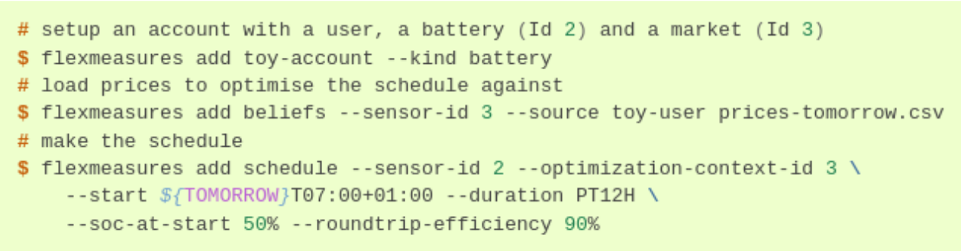
Tutorial

Slide 10
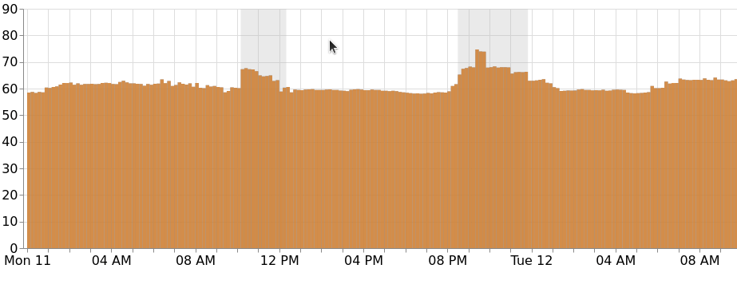
Roadmap (1/3): Annotations

Slide 11
Roadmap (2/3): Optimize for self-consumption
[Already possible] Post solar forecasts / self-consumption forecasts
[Q3 -> Q2 2022] Scheduler takes into account solar forecasts / self-consumption forecasts
[Q3 -> Q2 2022] Scheduler takes into account asymmetric tariffs (e.g. to support cases where taxes apply only to consumption)
[Q3 2022] Trigger forecasts with dedicated API endpoint
[Q3 2022] Ability to plug in your own custom forecast models
[Not planned -> Q3 2022] Scheduler takes into account usage-dependent device depreciation

Slide 12
Roadmap (3/3): Faster projects
Vision soundboard:
Can we make it possible to get a new real-time optimization project up & running within hours instead of days?

Slide 13
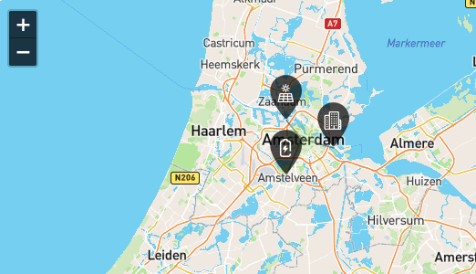

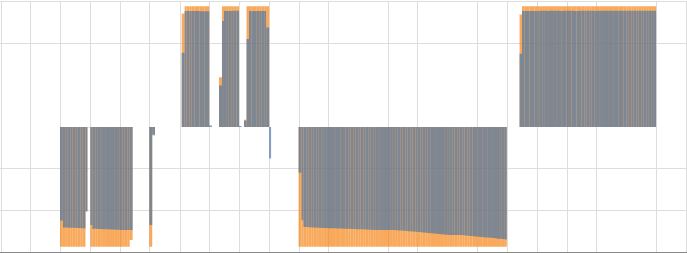


6. UI/UX
5. Asset control
4. Optimization
Pick / Adapt
3. Data integrations
2. Asset modeling
Loop
1. Idea
Structure? Properties? Flex?
Forecasting

Slide 14
Q&A
What are you working on?
What is unclear?

Slide 15
Resources – do get in touch!
https://github.com/FlexMeasures/flexmeasures/
https://www.flexmeasures.io
https://lists.lfenergy.org/g/flexmeasures
https://twitter.com/flexmeasures
LF Energy Slack: #flexmeasures

