Slide 1
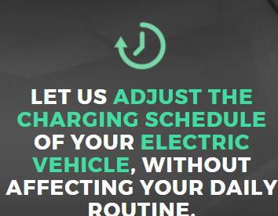


IN RETURN
YOU WILL
FlexiDA
FlexiDA

Slide 2
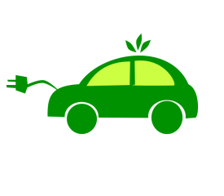

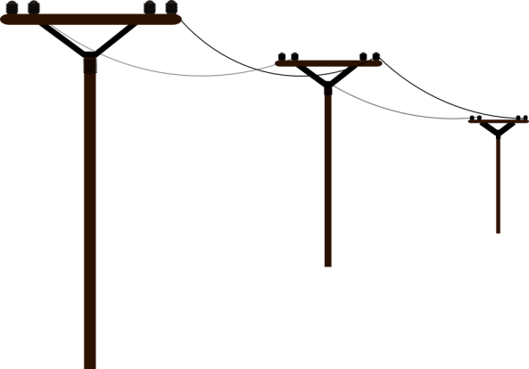

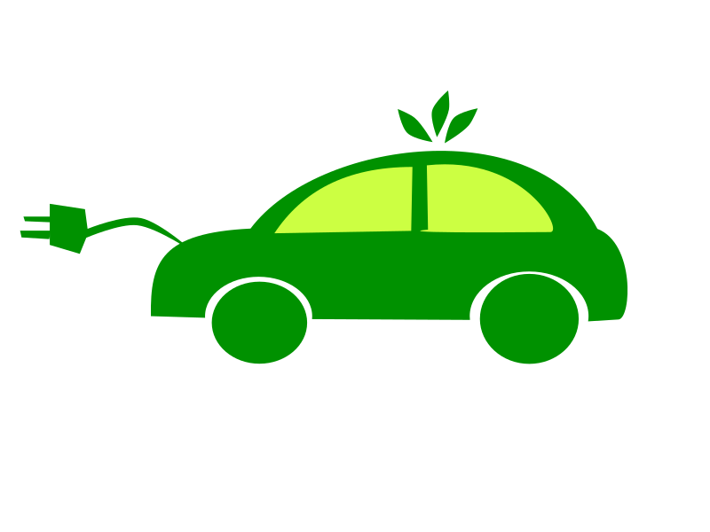
++€
How it works ?
flexibility
revenues
Grid Operator
revenues
flexibility
++€
++€
++€

Slide 3
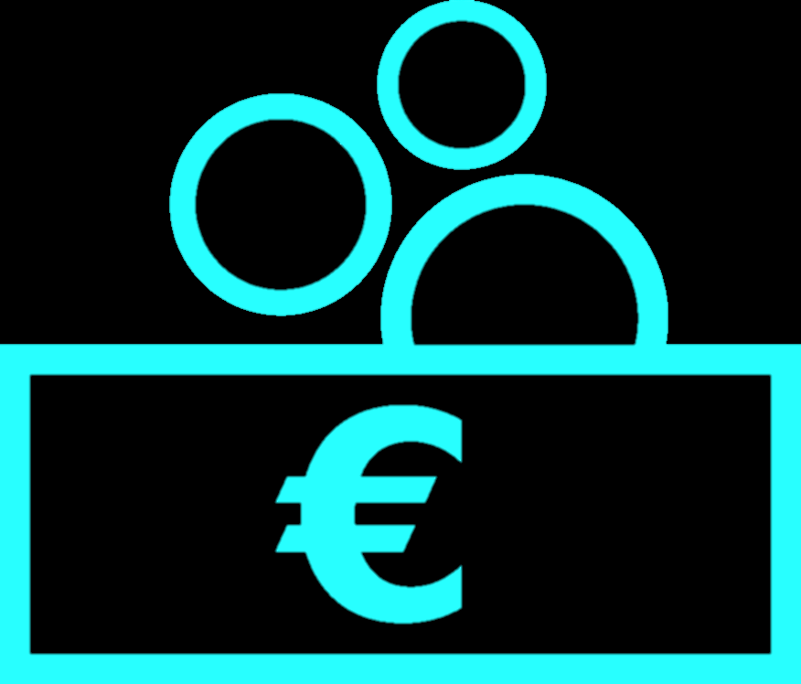
FlexiDA
Get paid for charging.
FlexiDA
Get paid for charging..

Slide 4



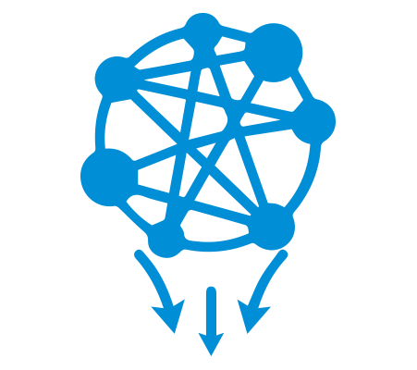



Slide 5



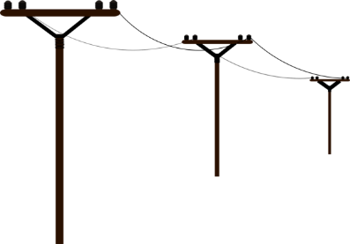
FlexiDA
Blockchain-based transactive
energy services platform
++€
++€
revenues
flexibility
++€
flexibility
revenues
Grid Operator
++€

Slide 6





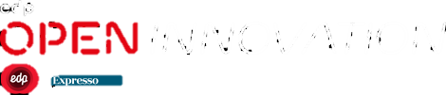
S5
%
^
Fds%$&^%*&^*&(*JBBBMNB
S5
%
^
Fds%$&^%*&^*&(*JBBBMNB
S5
%
^
Fds%$&^%*&^*&(*JBBBMNB754tr
S5
%
^
Fds%$&^%*&^*&(*JBBBMNB
S5
%
^
Fds%$&^%*&^*&(*JBBBMNB
FlexiDA
S5
%
^
Fds%$&^%*&^*&(*JBBBMNB
Blockchain-based transactive
energy services platform
S5
%
^
Fds%$&^%*&^*&(*JBBBMNB

