Slide 1

Programmeren in C#
Project management

Slide 2

Projectmanagement Inleiding

Slide 4
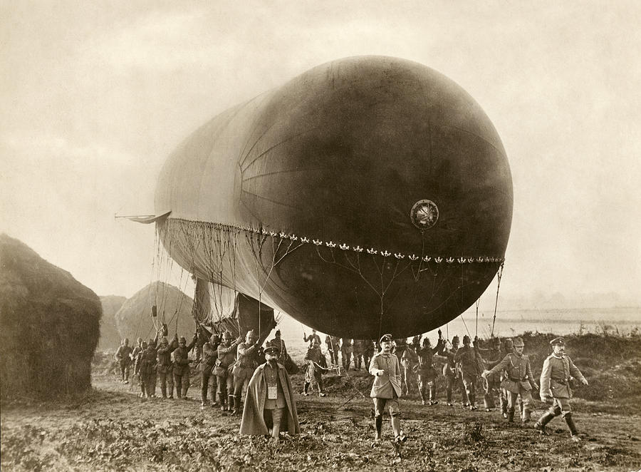

Slide 6
Labo

Slide 9
Labo

