Slide 1
Rendering for Artists
Or : What the hell IS the difference between alpha test and alpha blend?

Slide 2
Introduction
Why do you need to know this?
The state machine
  Global state vs. materials
The rendering pipeline
  Vertex processing
  Fragment assembly
  Framebuffer blending
Tips & Tricks

Slide 3
Rationale
Why do you care?
  Rendering hardware is powerful and programmable.
    Even from art
    Even the PS2
  Some problems can’t be solved without this understanding
  Understanding how the rendering hardware works drives Pure3D features.

Slide 4
Basic Terminology
Frame buffer
  Stencil buffer
  Z Buffer
Vertices
  Vertex buffers
  Components
Fragment

Slide 5
State
Rendering hardware is a big state machine
  You set up a bunch of options, then send it some vertices and textures.
  Options affect the processing of the vertices

Slide 6
State (cont’d)
Two types of state
  Global : “programmer” state
  Shaders : “artist” state
    Lights / Particles / Billboard Quads
  This distinction is part of Pure3D, not the hardware itself
    Things can be moved
      Alpha reference
    There may be some overlap
      Backface culling
      Z-Test on particles

Slide 7
Rendering pipeline
Four stages
  Vertex transformation
    Converts vertex buffers to screen space polygons
  Polygon rasterization
    From screen space polygons, generate pixel parameters

Slide 8
Rendering pipeline (cont’d)
The four stages (cont’d)
  Fragment calculation
    Take pixel parameters, produce single colour
  Framebuffer blending
    Apply pixel colour to frame buffer

Slide 9
Vertex processing
Programmable vs. Fixed function
Input vertices can have many components
  Position
    Transform to screen space
  Colour
    Not usually manipulated
    All colours are 4-component
      Alpha is really just another number

Slide 10
Vertex processing (cont’d)
Input vertices (cont’d)
  UVs
    UV generation
      In some shaders, but not controllable (yet)
    UV transform
      Global state
  Normal
    Lighting

Slide 11
Lighting
Calculate angle between light and normal and set vertex colour.
  emissive +
  (ambient * global ambient) +
  (diffuse * light colour * diffuse factor) +
  (specular * light colour * specular factor)

Slide 12
Lighting (cont’d)
Once lighting values are calculated, they become vertex colours
  Treated just like vertex colours by all subsequent steps
  Specular vertex colour added

Slide 13
Vertex transform (cont’d)
Other output vertex components
  Fog
  Could come straight from input vertices
  Xbox and Gamecube have additional colours

Slide 14
Polygon Rasterization
We have three transformed vertices
  For each pixel inside poly, generate vertex components
  Interpolated, w/ perspective correction
  Position is no longer important, but z-component is stored

Slide 15
Fragment assembly
By now, we have a z-position, some colours, and some UVs
  We need to have only colours
Texture sampling
  Texture filtering
You can do other math to generate colours (Dot product, for example), depending on platform

Slide 16
Fragment assembly (cont’d)
Post texture sampling, we have just colours
  Except z-position
  Now we start doing math
  Level of flexibility
Math on colours
  Zero to one, Clamping
  Modulation / Add / Subtract
  Alpha

Slide 17
Fragment assembly (cont’d)
Example blend equations
  simple : (Colour * Texture1)
  specular : (<simple> + Specular)
  - layered : (Colour * Texture1 * Texture2)
These are hard coded for particular shaders right now

Slide 18
Framebuffer blend
Finally, we have a single colour (plus z-value) for this pixel
  We need to combine with framebuffer
Framebuffer blend operations
  Alpha / Z / Stencil Test
  Z Write
  Alpha blend
  Framebuffer write

Slide 19
Alpha test
Finally we get to use alpha for something
Take alpha value in fragment, compare against (global) reference value
  standard compare modes ( <, >, <=, etc)
If pixel fails alpha test, further processing is not done

Slide 20
Z Testing
For each pixel in framebuffer, we also store depth value
  We store the nearest depth value
  Anything farther isn’t visible
Test incoming fragment depth against stored depth
  Similar compare options to alpha test
  If it fails, it’s gone

Slide 21
Z Write
If z-write is true, z value of fragment replaces z value in framebuffer
  All tests must be passed
  It’s now the nearest pixel
  For translucent objects, this doesn’t work
All these operations happen in order
  Alpha -> Z test -> Stencil ->Z Write
  All are independent

Slide 22
Alpha blending
If our pixel has made it this far, all we have is a colour that we are going to write to the framebuffer
  We blend the fragment colour and the existing framebuffer colour
  Common blends
    Replace
    Using alpha as a “fader” between fragment and framebuffer
    Additive

Slide 23
Alpha blending (cont’d)
Standard blend equation (Xbox and GC)
  (src * src factor) + (dest * dest factor)
  Source / Dest factors can be
    Source or dest colour
    Zero or one
    Alpha, one minus alpha
    Destination alpha
  Example, alpha is percentage mix
    (source alpha, 1 - source alpha)

Slide 24
Alpha blending (cont’d)
Platforms
  PS2 has very different equation
    (A - B) * C + D
    A few options for what each of A,B,C,D can be
  Other ops can be selected for Xbox and GameCube
    (src * A) - (dest * D)
    Logic ops

Slide 25
Tips and tricks
Lighting
  Lighting is just a way to generate vertex colours
  Emissive and ambient are independent of what “lights” are in the scene
  Emissive is completely under your control
  From the point of view of operations farther down the pipe, CBV and lit values are the same

Slide 26
Tips and tricks (cont’d)
Other vertex transform
  You can get a lot of control from code
    Xbox and PS2 have fully programmable systems
    GameCube just has flexible fixed function
UV Generation
  Reflection maps
  Projected texture

Slide 27
Tips and tricks (cont’d)
Fragment operations
  Don’t have full combine control right now, fragment combine is generally hardcoded for shaders
Alpha test and alpha blend are unrelated

Slide 28
Tips and tricks (cont’d)
Common artifacts
  Fringing
  Portaling / Bad Sorting
  Z fighting

Slide 29
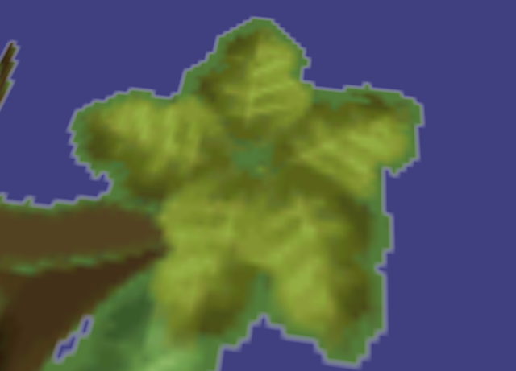

Fringing

Slide 30
Fringing
Fringing
  Texture filtering samples ½ a pixel away from the pixel centre
  Filtering is pulling in bad colours from transparent region
Solution
  Make transparent areas similar colour to edge areas
  Or turn off filtering
    Makes magnified textures look blocky
  Or alpha test

Slide 31
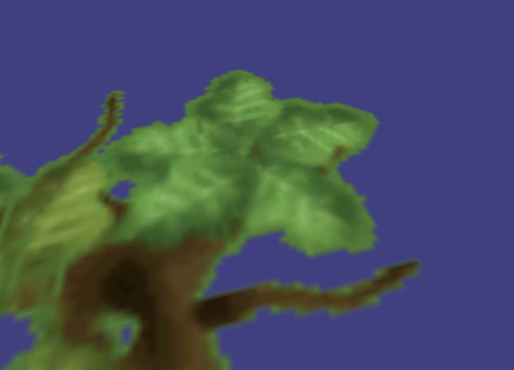
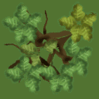
Less Fringing

Slide 32
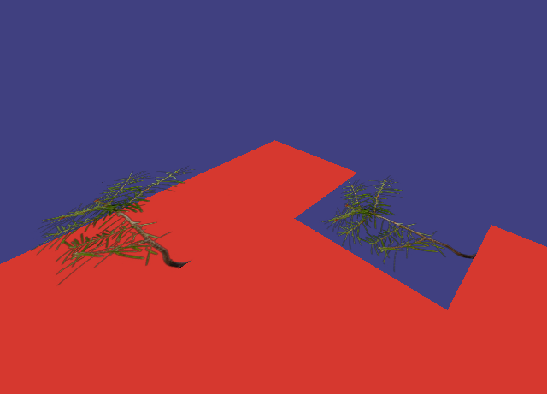
Portaling / Bad sorting

Slide 33
Portaling
Portaling / Bad Sorting
  Transparent regions are being written into the z-buffer and acting as occluders
  Z buffer has bunk information
Solution
  Alpha test – transparent regions fail alpha test and are not written into z-buffer
  Disable z-writes – transparent object can’t occlude
  Sort geometry – draw scene back-to-front
  None of these solutions work all of the time

Slide 34
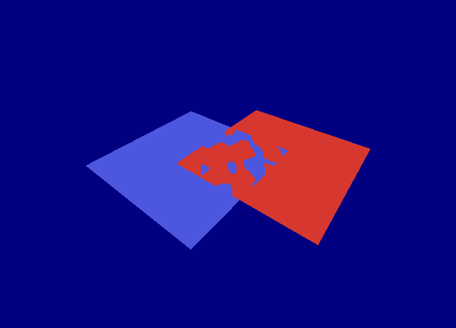
Z Fighting

Slide 35
Z Fighting
Z Fighting
  Not enough precision in z buffer to resolve depth of polygons
  Gets worse as objects move farther away
Solution
  Move polygons apart slightly
  Moving camera near plane out helps a lot

Slide 36
Conclusions
Remember the order of operations
  Visualize each pixel moving down the pipeline
Shader state and global state
It’s just math
  Don’t have preconceived notions of what the numbers mean

Slide 37
Questions?
Ask em now!
Or e-mail me :
    nbrooke@radical.ca

