Slide 1
MIPS Architecture Overview
Course 3
PS2 Lecture Series

Slide 2
Introduction
RISC architecture concepts
Pipelined, superscalar processors
Memory systems
Instruction set enhancements
  SIMD

Slide 3
RISC Architecture
RISC stands for Reduced Instruction Set Computer
  MIPS
  Alpha
  PowerPC
Traditional Complex Instruction Set (CISC)
  VAX
  8086
  68000

Slide 4
Properties of CISC architectures
Variable length instructions
Complex memory addressing modes
Microcoded instructions
Multi-cycle (often variable) instruction times
Complicated hardware design
  eg. Instruction decode logic
Harder to achieve high performance

Slide 5
Properties of RISC architectures
Fixed Instruction length
Simplified memory addressing
  Load - Store architecture
  Lots of registers
Hardwired instructions
Single cycle instruction times ( sort of )
Simpler design can make high performance easier

Slide 6
Properties of Others Architectures
Many modern architectures are a blend of RISC and CISC
  eg. Pentium III presents a CISC instruction set, but uses a RISC internal architecture. The CPU contains many registers, but they’re magically hidden away from the instruction set.

Slide 7
Pipelined Architectures
The PS2 uses a CPU based on the MIPS 5900
MIPS 5900 is a pipelined design
  Instructions are broken into several stages, each taking one clock cycle
  One stage of an instruction can be executing in parallel with other stages of a different instruction
  This increases instruction throughput, and allows for higher clock rates
  The MIPS pipeline has six stages:
  Instruction Fetch -> Queue -> Register Fetch -> Execute -> Data Fetch -> Writeback

Slide 8
Superscalar Architectures
MIPS 5900 is a two issue superscalar design
  Every clock, the CPU fetches 2 instructions from the instruction cache and executes them at the same time if possible
  32 bit instructions, 64 bit bus = 2 instruction fetches per cycle
  at 300MHz, the CPU can execute up to 600 million instructions per second (best case)

Slide 9
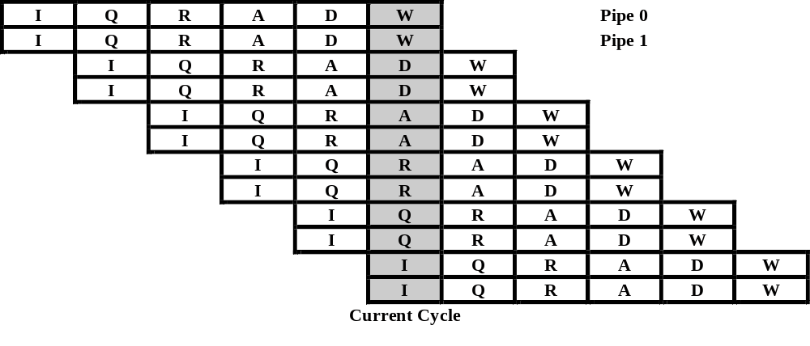
Pipelined Superscalar example

Slide 10
Issues: Branches
Branches can screw up the pipeline
  Delay slot
  mov.w $r1, (Arg1)
  mov.w $r2, (Arg2)
  jr subroutine
  mov.w $r3, (Arg3)
  Branch Prediction
    Rule of thumb: branch predictably!

Slide 11
Issues: Pipeline Stalls
Execution stage is longer than one cycle for some instructions (like floating point)
  Pipes are interlocked
Hazards
  The CPU will stall when the value of a needed register isn’t ready
  The CPU will stall if the data or code is not in the cache
  The CPU will stall if the two instructions aren’t “pairable”

Slide 12
Memory systems
RDRAM (Rambus) 32MB
  High bandwidth, but high latency
  Good at streaming, but slow at random access
Instruction Cache (I$) 16K
  two way set-associative
Data Cache (D$) 8K
  two way set-associative
Scratchpad (SPR) 16K

Slide 13
Memory Reading
When we read memory:
  The EE computes the cache line where the data may reside
  If the address tag in the cache matches the read address, and the data in the cache is valid, the data data is returned (cache hit)
  If the address does not match, the entire cache line where the data resides is read into the cache and returned (cache miss)
  a cache miss may evict data in the cache

Slide 14
Memory Writing
Writes to cached memory write to the appropriate cache line and set the “dirty” bit
When this cache line is evicted, it is written to memory through the Write Back Buffer (WBB)
  This is an 8 entry by 16 byte FIFO for storing data, which isolates the CPU from the main bus
This means that cache and memory can be out of sync for long periods of time
  This can affect DMA, since it reads from memory

Slide 15
Cache Structure
The D$ is split up into two sets of 64, 64 byte cache lines (8K)
Cache fills, and write-backs always involve the whole cache line
When data is placed into the cache, any given address can be stored in one of the two sets
  “two way set-associative cache”
Any addresses whose bits 6-11 match will compete for the same sets in the cache

Slide 16
Cache Example
Instruction Set 0 Set 1
a = foo[0]; foo[0]* invalid
b = foo[4096]; foo[0] foo[4096]*
c = foo[8192]; foo[8192]* foo[4096]
d = foo[4]; foo[8192] foo[0]*
e = foo[4100]; foo[4096]* foo[0]
f = foo[8196]; foo[4096] foo[8192]*
* = cache miss

Slide 17
Cost of a cache miss
A cache miss is up to 30x slower than a cache hit
Solution: Access memory in a coherent fashion
  cache align data structures
  try to operate on small blocks of data at a time
  favour sequential access over random access
    watch out for set contention!
  prefetch data before using it
    issue dummy reads, or use PREF instruction
  use the scratchpad
  keep related code together

Slide 18
Scratchpad
16 K of uncached fast memory
Similar in speed to the data cache
Address 0x70000000-0x70003fff
Accessible by DMA controller!
Be careful, Pure3D uses it!
  Call pddiRenderContext::DrawSync() before using the scratchpad

Slide 19
Instruction set enhancements: SIMD
The EE supports a 128 bit Single Instruction, Multiple Data (SIMD) instruction set.
  Can operate on 16 bytes, 8 shorts, 4 words, or two dwords in parallel
  Good for moving large blocks of 128 bit aligned memory
  Good for image manipulation
  Only available from assembly

Slide 20
SIMD Example
Parallel add word (32 bits)
PADDW $r2, $r0, $r1
r0 = [A3 A2 A1 A0]
r1 = [B3 B2 B1 B0]
r2 = [A3+B3 A2+B2 A1+B1 A0+B0]

Slide 21
Points to Take With You
Understanding the MIPS architecture will help you write faster code
Branch predictably
  Even better: not at all!
Read coherently
  Cache misses are deadly!
  The scratchpad is your friend
Consider the architectural enhancements
  Read the EE manuals
Notes:
Summary

