Slide 1
DMA Programming
Course 4
PS2 Lecture Series

Slide 2
Introduction
Uses for DMA
DMA Modes
DMA Paths
Talking to the VIF
Uncached memory
Debugging

Slide 3
Uses for DMA
CPU to VU0 or VU1
  Microprograms
  Polygon / Vertex data
CPU to GS
  Textures
  Material state changes
  Polygon / Vertex data
GS to CPU
  Screen Capture
CPU to IOP
  Sound
  Input
Main Memory to Scratchpad
  Any complex data

Slide 4
DMA Modes
Normal mode
  This is the simplest DMA mode. You tell the DMA controller the size and address of the data, and the device to send it to.
Chain mode
  This is the most powerful mode. The DMA controller is given a pointer to a list of packets to send.
MFIFO
  Uses memory to buffer DMA packets

Slide 5
Chain Mode
Multiple DMA operations can be chained together
  multiple sources (addresses) in a single DMA operation
Two variations:
  Destination chain mode
    peripherals/scratchpad to main memory
  Source chain mode
    main memory to peripherals
    data can be inline with the packet, or referenced

Slide 6
Chain Mode: DMA tag
63 32
31 24
15 0
ADDR
ID/FLG
QWC
127 64
UNUSED
Starts a chain mode DMA Packet
ADDR: data address (set bit 63 if address is in SPR)
  address must be 128 bit aligned (bottom 4 bits of addr are ignored)
ID/FLG: Packet information (type, priority, etc)
QWC: Transfer size in quadwords (1 quadword = 16 bytes)
The “unused” section is handy when talking to the VIF

Slide 7
Chain mode packets
CNT Reads data after tag
REF Reads data from specified address
END Same as CNT, but this is the last packet
NEXT Like CNT, but continue from a different address
CALL Like NEXT, but stores return address
RET Like CNT, but uses address stored by CALL

Slide 8
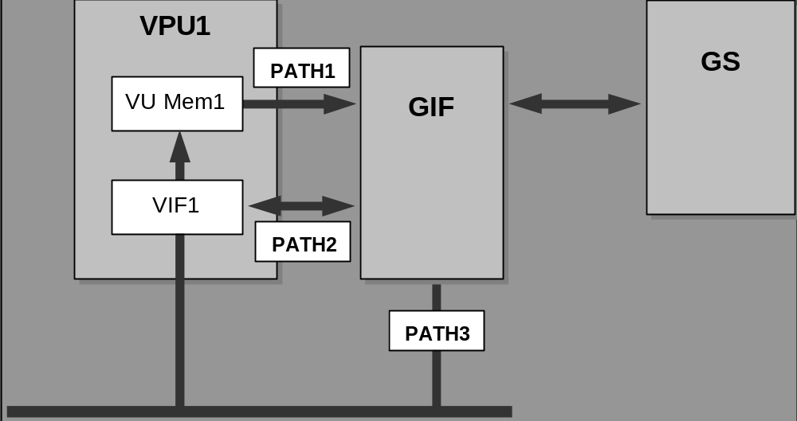
DMA Paths

Slide 9
VIFs
Interface between the DMA system and the vector units
  All DMA transfers to VU0, VU1 go through VIF0, VIF1
FIFO, with simple, command-based language (VIF codes)
VIF can upload and run microcode programs, upload data to the VU and GS (VIF1 only)
Supports on-the-fly conversion of data

Slide 10
Talking to the VIF
VIF is controlled through 32 bit VIF codes
  IMMEDIATE: Parameter of VIF command
    eg. Transfer address, microprogram address, etc.
  NUM: Number of quadwords to write
    Can differ from the amount of quadwords that are transferred
    256 quadwords can be written at once
  CMD: VIF command
31 24
23 16
15 0
CMD
NUM
IMMEDIATE

Slide 11
VIF Commands
MPG Upload a microprogram
UNPACK Upload program data
DIRECT Send data to the GIF (Path 2)
MSCAL Run a microprogram
MSCNT Continue a microprogram
FLUSH Wait for a microprogram to finish
See the EE User’s Manual for others

Slide 12
DMA tag transfer
DMA tag not transferred
  VIF codes must be part of the transferred data
DMA tag transferred
  extra space can be used to send VIF code(s) and data
    Pure3D uses REF DMA tag with UNPACK VIF code to transmit vertex data without putting VIF codes in the vertex list
    The VIF ignores the first 64 bits of the data (it skips over the DMA tag)
Selected via the Dn_CHCR.TTE register field
--
--
DMA tag
data
VIF code
DMA tag

Slide 13
Sample code to talk to the VIF
Scratch Pad
Main Memory
(1) CNT UNPACK
Vertex Data
VU Context Data
(2) CNT UNPACK
Prim Group Info
(3) CNT UNPACK
Vertex List Info
(4) REF UNPACK
(5) CNT DIRECT
GS State Data
(6) CNT ITOP MSCAL
(7) REF UNPACK
(8) CNT ITOP MSCNT
(9) END

Slide 14
libpkt code example
#include <libpkt.h>
sceDmaChan* dmaVif1 = sceDmaGetChan(SCE_DMA_VIF1); // get the VIF1 DMA channel
// initialize packet
sceVif1Packet vifPacket;
sceVif1PkInit(&vifPacket, (u_long128*)0x70000000); // build packet on scratch pad
// build packet
const u_long giftag0[2] =
{ SCE_GIF_SET_TAG(0, 1, 0, 0, 0, 1), 0x000000000000000eL };
sceVif1PkOpenDirectCode(&vifPacket, 0);
sceVif1PkOpenGifTag(&vifPacket, *(u_long128*)&giftag0);
sceVif1PkAddGsAD(&vifPacket,gsContext.tex0.addr, gsContext.tex0.reg.data);
sceVif1PkCloseGifTag(&vifPacket);
sceVif1PkCloseDirectCode(&vifPacket);
// send packet
sceVif1PkEnd(&vifPacket, 0);
sceVif1PkTerminate(&vifPacket);
sceDmaSend(dmaVif1, (u_long128*)(((u_int)vifPacket.pBase&0x3ff0)|0x80000000));

Slide 15
DMA start/wait code example
DMA start
  libdma
    sceDmaSend(dmaVif1, (u_long128*)(((u_int)vifPacket.pBase & 0x3ff0) | 0x80000000));
  EE registers (see EE User’s Manual)
    *D1_QWC = 0x0; // transfer data size (p. 62)
    *D1_TADR = 0x80000000; // tag address (p. 59)
    *D_STAT = 2; // interrupt status (p. 48)
    *D1_CHCR = 1 | (1<<2) | (0<<4) | (1<<6) | (0<<7) | (1<<8); // channel control (p. 57)
DMA wait
  libdma
    sceDmaSync(dmaVif1, 0, 100000); // wait for VIF1 DMA to complete
  EE registers
    while(*D1_CHCR & D_CHCR_STR_M); // channel control (p. 57)

Slide 16
Uncached memory
The DMA controller is not cache aware
  If data is in D$, and not in memory, it won’t be sent
One solution: Call FlushCache(0) before every DMA transfer.
  Flushes the D$ so memory is up to date
  Can be a large performance hit
Another solution: place data in uncached memory
  No need for FlushCache()
  Reads are very slow
Third solution: place data in scratchpad (SPR)

Slide 17
Uncached Memory cont’d
Mapped into the 0x20100000-0x21ffffff range
“Or in” a 0x20000000 to address to treat it as uncached
0x30100000 - 0x31ffffff is “uncached accelerated” memory
  like uncached, except with a small write-combining buffer in the EE to speed up writes
Danger!
  Reading from uncached memory is very slow
  Cache evictions can cause memory corruption
    Align the head and tail of the memory to cache-line boundaries
  Unset the 0x20000000 bit before calling free()

Slide 18
A Safe Uncached Malloc
void* malloc_uncached(unsigned size)
{
size += (size + 63) & ~64;
void* ptr = memalign(64, size);
FlushCache(0);
ptr = (void*)((unsigned)ptr | 0x20000000);
return ptr;
}
If allocating memory for Pure3D vertices use: p3d::pddi->AllocateVertices()
  Vertex memory will be uncached

Slide 19
Debugging
Very tricky!
  Most rendering bugs in Pure3D are DMA related
Make sure data is aligned to 128 bit boundaries
Be careful not to write to memory that the DMA controller might be reading from
Watch out for the cached/uncached issues
Use the hardware synchronization features
Use the packet disassembler that ships with the Sony demos

Slide 20
Points to Take With You
DMA is central to the functioning and performance on the PS2
Tricky to set up and debug
  Read the docs, Sony examples
  Talk to people in Pure3D
    We’ve figured out about 20% of it
Be aware of how memory interacts with the DMA system
Notes:
Summary

