Slide 1
Introduction to VU Programming
Course 5
PS2 Lecture Series

Slide 2
Introduction
SIMD / LIW overview
VU0 Introduction
Macro Mode
Inline assembly with GCC
Maintaining Assembly Code
Profiling

Slide 3
What is a VU?
Vector Unit
  Specialized floating point processors in the EE
  EE contains two VUs: VU0, VU1
LIW (Long Instruction Word)
  Each 64 instruction contains two operations:
    Upper Instruction: Multiply and accumulate
    Lower Instruction: Integer, division, sqrt, trig, rand, branching
    Both instructions operate in parallel
SIMD (Single Instruction, Multiple Data)
  Upper instruction processes 4 floats in parallel

Slide 4
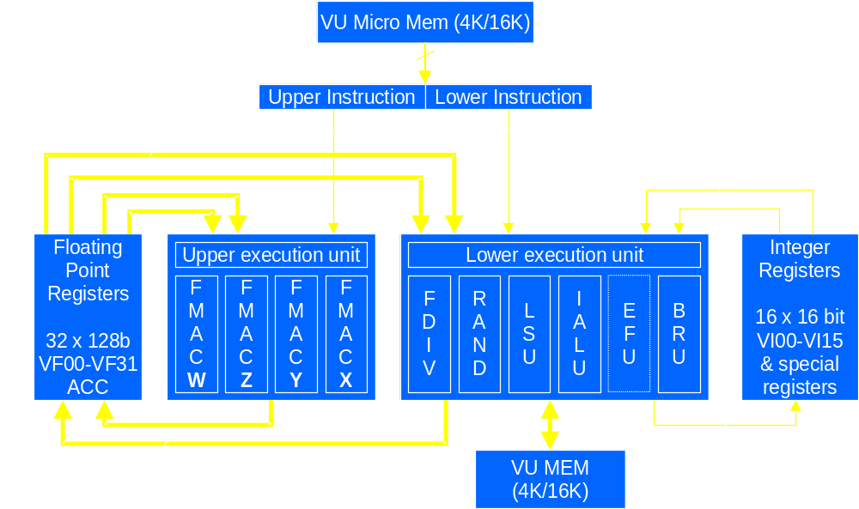
VU Architecture

Slide 5
VU0 Overview
VU0 can operate as coprocessor 2 (COP2)
  FPU is COP1
32 128 bit SIMD registers (VF00 - VF31)
16 16 bit integer registers (VI00 - VI15)
4 KB program, 4 KB data memory
often used to speed up code written mostly in C++
can operate in macro or micro mode
  Micro mode is next week

Slide 6
Macro Mode
VU0 is treated as a coprocessor of the CPU
Only a subset of the VU instructions can be called from macro mode
Can be used from inline assembly within GCC
Can call VU0 subroutines with VCALLMS
  subroutines can use all VU0 features
  including parallel integer operations
    next week

Slide 7
Registers
32 128 bits wide floating point registers (VF00-VF31)
  each register has 4 fields: X, Y, Z, W
  VF00 is read only, it contains:
127
0
W
Z
Y
X
127
0
1.0
0.0
0.0
0.0

Slide 8
Types of Instructions
General floating point (VADD, VSUB, etc.)
Performs operations on two registers, and stores result in third:
VADD.wxyz VF03, VF01, VF02
VF01 [Aw Az Ay Ax]
VF02 [Bw Bz By Bx]
VF03 [Aw+Bw Az+Bz Ay+By Ax+Bx]

Slide 9
Register Mask
Certain instructions can specify a subset of the fields for the destination register.
VMAX.xyz VF03, VF01, VF02
VF03.x = max(VF01.x, VF02.x)
VF03.y = max(VF01.y, VF02.y)
VF03.z = max(VF01.z, VF02.z)
VF03.w = unaffected

Slide 10
Field Broadcast
Certain instructions can specify a single field of one source register that will operate on all the fields of another source register.
VSUBx.xyzw VF03, VF01, VF02x
VF03.x = VF01.x - VF02.x
VF03.y = VF01.y - VF02.x
VF03.z = VF01.z - VF02.x
VF03.w = VF01.w - VF02.x

Slide 11
Multiply and Accumulate
Basic component of many vector operations:
  dot product, vector length, transform, matrix multiply
Uses special ACC register to store result
  VMADDA.xyzw ACC, VF01, VF02
  ACC.x = ACC.x + VF01.x*VF02.x
  ACC.y = ACC.y + VF01.y*VF02.y
  ACC.z = ACC.z + VF01.z*VF02.z
  ACC.w = ACC.w + VF01.w*VF02.w

Slide 12
Multiply and Accumulate Cont’d
A vector transform can be done in four instructions:
  vector is in VF5
  matrix rows are stored in VF6-VF9
  result is in VF10
VMULAx.wxyz ACC, VF6, VF5x
VMADDAy.wxyz ACC, VF7, VF5y
VMADDAz.wxyz ACC, VF8, VF5z
VMADDw.wyxz VF10, VF9, VF5w

Slide 13
Q Register
Some operations output to the Q register
  VDIV divide
  VSQRT square root
  VRSQRT reciprocal square root
There are no dependency stalls generated on the Q register
  The VWAITQ can be used to wait for the result
  Even better, do some work while waiting

Slide 14
Q Register Example
Take the square root of the X field of the VF5 register, and store the result in the X field of the VF3 register
  Uses the “add to 0” idiom to move the result
VSQRT Q, VF5x
VWAITQ
VADDq.x, VF3, VF0, Q
VF3.x = sqrt(VF5.x)

Slide 15
I Register
Some instructions can use the 32 bit I (Immediate) register as a field broadcast register
CTC2 $1, VI21 # $1 contains 0.5
VMULi.xyz VF03, VF02, I
VF03.x = VF02.x * 0.5
VF03.y = VF02.y * 0.5
VF03.z = VF02.z * 0.5
VF03.w = unaffected
Much more useful in micro mode

Slide 16
R Register
Random number generator functions use the R register
  VRINIT seeds the random number generator
  VRGET transfers R register to VF register
  VRNEXT generates next number and transfers
  VRXOR XORs R register with a VF register
Generates 23 bits
  Same as the mantissa of a 32 bit float
Range of values generated is (+1.0, +2.0)

Slide 17
Macro Mode Example
static void
VectorTimesMatrix(Vector4* result, Vector4* source)
{
asm __volatile__("
lqc2 vf5, 0x0(%1) # load source
vmulax.wxyz ACC, vf6, vf5x
vmadday.wxyz ACC, vf7, vf5y
vmaddaz.wxyz ACC, vf8, vf5z
vmaddw.wyxz vf10, vf9, vf5w # matrix * vector
sqc2 vf10, 0x0(%0) # store result
": // no outputs
: "r" (result), "r" (source));
}

Slide 18
Inline Assembly Notes
Uses LQC2, SQC2 to move data in and out of VU0 registers
  Data must be 128 bit aligned
Have to declare input and output parameters
Have to declare which registers are being used
Documentation:
  Type from Linux shell:
  info “(gcc) Extended Asm”

Slide 19
Maintaining Assembly
Very time consuming to debug and maintain
Consider algorithm carefully before coding in assembly
  Profile before coding
  VU only works well with certain algorithms
Maintain a C++ version as well
Comment the code very well
  You probably won’t know what it does a week after writing it!

Slide 20
Profiling
Can use hardware timers for quick timings:
  Ticks at 150 MHz, 150/16 MHz, 150/256 MHz, or every H-sync
  Rolls over every 16 bits
#include <eeregs.h>
static void StartTiming()
{
*T0_MODE = 0x00000082; // ticks/256 + enable
*T0_COUNT = 0;
}
static int EndTiming()
{
return (int)*T0_COUNT; // elapsed time
}

Slide 21
Points to Take With You
The fastest way to do vector math on the PS2 is with the VUs
  Read the documentation
    many times
Macro mode on VU0 is the easiest way to move computation to the VU
Macro mode is fast, but there are faster ways
  Next week’s talk
Profile to find code suitable for VU optimisation
  Don’t optimise prematurely!
Notes:
Summary

