Slide 1
Advanced VU Programming
Course 6
PS2 Lecture Series

Slide 2
Introduction
Recap from last week
Micro mode overview
Micro mode example
Subroutines
Performance vs. Development Time

Slide 3
Recap
Last week we talked about VU0 macro mode
  extension of MIPS instruction set
  allows easy access of certain VU instructions from inline assembly
  good for quickly speeding up algorithm “hot spots”
  can operate on data that resides in main memory
Macro mode has limitations
  only available from VU0
  only one VU instruction can operate at a time (not LIW)
  many instructions not available
  operates in lockstep with the CPU

Slide 4
Micro Mode
VU0 and VU1 can operate in micro mode
  Each VU operates in parallel with the CPU
  Dedicated program and data memory
  Full SIMD/LIW instructions are available
  Data conversion via VIF0, VIF1
  Elementary Function Unit (EFU) instructions available (VU1 only)
  Dedicated, high priority path to the GIF (VU1 only)
  Synchronisation control with DMA

Slide 5
Micro Mode Cont’d
Programming in micro mode is more involved
  Inline assembly is not available
    code must be in separate assembly modules
  Code has to be DMAed to VU microprogram memory before being run
  Data has to be DMAed to VU memory
  Dedicated VU memory (4K VU0, 16K VU1) is small, so management is needed for large data sets
  Must be very aware of pipelining issues to get good performance

Slide 6
Micro Mode Advantages
The good news is that a well coded micro mode algorithm can be 2-20X faster than the equivalent macro mode algorithm
  which is already 2-10X faster than C++ in some cases

Slide 7
VU Code
Each 64 bit VU instruction encodes two operations
  Upper Instruction (FMAC)
  Lower Instruction (Integer, load/store, compare, rand, branch, etc.)
  Upper instruction Lower instruction
  add.xyz vf03, vf03, vf05 lq vf07, 1(vi04)
  mulq.xyz vf06, vf06, q nop
  mulq vf04, vf04, q mfir.w vf03w, vi01

Slide 8
VU Code Cont’d
Upper instructions and lower instructions operate in parallel
  If you only have one thing to do, nop out the other instruction
  When both try to write into the same register, the upper instruction has priority
16 integer registers are available (VI00-VI15)
  16 bits wide
  VI00 is read-only, it always returns 0
  The integer instructions are very limited (eg. no shifts!)

Slide 9
VU Memory
Like the MIPS CPU, the VU is a load/store architecture
  LQ load quadword from memory into a VF register
  SQ store quadword from VF register to memory
Addresses refer to 128 bit quantities
  VU0: 0-0x100 (4 K)
  VU1: 0-0x400 (16 K)

Slide 10
Micro Mode Usage
Write some VU code
Embed into a DMA packet
DMA code to VU0, or VU1 through VIF0, VIF1
DMA data to VU0 or VU1 through VIF0, VIF1
Call micro-program with VCALLMS (VU0 macro mode), or MSCAL, MSCNT (VIF0, VIF1)
Perhaps copy results back into main memory (VU0) or to the GIF (VU1)

Slide 11
Example: Vector Transform
Take an array of vectors, transform them by a matrix, and store the results in an output array.
void VectorTransform(Vector* input, Matrix* matrix, int count, Vector* output)
DMA control code will be written in C++, matrix math will be done using VU0 micro mode
Full source is available on T drive
  T:/Pure3D/Handouts/PS2 Courses/Course_6

Slide 12
Vector Transform (vector.vsm)
Matrix is stored in VF05-VF08
Input vector address is stored in VI01
Count is stored in VI02
top:
mulaw ACC, vf08, vf00w lq vf09, 0(vi01)
maddaz ACC, vf07, vf09z iaddi vi02, vi02, -1
madday ACC, vf06, vf09y nop
maddx vf10, vf05, vf09x nop
nop ibne vi02, vi00, top
nop sqi vf10, (vi01++)

Slide 13
DMA Packet (vector.dsm)
The assembler can build DMA packets using a special macro language
.include "vumacros.h"
.global VU_BaseAddress
VU_BaseAddress:
.align 0
DMAend *
MPG 0, *
.include ”vector.vsm"
.EndMPG
.EndDmaData

Slide 14
DMA Program to VU0
We’ll use libdma and libpkt in this example
Step 1: acquire the VIF0 DMA channel
  Set Tag Transfer Enable, so we can embed VIF codes in the DMA tag
dmaVif = sceDmaGetChan(SCE_DMA_VIF0);
dmaVif->chcr.TTE = 1;
Step 2: DMA program to VU0 microcode memory:
sceDmaChan* dmaVif0 = sceDmaGetChan(SCE_DMA_VIF0);
dmaVif0->chcr.TTE = 1;
sceDMASend(dmaVif0, (u_long128*)&VU_BaseAddress));
sceDMASync(dmaVif0, 0, 100000);

Slide 15
Prepare the DMA Packet
Step 3: Initialise new DMA packet on the scratchpad
sceVif0Packet vifPacket;
sceVif0PkInit(&vifPacket,(u_long128*)0x7000000);
Step 4: Add command to upload vertices to the VU0 with a DMA REF packet
  The VIF UNPACK command is used to transfer the data to the VU memory
  Can only upload 256 qwords at a time
    To do more, multiple UNPACK commands are needed
sceVif0PkRef(&vifPacket, vertices, dmaSize, 0, SCE_VIF0_SET_UNPACK(vuAddress, dmaSize, V4_32, 0));

Slide 16
Start DMA, VU
Step 5: Call the VU program, end the packet, and initiate DMA transfer
  VIF MSCAL command starts the VU running
  VIF FLUSHE command waits for VU to finish processing
sceVif0PkEnd(&vifPacket, 0);
sceVif0PkAddCode(&vifPacket, SCE_VIF0_SET_MSCAL(0, 0));
sceVif0PkAddCode(&vifPacket, SCE_VIF0_SET_FLUSHE(0));
sceVif0PkTerminate(&vifPacket);
sceDmaSend(dmaVif0, 0x8000000); // Magic here
The DMA system will now upload the vertices, and start the VU program. This happens asynchronously.

Slide 17
Getting the Results
Before getting the results, we must wait for the VU to finish:
sceDmaSync(dmaVif0, 0, 10000);
Then we can copy the results from the memory mapped VU0 memory to main memory:
for(int i=0; i < count; i++)
{
*(u_long128*)&output[i] = (u_long128*)&VU0_MEM[i];
}

Slide 18
Example Notes
Piece of cake, eh?
All data is assumed to be 16 byte aligned
Could overlap data-send and results-receive by double-buffering the VU0 memory
  The VIF1 can manage the double buffering with the GIF with no CPU intervention
This is supposed to be a simple example
  Production code is much more complicated

Slide 19
Micro Mode Subroutines
VU0 micro mode programs can be called from macro mode using the VCALLMS instruction
Allows a mixture of macro and micro mode programming
  combines some of the ease of macro mode with the speed of micro mode
  can eliminate a lot of the DMA related work
Doesn’t work well for large data sets
  parameters/data are passed through VU0 registers

Slide 20
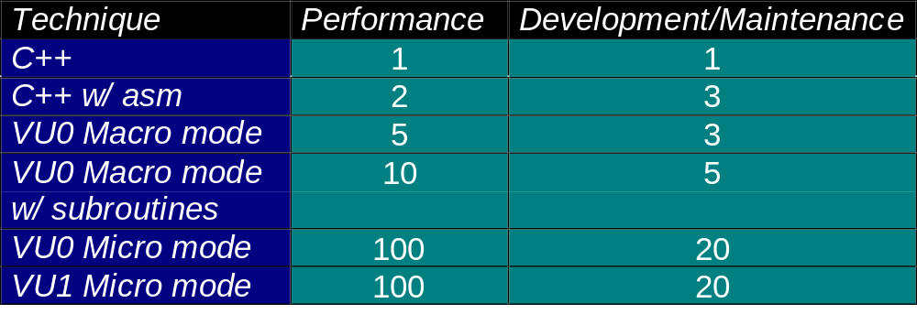
Analysis of Techniques
As you get “closer to the metal” performance goes up, but so does the development and maintenance time

Slide 21
Points to Take With You
Micro mode VU programming is very hard
  There is a huge amount of setup involved
But it can run very very fast
Good use of DMA is critical to micro mode
Look at the sample code
Next week we talk about specific optimisation techniques
Notes:
Summary

