Slide 1
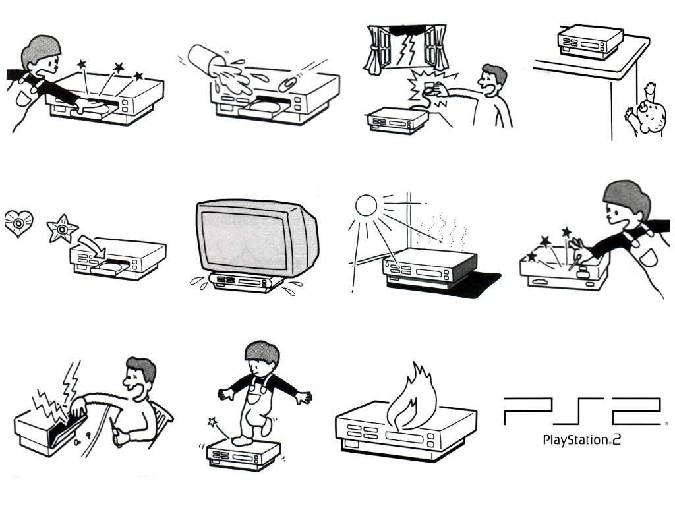
PS2 Memory
Architecture

Slide 2
Introduction
How you organize your code and data is critical to performance
The PS2 hardware is much more sensitive to this than the other consoles
Understanding of the PS2 architecture is one of the tools towards writing efficient code

Slide 3
Peak Performance
EE MIPS core is a two issue superscalar design
  Every clock, the CPU fetches 2 instructions from the instruction cache and executes them at the same time if possible
  at 300MHz, the CPU can execute up to 600 million instructions per second (best case)

Slide 4
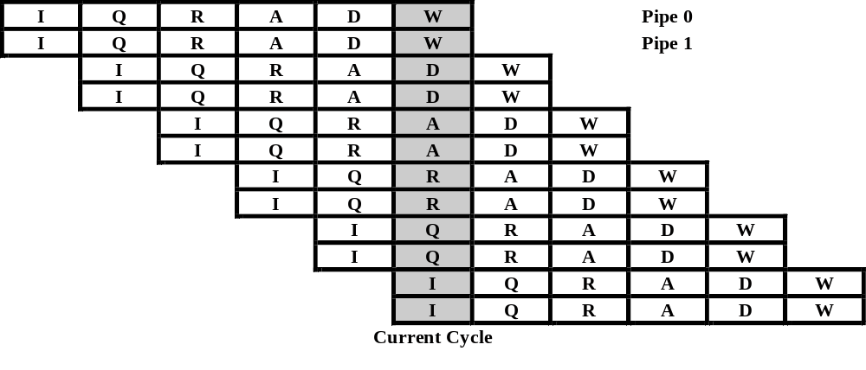
EE Running Flat-out
Instruction Fetch -> Queue -> Register Fetch -> Execute -> Data Fetch -> Writeback

Slide 5
What Slows Code Down
Not all instructions can be paired
  Data dependencies, ALUs aren’t equivalent, multi-cycle instructions (DIV), etc.
  Good compilers, or assembly can improve this
Previous slide assumes data and instructions are in the caches
  This is mostly the programmer’s responsibility
  Ensuring this can be very complicated

Slide 6
Memory systems
RDRAM (Rambus) 32MB
  High bandwidth (~1 GB/s), high latency
Instruction Cache (I$) 16K
  two way set-associative
Data Cache (D$) 8K
  two way set-associative
Scratchpad (SPR) 16K
10 channel DMA controller (DMAC)
  We won’t talk about this today
Note: No L2 cache!

Slide 7
Memory Reading
When we read memory:
  The EE computes the cache line where the data may reside
  If the address tag in the cache matches the read address, and the data in the cache is valid, the data is returned (cache hit)
  If the address does not match, the entire cache line where the data resides is read into the cache and the data returned (cache miss)
  a cache miss may evict data in the cache

Slide 8
Memory Writing
Writes to cached memory write to the appropriate cache line and set the “dirty” flag
When this cache line is evicted, it is written to memory through the Write Back Buffer (WBB)
  This is an 8 entry by 16 byte FIFO for storing data, which isolates the CPU from the main bus
This means that cache and memory can be out of sync for long periods of time
  This can affect DMA, since it reads only from memory

Slide 9
Instruction Cache
The I$ is split up into two sets of 128, 64 byte cache lines (16K)
  32 bit instructions = 16 instructions per line, 4096 instructions total
Connected to CPU via 64 bit bus
  2 instructions fetched per cycle

Slide 10
Data Cache
The D$ is split up into two sets of 64, 64 byte cache lines (8K)
Cache fills, and write-backs always involve the whole cache line
When data is placed into the cache, any given address can be stored in one of the two sets
  “two way set-associative cache”
Any addresses whose bits 6-11 match will compete for the same sets in the cache

Slide 11
Memory Latency
Small size, coupled with a low number of sets means that it is easy to thrash the cache (lots of cache misses)
Cost:
  Cache miss: 40-56 cycles
  Cache hit: 2-7 cycles
  Register: 0-1 cycles
Conclusion: Cache unfriendly = slow

Slide 12
Avoiding I$ Thrashing
Make code small as possible
Inline functions
Avoid branches
Force spatial locality
  Functions used together should be grouped together

Slide 13
D$ Thrashing
The D$ “wraps” every 4K
There are two slots for every cache line
Bad: Accessing 3 (or more) items that map to the same cache entry at different physical addresses

Slide 14
Data Alignment
Structure elements within the same cache line will only incur one or zero cache hits if accessed close together
Align critical structures to 128 bit (or 64 byte) boundaries
Pack as much data as possible into a cache line
Any data that’s in the cache and not being used is a waste of the resource

Slide 15
Scratchpad
16 K of fast uncached memory
Similar in speed to the data cache
Address 0x70000000-0x70003fff
Can DMA from and to it
Be careful, Pure3D uses it!
  Talk to us about how we can share

Slide 16
Cache Pollution
When the CPU issues a write to memory, generally the relevant cache line is pulled into the D$, the data is written to the cache, and the line is committed to main memory sometime later.
  Cache line eviction, or explicit FlushCache()
Write-only operations pollute the cache with respect to Read-only/Read-write operations
Various memory access modes are provided accommodate different access patterns

Slide 17
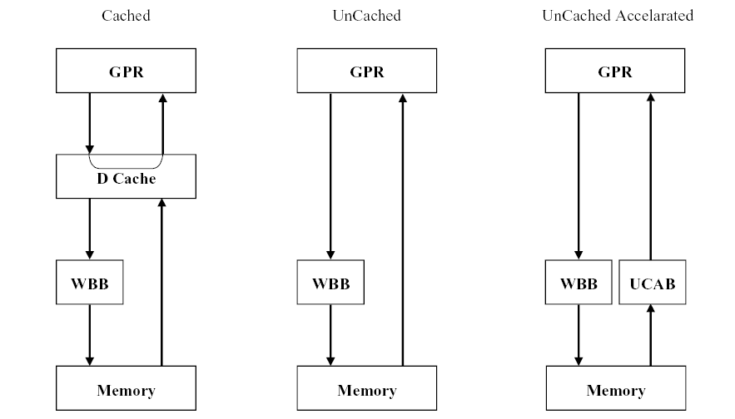
Memory Access Modes

Slide 18
Uncached Memory
Two types:
  Uncached
    Each write goes into the Write Back Buffer (WBB), then to main memory
    Reads come directly from main memory
      Very, very slow
  Uncached-accelerated
    Writes go into WBB
    Reads come from 8 quad word UnCached Accelerated Buffer (UCAB)
      Like a very small, direct mapped cache
      Invalidated by any read or write not in the UCAB
      Can be used as a “third read channel”

Slide 19
Virtual Functions
class A
{
public:
virtual void foo();
};
…
a->foo();

Slide 20
Dissasembly
a->foo()
lw v0, 0(a1) ; compute fn address (possible D$ miss)
addu v0, v0, 8 ;
lw v1, 4(v0) ; possible D$ miss
lh a0, 0(v0) ; compute this pointer (no miss)
addu a0, a1, a0 ;
jal ra, v1 ; call function (possible I$ miss)
nop

Slide 21
Observations
Potentially three cache misses per virtual function call
Best case: ~30 cycles
Worst case: ~150+ cycles
Frequent calls to the same function will have fewer misses, but:
  Small cache = frequent eviction

Slide 22
Arrays
We tested processing simple arrays using a variety of access patterns
The performance between the patterns can vary greatly

Slide 23
Memory vs. Scratchpad
for(i=0; i < SIZE; i++)
{
j = data[i]; // memory
}
24551 cycles, 513 D$ misses
for(i=0; i < SIZE; i++)
{
j = SPR[i]; // scratch pad
}
16475 cycles, 3 D$ misses (33% faster)

Slide 24
Access Pattern #1
for(i=0; i < SIZE; i++) {
j = datapnts[i].x;
}
for(i=0; i < SIZE; i++) {
j = datapnts[i].y;
}
for(i=0; i < SIZE; i++) {
j = datapnts[i].z;
}
118807 cycles, 4611 D$ misses
struct
{
int x;
int y;
int z;
} datapnts[4096];

Slide 25
Access Pattern #2
for(i=0; i < SIZE; i++)
{
j = X[i];
}
for(i=0; i < SIZE; i++)
{
j = Y[i];
}
for(i=0; i < SIZE; i++)
{
j = Z[i];
}
73559 cycles, 1539 D$ misses
int X[4096];
int Y[4096];
int Z[4096];

Slide 26
Access Pattern #3
for(i=0; i < SIZE; i++)
{
j = datapnts[i].x;
j = datapnts[i].y;
j = datapnts[i].z;
}
39589 cycles, 1537 D$ misses
struct
{
int x;
int y;
int z;
} datapnts[4096];

Slide 27
Results
 | #1 – structs, 3 loops | #2 – arrays, 3 loops | #3 – structs, 1 loop
Cycles | 118,807 | 73,559 | 39,589
D$ Misses | 4,611 | 1,539 | 1,537
Relative Speed | 0.33 | 0.54 | 1

Slide 28
Best Practices
Profile, profile, profile
  Use the PS2 performance counters
Maximize I$ use
Use up the whole cache line
Don’t pollute the cache
Use data structures and algorithms with cache friendly access patterns
  Arrays, not “pointery” structures (linked-lists)
  Beware of virtual functions in critical loops
Study the PS2 architecture
  This is not the whole story
  You can’t take it in with one reading

Slide 29
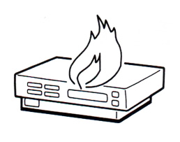
Questions? Feedback?
Neall (verheyde@radical.ca)
Mark (jamesm@radical.ca)

