Slide 1
Tristrips
Everything you’ve always wanted to know about tristrips (but were afraid to ask)

Slide 2
Overview
What is a tristrip?
Benefits of tristrips.
Breaking and stitching tristrips.
What is “tristrip friendly” art?
How much does this all really matter?
Useful tools in Maya
Other tools

Slide 3
What is a tristrip?
Consider a simple triangle mesh

Slide 4
As Triangles
2,5
6,7,11
12
1
3,4,8
9,10

Slide 5
As a Tristrip
2
4
6
1
3
5

Slide 6
Benefits of tristrips
Hardware is designed to use them
  They’re faster
    When a vertex is re-used, we don’t need to recalculate position, lighting, etc.
  They use less memory
    1000 poly model as Triangles: 3000 vertices
    1000 poly model as Tristrip: 1002 vertices

Slide 7
Breaking tristrips
For vertices in a mesh to be shared in a tristrip, ALL the vertex components must be the same.
  Texture map
  UV coordinates
  Colour
  Normals
  Bone Weightings

Slide 8
Breaking tristrips...
Different texture maps mean separate strips
Even worse, different texture maps require the hardware to do a “state change”. It needs to set things up for the new drawing enviroment, which takes time. Another term you may have heard is “Primgroup”.
One way to avoid this problem is to merge several small maps together into one large one.

Slide 9
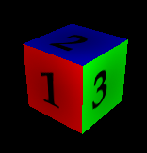






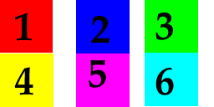
Merged maps
6 maps:
64x64
1 map:
256x128

Slide 10

Mipmapping + Filtering
Merged maps can be problematic with mipmapping and bilinear filtering
64
32
16
8

Slide 11

Helpful hints
Stick with power of 2 subtextures
Leave a border in your UV coordinates

Slide 12
More on breaking strips
UV coordinates
  If the UV coordinates aren’t welded, the tristrip will be broken.
  Skinning
Normals
  If the normals don’t match, the strip will be broken. This typically occurs with “hard edges”.

Slide 13
Triangle Fans
2
4
1
3,7
5,6
8

Slide 14
Stitching Tristrips
Since starting over is expensive, there are tricks we can use to merge them:
2
4
7,8
9
1
3
5,6
10

Slide 15
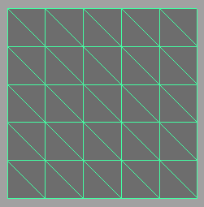
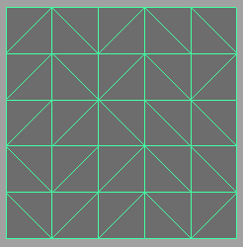
Tristrip friendly art
One big texture is better than lots of small textures
Weld UV coordinates
Don’t put in unnecessary hard edges
Simple, regular geometry tristrips well

Slide 16
How much does this all really matter?
It can be very important in some cases
  To achieve peak performance, art must be “perfect”.
For most things though, it’s a small difference
Common sense helps a lot:
  Spend a little extra time on “big ticket” items like the main character, or the trees in a boarding game
  Don’t waste time on the 20 poly lamp that’s only in one place on level 3.

Slide 17
Focus on the Art
Don’t compromise art for tristripping
  Hard edges are fine, just don’t put them in if you don’t want them.
  Multiple texture maps are okay if necessary.
A 32000 poly untextured sphere draws fast, but it doesn’t make for a very fun game.
Don’t rebuild art for performance if it’s not going to make a difference.
Again, use common sense

Slide 18
Useful tools in Maya
UV Topology
Show Hard Edges

Slide 19
Other tools
tristrip -d

Slide 20
Conclusion
Good tristrips are necessary for top performance rendering.
There are tools available to help

