Slide 1
Animation
Pure3D Training Series

Slide 2
Introduction
Terms
Base Classes
  tAnimation
  tFrameController
  tAnimationFrameController
Playback
Animation selection
Character animation

Slide 3
Terms
Frame
  Animation state at a particular time
  May be artist specified, procedurally generated, interpolated
Key frame
  Artist specified frame
Frame rate
  Speed of animation playback
Animation data
  Bundle of key frames
Controller
  Handles animation playback

Slide 4
tFrameController
Base interface for updating objects which change over time
Speed control
Examples:
  tAnimationFrameController
  tParticleSystem
  tMultiController

Slide 5
tFrameController cont’d
Time based, or frame based playback
Advance(float deltaT)
  Advances animation by deltaT milliseconds
  Preferred method
  Supports blending
SetFrame(float F)
  Advances animation to frame F
  Useful for direct control
  Does not support blending

Slide 6
tFrameController cont’d
To change the speed of a playback, call:
  SetRelativeSpeed(float speed)
Speed is a multiplier to the animation’s base rate
  set by the animator
eg. If the base rate is 30 fps, 0.5 will play the animation at 15 fps
  ie. The animation will take twice as long to complete

Slide 7
tAnimation
Holds animation data (key frames)
Frame-rate
Cyclic / non-cyclic
Playback ranges
Examples:
  tPoseAnimation
    Animates hierarchies (e.g. characters)
  tLightAnimation
    Animates light position and colour

Slide 8
tAnimation con’t
Animation speed is in frames per second
  Usually specified in Maya
To get playback length of an animation:
  GetNumFrames()
To create a subset of an animation for playback:
  SetRange(float min, float max)
  min = starting frame of animation
  max = ending frame of animation

Slide 9
tAnimationFrameController
Binds animation data to animated objects
Handles animation playback
Speed control
Blending
Examples:
  tPoseAnimationController
  tLightAnimationController
  tCameraAnimationController

Slide 10
Animation Selection
tFrameController::SetAnimation(anim)
  Attaches an animation to a frame controller
  Previous animation is discarded
  Might cause a pop
tFrameController::SetAnimation(anim, start, blend)
  Attaches with blending
  Starts new animation on frame start
  Blends over blend frames

Slide 11
Blending
Currently can blend up to 5 animations at once
Linear interpolation of non-rotational components
Spherical-linear (slerp) interpolation of rotation
Ease-in-ease out
Supported animation types:
  Pose
  Camera
  Light
  Facial expression
  Scene graph

Slide 12
Character Animation
Large section of Pure3D dedicated to characters
Animation of skeletal hierarchies
Modelling of skin on an animated hierarchy
Special considerations:
  Attachment points
  Context sensitive / procedural animation
  I.K.
  Root node handling (footsteps, gait)
  Split body animation
We’ll just talk about the basics here

Slide 13
Skeletons (tSkeleton)
Stores a hierarchy of transforms
  Characters
  Compound Meshes
Contains rest pose information
  Transforms skeleton into neutral state
Contains joint information
  Degrees of freedom of each joint
  Primary/secondary/twist axes

Slide 14
Poses
Relates the hierarchy to animation
Snapshot of hierarchy at a frame of animation
  Usually a unique pose per character instance
Matrices stored at each joint
Usually contained in drawables
Can query, or modify joint matrices
  Head tracking
  Physics
  Collision

Slide 15
Drawable Poses
tDrawablePose
Renderable hierarchical object
Derived from tDrawable
  Bounding sphere / box
Contains reference to a pose
Examples:
  tCompoundMesh
  tPolySkin
  tDeformPolySkin

Slide 16
Putting it all together
Get object to be animated out of the inventory:
  tDrawablePose* cartman = p3d::find<tDrawablePose>(“cartman”);
Create frame controller and attach pose:
tPoseAnimationController* controller = new tPoseAnimationController;
controller->SetPose(cartman->GetPose());
Attach an animation to the controller:
  controller->SetAnimation(currentAnim);

Slide 17
Cont’d
Update the animation
  controller->Advance(timeSinceLastUpdate);
Render the drawable
  cartman->Display();

Slide 18
Example
Walk cycle and run cycle
Blending
Speed adjustment

Slide 19
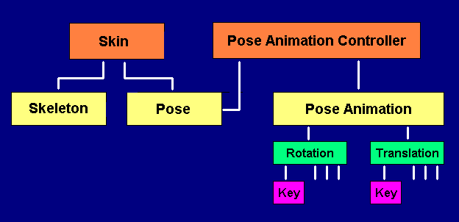
Relationships

Slide 20
Points to Take With You
Understand the difference between frames, key frames, and time
Let animation system play animations for you
  Use Advance() rather than SetFrame()
Blending works well now
It’s fun and easy!
Questions?
  verheyde@radical.ca
Notes:
Summary

