Slide 1
Pure3D Art Tools
Course 9
Pure3D Training Series

Slide 2
Introduction
Skin Deformer
Skeleton Builder
Pure3D Explorer
Pure3D Viewer
For further information or as reference, see the Pure3D Artist’s Guide

Slide 3
Skin Deformer
Overview
Installation
User interface
Usage
Muscle bulge example

Slide 4
Skin Deformer - Overview
Maya-based tool
Used for tweaking unwanted distortion when joints are rotated on skinned characters
Also used to create secondary effects such as muscle bulge or facial animation

Slide 5
Skin Deformer - Installation
From T:\Pure3D\tools\Maya Plugins\Deformer
  Copy *.mll to <MayaDir>\Maya2.5\bin\plug-ins
  Copy *.mel to <MayaDir>\Maya2.5\scripts\others
In Maya, load stateNode.mll
Create shelf button
  “source setStateUI; rdSkinDeformWnd;”
Click the button to launch the deformer interface

Slide 6
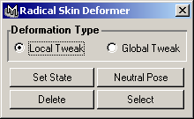
Skin Deformer - User Interface

Slide 7
Skin Deformer - Usage
“Local Tweak” radio button
  only tweaked vertices that are associated with the current joint are incorporated into the state
“Global Tweak” radio button
  all tweaks in the mesh are incorporated into the state
  used for secondary effects

Slide 8
Skin Deformer - Usage (cont’d)
“Set State” button
  Incorporates all vertex edits into a new state, associating these tweaks with the currently selected joint’s current rotation
  A joint must be selected
  What vertices are incorporated into the state depend on the deformation type selected (local or global)

Slide 9
Skin Deformer - Usage (cont’d)
“Neutral Pose” button
  Resets mesh and joints to the state they were in when initially bound
  Skinned mesh must be selected
  Important to use this button when doing global tweaks, otherwise unintended edits from other states might be incorporated into the new state

Slide 10
Skin Deformer - Usage (cont’d)
“Delete” button
  Pops up a menu from which you can select an existing state to delete

Slide 11
Skin Deformer - Usage (cont’d)
“Select” button
  Pops up a menu from which you can select an existing state
  Rotates the associated joint into the angle it was at when the state was set

Slide 12
Skin Deformer -
Muscle Bulge Example
Use “Global Tweak”
Set mesh to neutral position
Rotate joint into desired position
Tweak vertices (which can be anywhere on the mesh)
Click “Set State”
Test!

Slide 13
Points to Take With You
Use the Skin Deformer tool to:
  Fix skinned mesh problems (local tweaking)
  Associate secondary effects such as muscle bulge or facial animation with joint rotations (global tweaking)

Slide 14
Skeleton Builder
Purpose
Installation
User interface
Creating a skeleton

Slide 15
Skeleton Builder - Purpose
Common bone hierarchy for bipedal characters
Common joint naming conventions
Allows for easier cutting and pasting between animations later in the development cycle

Slide 16
Skeleton Builder - Installation
From T:\Pure3D\tools\Maya Plugins\SkelBuild
  Copy skelUI.mel to <MayaDir>\Maya2.5\scripts\others
Create shelf button “source skelUI; rdSkelBuildWnd;”
Click button to launch skeleton builder interface

Slide 17
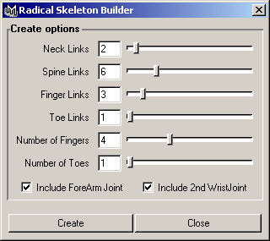
Skeleton Builder - User Interface

Slide 18
Skeleton Builder -
Creating a Skeleton
Select the number of neck, spine, finger and toe links
Select the number of fingers and toes
Check to include extra forearm and wrist joints
Click “Create”

Slide 19
Points to Take With You
Use the Skeleton Builder tool to:
  Create joint hierarchies with standard naming conventions

Slide 20
Pure3D Explorer
Overview
Installation
User interface
Deleting chunks
Editing chunks
Turning off warnings

Slide 21
Pure3D Explorer - Overview
Low-level Pure3D chunk browsing
View details of exported art
Deleting chunks from Pure3D files
Editing chunk fields

Slide 22
Pure3D Explorer - Installation
Copy T:\Pure3D\tools\gui\p3dexplorer.exe (or from Perforce in //depot/tools/gui/) to a convenient location on your hard drive
Associate .p3d files with p3dexplorer.exe

Slide 23
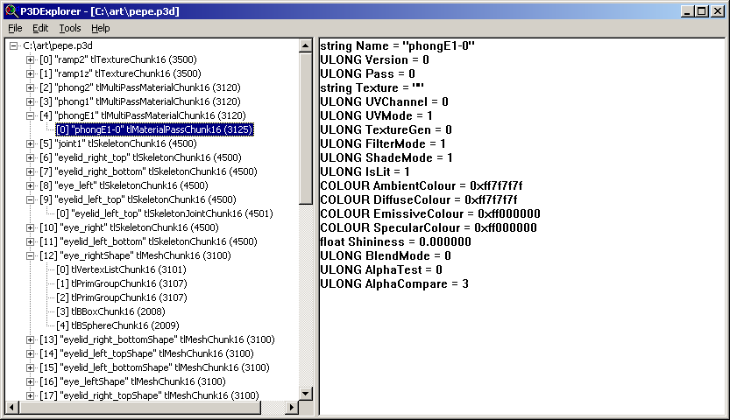
Pure3D Explorer - User Interface

Slide 24
Pure3D Explorer - Deleting Chunks
Hit the Delete key or select Edit | Delete from the menu to delete a chunk
Be careful what chunks you delete!

Slide 25
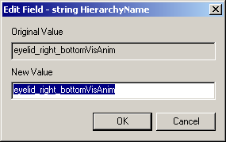
Pure3D Explorer - Editing Chunks
Hit enter, F2, or double-click to edit chunk fields
Generally, only fundamental types (string, ULONG, float, COLOUR, etc.) are editable
Watch out for field dependencies!

Slide 26
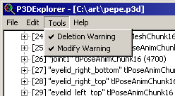
Pure3D Explorer -
Turning Off Warnings

Slide 27
Points to Take With You
Use the Pure3D Explorer tool to:
  Browse the low-level chunk format
  Perform small edits on chunk fields
Be careful what chunks you delete - other chunks may depend on them!
Be careful what fields you edit - other fields (possibly in other chunks) may depend on them!

Slide 28
Pure3D Viewer
Overview
Installing
Running
Using
Advanced Configuration

Slide 29
Pure3D Viewer : Overview
Used for viewing art using the same Pure3D runtime that games will use.
Supported on the PC & PS2
Supports almost all types of Pure3D data /animations
  Drawables : Geometry, Skins, Compound Meshes, Scenegraphs, Particles
  Animation : Pose, Camera, Light, Texture, Particle, Scenegraph, Visibility

Slide 30
Pure3D Viewer : Installing
Latest copy on T: drive and in perforce
  T:\Pure3D\Tools\p3dview
  \\depot\tools\gui\p3dview
Copy all the files in this directory to your machine

Slide 31
Pure3D Viewer : Running
PC Viewer - Just run p3dview.exe
  Can also drag-and-drop on a shortcut
PS2 Viewer
  Run ps2tm
  Set up dev. System in ps2tm
  Set IP address in p3dview.cfg
  Load and run ELF in ps2tm
  Run p3dview_ps2.exe

Slide 32
Pure3D Viewer : Using
Loading art
  Just drag-and drop
Controls
  Camera controls : Maya without the <Alt> key
  Arrow key select animation (up/down) and drawable (left/right)
  PgUp/PgDn switch camera
  Home/End switch lights

Slide 33
Pure3D Viewer : Configuration
Video configuration : config.cfg
  Resolution
  Driver
Viewer configuration
  Change key bindings
  Change rendering parameters
Console

Slide 34
Pure3D Viewer
Points to Take With You
Viewer will show you what art will look like in the game
Viewer is in T:\Pure3D\Tools\p3dview
Camera controls mimic Maya
Arrow/Page keys select objects/animations
Can change configuration using .cfg files

