Slide 1
2D Rendering
Pure3D Course Series

Slide 2
Introduction
2D Basics
Data Formats
Fonts
2D Primitives

Slide 3
2D Coordinate System
Orthographic projection
  pddiRenderContext::SetProjectionMode()
    PDDI_PROJECTION_PERSPECTIVE
    PDDI_PROJECTION_ORTHOGRAPHIC
    PDDI_PROJECTION_DEVICE

Slide 4
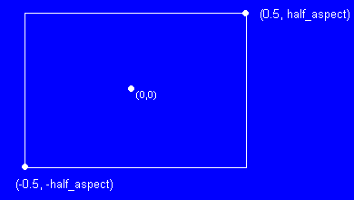
2D Coordinate System (cont’d)
Coordinate system is resolution independant
  centered on (0,0)
  width is 1
  height is 1 / aspect ratio (from tCamera)

Slide 5
Data Formats
Pure3D chunks
  Sprite
  Font
Standard file formats
  Sprite : TGA, PNG, BMP
  Font : TTF

Slide 6
Fonts
Can be loaded from .p3d also can be generated from .ttf
  v12 used Windows font registry, v13 loads .ttf files
  Doesn’t go through standard loading system (yet)
Unicode
  P3D_WCHAR
  Most functions have unicode/non-unicode versions

Slide 7
Fonts
tFontFactory produces fonts
  Can specify paramters of fonts
    Size
    Characters used
    Colours
    Anti-aliazing
    Bit depth
tFont
  tPolyFont

Slide 8
Pure3D Primitives
tSprite
  Arbitrarily sized bitmaps
  Sliced into power of two sections
    Most efficient when “mostly” powers of two
    need to be cautious of seaming issues when scaling
tTextString
  Holds reference to a string and a font
  Doesn’t “own” string
  Can be unicode or char

Slide 9
Pure3D Primitives (cont’d)
tGeometry
  Can be rendered in 2D
  Useful for large polygon collections (precalculated vector graphics)
  Need 3D package and have to obey power of two rules though.
Other Pure3D Rendering
PDDI Rendering

Slide 10
Pure3D Primitives (cont’d)
Other issues
  Aspect ratio
  native resolution
  seaming
  texture and material properties

Slide 11
Points to Take With You
2D Coordinate system is (almost) normalized, (0,0) in centre of screen
Only difference between 2D and 3D rendering is projection mode
Fonts are created from .ttf files using font factory
Sprite and Font are the main 2D primitives

