Slide 1
Art Pipeline
Maya Exporter Basics
Pure3D Training Series

Slide 2
Outline
Conceptual Art Pipeline
Distribution and Installation
Maya to Pure3d exporter - 2 key points
Hypergraph
Simple Export
The Transform Node
tlSkeleton
tlCompoundMesh
Affecting What Gets Exported
Transform Animation
Skinned Characters
Exporting Selection Only
Bad Art
Misc.
Points to take with you

Slide 3
Simple Conceptual Artpipeline
maya
to
p3d
exporter
Maya
.p3d file
optional
command-line
file processing
tools.
eg:
- tri-strip tool
- p3danim
runtime application
pure3d v13 library
THE artpipeline

Slide 4
Real Example of Simple Art Pipeline
maya
to
p3d
exporter
pure3d viewer
Maya
.p3d file
pure3d v13 library

Slide 5
Distribution and Installation
p3dmayaexp
T:\Pure3d\tools\p3dmayaexp\
put p3dmayaexp.mll in ....aw\maya2.5\bin\plug-ins
put .mel files in ...aw\maya2.5\scripts\others
T:\Pure3d\tools\p3dview\
T:\Pure3d\Guides\Artist\p3d_artist.htm
any problems, see me: gmayer@radical.ca
demo simple export and view...
p3dview
docs

Slide 6
The Maya-To-Pure3D Exporter
Two Key Points:
understand logically what you are making.
understand how the exporter decides what to write out to file.
how this is made easy...

Slide 7
The Hypergraph is your friend.

Slide 8
HyperGraph Options
almost always want to have Scene Hierarchy View
use: Options->Display->Shape Nodes
often helpful: Options->Display->Invisible Nodes

Slide 9
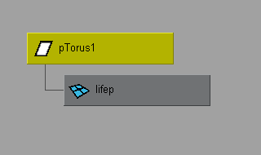
Simple Export Re-visited
what you see in the Hypergraph:
(with invisible nodes off)
what you see in the file:
(look at the Output Window)
tlMultiPassMaterial: lambert1
tlMultiPassMateiral: lambert2
(some other stuff we’ll get to soon)
tlPrimGroupMesh (or tlSkin): lifep
(some other stuff we’ll get to soon)
note:
- the order of things in the file - things need to come before things that reference them!
- where the mesh name comes from

Slide 10
The Transform Node
pTorus1 is the transform node
transform nodes can have many other nodes as children.
typically they will only have one mesh as a direct child (if there is more than one, one of them will be an intermediate object).
in Maya, the transform node holds translation, rotation and scale information for it’s child mesh.
in Pure3d, the transform node only holds translation and rotation - scale is multiplied through to the mesh.
why? let me show you...

Slide 11
Increasing Complexity
typically you want many meshes organized into a scene or into complex object.
this is dealt with in a .p3d file using two objects:
  tlSkeleton
  tlCompoundMesh
(note: there are corresponding runtime versions of these objects)

Slide 12
tlSkeleton
hierarchy of transforms.
name of tlSkeleton in the file is taken from the root node of the hierarchy in Maya.
you can’t draw it.
it is referenced by other things you can draw, for example, a tlCompoundMesh...

Slide 13
tlCompoundMesh
a thing you can draw.
organized collection of meshes.
references a tlSkeleton.
exporter gives it the same name as the skeleton it references.
made up of a list of (joint, mesh) pairs; one such pair for each mesh you want to draw.
(combination of these two used to be called an ETree or MTree)
example...

Slide 14
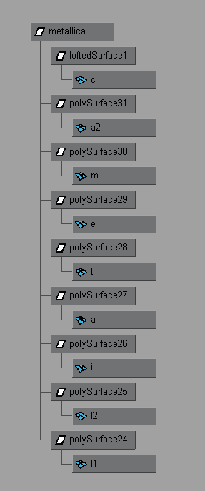
tlCompoundMesh Example
what you see in the Hypergraph:
(with invisible nodes off)
what you see in the file:
(look at the Output Window)
tlMultiPassMaterial: lambert1
tlSkeleton: metallica
tlPrimGroupMesh (or tlSkin): a
tlPrimGroupMesh (or tlSkin): c
tlPrimGroupMesh (or tlSkin): e
tlPrimGroupMesh (or tlSkin): i
tlPrimGroupMesh (or tlSkin): m
tlPrimGroupMesh (or tlSkin): t
tlPrimGroupMesh (or tlSkin): l1
tlPrimGroupMesh (or tlSkin): l2
tlPrimGroupMesh (or tlSkin): a2
tlCompoundMesh: metallica

Slide 15
tlSkeleton-tlCompoundMesh relationship
tlSkeleton
name: metallica, num joints = 10
joint 0 - name: metallica
parent: 0 (root is it’s own parent)
joint 1 - name: loftedSurface1
parent: 0
joint 2 - name: polySurface31
parent: 0
joint 3 - name: polySurface30
parent: 0
joint 4 - name: polySurface29
parent: 0
joint 5 - name: polySurface28
parent: 0
joint 6 - name: polySurface27
parent: 0
joint 7 - name: polySurface26
parent: 0
joint 8 - name: polySurface25
parent: 0
joint 9 - name: polySurface24
parent: 0
tlCompoundMesh
name: metallica, num nodes = 9, skeleton: metallica
node 0: mesh: “c” , joint: 1
node 1: mesh: “a2”, joint: 2
node 2: mesh: “m”, joint: 3
node 3: mesh: “e”, joint: 4
node 4: mesh: “t”, joint: 5
node 5: mesh: “a”, joint: 6
node 6: mesh: “i”, joint: 7
node 7: mesh: “l2”, joint: 8
node 8: mesh: “l1”, joint: 9

Slide 16
Affecting What Gets Exported
hide nodes you want the exporter to skip.
hiding transform nodes affects the tlSkeleton.
hiding mesh nodes does not.
both will affect the tlCompoundMesh.
also note: if you hide or template a whole layer, everything on it is ignored.

Slide 17
note......
in Maya, a ‘joint’ node is also a ‘transform’ node, just more specific.
also recall, a tlCompoundMesh can have far fewer nodes than the corresponding tlSkeleton.
one Maya ‘scene’, can have many tlCompoundMeshes in it - every top-level node will be the root of a new tlCompoundmesh and tlSkeleton.

Slide 18
Transform Animation
transform animations work on hierarchies of transforms.
ie. you get a tlTranAnim in the file, that can animate a tlSkeleton.
note naming options...
exporter simply reads out value of matrix in each transform node, for each frame; does auto-optimize on frames that are linear with 0.0 tolerance.
export and view...

Slide 19
Skinned Characters
a character is a single mesh that is smooth bound to a transform hierarchy.
the transform hierarchy is exported as a tlSkeleton like usual.
the mesh is put in the file as a tlSkin - this type of drawable also references a tlSkeleton, and holds joint weightings for each of its vertices.
in Maya the joint hierarchy and mesh are related by a skinCluster node; the exporter will not traverse the character’s hierarchy as SimpleScene.
‘real’ example...

Slide 20
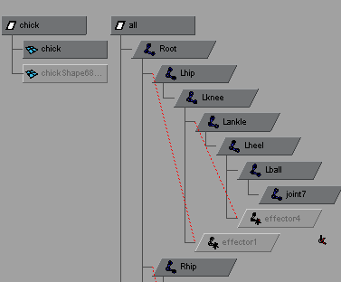
Skinned Character Example
part of the Hypergraph:
part of what’s in the file:
(note naming)
[materials and textures deleted]
tlSkeleton: all
tlPrimGroupMesh (or tlSkin): chick
tlTranAnim: allanim

Slide 21
Characters - Limitations and Precautions
only bind hierarchy to one mesh
currently only smooth-bind is supported.
try to smooth bind with as few max influence objects as possible.
if you have to tweak a mesh that is already bound, do the following:
  go to bind frame
  detatch
  tweak
  DELETE HISTORY of the mesh
  rebind
failure to do this will slow down both Maya and the exporter a lot.

Slide 22
Exporting Selection Only
you can start the export at the currenly selected node by:
  selecting a node
  choosing Export Selection instead of Export All.
currently, for this to work, the node must be a transform node.

Slide 23
Bad Art
faces must be tris or quads - if in doubt, triangulate in Maya.
textures dimensions must be powers of 2.
if you do the -1 scale trick to mirror geometry, use the Modify->Freeze Transformations on the result.
turn BACKFACE CULLING ON in Maya. (seems like this has to be reapplied as you create new objects)
when you Duplicate objects, pay attention to whether you are instancing or copying. (usually want to copy I suspect)
bad art examples...

Slide 24
Misc.
world-root option...
skinned character with props? to be investigated.
instancing - though you can change materials on instances of an object in Maya, currently all instances will look like the first object when exported.

Slide 25
Points to take with you
understand logically what you’re making.
understand how the exporter decides what to export.
the Hypergraph is your friend.
so is Greg Mayer in Pure3d.
PS2 friendly art:
  don’t use lots of little textures; do use (fewer) big textures
  smooth-bind to as few max joints per vertex as possible.
see artist guide for points to keep in mind when using Maya and the exporter.
Notes:
Summary

