Slide 1
Exporting
Basics, Tips and Tricks

Slide 2
Introduction
What does the Exporter do?
What doesn’t the Exporter do?
Exporter options and attributes
Known problems and workarounds

Slide 3
What does the Exporter do?
The goal of the exporter is to store everything in a Maya scene into a Pure3D file.
It handles:
  Geometries, Skins and Skeletons
  Shaders, Materials and Textures
  Animations
  Cameras and Lights
  Effects (Particle Systems, Lens Flares)

Slide 4
Some things are “Baked in”
Procedural Textures
Dynamics
IK

Slide 5
What doesn’t the Exporter do?
Splines, Nurbs, etc.
Locators (Outside a hierarchy)

Slide 6
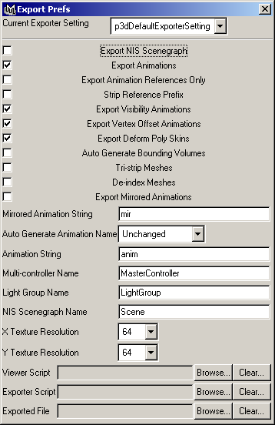
Exporter Options

Slide 7
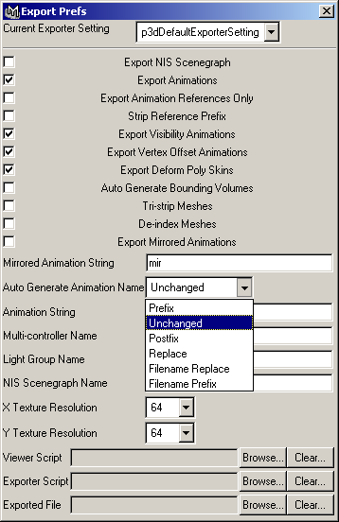
Exporter Options
Prefix: animname
Unchanged: name
Postfix: nameanim
Replace: anim1
File Replace: fileanim
File Prefix: animfile1

Slide 8
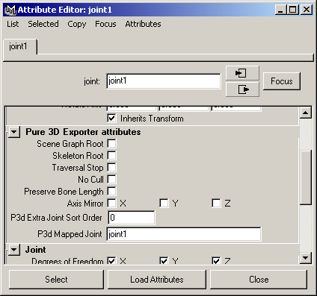
Joint Attributes

Slide 9
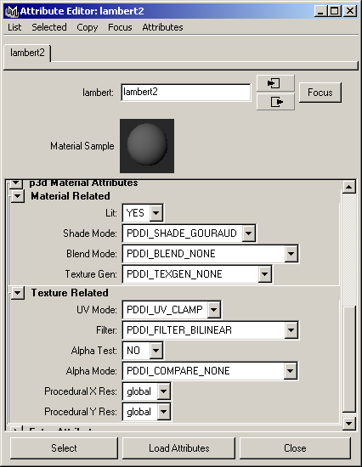
Old Material Attributes

Slide 10
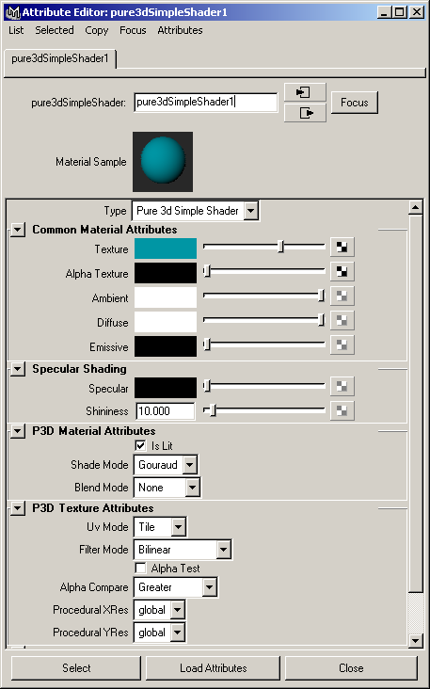
New Shaders

Slide 11
Known Problems
Hidden Layers are exported
“Bug” bug
  Attaching geometry to cameras causes problems
References lose shading groups

Slide 12
Contacts
Mark James
  x2720
  jamesm@radical.ca
  Room 733

