Slide 1
Shaders for Artists
Pure3D Training Courses

Slide 2
Introduction
Why do we need something new?
Multipass examples
Platform differences
The Pure3D Simple Shader

Slide 3
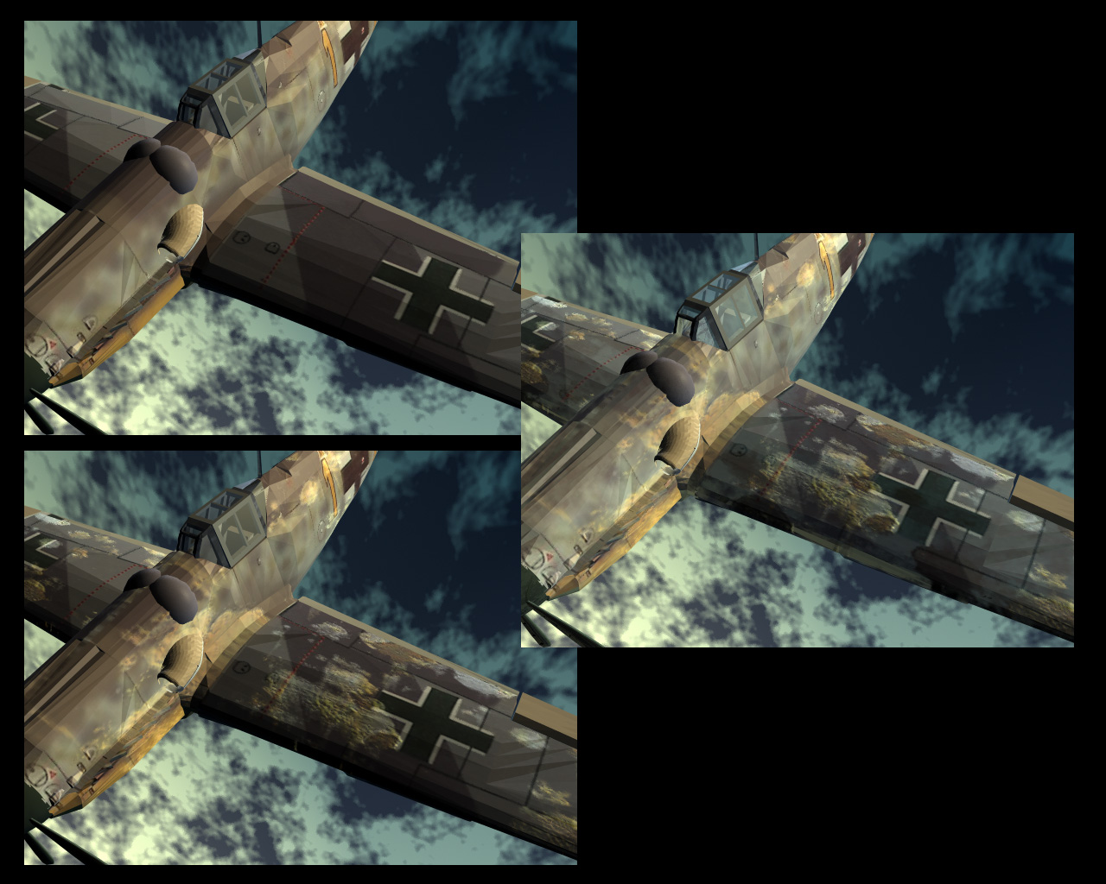
Multipass Rendering

Slide 4

Base Texture

Slide 5
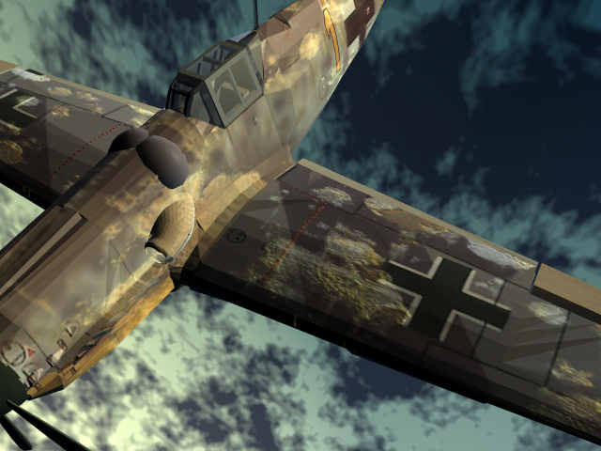
Bump Map

Slide 6
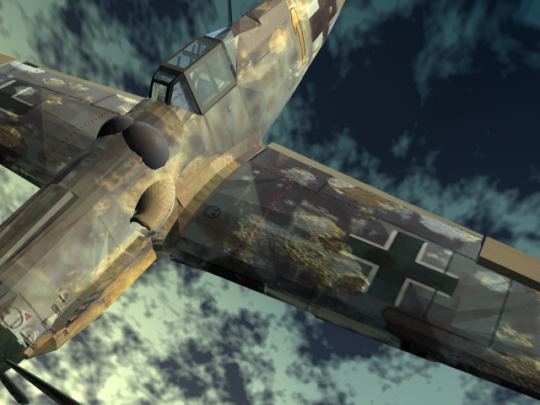
Reflection Map

Slide 7
Multipass Rendering
BaseTex
Modulate
Add
Output
Lightmap
Constant

Slide 8
Effects
Light Mapping
Environment Mapping
Bump Mapping
Masking
“True” spotlights
Many more

Slide 9
Platform Differences
PS2 is the most limited
  Bump mapping is hard
XBox and Game Cube are much more powerful
  Lots of things are possible

Slide 10
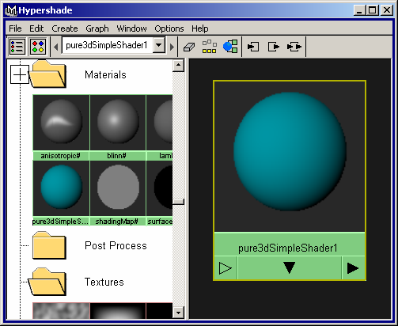
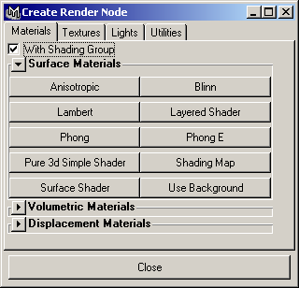
Pure3D Simple Shader

Slide 11
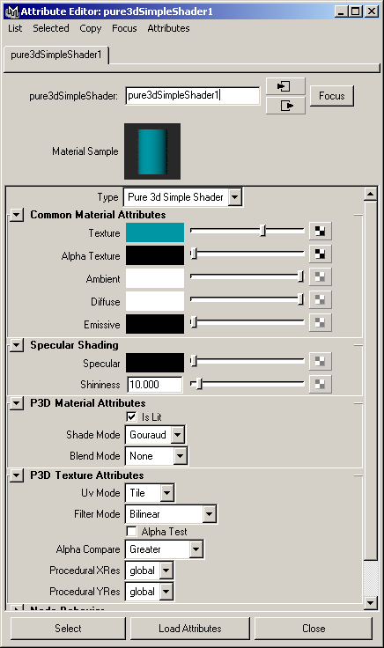
Simple Shader Attributes

Slide 12
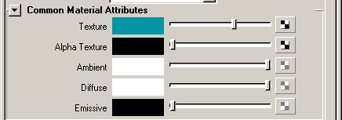
Common Attributes

Slide 13

Specular Shading

Slide 14

Pure3D Material Attributes

Slide 15
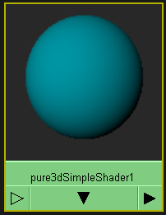
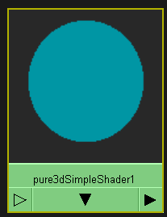
Is Lit

Slide 16
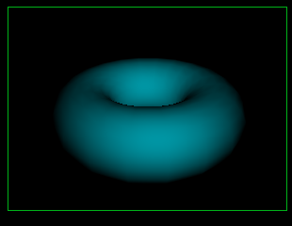
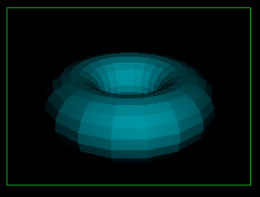
Shade Mode
Gouraud Flat

Slide 17
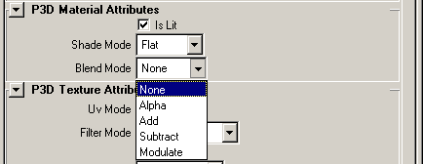
Blend Mode

Slide 18
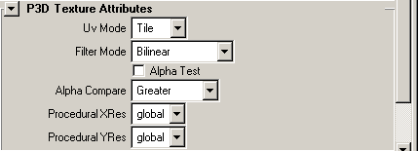
Texutre Attributes

Slide 19

UV Mode

Slide 20
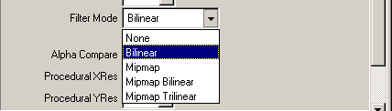
Filter Mode

Slide 21
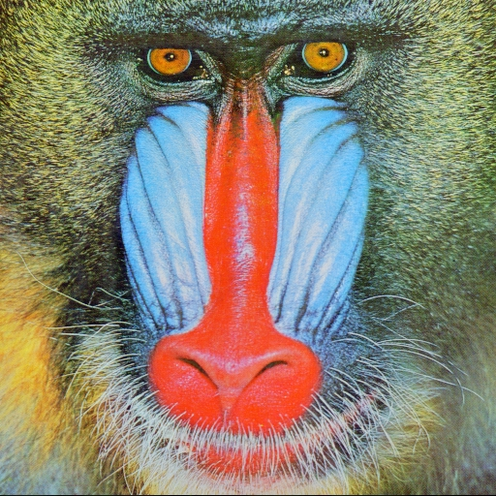





Mipmapping

Slide 22
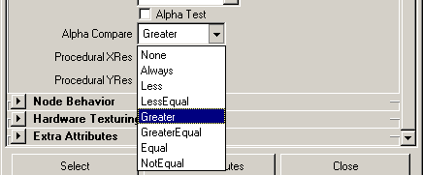
Alpha Testing

Slide 23
Points To Take with You
Shaders open up the brave new world of multipass rendering.
There are many more rendering effects available with new hardware

