Slide 1
Animation
Pure3D Training Series

Slide 2
Introduction
Terms
Types of Animations
Character animation
Sequencer

Slide 3
Terms
Frame
  Animation state at a particular time
  May be artist specified, procedurally generated, interpolated
Key frame
  Artist specified frame
Frame rate
  Speed of animation playback
Animation data
  Bundle of key frames
Controller
  Handles animation playback

Slide 4
Types of Animation
Skeletal
Light
Camera
Visibility
Particle
Scenegraph
Texture
Facial
Event

Slide 5
Character Animation
Large part of Pure3D dedicated to characters
Animation of skeletal hierarchies
Modelling of skin on an animated hierarchy
Facial Animation

Slide 6
Controllers
Handles animation playback
Sits between animation data and object that is animated
  hierarchy, light, camera, etc.
Handles blending
Each character instance needs its own controller
Controllers are exported from Maya for the viewer

Slide 7
Skeletons
Hierarchy of transforms (bones, joints)
  “topology”
Contains rest pose information
  Transforms skeleton into neutral state
Contains joint information
  Degrees of freedom of each joint
  Primary/secondary/twist axes
  Mirroring symmetry and joint swapping
  Re-targeting information

Slide 8
Poses
Live version of the hierarchy
  This is what gets animated
  Usually a unique pose per character instance
Matrices stored at each joint
Usually contained in drawables
Can query, or modify joint matrices
  Head tracking
  Physics
  Collision

Slide 9
Drawable Poses
Renderable hierarchical object
Combines rendering and animation
Contains bounding sphere / box
Contains reference to a pose
Examples:
  tCompositeDrawable
  tPolySkin

Slide 10
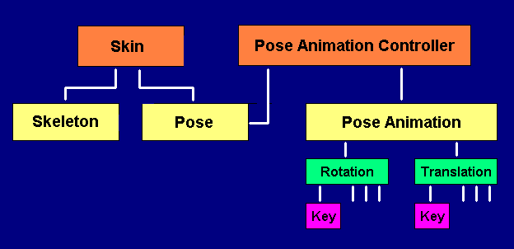
Relationships

Slide 11
What is the Sequencer?
High level animation control
Script based
Describes interactions between animations (motion tree)
Based on the concept of states
States interact by defined transitions
Event animations can be associated with states

Slide 12
Describing a Sequencer
Text based script file
Define a sequencer
  set animation information
  define the states
  define the transitions

Slide 13
Sequencer Definition
name
  name of the sequencer
animtarget
  name of the controller to sequence
speed
  relative speed of animations for this sequencer

Slide 14
Sequencer State Definition
Mandatory fields
  name
  anim
Optional fields
  loop
  minframe/maxfrmae
  event
  subpart

Slide 15
Transitions
Defines how one state goes to another
  frame ranges
  blending
  legal/illegal targets

Slide 16
Transition Types
transition
  Defines a transition TO this state
  Can cut or blend over specified time
default
  used when no specific transition is defined
  is optional
outtransiton
  is executed when state has looped a specified number of times
  is optional

Slide 17
Blending
“Cross fade” between animations
  Up to five at once
Linear interpolation of non-rotational components
Spherical-linear (slerp) interpolation of rotation
Ease-in-ease out
Supported animation types:
  Pose, Camera, Light, Scene graph

Slide 18
Points to Take With You
Many objects in Pure3D can be animated from Maya
The skeleton defines a hierarchy for a character
The pose stores the current configuration of a skeleton
  under animation, physics, etc. control
The sequencer can be used to build a motion tree
Notes:
Summary

