Slide 1
Playstation2
Pure3D Training Courses

Slide 2
Introduction
Overview of PDDI architecture
Estimating memory size
Performance improvements over V13
Using the clipper
Future

Slide 3
Overview of PDDI Architecture
V14 supports two rendering APIs: buffered and streamed
Buffers can be either indexed, or non-indexed
All three system are implemented quite differently on the PS2

Slide 4
Buffered Prims
Non-indexed prim buffers hold the vertices in pre-built DMA packets designed to be DMA’ed directly to the VIF1 for rendering
Maximum amount of prims per buffer limited by DMA
  about 30,000 vertices/buffer lit
  about 43,000 vertices/buffer unlit

Slide 5
Buffered Prims cont’d
Uncached-accelerated memory used for DMA buffer
Colours are stored in ARGB 1555 format
  VIF1 expands the colours to 128 bits
  Streamed prims have 8 bits of alpha
Tri-strips are restarted at buffer boundaries for the clipper
  Two duplicate vertices per buffer (96 vertices)

Slide 6
Memory Usage
Non-indexed, prim buffer:
23*nVertices / 96 + 32*nVertices (lit)
23*nVertices / 96 + 22*nVertices (unlit)
eg.
2,000 vertices = 64,480 bytes (lit)
44,480 bytes (unlit)
10,000 vertices = 322,396 bytes (lit)
222,396 bytes (unlit)

Slide 7
Memory Usage cont’d
The previous equations are approximations
Additional overhead per buffer
  Padding to ensure 128 bit alignment
  Two duplicate vertices per buffer for tri-strips (non-indexed only)
  Misc. bookkeeping

Slide 8
Streamed Prims
The streamed rendering system builds a DMA packets on-the-fly in the scratchpad (SPR)
A simpler layout is used to make packet-building efficient
  vertices are interleaved in SPR
  all components are 128 bits wide
SPR buffer is sent to VIF1 every 84 vertices

Slide 9
Buffered-Indexed Prims
Buffered-indexed prims are stored in a simple vertex-list/index-list data structure
Vertices are de-indexed by the CPU on the fly, and sent through the stream renderer
  reasonable performance since de-indexing overlaps rendering

Slide 10
Memory Usage
Indexed, prim buffer:
  2*nIndices + 36*nVertices
eg.
2,000 vertices, 4,000 indices = 80,000 bytes
10,000 vertices, 20,000 indices = 400,000 bytes

Slide 11
Performance
Streamed prims are roughly the same speed as the old V13 prim system
Buffered prims are about 2X over V13
Indexed prims are about 4X the speed over V13
Skins are 2X faster in V14
Coming soon: new version of the PS2 performance guide

Slide 12
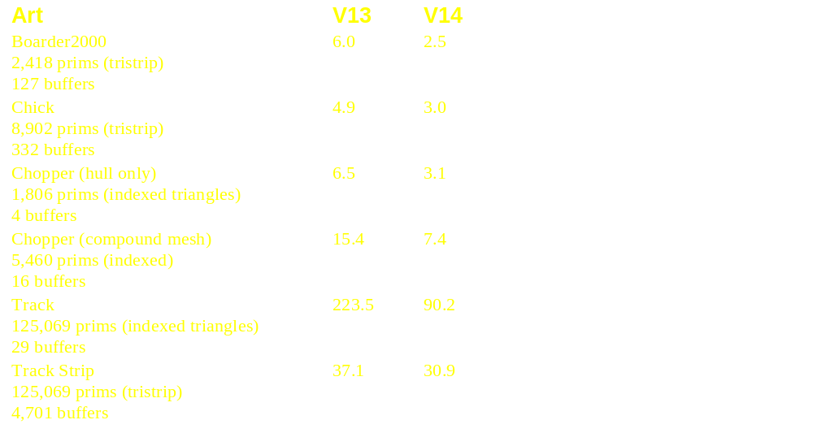
Performance cont’d

Slide 13
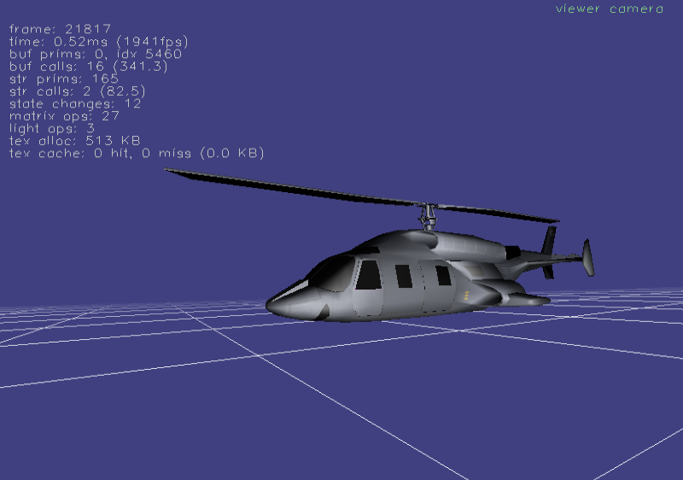
Buffered prims drawn
Indexed prims drawn
Buffered draw calls (avg prims/buffer)
Streamed prims drawn
Streamed draw calls (avg prims/buffer)

Slide 14
Performance Tips
Same as V13:
  large buffers are better than small buffers
  reduce state changes, “skin textures”
  tri-strip, de-index
  avoid lighting/fog/specular when possible
  use 4/8 bit textures to save VRAM
New:
  use clipper only when necessary
  fewer bones/vertex for skins

Slide 15
Clipping
The PS2 uses a 12.4 bit screen co-ordinate system
  co-ordinates range from [0.0 - 4095.9375]
PDDI places the frame buffer in the middle of the range
The area off the screen is known as the “guard band”

Slide 16
0,0
Guard band
Frame buffer:
640x448
4096,4096

Slide 17
Clipping cont’d
The hardware will scissor valid primitives that go outside of the screen boundaries
Valid = vertices lie within 12.4 co-ordinate range
If any vertices go outside this range, the co-ordinates will wrap
  causes ugly “streak” polygons when drawn

Slide 18
0,0
Guard band
Correctly drawn
Incorrectly drawn
4096,4096

Slide 19
Clipping cont’d
Projection is undefined at z=0, and “mirrors” at z<0
Therefore, we need clipping
Unfortunately, the PS2 hardware has no native support for clipping
  Have to implement the clipper in the VU1
  Speed issues

Slide 20
Clipping cont’d
PDDI currently implements near-plane clipping with guard-band clamping
  Vertices that touch the near plane are clipped
  Vertices that touch the guard band edges are clamped to the guard band
    prevents dropouts, but warps textures

Slide 21
Clipper Artifacts
To reduce warping:
  Move near plane far out as possible
    side benefit of increasing z-buffer precision
  Use smaller triangles
  Prevent objects from getting too close to the camera
We will implement a full five-plane clipper for V15
  no artifacts! (we hope)

Slide 22
Clipper Speed
Clipping is slow
  ~20% slowdown when enabled
Can be toggled in PDDI:
pddiExtVU1Control* vu1 = (pddiExtVU1Control*)
p3d::pddi->GetExtension(PDDI_EXT_VU1_CONTROL);
if(vu1)
{
vu1->EnableClipper(false);
}
V15 will add auto clip-toggling

Slide 23
Other Clipper Issues
Objects with specular lighting don’t go through the clipper right now
  They are just guard band clipped
Fog isn’t clipped properly
  fog value is just set to 0 at near plane
  usually, this looks fine

Slide 24
Future
New clipper
Tri-strip combining
Two pass rendering on VU1
More speed!
Special effects

