Slide 1
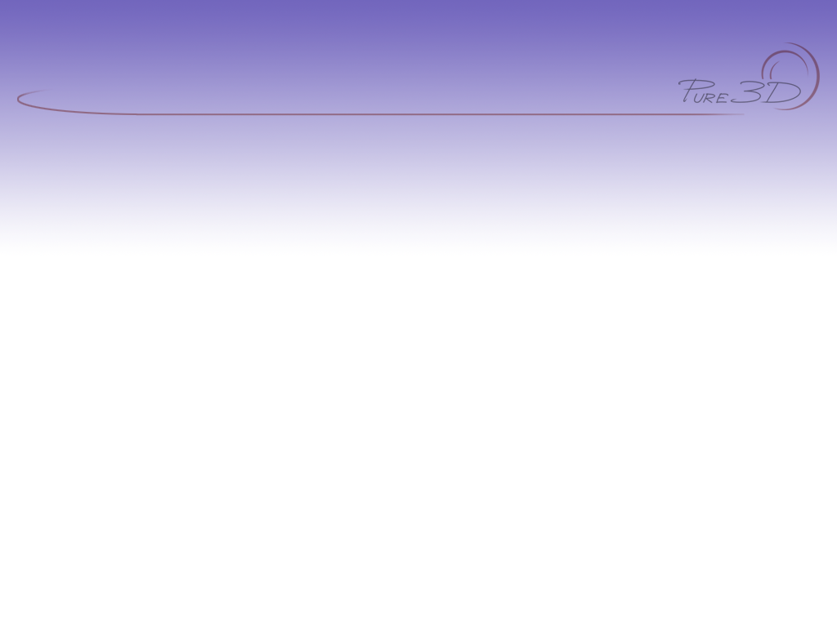
Pure3D Basics

Slide 2

Introduction
Terminology
Initialization
Reference Counting
Loading
  Load Requests
  Inventory
Views, Cameras
Main Loop
Rendering

Slide 3
Basics & Terminology
Pure3D is an immediate mode API
  All rendering commands are issued by clients each frame.
PDDI - Pure3D Device Driver Interface
  Rendering hardware abstraction
  Very platform specific implementation
Pure3D
  Platform independent (mostly)
  Many subsystems (anim, effects, etc…)
Radmath

Slide 4
Initialization
Two stage initialization
  tPlatform
    tPlatform::Create()
  tContext
    tPlatform::CreateContext();
    Needs initilization structure
      Resolution/ Bit depth
      Platform specific
        PDDI Driver (PC)
        PAL
        etc..
    Can be multiple contexts in some cases

Slide 5
Win32 Issues
Need to select a PDDI DLL
Need to call p3d::platform->ProcessWindowsMessage()
Should handle WM_PDDI_DRAW_ENABLE
Windowed vs. Fullscreen rendering
Multiple resolutions / colour depth

Slide 6
Core Objects
Once initialized, you generally access core object through ‘p3d’ namespace
  Contains shortcuts to active objects
    p3d::context = current context
    p3d::pddi = current PDDI render context
  These are special pointers that map to the same objects as tPlatform::GetPlatform() and tPlatform::GetActiveContext()
  Also contains some utility functions

Slide 7
Reference Counting
Manages lifetimes of Objects
  Call AddRef when you take a reference
  Call Release when you are done
  tRefCounted::Assign, tRefCounted::Release
Pure3D objects hold references
  Inventory references all loaded objects
  Use ReleasedVerified if you think you own it
Be careful when deriving
  No stack or static allocations

Slide 8
Loading
Handled via Load Manager (p3d::loadManager)
tLoadManager has various handlers
  File : .p3d, .bmp, .tga, .png
  Chunks
  Both can be customized

Slide 9
Loading cont’d
To prepare for loading:
  p3d::InstallDefaultLoaders();
  install game specific loaders
To load a file:
  p3d::load(“foo.p3d”);
  p3d::loadManager->Load(request);

Slide 10
Load Requests
More complex descriptions of loading
  Allocate tLoadRequest objects
  Set parameters
    Async / Callbacks
    Memory Pool
    Inventory Section
  Call p3d::LoadManager->Load(request)

Slide 11
Inventory
Stores loaded Pure3D objects
  Resolves references during loading
Accessible through p3d::inventory
Supports searching by name/type and UID/type
  e.g. p3d::find<tDrawable>(“bar”);
  searching on base classes works:
  p3d::find<tEntity>(“bar”);
    finds any item named “bar”

Slide 12
Inventory cont’d
To store an item:
  p3d::inventory->Store(bar);
The inventory will AddRef() stored items
Be careful of collisions
The inventory can be scanned with Iterators

Slide 13
Inventory (cont’d)
Sections
  Used to organize/separate data
  Create with p3d::inventory->CreateSection
  SetCurrentSection, SetCurrentSectionOnly

Slide 14
Views
Defines the current rendering environment
Screen layout of rendering
  View rectangle (must be onscree)
  Clear parameters (Colour, etc.)
Describe 3D rendering environment
  Camera, Lights, Fog
Can have multiple views
  cannot nest

Slide 15
Cameras
Defines point-of view from which a scene is rendered
  Position/look direction of viewer
  field-of-view
  near and far clipping planes
Different ways to define
  tCamera
  tVectorCamera
  tPointCamera
  Your own

Slide 16
Cameras (cont’d)
Example : Initializing a camera
Vector cameraPosition(0.0f, 0.0f, -200.0f);
camera = new tPointCamera;
camera->SetPosition(cameraPosition);
camera->SetTarget(rmt::Vector(0,0,0));
view->SetCamera(camera);

Slide 17
Lights
Directional, Point, Spot
  Colour & other parameters
Add to a view : tView::AddLight(light)
Example : initializing a light
light = new tDirectionalLight;
light->SetDirection(0.0f, 0.0f, 1.0f);
light->SetColour(tColour(255, 255, 0));
view->AddLight(light);

Slide 18
Matrix Stacks
Model/View
  Holds current object space to camera space transformation.
  Camera matrix placed on stack by tView::BeginRender()
  Manipulated to control drawing position
  Can be pushed and popped to handle hierarchies
Texture

Slide 19
Primitives
tDrawable
  Display
  Bounding volumes
Primitive types
  tGeometry
  tDrawablePose (tCompositeDrawable, tPolySkin)
Deriving you own Drawables
PDDI Rendering

Slide 20
Main Loop
p3d::context->BeginFrame()
view->BeginRender();
p3d::stack->Push();
p3d::stack->Multiply(transform);
object->Display();
p3d::stack->Pop();
view->EndRender();
p3d::context->EndFrame();

Slide 21
Main Loop (cont’d)
After begin render, view state is loaded into hardware and wont change.
Can control end of frame and framebuffer swap separately
  p3d::context->EndFrame(false);
  p3d::context->SwapBuffers();
Could be more than one view
  Can even do without view in some cases

Slide 22
Summary
Pure3D vs. PDDI
Use reference counting safely.
Load requests encapsulate loading
  Inventory sores stuff once loaded
Main Render Loop
  View, camera, matrix stack & drawables

Slide 23
Comments?
Email: pure3dfeedback@radical.ca
Web: http://radnet/
  Select “Pure3D” project in Tracker box on left hand side, click “Login”
  Login in with e-mail ID (Password is blank if you’ve never logged in before)

