Slide 1
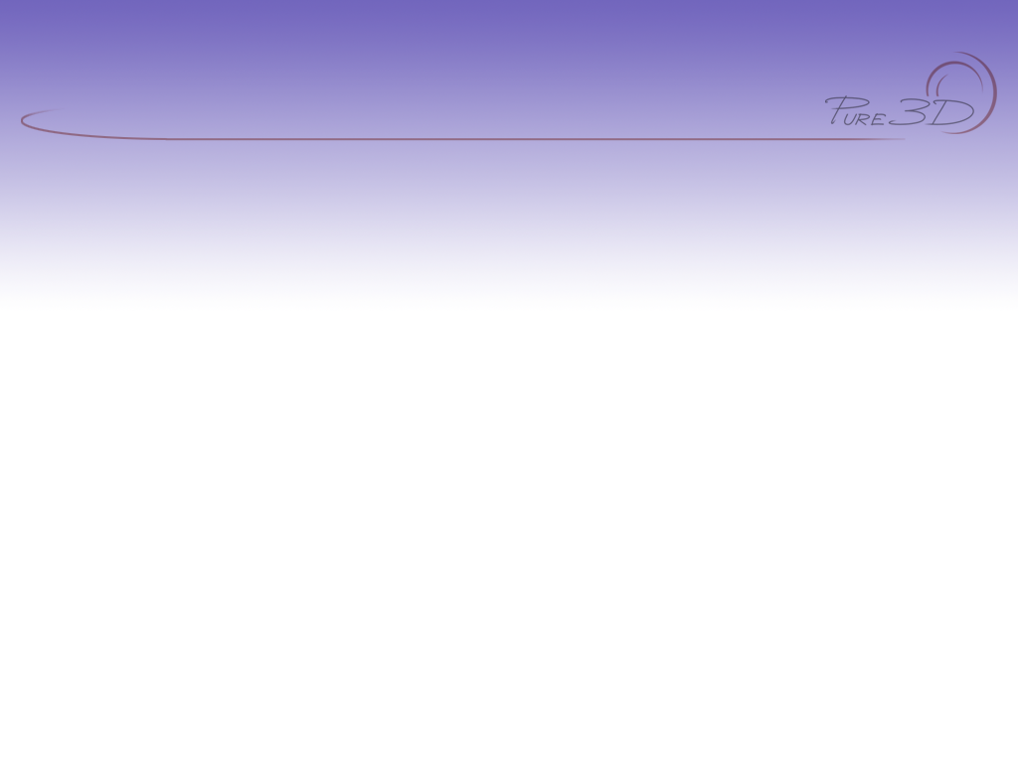
Pure3D Release 16
Deformer Run-Time

Slide 2

Introduction
The Deformer handles vertex based animation
Used primarily for facial animation
Data Structures
Basic Run-time

Slide 3
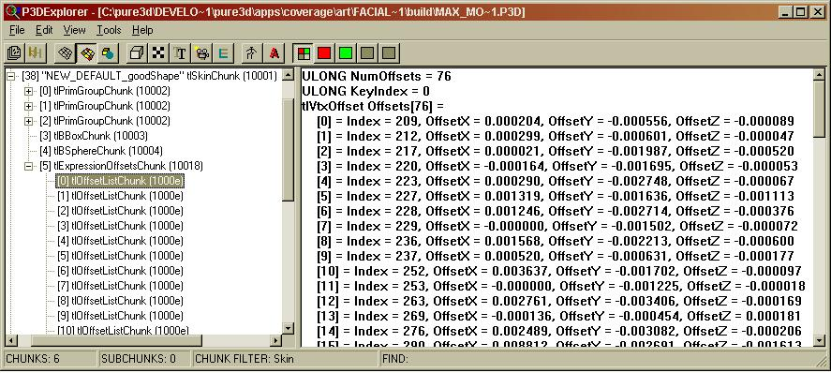
tExpressionOffsets
Offset data is local space positional offset for a vertex

Slide 4
tExpression
Typically a facial expression.
Provides a mapping between tExpressionOffset Data and an actual expression
This is a low level class
Only use this if you need to know about expression data directly.

Slide 5
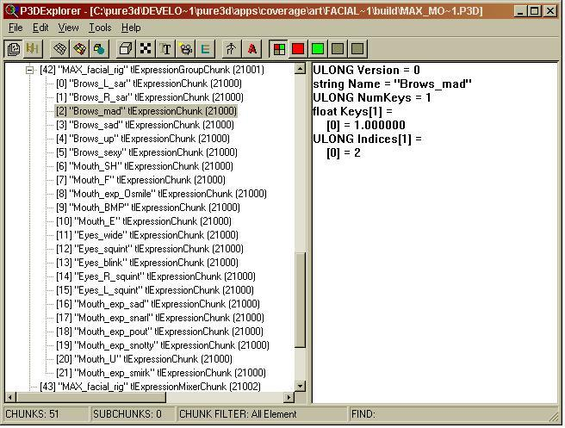
tExpressionGroup
Just a container for tExpressions

Slide 6
tExpressionMixer
Holds the reference to the deformed skin
Holds the current expression state
Use this class if you want to directly set expressions.
tExpressionMixer* mixer = maxHeadController->GetTargetMixer();
if(mixer)
{
float expression = 0.5;
mixer->SetTarget(max_skin_deformer); // binds up the skin
mixer->ResetToNeutral(); // clears the expression states
mixer->SetExpressionState("Brows_mad", 1.0f);
mixer->SetExpressionState(“Mouth_exp_snarl", expression);
mixer->Update();
}

Slide 7
tExpressionAnimationController
Use this to set and play expression animations.
Derived from tBlendFrameController
if (maxHeadController)
{
float startFrame = 0.0f;
float blendFrames = 10.0f;
maxHeadController->SetAnimation(smileAnim, startFrame, blendFrames);
maxHeadController->Advance(deltaTime);
}

Slide 8
Summary
Uses Pure3D’s tFrameController paradigm
Works directly with a SceneGraph
For instances you need to adopt an update then render for each
It’s Expensive

Slide 9
Comments?
Email: pure3dfeedback@radical.ca
Web: radnetTrackerPure3Dlogin

