Slide 1
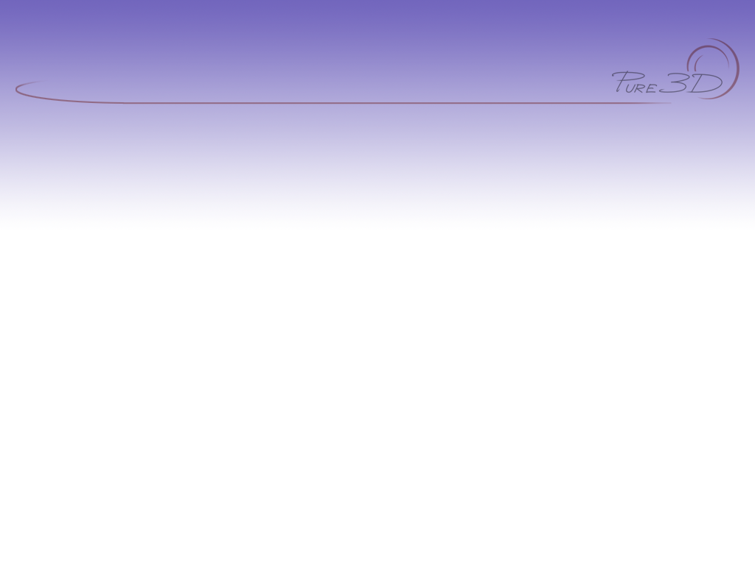
Pure3D Release 16
Drawing

Slide 2

Introduction
Pure3D high level rendering
  Camera, View
  Drawables
  DrawablePoses
  Scene Graph
  Effects
  Animated Objects
  Text
  Sprites
PDDI low level rendering

Slide 3
View
tView object contains:
  Current camera, rendering window, clear parameters
To render within a view:
  view->SetCamera(camera);
  view->BeginRender();
  //…draw stuff
  view->EndRender();
Pure3D supports multiple/overlapping views
  Split screen, rear-view mirrors, overlays
Camera is bound during BeginRender() call

Slide 4
Camera
tCamera object contains (camera.hpp):
  FOV, h:v aspect ratio, near-far planes
  SetCameraMatrix()
  Camera<->world<->view space conversion
  Point/sphere visibility testing
    PointVisible() / SphereVisible() / PointVisibleCamera() / SphereVisibleCamera() / PointClipCode()
    Use with tDrawable::GetBoundingSphere() for simple culling
Bound to tView objects
  When tView::BeginRender() is called, object-to-camera matrix is placed on the matrix stack.

Slide 5
Camera Cont’d
Base tCamera requires camera matrix
Derived classes offer more intuitive control:
  tPointCamera
    SetTarget() / SetPosition() SetTwist() / SetUpVector()
  tVectorCamera
    SetDirection() / SetUpVector() SetPosition()

Slide 6
Drawables
tDrawable: base class for all high-level Pure3D rendering objects
  tGeometry, tSprite, tTextString, tAnimatedObject, tPolySkin, tOpticEffect, tParticleSystem, tSceneGraph
Display(), DisplayBoundingBox(), GetBoundingBox(), GetBoundingSphere()

Slide 7
Drawables Cont’d
Usage:
  p3d::loadManager->Load(loadRequest);
  tDrawable* drawMe = p3d::find<tDrawable>(“foo”);
  …
  view->BeginRender();
  p3d::stack->Push();
  p3d::stack->Translate(0.0f, 0.0f, 10.0f);
  drawMe->Display();
  p3d::stack->Pop();
  view->EndRender();

Slide 8
Poses
tPose: Hierarchy of transforms
  Parent/child relationship
    Object & world matrices
  Neutral state (Rest Pose)
  GetJoint(), FindJoint(char* name), Evaluate(), EvaluateJointMatrix(), EvaluateJointPosition(), ResetToRestPose()
Often bound to animation systems
  Pure3D, Choreo, Physics, IK
Poses can be modified, or queried at runtime
  Head tracking, collision, object attachment
  Ideally, use higher-level poser::Pose interface
    Fully tPose, tSkeleton compatible

Slide 9
Drawable Poses
Drawable object, with a posable skeleton
Methods: Display(), Display(tPose*), SetPose(), GetSkeleton()
Skeleton is defined in Maya, then loaded
  Pose is then bound to drawable object
  Usually animation / procedural system binds to the Pose to manipulate the bone transforms
Two types:
  tPolySkin – seamless mesh w/ skeletal deformation
  tCompositeDrawable – each node in skeleton is bound to one or more drawable objects
    Skins, particles, meshes, etc.

Slide 10
Scene Graphs
Directed Acyclic Graph (DAG) of drawable objects
Camera and light support
Can add & remove nodes at runtime
Used to group / manipulate / animate complex collections of drawable objects
  NIS
Object-level translucency sorting

Slide 11
Effects
Drawable that changes over time
  tCorona, tLensFlare, tParticleSystem
tEffect: Drawable component
  Display()
tEffectController: Animation component
  Advance(), Reset(), LastFrameReached(), SetRelativeSpeed(), SetFrame()

Slide 12
Animated Objects
Packages together:
  Composite drawable
  Animation set
  Frame controllers
Factory object used to create instances
Single frame controller to animate entire effect
Uses p3dAnimatedObject tool to create factory

Slide 13
Text
Simple text, use PDDI:
  p3d::pddi->DrawString(“hello”, 10, 10);
Complex text, use tTextString:
  Display(), SetFont(), SetString(), SetColour(), GetBoundingBox()
Pure3D uses Unicode strings
    p3d::AsciiToUnicode() to convert
Text is positioned with matrix stack

Slide 14
Sprites
Like textures, minus the power-of-two restrictions
Positioned using matrix stack

Slide 15
Drawable Hierarchy
tEffect
tParticleSystem
tEntity
tOpticEffect
tLensFlare
tCorona
tPosable
tDrawable
tDrawablePose
tPolySkin
tCompositeDrawable
tGeometry
tSprite
tTextString
SceneGraph
tAnimatedObject

Slide 16
Low Level Rendering
Shaders
PDDI
  pddiPrimBuffer
  pddiPrimStream

Slide 17
Shaders
Collection of rendering hardware state
Created from named templates:
tShader* shader = new tShader(“simple”);
Generic parameter mechanism
shader->SetInt(PDDI_SP_ISLIT, true);
shader->SetTexture(PDDI_SP_BASETEX, t0);
shader->SetFloat(PDDI_SP_SHININESS, 10.0f);
Parameters specified as FOURCC codes in pddi/pddishade.hpp
Unknown parameters ignored

Slide 18
PDDI
Driver layer of Pure3D
OpenGL-level abstraction
Low-level rendering system:
  Display (pddiDisplay)
  Context (pddiRenderContext)
  Shaders (pddiShader)
  Textures (pddiTexture)
  Primitive Buffers (pddiPrimBuffer)
  Primitive Streams (pddiPrimStream)

Slide 19
Prim Buffers
Static collection of vertices + connectivity
  Triangles, strips, lines
  Indexed / non-indexed
Fastest rendering performance
Basis for tGeometry, tPolySkin

Slide 20
Prim Buffers Cont’d
Fill in pddiPrimBufferDesc structure
  pddiPrimBufferDesc desc(
    PDDI_PRIM_TRIANGLES, // type
    PDDI_V_CT, // vertex format
    12, // vertex count
    0 ); // index count
Create with PDDI factory:
  pddiPrimBuffer* buf = p3d::device-> NewPrimBuffer(&desc);
  buf->AddRef();

Slide 21
Prim Buffers Cont’d
Lock, and fill vertices:
  pddiPrimBufferStream* stream = buf-> Lock();
    stream->Vertex(…);
    stream->Vertex(…);
    stream->Vertex(…);
    //…
  buf->Unlock(stream);
  buf->SetIndices(…); //if needed

Slide 22
Prim Buffers Cont’d
To render:
p3d::pddi->DrawPrimBuffer(shader, buf);
Can get a pddiShader from a Pure3D shader via tShader::GetShader()
When done:
buf->Release();

Slide 23
Stream Prims
Modeled after OpenGL glBegin() / glEnd() paradigm
Vertex data not cached in a PDDI object
Primitives are rendered while vertices are being fed to the stream

Slide 24

Stream Prims Cont’d
To use, begin a stream:
pddiPrimStream* stream = p3d::pddi-> BeginPrims(shader, PDDI_PRIM_TRIANGLES, PDDI_V_C );
All the vertex types are listed in pddienum.hpp
For a speed-boost on the GameCube, specify the vertex count as the last parameter

Slide 25
Stream Prims Cont’d
Submit vertices to the stream one component at a time:
stream->Colour(tColour(255,0,0));
stream->Position(0.0f, 10.0f, 10.0f);
stream->Colour(tColour(0,255,0));
stream->Position(-10.0f, -10.0f, 10.0f);
stream->Colour(tColour(0,0,255));
stream->Position(10.0f, -10.0f, 10.0f);
Position is always specified last

Slide 26
Stream Prims Cont’d
After all the vertices have been submitted, end the stream:
p3d::pddi->EndPrims(stream);
Components can be specified one at a time, or all at once:
stream->Vertex(&coord, &normal, &uv);
Usually faster

Slide 27
Stream Prims Cont’d
Streamed prims are good when:
  Rendering vertices are read/write
    format of vertex data is under user control
  Rendering involves significant per-vertex work by the CPU
    allows overlap of computation with drawing
  Vertices are generated procedurally
    no need to keep a rendering buffer around

Slide 28
Other PDDI Tricks
Z-Buffer Control:
  EnableZBuffer() / SetZWrite() / SetZCompare()
Stencil Buffer Control:
  EnableStencilBuffer() / SetStencilCompare() / SetStencilRef() / SetStencilMask() / SetStencilWriteMask() / SetStencilOp()
Render-to-Texture:
  SetRenderTarget()
See pddi.hpp for the complete list

Slide 29
Summary
Pure3D drawing objects share a small set of simple interfaces
  tDrawable, tPose, tEffect
Operate through camera, view, matrix stack
Low level interfaces available for custom work
PDDI gives fine-grained control over rendering state

Slide 30
Comments?
Email: pure3dfeedback@radical.ca
Web: http://radnet/
  Select “Pure3D” project in Tracker box on left hand side, click “Login”
  Login in with e-mail ID (Password is blank if you’ve never logged in before)

