Slide 1
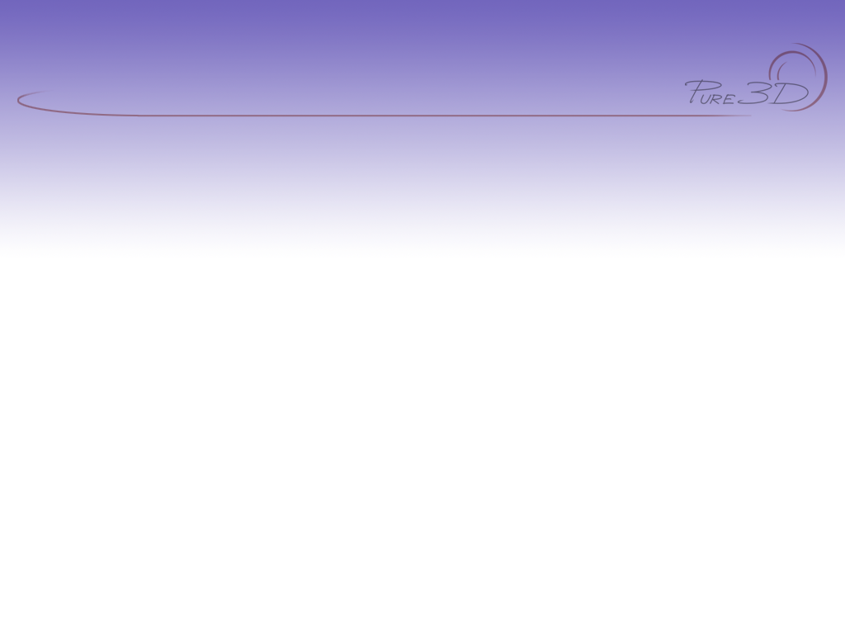
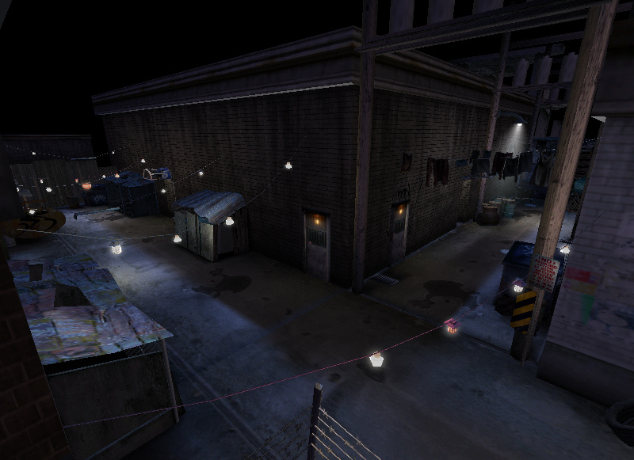
Pure3D Lighting Tools
Presented by
Mike Peredo Harold Westlund Hongzhi Wang

Slide 2

Overview
Lighting techniques
Pure3d lighting tools
Maya vs p3d tools
Strategies
Platform specific considerations

Slide 3
Lighting techniques
CBV (color by vertex) lighting
  Bake lighting into vertices
  Number of vertices = lighting resolution
  Cheapest method of lighting

Slide 4
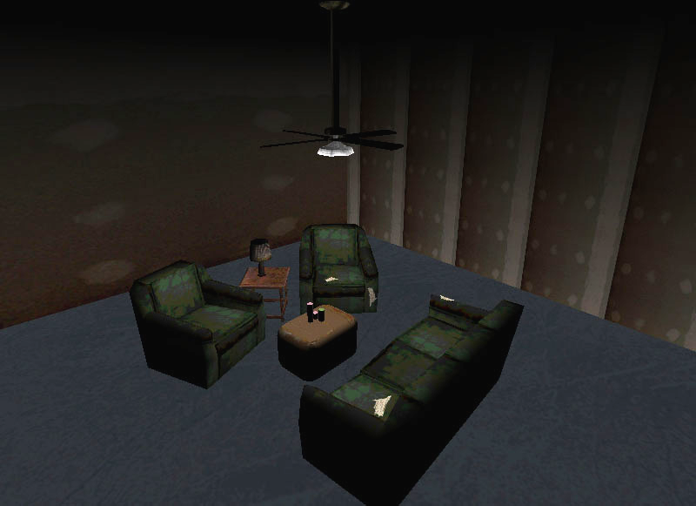
Lighting techniques
Color By Vertex

Slide 5
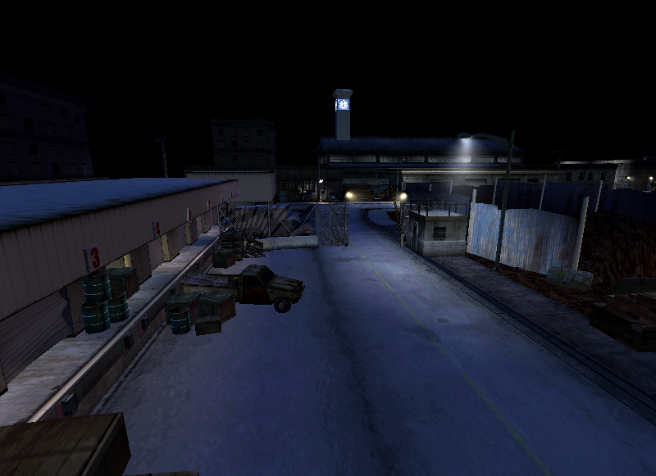
Lighting techniques
Color By Vertex

Slide 6
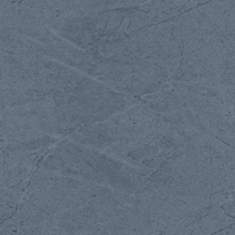
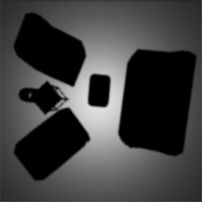
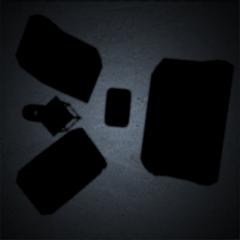
Lighting techniques
Lightmapping
  Like multiply layer in photoshop or modulate in layered shader
base * lightmap = result

Slide 7
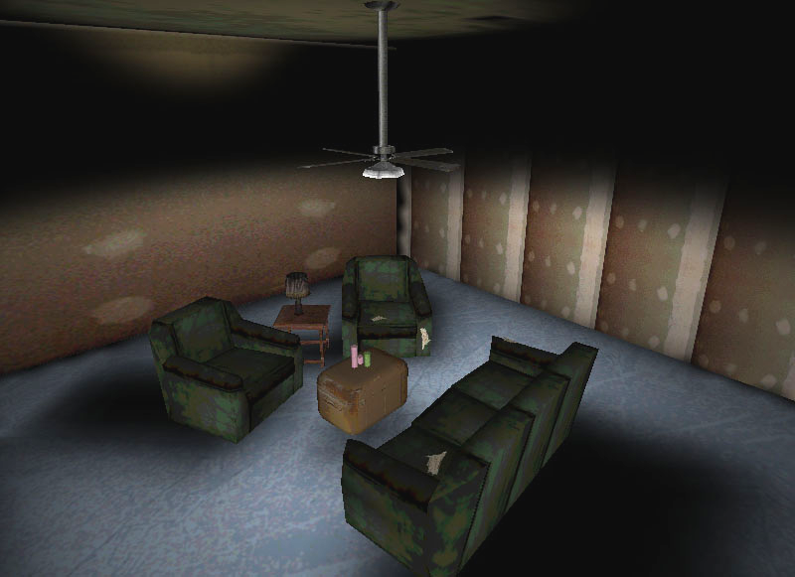
Lighting techniques
Lightmapped

Slide 8
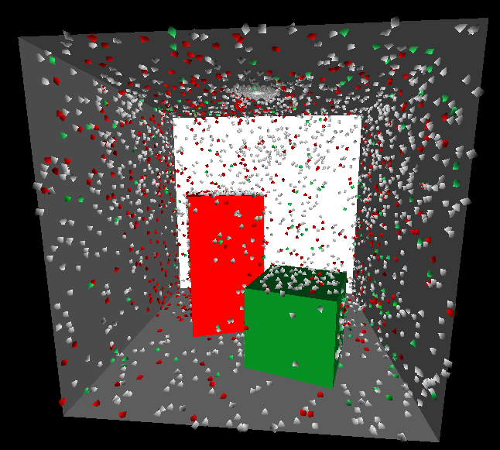

Lighting techniques
Photon mapping
  Photons emitted from light source
  Reflected photons pick up colour
  Photon map used to generate CBV and lightmaps

Slide 9
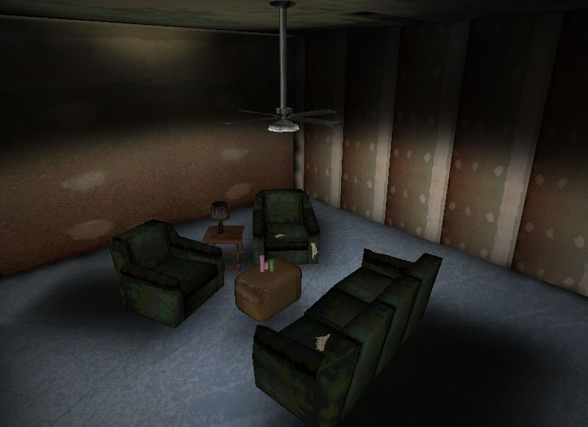
Lighting techniques
Photon mapping

Slide 10
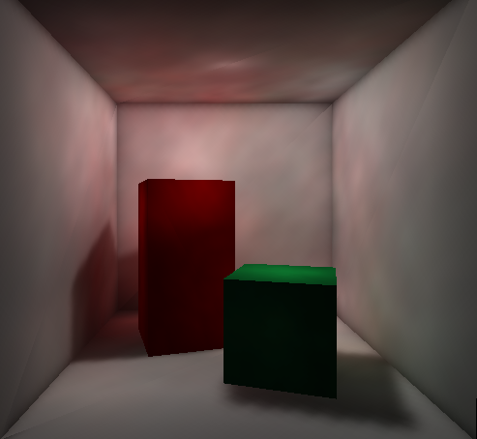
Lighting techniques
Photon mapping

Slide 11
Pure3d Lighting tools
p3dlight
p3dunishader
p3dphotonmap
p3dps2

Slide 12
p3dlight
  CBV lighting
  Lightmapping
  Photon map support
  Same equations as Maya lighting
  Supported light sources: spot, point, and directional

Slide 13
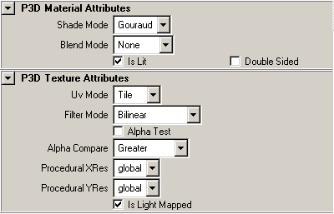
P3dlight – CBV lighting
Shader setup
  Works with simpleshader or layeredshader
  Turn on “is lit” flag in shader
Workflow
  Preview as hardware lighting in Maya
  Turn on depth map shadows on shadow casting lights
  Export with de-index meshes
  Run p3dlight

Slide 14
P3dlight flags – CBV color
-c | generate CBV color
-r | use raycasting to determine shadowing (for use with CBV color only)
-b | apply CBV lighting to objects with lightmapped shaders
-g | specify the primitive group name to generate lightmap or CBV color for
Examples of use:
P3dlight –c –r mylevel.p3d
P3dlight –c –g walls* mylevel.p3d

Slide 15
Color By Vertex lighting

Slide 16
P3dlight – lightmapping
  Creates lightmap shader or layered lightmap shader
  Lightmaps can be imported / exported from .p3d file (v16)

Slide 17
P3dlight – lightmapping
Shader setup
  Works with simpleshader or layeredshader
  Turn on “is lit” and “is lightmapped” flags

Slide 18
P3dlight – lightmapping
Workflow
  Use regular render or IPR to preview
  Export with de-index meshes
  Run p3dlight with desired settings
  Lightmaps stored in p3d file
Time considerations

Slide 19
P3dlight flags - lightmapping
-l | create light map for geometry
-w | width of each lightmap per plane or per triangle
-t | height of each lightmap per plane or per triangle
-d | specify the sampling density of light map texture
-f | Filter the light map. Gets rid of jaggy edges on cast shadows
-I | create grayscaled lightmap contain only the intensity of light
Example of use:
P3dlight –l –f –w 64 -t 64 –g floors* mylevel.p3d

Slide 20
P3dlight flags - general
-o | specify output file name
-u | turn off lighting flag on all shaders
-s | remove-lights
Example of use:
P3dlight –u –s mylevel.p3d –o mylevel_nolights.p3d

Slide 21
p3dphotonmap
Maya setup
  Independent of shader setup
  Recognizes shadow casting on lights and objects
  Can adjust exposure of lightmaps without regenerating photon map

Slide 22
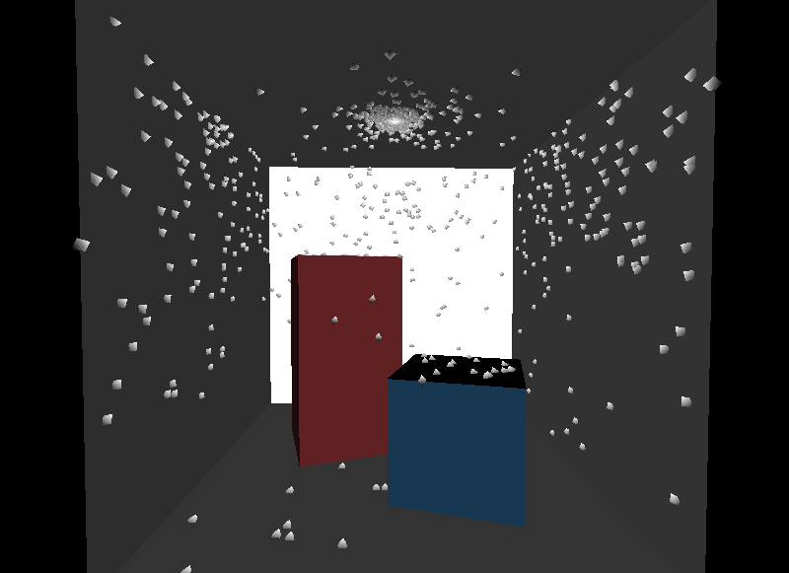
p3dphotonmap
photons reflect about in the scene
depth = 1

Slide 23
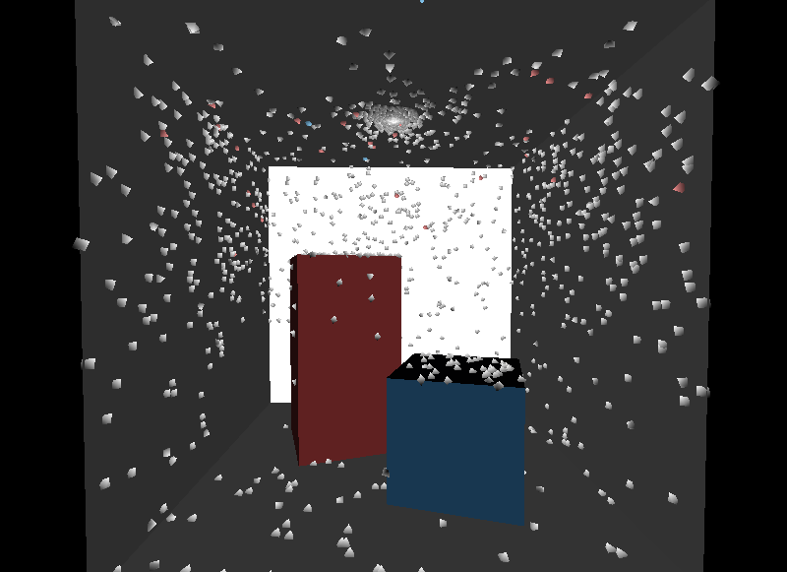
p3dphotonmap
photons reflect about in the scene
depth = 2

Slide 24
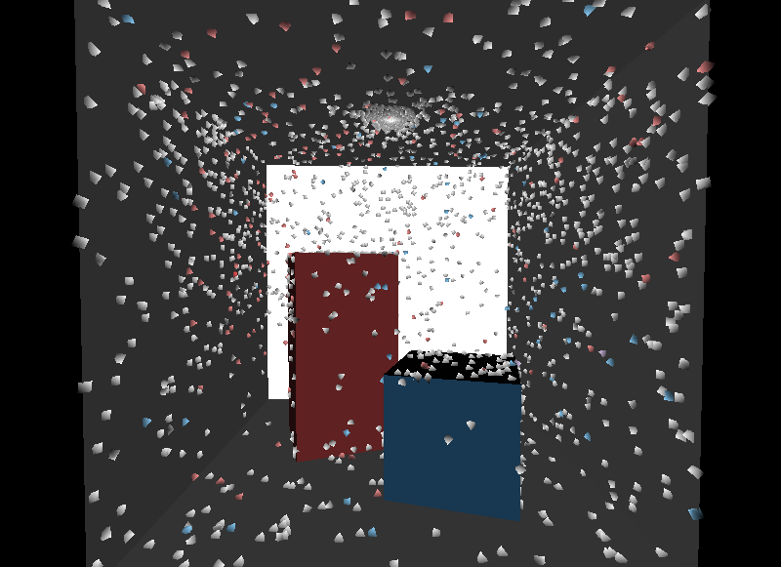
p3dphotonmap
photons reflect about in the scene
depth = 4

Slide 25
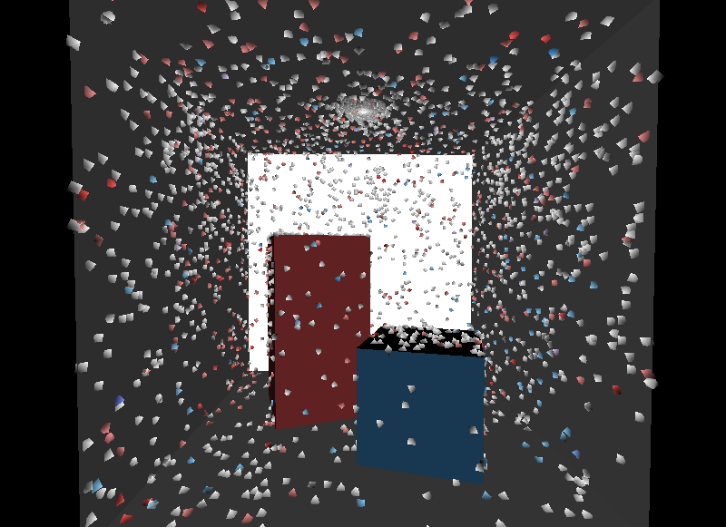
p3dphotonmap
photons reflect about in the scene
depth = 12

Slide 26
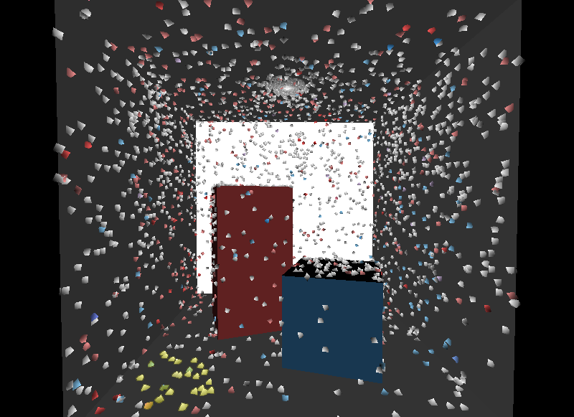
p3dphotonmap
Sample the N nearest photons
N = 25

Slide 27
p3dphotonmap
Sample photons within radius R
radius = 1

Slide 28
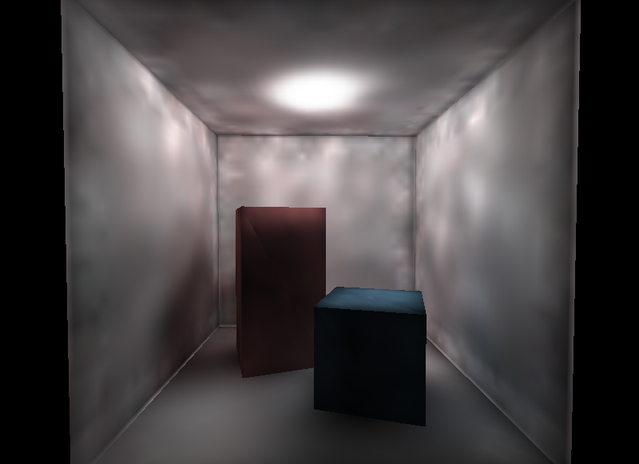
p3dphotonmap
Under sampling results in variance
10,000 photons
N = 100
radius = .5

Slide 29
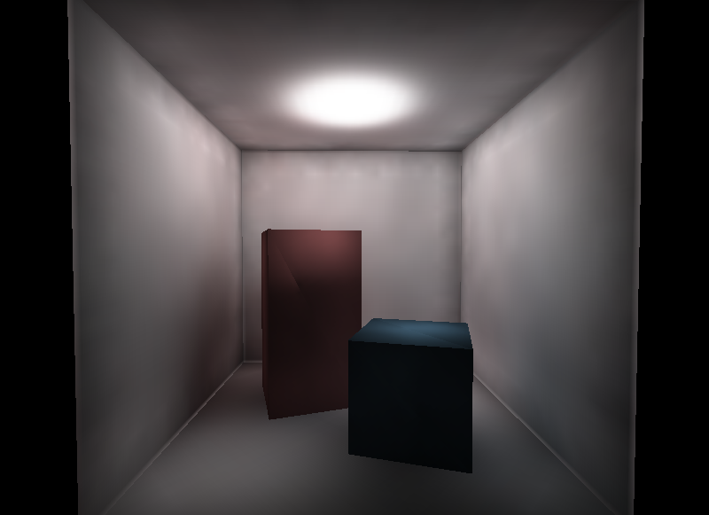
p3dphotonmap
Under sampling results in variance
10,000 photons
N = 500
radius = 1

Slide 30
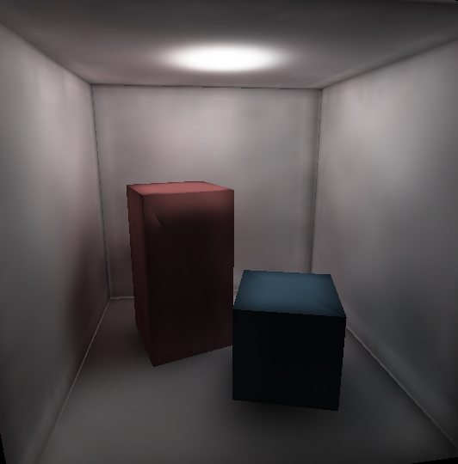
p3dphotonmap
50,000 photons
N = 1000
radius = .5

Slide 31
Photon mapping flags
p3dphotonmap
-d | Depth – number of photon bounces
-N | Total number of photons to generate
-p | Generate visible photon geometry debugging
p3dlight
-e | Exposure value
-p | Use photon map combined with direct lighting (first hit shadows)
-E | Use photon map exclusively
-a | Sampling radius
-A | Maximum photons to count (in sampling radius)

Slide 32
p3dphotonmap
Examples of use:
p3dphotonmap -v -N 10000 -d 12 mylevel.p3d
p3dlight –p –e 1 –a .7 –A 160–l –f –w 64 -t 64 –g floors* \
mylevel.p3d

Slide 33
p3dphotonmap
future modifications
  save and combine different photon maps
  speed optimization
  area lights
  interactive control (eg. exposure)
  import back into Maya

Slide 34
p3dunishader
  Only required for lightmaps
  Makes unique shader for each lightmapped object

Slide 35
p3dps2
  Converts lightmap shaders for use on the PS2
  Merges grime with lightmap on layered shader lightmaps
  Creates subtractive version of lightmap

Slide 36
Comparison - CBV
Maya
  Prelight or apply color
  Easy to tweak specific objects
  Harder to process scene as a whole if objects individually tweaked
p3dlight
  Basically the same results as Maya
  Can process scene as a whole
  Only “is lit” shaders will be prelit

Slide 37
Comparison - lightmaps
Maya (manual method)
  Can bake in shadows and create layered shader
  Viewable in Maya
  Easy to handpaint in Photoshop
  Don’t work with overlapping UV’s
  Changes to geo and lights require manual rebuilding of lightmaps
p3dlight
  Changes to geo and lights not a problem
  Can export import from p3d file
  Lightmaps need to be generated every time

Slide 38
Strategies
  naming objects lmap16, etc
  Use where most effective (floors, walls)
  Batch files can make the process easier

Slide 39
Sample batch file
  // generic batch file to create lighting
  p3dunishader %1
  p3dlight -v -c %1
  p3dlight -v -f -l -t 16 -w 16 -g lmap16* %1
  p3dlight -v -f -l -t 32 -w 32 -g lmap32* %1
  p3dlight -v -f -l -t 64 -w 64 -g lmap64* %1
  p3dlight -v -f -l -t 128 -w 128 -g lmap128* %1
  p3dlight -s -u %1

Slide 40
Platform specific considerations
Xbox / Gamecube
  supports 3 pass textures (4 passes = 2 passes)
  base + grime + lightmap = OK
PS2
  3 passes too expensive / not supported
  multiply not supported
  run p3dps2 to process layered / lightmapped shaders

Slide 41
Future work of p3dlight
Ambient light support
Performance optimization
Error reporting

Slide 42
Summary
  CBV lighting is cheap and can look great if used carefully but doesn’t support cast shadows
  Lightmaps are effective but use sparingly
  Photon mapping requires the most tweaking and experimentation but provides the most realistic results
  Files with lightmaps or layered shaders need to be processed with p3dps2 to view on PS2

Slide 43
Comments?
Email: pure3dfeedback@radical.ca
Web: http://radnet/
  Select “Pure3D” project in Tracker box on left hand side, click “Login”
  Login in with e-mail ID (Password is blank if you’ve never logged in before)
Resources
  T:\Pure3D\Pure3D_docs\word\lightmapping_guide.doc

