Slide 1

Pure3D Release 16
Scrooby

Slide 2

Introduction
Introduction to Scrooby
Changes in version 16
  Pure3D and FTech alignment
  Callbacks
  New features
Converting to Version 16
Future directions
Feedback and questions

Slide 3
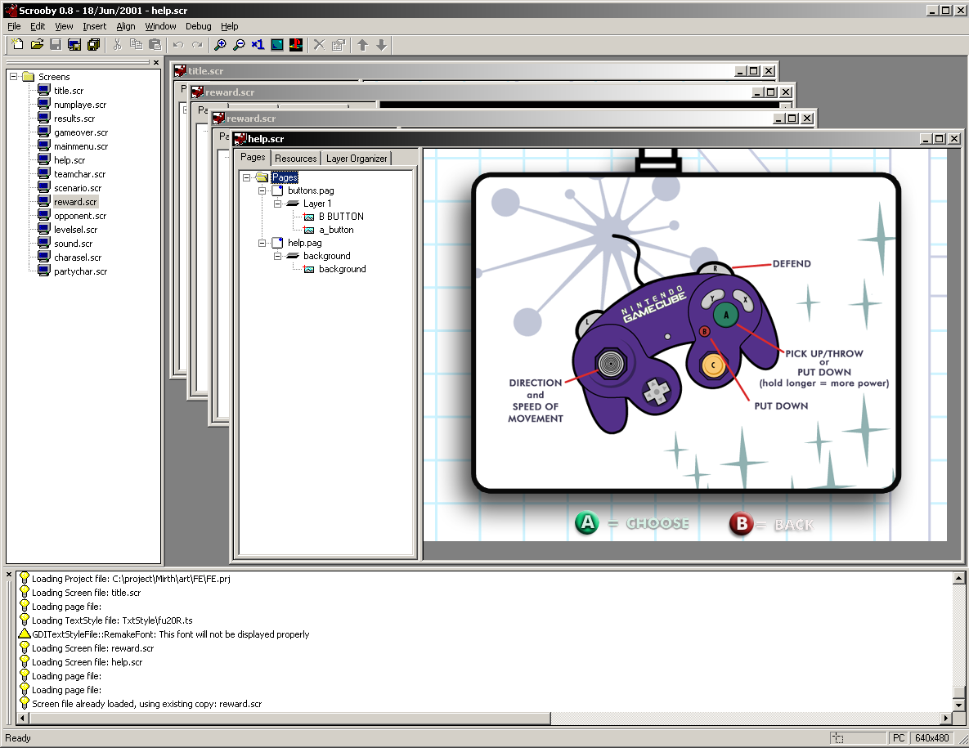
Introduction to Scrooby
Builder

Slide 4
Introduction (cont…)
Runtime
App
Project
Screen
Page
Layer
Group
Pure3DObject
Sprite
Text

Slide 5
Changes in Version 16
Pure3D and FTech alignment
  Follows FTech build.bat and library conventions
  Moving further towards Pure3D integration
    Uses Pure3D loading mechanisms
      XML still supported for project files
    TextBibles now contained in p3d file
    TextStyles/Fonts replaced by makefont
    Uses Pure3D memory handling, inventories, reference counting

Slide 6
Changes (cont…)
Callbacks
  Load Project is issued
  OnProjectLoadComplete callback triggered after project, screens, and pages loaded
  OnGotoScreenComplete callback triggered when remaining resources are loaded
  No project loading until after GotoScreen callback

Slide 7
Changes (cont…)
New Features
  Text wrap and clip
  More information on text strings at runtime
  New loading methods

Slide 8
Converting
Convert the textstyles and textbibles
  There is a script available which will convert textstyles to pure3d fonts
  Textbibles need to be put through the newest version of the textbible compiler
Reload your project in the builder
Be sure to redo any pure3d previous pure3d objects

Slide 9
Future Directions
Further move towards Pure3D integration
More 3D elements in the front ends
Transition effects
GUI toolkit
Builder changes to reflect new features

Slide 10
Summary
Most changes internal
May need some pipeline changes
Callbacks are important for timing

Slide 11
Comments?
Email: pure3dfeedback@radical.ca
Web: http://radnet/
  Select “Pure3D” project in Tracker box on left hand side, click “Login”
  Login in with e-mail ID (Password is blank if you’ve never logged in before)

