Slide 1
Graph Representation
付荣亮
2020.05.28

Slide 2
Graph Representation
Adjacency Matrix
Incidence Matrix
Adjacency List
Edge List
Require O(1) for searching, and minimize memory
http://people.csail.mit.edu/jshun/6886-s18/

Slide 3
Graph Representation Base on Class Vertex and Edge
Edge: 10W, outEdges: 20
No memory reuse
Class Vertex { id, property, List<Edge> INs, List<Edge> OUTs}
Class Edge { src_id, des_id, value, Type(IN/OUT), property }
Adjacency List
Map<K, Vertex> vertices. Map<K, List<Edge>> edges 284 MB
Reduce K, O(N) for querying the vertex.
List<Vertex> vertices. List<List<Edge> edges
Map<K, Integer> dict_V_edges. Map<K, Integer> dict_V_alone
List<Integer> csr
Reduce K, O(1) for querying the vertex. 282.2 MB
List<Vertex> vertices. List<List<Edge> edges, Map<K, Integer> dict_V

Slide 4
Graph Representation Base on K (the id of vertex)
Edge: 10W, outEdges: 20
No memory reuse
Adjacency List 35.1 MB
Map<K, List<K>> edges;
Reduce K
Map<K, Integer> dict_V; Map<Integer, List<Integer>> targets; 32 MB
Map<K, Integer> dict_V; List<List<Integer>> targets;
Compressed Sparse Row (CSR)
Map<K, Integer> dict_V; List<List<byte[]>> targets; List<Integer> csr;
i = csr[dict_V[sid]]
targets[i][0] = dict_V[tid] - dict_V[sid],
targets[i][j] = SUB(dict_V[tid] - targets[i][k]) - dict_V[sid], k in [0, j)
Map<K, Integer> dict_V; List<List< byte[]>> targets;
20.56MB
39.1 MB
19.56MB
38.2 MB

Slide 5
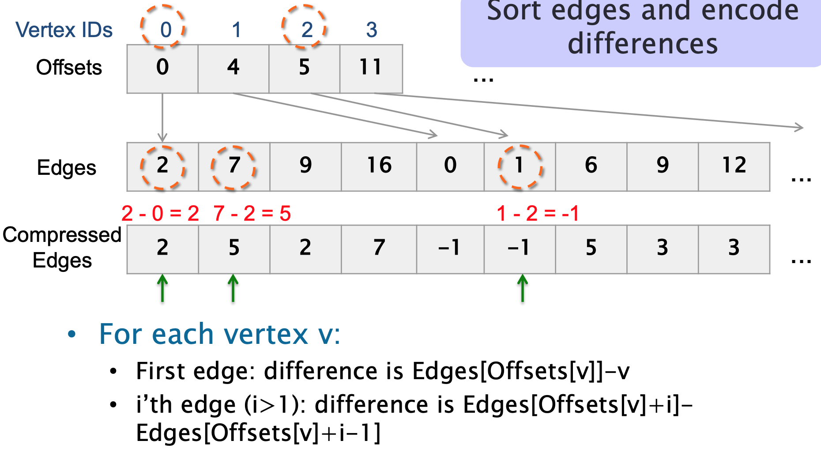
Graph Reordering
dict_V | Ka1 | K2 | K3 | K4
csr | 0 | 3 | 1 | 2
targets | 2-0 | 1-1 | 6-2 | 0-3
 | 7-2 |  | 9-6
 | 9-7 |  | 12-9
 | 16-9
Input: Graph<V, E>
Calculate the degree of each vertex
Sort vertices according to their degree in descending order
Assign the id for each vertex by BFS
For each layer, sort the queue according to their degree in ascending order
Return Graph<V, E>
CR = 11885620/11909056 = 0.9976
https://github.com/RapidsAtHKUST/GraphReorderAndConverter
https://www.cs.cmu.edu/afs/cs/project/pscico-guyb/realworld/www/slidesS18/compression6.pdf

Slide 6
Thank You!

