Slide 1
Logic Synthesis
Equivalence Checking

Slide 2
Application of EC in μP Designs
Architectural Specification
(informal)
Cycle Simulation
Test Programs
RTL Specification
(Verilog, VHDL)
Equivalence
Checking
Circuit Implementation
(Schematic)
Circuit Simulation
Layout Implementation
(GDS II)

Slide 3
Application of EC in ASIC Designs
RTL
Specification
Cell-Based
Synthesis
Equivalence
Checking
Standard Cell
Implementation
Engineering
Changes (ECOs)
Equivalence
Checking
Final
Implementation

Slide 4
Basic Model Finite State Machines
M(X,Y,S,S₀,δ,λ):
X: Inputs
Y: Outputs
S: Current State
S₀: Initial State(s)
δ: X × S → S (next state function)
λ: X × S → Y (output function)
X=(x₁,x₂,…,x_{n})
Y=(y₁,y₂,…,y_{n})
λ
S=(s₁,s₂,…,s_{n})
δ
S’=(s’₁,s’₂,…,s’_{n})
D
Delay element:
  Clocked: synchronous
    single-phase clock, multiple-phase clocks
  Unclocked: asynchronous

Slide 5
Finite State Machines Equivalence
Build Product Machine M₁× M₂:
λ
y₁
δ
{X¹,X²,…,X^{n}}
{0,0,...,0}
D
M₁
λ
y₂
δ
D
M₂
Definition:
M₁ and M₂ are functionally equivalent iff the product machine
M₁ × M₂ produces a constant 0 for all valid input sequences {X₁,…,X_{n}}.

Slide 6
General Approach to EC
State Space of
S = M₁ × M₂
miscomparing states
i.e. λ ≠ 0
comparing states
i.e. λ = 0
Initial State S⁰
R “Good half”
r(s) = 1
(S-R) “Bad half”
r(s) =
Inductive proof of equivalence:
Find subset R ⊆ S with characteristic function f: S→ {0,1} such that:
1. r(s⁰) = 1 (initial state is in good half)
2. (r(s) = 1) ⇒ r(δ(x,s)) = 1 (all states from good half lead go to states in good half)
3. (r(s) = 1) ⇒ λ(x,s)) = 1 (all states in good half are comparing states)

Slide 7
Proving R
1. Use SAT check to verify that initial state S⁰ is contained in R: (r(s⁰) = 1)
2. Use SAT check to verify that:
  states in R are comparing states
  all states from R lead only to states in R
x
F
0?
s
r
0?
D
r

Slide 8
Soundness and Completeness
With a candidate for R we can:
  prove equivalance
    that means the method is “sound”
    we will not produce “false positives”
  but not disprove it:
    that means the method is “incomplete”
    we may produce “false negatives”

Slide 9
How Do We Obtain R?
Reachability analysis:
  state traversal until no more states can be explored
    forward
    backward
    explicit
    symbolic
Relying on the design methodology to provide R:
  equivalent state encoding in both machines
  synthesis tool provides hint for R from sequential optimization
    manual register correspondence
    automatic register correspondence
Combination of them

Slide 10
Combinational EC
Industrial EC checkers almost exclusively use an combinational EC paradigm
  sequential EC is too complex, can only be applied to design with a few hundred state bits
  combinational methods scale linearly with the design size for a given fixed size and “functional complexity” of the individual cones
Still, pure BDDs are plain SAT solver cannot handle all cones
  BDDs can be built for about 80% of the cones of high-speed designs
  less for complex ASICs
  plain SAT blows up on a “Miter” structure
Contemporary method highly exploit structural similarity of designs to be compared

Slide 11
Miter Structure for Combinational EC
x
0?
Basic methods:
  random simulation, good for finding miscompares
  BDD based and modifications
  structural SAT based with modifications

Slide 12
History of Equivalence Checking
SAS (IBM 1978 - 1994):
  standard equivalence checking tool running on mainframes
  based on the DBA algorithm (“BDDs in time”)
  verified manual cell-based designs against RTL spec
  handling of entire processor designs
    application of “proper cutpoints”
    application of synthesis routines to make circuits structurally similar
    special hacks for hard problems
BEC (IBM 1991 - 1996):
  workstation based re-implementation of SAS
  mainly used in BooleDozer synthesis environment
Verity (IBM 1992 - today):
  originally developed for switch-level designs
  today IBMs standard EC tool for any combination of switch-, gate-, and RTL designs

Slide 13
History of Equivalence Checking
Chrysalis (1994 - now Avanti):
  based on ATPG technology and cutpoint exploitation
  very weak if many cutpoints present
  did not adopt BDDs for a long time
Formality (1997 - Synopsys)
  multi-engine technology including strong structural matching techniques
Verplex (1998)
  strong multi-engine based tool
  to our knowledge heavy SAT-based
  very fast front-end

Slide 14
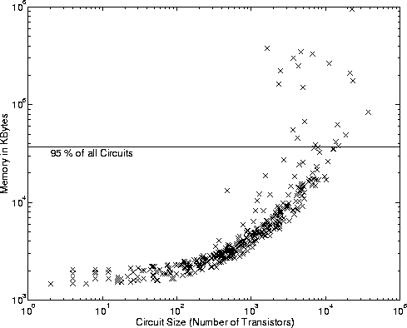
Application of Pure BDDs
Statistics on a PowerPC processor design:

Slide 15
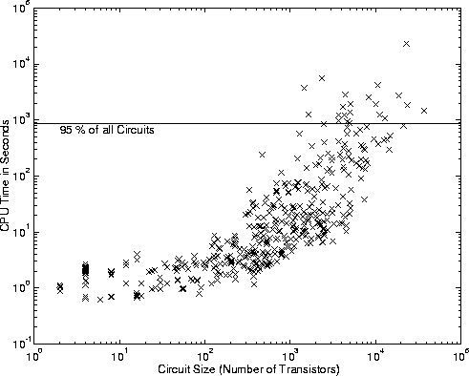
Application of Pure BDDs
Time for identical set of circuits:

Slide 16
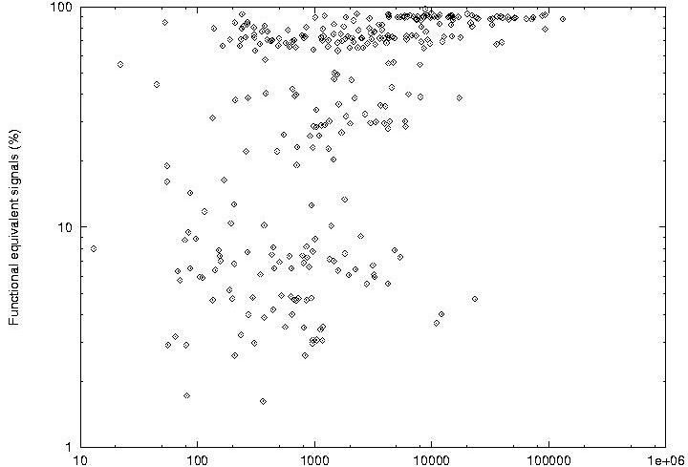
Structural Similarity
Functional Equivalent Nets (%)
Circuit Size

Slide 17
Structural Similarity
Functional Equivalent Nets (%)
Circuit Size

Slide 18
Methods
Degree of Structural Difference
Struture-
independent
techniques
Combined
methods
Structure-dependent
techniques
Size
Structure-independent techniques:
  exhaustive simulation
  decision diagrams (*DD*)
Structure dependent techniques:
  graph hashing
  SAT solvers including learning techniques

Slide 19
Handling Constraints
Input constraints:
  non-occuring input values (don’t cares)
  non-reachable states
  candidate for R
1. Input Mapping:
x
MAP
0?
x’
2. Output Masking:
x
0?
Characteristic
function for constraint
c

Slide 20
Cutpoint-based EC
Cutpoints are used to
partition the Miter
v₁
f₁
f₃
f₂
v₂
0?
x
0?
0?
v₁
f₁
f₃
f₂
v₂
Cutpoint guessing:
  Compute net signature with random simulator
  Sort signatures + select cutpoints
  Iteratively verify and refine cutpoints
  Verify outputs

Slide 21
False Negatives
Outputs may miscompare for invalid cutpoint values:
xy
00
10
11
01
vz
Constraint:
c = (v ≡ y+z)
x
00
1
y
01
1
11
1
1
1
xy
00
10
11
01
z
v
vz
out
10
1
1
1
00
1
1
xy
01
vz
00
10
11
01
11
1
1
1
1
00
10
1
1
01
v
11
1
1
1
10
1
1
1
What can we do about false negatives:
  constrain input space to c = (v ≡ y+z)
  if (v in SUPPORT(out) then out = compose(out, v, f_{v})

Slide 22
Permissible Cutpoints
Testable for s-a-0 or s-a-1?
Based in ATPG:
- test for s-a-0 at output
checks for permissible functions
- test for s-a-1 out output
checks for inverse permissibe
functions
x
Permissible functions:
- successively merge circuits
from input to outputs
x
0?

Slide 23
Sequential Equivalence Checking
If combinational verification paradigm fails (e.g. we have no name matching
Two options:
  run full sequential verification based on state traversal
    very expensive but most general
  try to match registers automatically
    functional register correspondence
    structural register correspondence

Slide 24


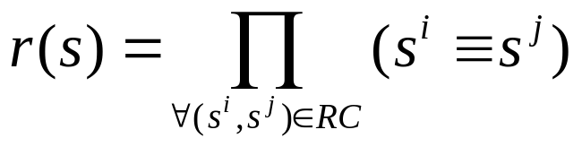
Register Correspondence
Find registers in product machine that implement identical or complemented function
  these are matching registers in the two machines under comparison
  BUT: might be more, we may have redundant registers
Definition: A register correspondence
is an equivalence relation in the set of registers
(This definition includes only identical functions, it can be extended to also include complemented functions)
A register correspondence can be used as a candidate for R:

Slide 25
Functional Register Correspondence
Algorithm REGISTER_CORRESPONDENCE {
RC’ = {(s^{i},s^{j}) | s^{i}₀ = s^{j}₀} // start with registers with
do { // identical initial states
RC = RC’
r(s) = Π_{∀ (si,sj) ∈RC} (s^{i} ≡ s^{j})
RC’ = {(s^{i},s^{j}) | (s^{i},s^{j}) ∈ RC ∧ δ^{i}(x,s)=δ^{j}(x,s) ∧ r(s)}
} while (RC’ != RC)
return RC
}
In essence:
  the algorithm starts with an initial partitioning with two equivalence classes,
  one for each initial value
  the algorithm computes iteratively the next state function, assuming that
  the RC is correct
  - if yes, fixed point is reached and RC returned
  - if no, split equivalence classes along the miscompares

Slide 26
Example
Instead of using
constraint, use
fresh variable
for each class
s¹=1
s²=1
s³=1
s⁴=1
s⁵=1
s¹
s²
s³
v
x
1
1
1
s²= ¬v
s¹= x ⊕ v
s³= ¬v
s⁴= x ⊕ v
s⁵= ¬v
v¹
v²
s⁴
s⁵
1
1
s¹= x ⊕ v¹
s²= ¬(v¹v²)
s⁴= x ⊕ v¹
s³= ¬(v¹v²)
Result:
{s¹,s⁴}
{s²,s³,s⁵}
v¹
s⁵= ¬(v¹v²)
v²

Slide 27
Problems with Functional Reg. Corr.
In case of micomparing designs
  effect of miscomparing cone may ripple through entire algorithm and split all equivalence classes until they contain only single registers
  difficult to debug since no hint of error location
Solution:
  relaxation of equivalence criteria
    e.g. structural register correspondence algorithm based on support set of registers
    combined techniques with name mapping, functional/structural criteria

Slide 28
Sequential Equivalence Checking
In case that combinational equivalence checking model fails:
  use generalized register correspondence to also consider retiming
    in essence, use all internal nets as candidates for possible matches
Worst case: full sequential verification
  Prove that the output of the product machine is not satisfiable (sequentially)
  special case of general property checking

Slide 29
State Traversal Techniques
Forward Traversal:
start from initial state(s)
traverse forward to check whether “bad”
state(s) is reachable
S⁰
Backward Traversal:
start from bad state(s)
traverse backward to check whether intial
state(s) can reach them
S⁰
Combines Forward/Backward traversal:
compute over-approximation of reachable
states by forward traversal
for all bad states in over-approximation, start
backward traversal to see whether intial state
can reach them
S⁰

Slide 30
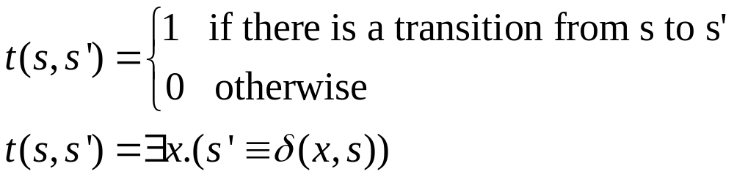
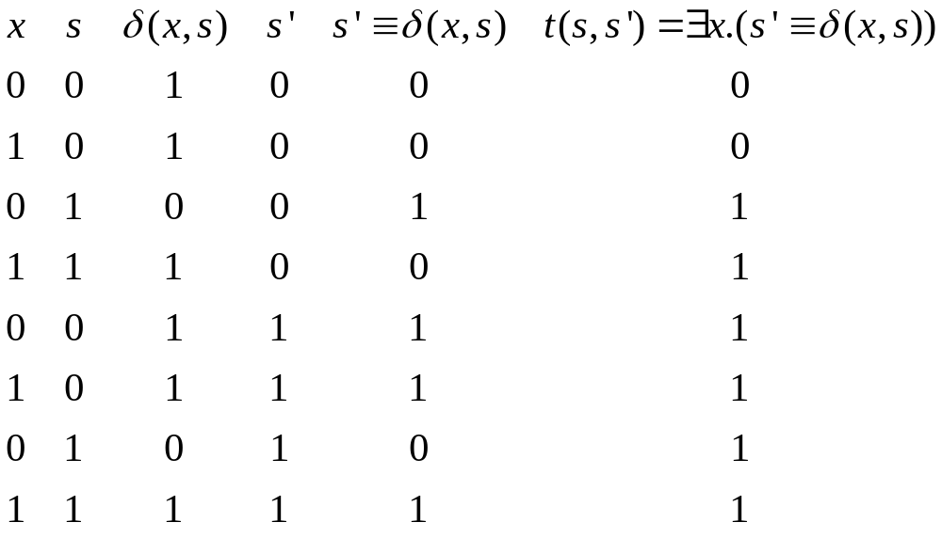

Transition Relation
Transition Relation t(s,s’):
X=0
Examples:
0
1
X=1
1

Slide 31

Image and Pre-Image of States
Image of a set of states r(s):
Pre-Image of a set of states r(s):
Example:
r(s) = (s ≡ 0) ∨ (s ≡ 1) {0,1}
t(s,s’) = (s ≡ 0) ∧ (s’ ≡ 2) ∨ {(0,2),
(s ≡ 0) ∧ (s’ ≡ 3) ∨ (0,3),
(s ≡ 1) ∧ (s’ ≡ 3) ∨ (1,3),
(s ≡ 2) ∧ (s’ ≡ 4) (2,4)}
t ∧ r = (s ≡ 0) ∧ (s’ ≡ 2) ∨ {(0,2),
(s ≡ 0) ∧ (s’ ≡ 3) ∨ (0,3),
(s ≡ 1) ∧ (s’ ≡ 3) (1,3)}
∃s.(r ∧ t) = (s ≡ 2) ∨ (s’ ≡ 3) {(2,3)}
0
2
4
1
3
r(s)
Img(t,r(s))

Slide 32
Forward State Traversal
Algorithm TRAVERSE_FORWARD(t, λ ,S⁰) {
reached = ∅
current = S⁰ // start from init
while (reached ≠ (reached ∨ current)) { // fixed point
reached = reached ∨ current // add new states
next = IMG(t,current) // one trans.
current = next // rename variab.
}
return ∃x.(λ(x,s) ∧ reached)
}
Example:
Iteration: 1 2 3
Reached: {0} {0,1,2} {0,1,2,3}
Current: {0} {1,2} {1,2,3}
Next: {1,2} {1,2,3} {0,1,2,3}
0
1
4
3
2
5
6

Slide 33
Backward State Traversal
Algorithm TRAVERSE_BACKWARD(t, λ ,S⁰) {
reached = ∅
current = ∃x.(λ(x,s)=1) // start from bad
while (reached ≠ (reached ∨ current)) { // fixed point
reached = reached ∨ current // add new states
previous = PRE_IMG(t,current) // one trans.
current = previous // rename variab.
}
return (S⁰ ∧ reached)
}
Example:
Iteration: 1 2 3
Reached: {6} {4,6} {4,5,6}
Current: {6} {4} {4,5}
Previous: {4} {4,5} {4,5,6}
0
1
4
3
2
5
6

