Slide 1
The Question
How to make ribsome profiling data quantifiable, comparable & easier to process?
04 March 2020
Flic Anderson
The Wallace Lab, University of Edinburgh

Slide 2
The Answer
RiboViz?

Slide 3
The Longer Answer
What is RiboViz
Ribosome Profiling Technique
How Can I Make RiboViz Better?
Ongoing Work
What’s Next
Summary: Back to The Question

Slide 4
What is RiboViz
RiboViz: software pipeline developed across multiple labs to enable comparative analyses of ribosome-profiling datasets to allow researchers to identify patterns of transcriptional and translational regulation across different organisms and conditions
Carja, O., Xing, T., Wallace, E.W.J. et al. riboviz: analysis and visualization of ribosome profiling datasets. BMC Bioinformatics 18, 461 (2017). https://doi.org/10.1186/s12859-017-1873-8

Slide 5
Thanks / Acknowledgements
BBSRC-NSF funded project
Collaborative project:
  Edward Wallace: The Wallace Lab, The University of Edinburgh.
  Premal Shah, John Favate, Tongji Xing: The Shah Lab, Rutgers University.
  Liana Lareau, Amanda Mok: The Lareau Lab, University of California, Berkeley.
  Kostas Kavousannakis, Mike Jackson: EPCC, The University of Edinburgh.
  Oana Carja, Joshua Plotkin: The University of Pennsylvania

Slide 6
Ribosome Profiling
Technique exploits ribosome-protected sections of mRNA: snapshot of active translation in vivo
Showing active translation allows direct comparison of translational efficiency and gene expression between conditions
Allows us to address key questions about gene regulation in a range of organisms
Ingolia NT, Ghaemmaghami S, Newman JR, Weissman JS (2009). "Genome-wide analysis in vivo of translation with nucleotide resolution using ribosome profiling". Science. 324 (5924): 218–23. doi:10.1126/science.1168978

Slide 7
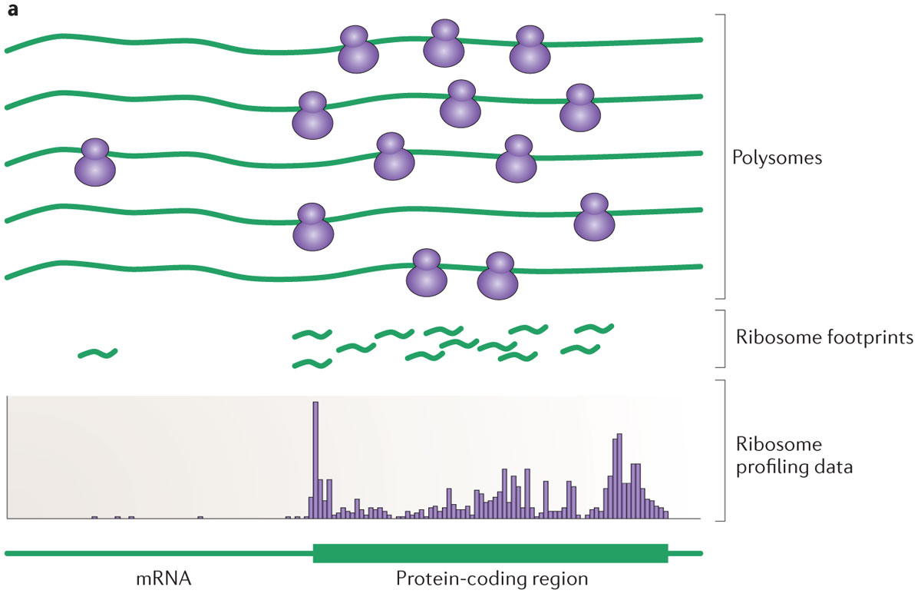
Ribosome Profiling
First need to go from polysomes to footprints…
< 9 steps
< lots of steps
Ingolia (2014). "Ribosome profiling: new views of translation, from single codons to genome scale". Nature Reviews. Genetics. 15 (3): 205–13. doi:10.1038/nrg3645

Slide 8
Polysomes to Footprints
Lyse the cells to get at the mRNA molecules bound to ribosomes.
'Stop' the translation process: e.g. with cyclohexamide or other means
Digest the non-protected RNA using a nuclease
Strip away the ribosomes and proteins
Size-select for these previously 'masked' fragments of mRNA
Add adapters
Reverse-transcribe to complimentary DNA
Amplify
Sequence
… PARTY?*
  (NO! Not yet.)
Ingolia NT, Ghaemmaghami S, Newman JR, Weissman JS (2009). "Genome-wide analysis in vivo of translation with nucleotide resolution using ribosome profiling". Science. 324 (5924): 218–23. doi:10.1126/science.1168978
* Note: not included in original methods of Ingolia et al.

Slide 9
Ribosome Profiling
Then need to get from footprints to profiling data.
< 9 steps
< lots more steps
Ingolia (2014). "Ribosome profiling: new views of translation, from single codons to genome scale". Nature Reviews. Genetics. 15 (3): 205–13. doi:10.1038/nrg3645

Slide 10
Ribosome Profiling
While wet-lab protocols are often fairly well explained in methods sections, papers tend to gloss over which data processing & analysis parameters are used;
But the processing / analysis stage is important in obtaining context for interpretation

Slide 11
Ribosome Profiling
Aiming to gather robust comparable data to test hypotheses
  Translational efficiency differences (changes in gene expression)
  Transcription start sites
  Ribosome occupancy

Slide 12
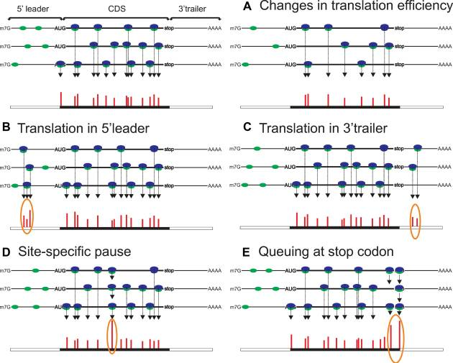
Ribosome Profiling
Control
Changed Conditions
A. Changes in translation efficiency (TE), represented here by decrease of TE between Control & Changed Conditions
Andreev et al. (2017). "Insights into the mechanisms of eukaryotic translation gained with ribosome profiling". Nucleic Acids Research. 45 (2): 513–526. doi:10.1093/nar/gkw1190

Slide 13
Ribosome Profiling
B. Translation in 5′ leader C. Presence of ribosomes in 3′ trailer
Andreev et al. (2017). "Insights into the mechanisms of eukaryotic translation gained with ribosome profiling". Nucleic Acids Research. 45 (2): 513–526. doi:10.1093/nar/gkw1190

Slide 14
Ribosome Profiling
D. Site specific pause originating from ribosomes stalled within acORF (annotated coding ORF) at a specific location.
E. Ribosomes paused at the stop codon and queued upstream ribosomes
Andreev et al. (2017). "Insights into the mechanisms of eukaryotic translation gained with ribosome profiling". Nucleic Acids Research. 45 (2): 513–526. doi:10.1093/nar/gkw1190

Slide 15
Ribosome Profiling
In order to obtain that comparable data for testing, still more work to do.
< 9 steps
< lots more steps
Ingolia (2014). "Ribosome profiling: new views of translation, from single codons to genome scale". Nature Reviews. Genetics. 15 (3): 205–13. doi:10.1038/nrg3645

Slide 16
Footprints to Profiling Data
Processing: lots of steps
  Removing adapter sequences
  Remove UMIs (Unique Molecular Identifiers) & barcodes if present
  Demultiplex / Deduplicate reads if required
  Need to filter out contaminant reads
  Align reads to transcriptome
Analysis: more steps
  Analyse & quantify data
  Create outputs (including for quality-control, further analysis)

Slide 17
Footprints to Profiling Data: Problems
Processing: lots of steps & lots of problems
  Different steps done best by different tools
  Different file types created – compatability?
  May not be easily able to check outputs are reasonable
  Tools may not be actively developed / not updated, necessary features may not be added
  Can be computationally intensive
Analysis: more steps & even more problems
  Data analysis methods often vary…
  Software versions change…
  Documentation may not be helpful
  Re-running datasets can be difficult if parameters not recorded…
  Output files may be stored in multiple locations without clear provenance...

Slide 18
Why do we need RiboViz?
Solves those problems!
Comparability! Simplicity! Ease of Use!
One-stop-shop for Ribosome Profiling Data – pipeline that uses a combination of local Python and R scripts and third-party components,
Riboviz takes: configuration file with the key parameters + organism-specific input files
Builds script from these parameters & runs the pipeline, recording your workflow exactly!
Delivers outputs with provenance information

Slide 19
RiboViz Workflow: Inputs
Organism Specific
Sample Specific
Transcript Sequences
.fasta
Read Data
.fastq
Genome / Transcriptome
Features
.gff
Configuration File
.yaml
Contaminant Sequences
(rRNA)
.fasta
(Additional
Organism-Specific
Data)
Configuration File lists all files & parameters needed to run RiboViz

Slide 20
RiboViz Workflow
Read Data
.fastq
Processing
Transcript Sequences
.fasta
Aligned Data
.bam
Genome / Transcriptome
Features
.gff
Contaminant Sequences
(rRNA)
.fasta
(Additional
Organism-Specific
Data)

Slide 21
RiboViz Workflow
Read Data
.fastq
Processing
Transcript Sequences
.fasta
Aligned Data
.bam
Genome / Transcriptome
Features
.gff
Ribogrid Data
.h5
Contaminant Sequences
(rRNA)
.fasta
(Additional
Organism-Specific
Data)

Slide 22
RiboViz Workflow
Read Data
.fastq
Analysis
Transcript Sequences
.fasta
Aligned Data
.bam
Genome / Transcriptome
Features
.gff
Ribogrid Data
.h5
Contaminant Sequences
(rRNA)
.fasta
Per-ORF Summary Data
.tsv
(Additional
Organism-Specific
Data)

Slide 23
Data Quality in Ribosome Profiling
Looking for 3-NT periodicity
Reasonable read-lengths (e.g. know should look for appx ~28-30NT)
Looking for most reads to be in one frame
Most reads map to coding regions (98.8% in Ingolia et al 2009)

Slide 24
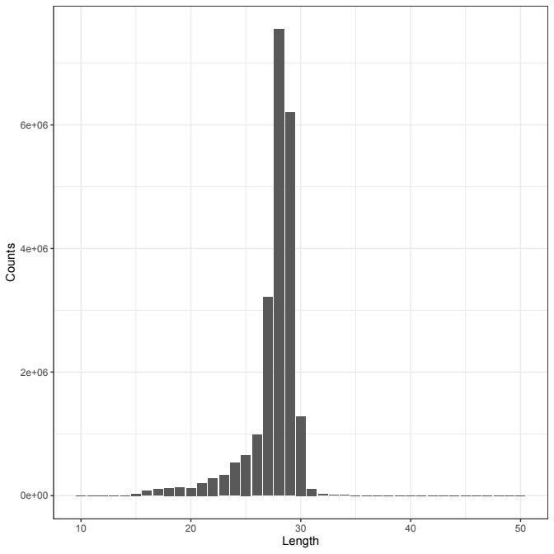
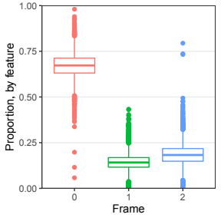
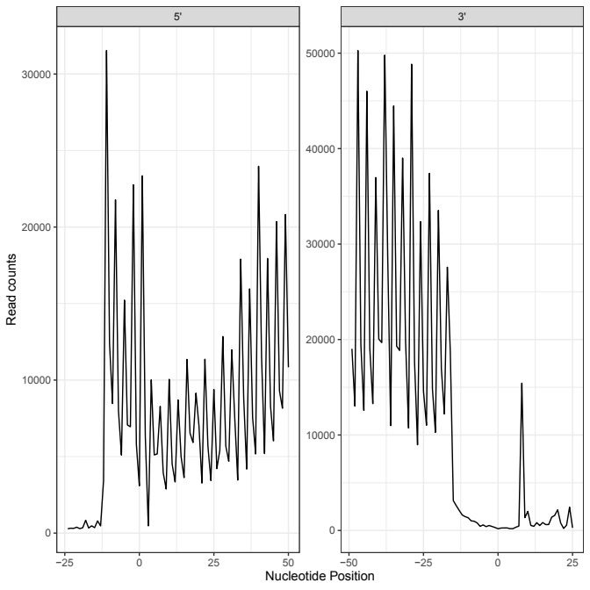
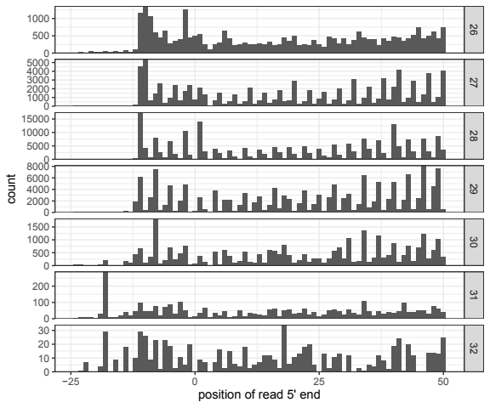
How does Riboviz show dataset is good quality?
G-Sc_2014: WTnone
Data: Guydosh & Green (2014). “Dom34 rescues ribosomes in 3' untranslated regions.” Cell. 156 (5): 950-62. doi: 10.1016/j.cell.2014.02.006.

Slide 25
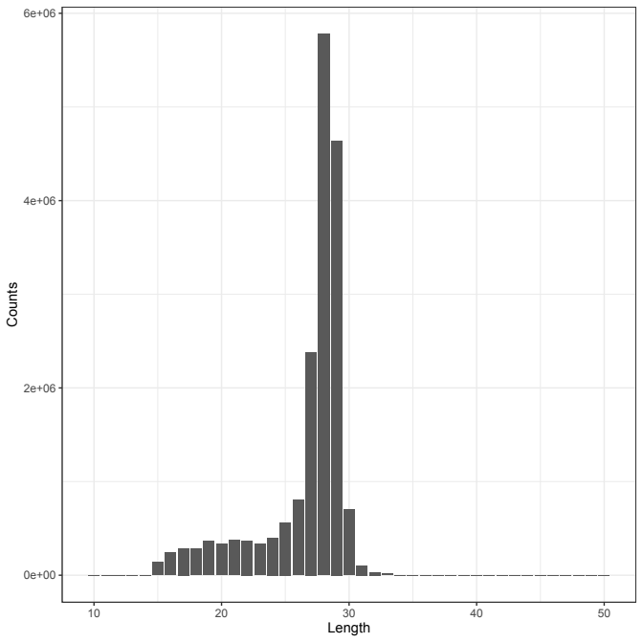
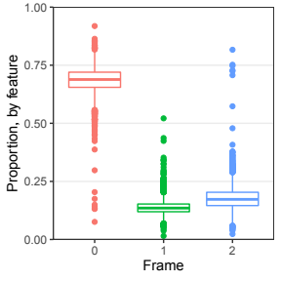
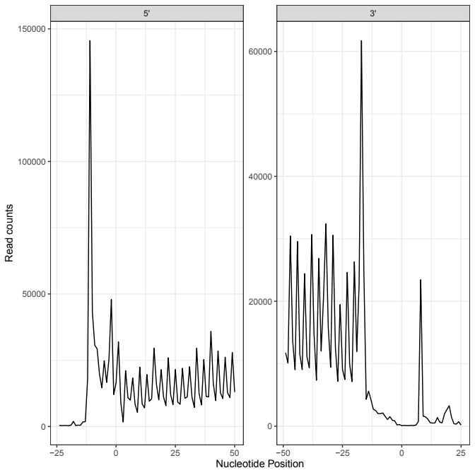
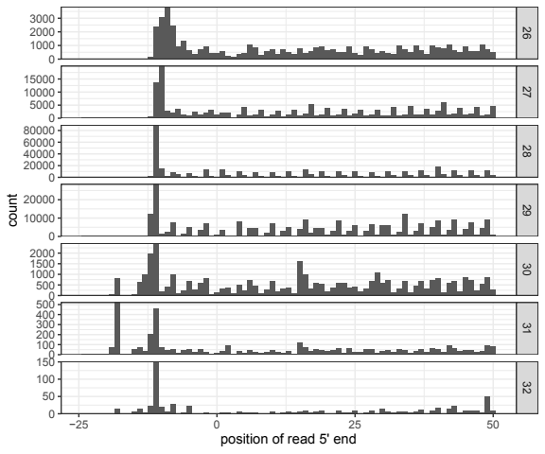
How does Riboviz show dataset is good quality?
G-Sc_2014: WT3AT
Data: Guydosh & Green (2014). “Dom34 rescues ribosomes in 3' untranslated regions.” Cell. 156 (5): 950-62. doi: 10.1016/j.cell.2014.02.006.

Slide 26
Hmm...
Certainly quantifiable!
Comparable plots (& underlying data), but difficult to view and ‘really’ compare by eye as in different folders; at different scales.
Really want to plot some of these side by side or in the same plot.
Better labelling of axes/units

Slide 27
How Can I Make This Better?
Plan to redesign the output format: .html output to allow easier comparison between samples
Improve documentation covering how to interpret outputs
Include code to plot multiple samples in one plot
Requires refactoring & developing RiboViz analysis code & documentation… (Ongoing!)

Slide 28
Ongoing
Learning the codebase, software development / testing skills, best practices
Assisting new users to install & run RiboViz on already-tested datasets, then new datasets
Supporting lab members & students using RiboViz in their projects

Slide 29
Ongoing
Git / Github: aka “how I learned to stop worrying & love version control”
Creating “oven-ready” example datasets
Testing RiboViz code, developing other features, fixing bugs, code review
Running new datasets (to see if it breaks things)

Slide 30
What’s next?
v2.0-beta – coming soon!
Testing code & documentation with ‘real’ users (not just development team)
Users: “the ~5 Es” - Identify, Engage, Encourage, Evaluate, Expand
Ribosome Profiling Analysis Workshop at Translation June 2020

Slide 31
What’s next?
Clear documentation for Riboviz, especially the analysis & outputs, and how to interpret them: UX (user experience) & supporting materials
Better testing in the analysis section: are the inputs reliable? How do I prove the functions work as expected?
Working with Amanda Knox in the Lareau Lab to run RiboViz on statistically ‘realistic’ generated ribosome profiling data:
  expected inputs → expected outputs?

Slide 32
What’s next?
Brave New Datasets!
  Wallace Lab Ribosome Profiling Data? TBC!
Strange New Organisms!
  Currently yeast-focussed…
  March & April: Mouse data (Rutgers), Drosophila data (Leeds)

Slide 33
Back to The Question
The Question:
How to make ribsome profiling data quantifiable, comparable & easier to process?
The Answer?
RiboViz pipeline allows easy processing & analysis of ribosome profiling data to identify patterns of transcriptional and translational regulation across different organisms and conditions.
… And the development team are working to make it more friendly to use, create more easily comparable outputs and apply it to quantify more new datasets.

Slide 34
Why RiboViz Is The Answer
Currently pretty good at quantifying, but adding testing & improving robustness
Flexible outputs lend themselves to subsequent analyses & comparisons & will be improved upon.
Reproducibility & User Experience:
  configuration file with key parameters & input filenames
  riboviz run script shows what commands were run with those parameters
  Dry-run feature
  outputs hold provenance information including (.log files include software versions, riboviz version information)
Can already check quality control easily, but this will be improved in the next few months
Learn one tool, not many – effective use of time!
User can focus on the science, not data processing.

Slide 35
… And when ribosome profiling data is quantifiable, comparable & easy to interpret?
?

Slide 36

… And when ribosome profiling data is quantifiable, comparable & easy to interpret?

Slide 37
… And when ribosome profiling data is quantifiable, comparable & easy to interpret?
PUBLISH

Slide 38
Questions

Slide 39
EXTRA SLIDES

Slide 40
Run Times
Test Vignette: 2 downsampled samples (94MB total)… 2m
On Ubuntu 18.04 Linux, using 8 processors:
G-Sc_2014: 8 samples (13.3GB total)… ~4hr
M-Ca_2014: 3 samples (17GB total)... ~3hr 10m
W-Sc_2016: 1 sample with UMIs (3.7GB)… ~4hr 30m

Slide 41
RiboViz Technical Bits
Bash, Python & R co-ordinating multiple externally- & internally- developed tools.
  hisat2-build: build rRNA and ORF indices.
  cutadapt: cut adapters.
  hisat2: align reads.
  riboviz.tools.trim_5p_mismatch: trim 5' mismatches from reads and remove reads with more than a set number of mismatches (local script, in riboviz/tools/).
  umi_tools (extract, dedup, group): extract barcodes and UMIs, deduplicate reads and group reads.
  riboviz.tools.demultiplex_fastq: demultiplex multiplexed files (local script, in riboviz/tools/).
  samtools (view, sort, index): convert SAM files to BAM files and index.
  bedtools (genomecov): export transcriptome coverage as bedgraphs.
  bam_to_h5.R: convert BAM to compressed H5 format (local script, in rscripts/)
  generate_stats_figs.R: generate summary statistics, analyses plots and QC plots (local script, in rscripts/)
  collate_tpms.R: collate TPMs across samples (local script, in rscripts/)
  riboviz.tools.count_reads: count the number of reads (sequences) processed by specific stages of the workflow (local script, in riboviz/tools/).

