Slide 1
The Question
How to make ribosome profiling data reliable, comparable & easier to analyse?
04 March 2020
Flic Anderson
The Wallace Lab, University of Edinburgh

Slide 2
The Answer
RiboViz?

Slide 3
The Longer Answer
What is RiboViz
Ribosome Profiling Process
  What can the data answer?
  Methods
  Problems
What does RiboViz Do?
  Workflow
  Outputs
Challenges:
  User Experience
  Testing Reliability
Summary: Back to The Question

Slide 4
What is RiboViz
RiboViz:
software pipeline to enable comparative analyses of ribosome-profiling datasets to allow researchers to identify patterns of transcriptional and translational regulation across different organisms and conditions
Carja, O., Xing, T., Wallace, E.W.J. et al. riboviz: analysis and visualization of ribosome profiling datasets. BMC Bioinformatics 18, 461 (2017). https://doi.org/10.1186/s12859-017-1873-8

Slide 5
Thanks / Acknowledgements
BBSRC-NSF funded project
Collaborative project:
  Edward Wallace: The Wallace Lab, The University of Edinburgh.
  Premal Shah, John Favate, Tongji Xing: The Shah Lab, Rutgers University.
  Liana Lareau, Amanda Mok: The Lareau Lab, University of California, Berkeley.
  Kostas Kavousannakis, Mike Jackson: EPCC, The University of Edinburgh.
  Oana Carja, Joshua Plotkin: The University of Pennsylvania

Slide 6
Ribosome Profiling
Technique exploits ribosome-protected sections of mRNA: snapshot of active translation in vivo
Showing active translation allows direct comparison of translational efficiency and gene expression between conditions
Allows us to address key questions about gene regulation in a range of organisms
Ingolia NT, Ghaemmaghami S, Newman JR, Weissman JS (2009). "Genome-wide analysis in vivo of translation with nucleotide resolution using ribosome profiling". Science. 324 (5924): 218–23. doi:10.1126/science.1168978

Slide 7
What Will It Answer?
Aiming to gather robust comparable data to test hypotheses
  Translational efficiency differences (changes in gene expression)
  Transcription start sites
  Ribosome occupancy per codon

Slide 8
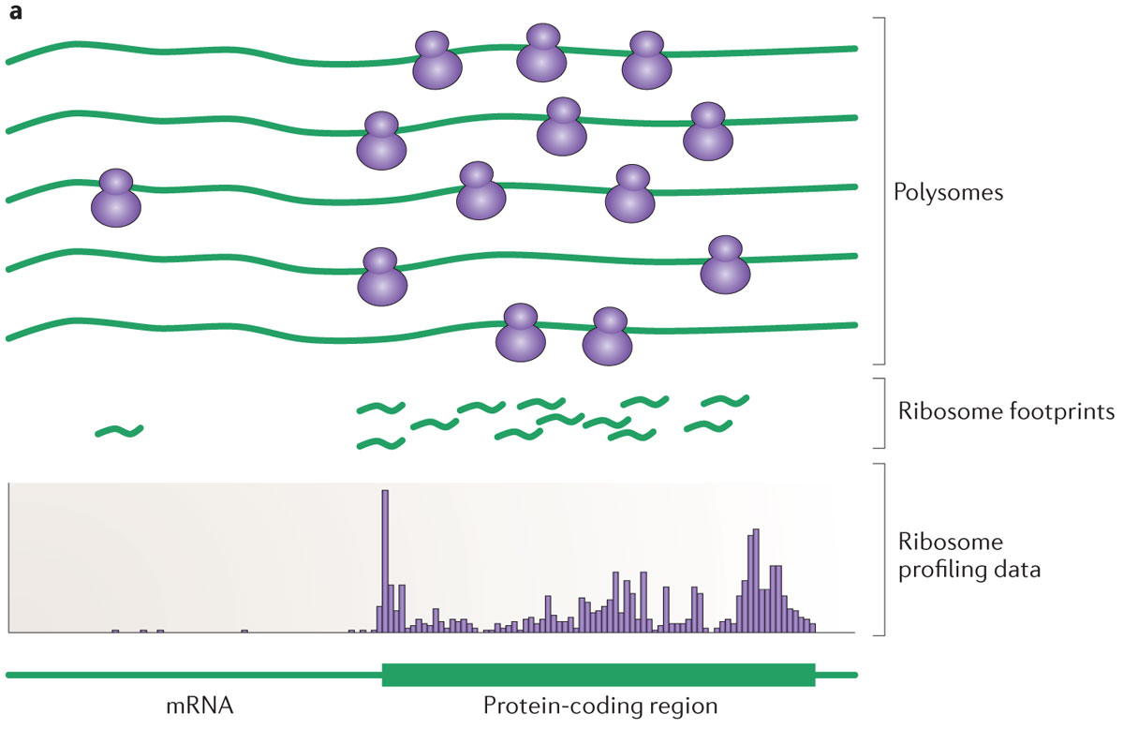
Polysomes to Footprints
< Experimental Stages
< Processing & Analysis
Ingolia (2014). "Ribosome profiling: new views of translation, from single codons to genome scale". Nature Reviews. Genetics. 15 (3): 205–13. doi:10.1038/nrg3645

Slide 9
Polysomes to Footprints
Lyse the cells to get at the mRNA molecules bound to ribosomes.
'Stop' the translation process: e.g. with cycloheximide or other means
Digest the non-protected RNA using a nuclease
Strip away the ribosomes and proteins
Size-select for these previously 'masked' fragments of mRNA
Add adapters
Reverse-transcribe to complimentary DNA
Amplify
Sequence
… PARTY?*
  (NO! Not yet.)
Ingolia NT, Ghaemmaghami S, Newman JR, Weissman JS (2009). "Genome-wide analysis in vivo of translation with nucleotide resolution using ribosome profiling". Science. 324 (5924): 218–23. doi:10.1126/science.1168978
* Note: not included in original methods of Ingolia et al.

Slide 10
Footprints to Profiling Data
< Experimental Stages
< Processing & Analysis
Ingolia (2014). "Ribosome profiling: new views of translation, from single codons to genome scale". Nature Reviews. Genetics. 15 (3): 205–13. doi:10.1038/nrg3645

Slide 11
Footprints to Ribosome Profiling Data
Processing: lots of steps
  Removing adapter sequences
  Remove UMIs (Unique Molecular Identifiers) & barcodes if present
  Demultiplex / Deduplicate reads if required
  Need to filter out contaminant reads
  Align reads to transcriptome
Analysis: more steps
  Analyse & quantify data
  Create outputs (including for quality-control, further analysis)

Slide 12
Footprints to Profiling Data: Problems
Processing: lots of steps & lots of problems
  Different tools
  Compatability of inputs/outputs
  Poor testing / no checks on reliability
  Tools not updated, necessary features may not be added
Analysis: more steps & even more problems
  Data analysis methods not transparent (black box software)
  Software versions
  Unhelpful documentation
  Re-running datasets can be difficult
  Output file chaos

Slide 13
Methods Discussions
Methods used in experimental and processing/analysis steps can impact results considerably:
  e.g. Debate on experimental protocol aspects such as use of cycloheximide (Duncan & Mata 2017)
Processing & analysis steps haven’t been widely examined and discussed;
Potential for obtaining unreliable results
  inconsistencies between methods
  lack of transparency
  unknown compatibility between inputs/outputs at key steps
Leads to difficulties in reproducing results
Duncan & Mata (2017). “Effects of cycloheximide on the interpretation of ribosome profiling experiments in Schizosaccharomyces pombe”. Sci Rep 7, 10331. https://doi.org/10.1038/s41598-017-10650-1

Slide 14
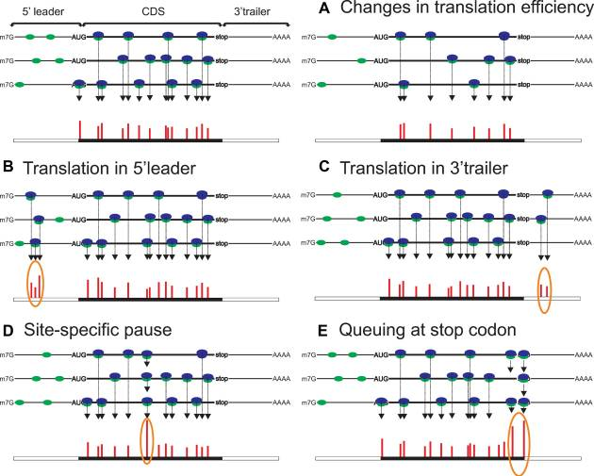
Translational Efficiency
Control
Changed Conditions
A. Changes in translation efficiency (TE), represented here by decrease of TE between Control & Changed Conditions
Andreev et al. (2017). "Insights into the mechanisms of eukaryotic translation gained with ribosome profiling". Nucleic Acids Research. 45 (2): 513–526. doi:10.1093/nar/gkw1190

Slide 15
5’ & 3’ Investigations
B. Translation in 5′ leader C. Presence of ribosomes in 3′ trailer
Andreev et al. (2017). "Insights into the mechanisms of eukaryotic translation gained with ribosome profiling". Nucleic Acids Research. 45 (2): 513–526. doi:10.1093/nar/gkw1190

Slide 16
What does RiboViz do?
Resolves the processing & analysis issues & allows us to focus on the science!
Software pipeline that uses a combination of local Python and R scripts and third-party components
Riboviz takes:
  one configuration file with the key parameters
  organism-specific input files
Builds script from these parameters & runs the pipeline, recording your workflow exactly!
Ensures inputs/outputs at each step are compatible
Delivers outputs with provenance information

Slide 17
RiboViz Workflow: Inputs
Organism Specific
Sample Specific
Transcript Sequences
.fasta
Read Data
.fastq
Genome / Transcriptome
Features
.gff
Configuration File
.yaml
Contaminant Sequences
(rRNA)
.fasta
(Additional
Organism-Specific
Data)
Configuration File lists all files & parameters needed to run RiboViz

Slide 18
RiboViz Workflow
Read Data
.fastq
Processing
Transcript Sequences
.fasta
Aligned Data
.bam
Genome / Transcriptome
Features
.gff
Contaminant Sequences
(rRNA)
.fasta
(Additional
Organism-Specific
Data)

Slide 19
RiboViz Workflow
Read Data
.fastq
Processing
Transcript Sequences
.fasta
Aligned Data
.bam
Genome / Transcriptome
Features
.gff
Ribogrid Data
.h5
Contaminant Sequences
(rRNA)
.fasta
(Additional
Organism-Specific
Data)

Slide 20
RiboViz Workflow
Read Data
.fastq
Analysis
Transcript Sequences
.fasta
Aligned Data
.bam
Genome / Transcriptome
Features
.gff
Ribogrid Data
.h5
Contaminant Sequences
(rRNA)
.fasta
Per-ORF Summary Data
.tsv
(Additional
Organism-Specific
Data)

Slide 21
Analysis of Ribosome Profiling Data
Looking for 3-NT periodicity: ribosomes moving along transcript 1 codon at a time
Most reads map to coding regions (98.8% in Ingolia et al 2009)
Reasonable read-lengths (e.g. know should look for appx ~28-30NT)
Looking for most reads to be in one frame

Slide 22
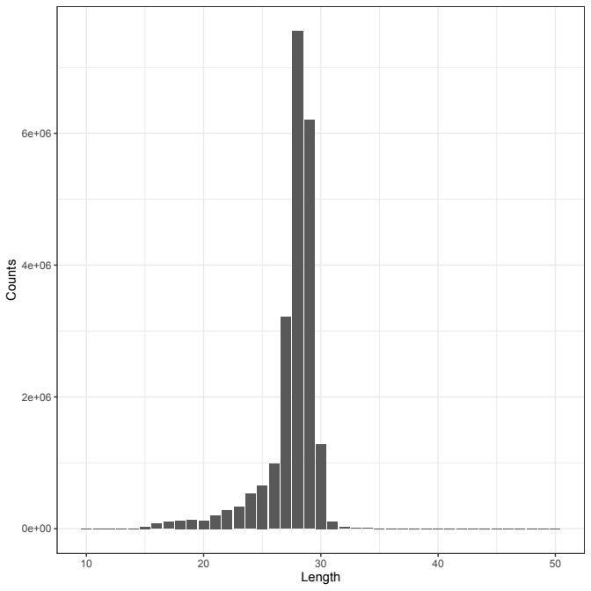
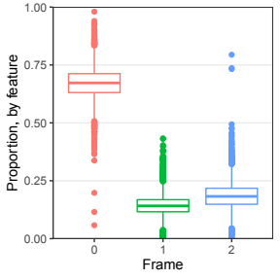
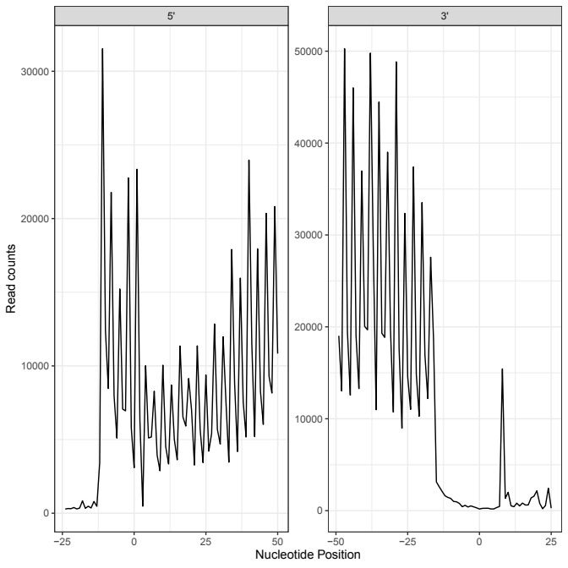
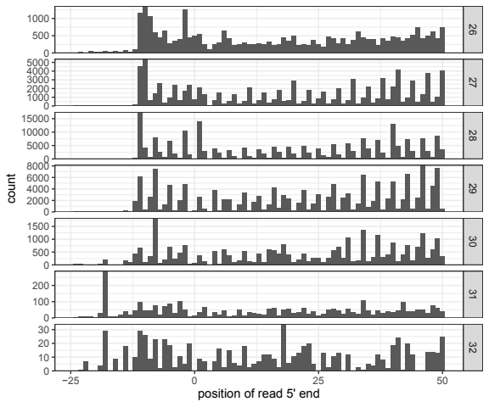
How does Riboviz show dataset is reliable?
G-Sc_2014: WTnone
Data: Guydosh & Green (2014). “Dom34 rescues ribosomes in 3' untranslated regions.”
Cell. 156 (5): 950-62. doi: 10.1016/j.cell.2014.02.006.

Slide 23
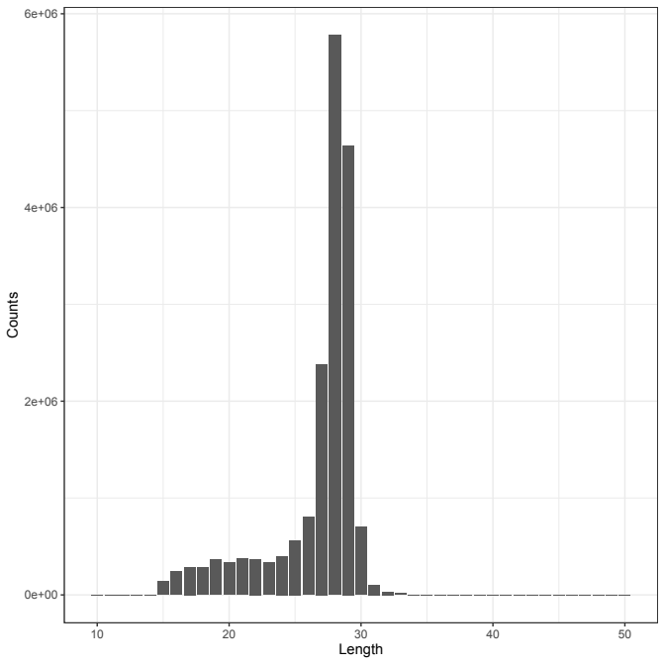
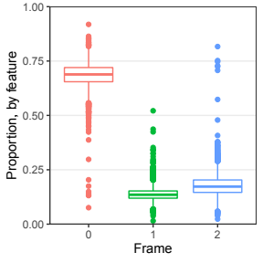
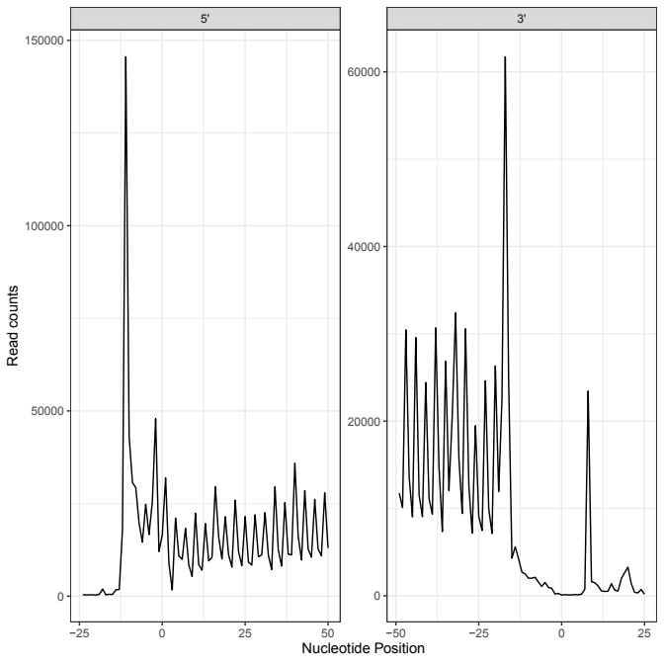
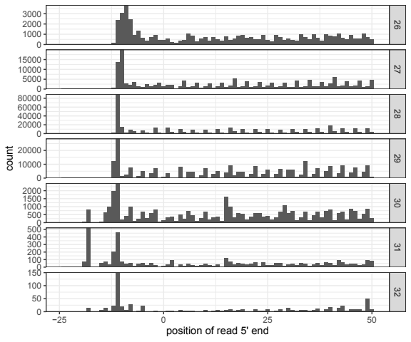
How does Riboviz show dataset is reliable?
G-Sc_2014: WT3AT
Data: Guydosh & Green (2014). “Dom34 rescues ribosomes in 3' untranslated regions.” Cell. 156 (5): 950-62. doi: 10.1016/j.cell.2014.02.006.

Slide 24
Good… How could I make it better?
Comparable plots (& underlying data) but difficult to ‘really’ compare
  Currently different files in different folders;
  Plotted at different scales
Going to redesign output format: .html output with clearer plotting
Test analysis functions in the code to ensure they’re reliable
Requires refactoring & developing RiboViz analysis code & documentation… (Ongoing!)

Slide 25
Challenges: User Experience (UX)
Users:
  Build user base → supporting lab members / collaborators to use RiboViz; identify more potential users
  What do users might need / want? → need to survey the ribosome profiling community
  ‘Onboarding’ → creating ‘oven-ready’ example datasets in separate repository as learning aid
Support & Documentation:
  Existing documentation suitable? → ‘test’ documentation with new users & improve based on their experiences
  Improve documentation of outputs → will improve documentation around analysis stage, including interpretation
  Workshop at Translation UK, June 2020 → will create teaching materials to support the workshop
v2.0-beta:
  Coming soon! More easily discoverable & ready for testing...

Slide 26
Challenges: Testing Reliability
General Testing:
  Developing features in RiboViz → ongoing software testing, bug fixes, code reviews
  Running new datasets
    Multiple datasets run so far… S. cerevisiae & C. albicans
    Wallace Lab Ribosome Profiling Data? TBC!
    In March/April: Mouse data (Rutgers), Drosophila data (Leeds)
Methods Testing:
  Are analysis methods working? → better testing in the analysis section
  Expected outputs? → working with Amanda Mok in the Lareau Lab to run RiboViz on statistically ‘realistic’ simulated ribosome profiling data

Slide 27
Back to The Question
The Question:
How to make ribosome profiling data reliable, comparable & easier to analyse?
The Answer?
RiboViz answers the key problems in ribosome profiling data processing & analysis...
… And the development team are working to make it more reliable and friendly to use, with easily comparable outputs.

Slide 28
… And when ribosome profiling data is reliable, comparable & easy to analyse?
?

Slide 29

… And when ribosome profiling data is reliable, comparable & easy to analyse?

Slide 30
… And when ribosome profiling data is reliable, comparable & easy to analyse?
PUBLISH

Slide 31
Questions?

Slide 32
EXTRA SLIDES

Slide 33
Run Times
Test Vignette: 2 downsampled samples (94MB total)… 2m
On Ubuntu 18.04 Linux, using 8 processors:
G-Sc_2014: 8 samples (13.3GB total)… ~4hr
M-Ca_2014: 3 samples (17GB total)... ~3hr 10m
W-Sc_2016: 1 sample with UMIs (3.7GB)… ~4hr 30m

Slide 34
Pausing & Queuing
D. Site specific pause originating from ribosomes stalled within acORF (annotated coding ORF) at a specific location.
E. Ribosomes paused at the stop codon and queued upstream ribosomes
Andreev et al. (2017). "Insights into the mechanisms of eukaryotic translation gained with ribosome profiling". Nucleic Acids Research. 45 (2): 513–526. doi:10.1093/nar/gkw1190

Slide 35
RiboViz Technical Bits
Bash, Python & R co-ordinating multiple externally- & internally- developed tools.
  hisat2-build: build rRNA and ORF indices.
  cutadapt: cut adapters.
  hisat2: align reads.
  riboviz.tools.trim_5p_mismatch: trim 5' mismatches from reads and remove reads with more than a set number of mismatches (local script, in riboviz/tools/).
  umi_tools (extract, dedup, group): extract barcodes and UMIs, deduplicate reads and group reads.
  riboviz.tools.demultiplex_fastq: demultiplex multiplexed files (local script, in riboviz/tools/).
  samtools (view, sort, index): convert SAM files to BAM files and index.
  bedtools (genomecov): export transcriptome coverage as bedgraphs.
  bam_to_h5.R: convert BAM to compressed H5 format (local script, in rscripts/)
  generate_stats_figs.R: generate summary statistics, analyses plots and QC plots (local script, in rscripts/)
  collate_tpms.R: collate TPMs across samples (local script, in rscripts/)
  riboviz.tools.count_reads: count the number of reads (sequences) processed by specific stages of the workflow (local script, in riboviz/tools/).

