Slide 1
QUESTION OF TALK

Slide 2
LEARNING OUTCOMES OF TALK
What have I worked on (Refactoring)
  Why? What was the point of that?
  What will it let me/us do?
What WILL I do next few months
  Why?
  What will THAT let me/us do?
How I can help people?
How can people help me?

Slide 3
Outline

Slide 4
Introduction:
Aim of my talk:
  update on riboviz progress
  seeking input for future aims!

Slide 5
Riboviz 101
Riboviz processes & analyses ribosome profiling data
Ribosome profiling data helps unlock details of active translation: mechanics of translation, regulation methods, translational efficiency
Developing/improving riboviz = more researcher time for biological questions rather than tinkering with pipelines & bespoke analysis code...

Slide 6
Ribsome Profiling
Frames & 3-NT Periodicity!
Ribosome profiling: produces reads ~30NT long (mRNA protected by the ribosome bound to it)
Ribosomes won’t bind to non-coding DNA!
3-NT periodicity because ribosomes read 1 codon (3NT) at a time & move along to next codon (3NT), and so on.
… If you freeze the process, you get lots of reads located at start of each ‘codon’ so get PEAKS at those positions : known as 3-Nucleotide Periodicity
Frame ALSO
[info goes here, find good image]
Data output image.

Slide 7
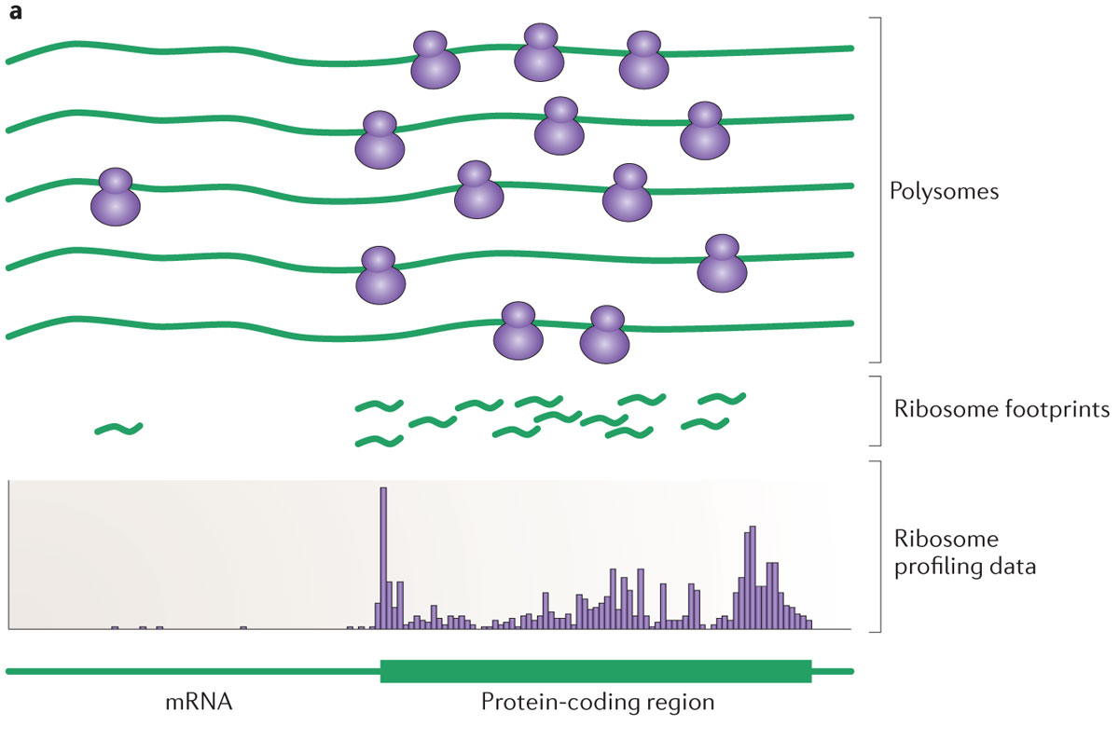
Polysomes to Footprints
< Experimental Stages
< Processing & Analysis
Ingolia (2014). "Ribosome profiling: new views of translation, from single codons to genome scale". Nature Reviews. Genetics. 15 (3): 205–13. doi:10.1038/nrg3645
Notes:
Lyse the cells to get at the mRNA molecules bound to ribosomes.
'Stop' the translation process: e.g. with cycloheximide or other means
Digest the non-protected RNA using a nuclease
Strip away the ribosomes and proteins
Size-select for these previously 'masked' fragments of mRNA
Add adapters
Reverse-transcribe to complimentary DNA
Amplify
Sequence
Ingolia NT, Ghaemmaghami S, Newman JR, Weissman JS (2009). "Genome-wide analysis in vivo of translation with nucleotide resolution using ribosome profiling". Science. 324 (5924): 218–23. doi:10.1126/science.1168978

Slide 8
Footprints to Profiling Data
< Experimental Stages
< Processing & Analysis
Ingolia (2014). "Ribosome profiling: new views of translation, from single codons to genome scale". Nature Reviews. Genetics. 15 (3): 205–13. doi:10.1038/nrg3645

Slide 9
Footprints to Ribosome Profiling Data
Processing: lots of steps
  Removing adapter sequences
  Remove UMIs (Unique Molecular Identifiers) & barcodes if present
  Demultiplex / Deduplicate reads if required
  Need to filter out contaminant reads
  Align reads to transcriptome
Analysis: more steps
  Analyse & quantify data:
  Create outputs (including for quality-control, further analysis)

Slide 10
RiboViz Workflow: Inputs
Organism Specific
Sample Specific
Transcript Sequences
.fasta
Read Data
.fastq
Genome / Transcriptome
Features
.gff
Configuration File
.yaml
Contaminant Sequences
(rRNA)
.fasta
(Additional
Organism-Specific
Data)
Configuration File lists all files & parameters needed to run RiboViz

Slide 11
RiboViz Workflow
Read Data
.fastq
Processing
Transcript Sequences
.fasta
Aligned Data
.bam
Genome / Transcriptome
Features
.gff
Contaminant Sequences
(rRNA)
.fasta
(Additional
Organism-Specific
Data)

Slide 12
RiboViz Workflow
Read Data
.fastq
Processing
Transcript Sequences
.fasta
Aligned Data
.bam
Genome / Transcriptome
Features
.gff
Ribogrid Data
.h5
Contaminant Sequences
(rRNA)
.fasta
(Additional
Organism-Specific
Data)

Slide 13
RiboViz Workflow
Read Data
.fastq
Analysis
Transcript Sequences
.fasta
Aligned Data
.bam
Genome / Transcriptome
Features
.gff
Ribogrid Data
.h5
Contaminant Sequences
(rRNA)
.fasta
Per-ORF Summary Data
.tsv .pdf
(Additional
Organism-Specific
Data)

Slide 14
Analysis Stage
1 key script which handles this: generate_stats_figs.R
WHAT IT DOES
What it outputs.

Slide 15
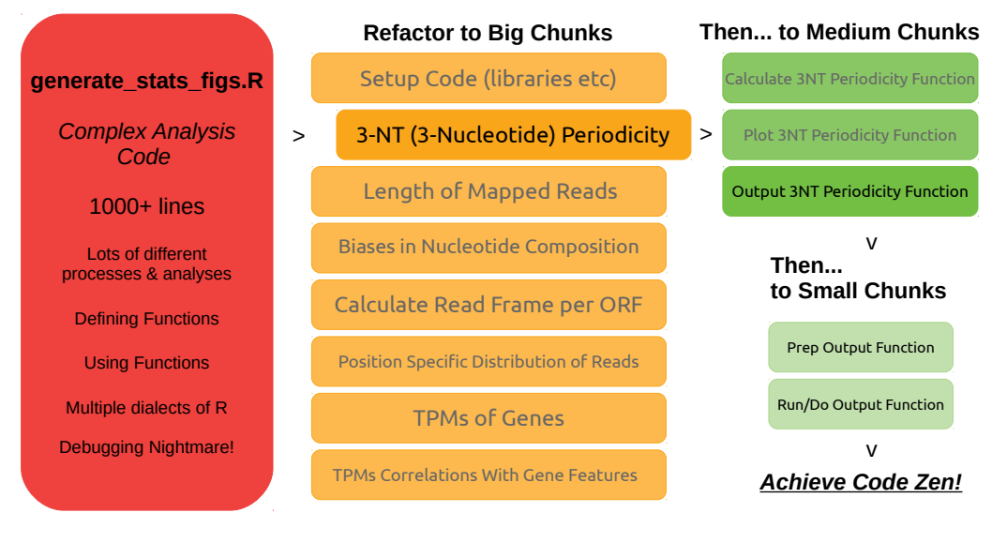
Refactoring Analysis Code

Slide 16
Refactoring Tips
Break it down into chunks!
Regression tests are your friend
Develop functions in your main script & then boot them out into another one
Keep it specific: issue-focussed working
Notes:
Think about WWMJD: What Would Mike Jackson Do?
Break it down: Big chunks, Medium chunks, Small chunks, success!
Otherwise you spend hours looking bleakly at a page of impenetrable code & have no idea how to make a dent in it...
Regression Tests: SO useful at telling you something has suddenly stopped working or gives different answers!
Functions in another script, called from the ‘main’ one. Avoids visual clutter, keeps the script easy to read & understand.
Specific issue tickets & issue branches keep you focussed on ONE thing: open branch, do work, merge branch, close issue, move on.
A good issue ticket tells you how you’ll know when it’s done, also...

Slide 17
Refactoring LFMFs
Issue proliferation… Getting lost amongst different issues & losing sight of the main goals
Biggest difficulty encountered? Schroedinger’s debugging issues!
Package::function() is very useful!
Remember to tell collaborators about & document the new packages you add to the code to solve problems...
Notes:
Issue proliferation: I got lost and delayed as I tried fixing other issues as they came up & the issues THOSE issues created and… MADNESS. Avoid.
Interactive function behaviour: some functions behave differently when run interactively vs in a sourced script… Makes debugging SUPER tricky!
Package::function() You WILL forget which snazzy package that important function came from otherwise
Also you will probably forget add it to the documentation and tell people to install it and There Will Be Errors.

Slide 18
“Putting the YOU into USER”
User Testing & User Interviews
Existing Documentation Feedback – Siyin & others already helping with this :)
Leave Code Docs to the Robots? – {roxygen2} – hoping to chat to Edward about this!
General Comparisons - what features of other software doing similar things do you find useful/unhelpful?
Notes:
User Testing & Interviews:
- First impressions
- Ease/difficulties of use
- Analyses you want to see
- What doesn’t work / isn’t helpful?
Getting folks to feedback on & improve existing documentation: learned quite a lot from Ania, & now Siyin, & other new users!
Documentation using {roxygen2}:
- Better code documentation is better for users (if nothing else, it ensures developers really THINK about their code before releasing it into the wild!!)
What processing/analysis software tools do you use now that you find useful?
- What features => useful / annoying?
- Any generalisations we can take to riboviz work?

Slide 19
Question Everything: testing & reliability
Code Testing:
  Integrating code from Ania & Siyin’s projects: want to have good testable code…
  {testthat} R package – would be great to chat with Xuejia on how this works
More data! This lab: Rosey? Others? Let’s talk :)

Slide 20
TODOs
Q: How does riboviz compare with other tools
Q: Do we have the right statistics for diagnostics?
Q: Users?
Q:

Slide 21
My Priorities (next few months)
More example datasets into the repo
Testing for analysis code & new functions
Style analysis code; rewrite in ONE dialect of R
User interviews / user testing
A paper?

Slide 22
Thanks / Acknowledgements
BBSRC-NSF funded project
Collaborative project:
  Edward Wallace: The Wallace Lab, The University of Edinburgh.
  + Siyin Xue, Ania Kurowska
  Premal Shah, John Favate, Tongji Xing: The Shah Lab, Rutgers University.
  Liana Lareau, Amanda Mok: The Lareau Lab, University of California, Berkeley.
  Kostas Kavousannakis, Mike Jackson: EPCC, The University of Edinburgh.
  Oana Carja, Joshua Plotkin: The University of Pennsylvania

