Slide 1
Refactoring Riboviz Analysis Code:
A Personal Journey
22 July 2020
Flic Anderson
The Wallace Lab, University of Edinburgh

Slide 2
Outline
Riboviz Aims
Riboviz Workflow
Analyis Code Refactoring
  Example
  Tips
  Fails
My Future Priorities
Outputs Discussion...

Slide 3
Riboviz 101
Riboviz processes & analyses ribosome profiling data
Ribosome profiling data helps unlock details of active translation: mechanics of translation, regulation methods, translational efficiency
Developing/improving riboviz = more researcher time for biological questions rather than tinkering with pipelines & bespoke analysis code…
Robust & reliable code

Slide 4
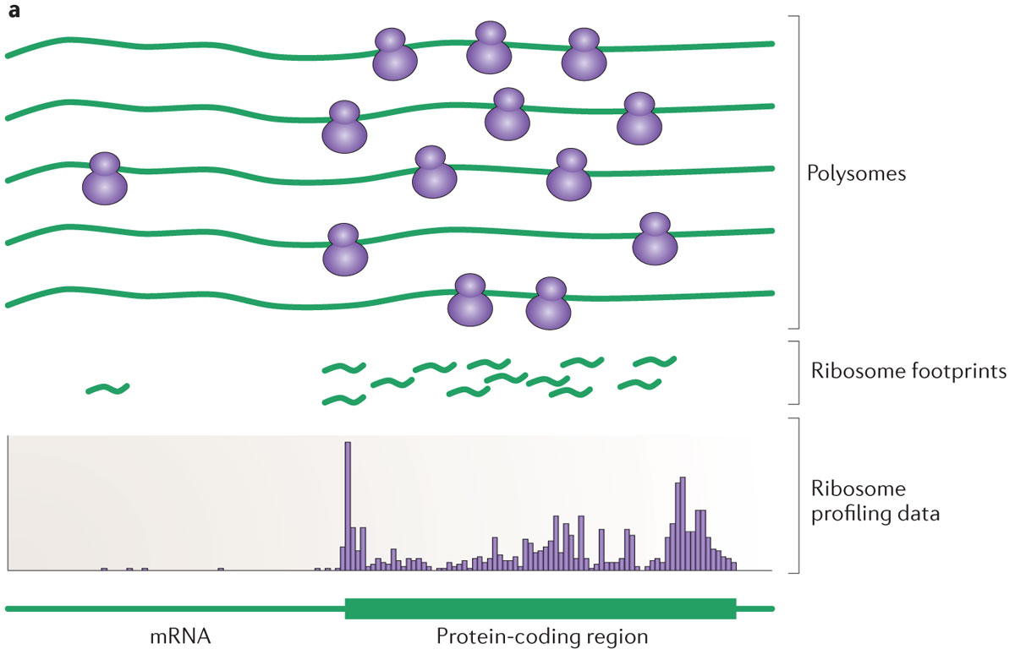
Polysomes to Footprints
< Experimental Stages
< Processing & Analysis
Ingolia (2014). "Ribosome profiling: new views of translation, from single codons to genome scale". Nature Reviews. Genetics. 15 (3): 205–13. doi:10.1038/nrg3645
Notes:
Lyse the cells to get at the mRNA molecules bound to ribosomes.
'Stop' the translation process: e.g. with cycloheximide or other means
Digest the non-protected RNA using a nuclease
Strip away the ribosomes and proteins
Size-select for these previously 'masked' fragments of mRNA
Add adapters
Reverse-transcribe to complimentary DNA
Amplify
Sequence
Ingolia NT, Ghaemmaghami S, Newman JR, Weissman JS (2009). "Genome-wide analysis in vivo of translation with nucleotide resolution using ribosome profiling". Science. 324 (5924): 218–23. doi:10.1126/science.1168978

Slide 5
Footprints to Profiling Data
< Experimental Stages
< Processing & Analysis
Ingolia (2014). "Ribosome profiling: new views of translation, from single codons to genome scale". Nature Reviews. Genetics. 15 (3): 205–13. doi:10.1038/nrg3645
Notes:
Take these reads & submit to further processing & analysis to get plots & information.
That’s where riboviz comes in!
Processing:
Multiple steps using a range of other tools ‘plumbed-in’.
Analysis:
Analyse & quantify data:
Create outputs (including for quality-control, further analysis)

Slide 6
Analysis of Ribosome Profiling Data
Looking for 3-NT periodicity: ribosomes moving along transcript 1 codon at a time
Most reads map to coding regions (98.8% in Ingolia et al 2009)
Reasonable read-lengths (e.g. know should look for appx ~28-30NT)
Looking for most reads to be in one frame: this is a key Quality Control measure
Notes:
Makes use of these key features of ribosome profiling data to produce diagnostic plots & data.

Slide 7
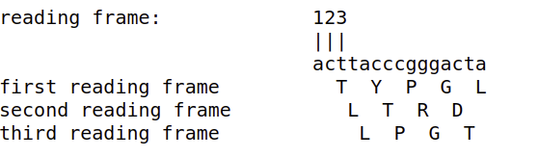
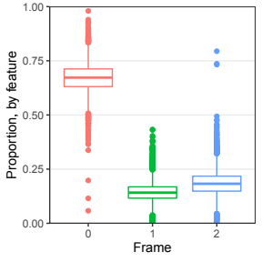
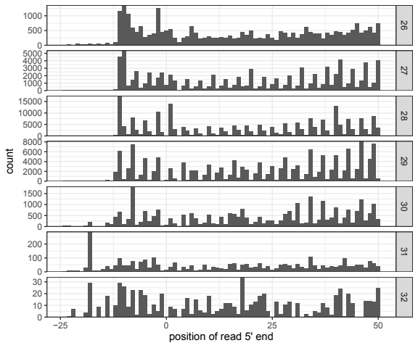
Ribosome Data & Reading Frame
AUG
G-Sc_2014: WTnone
Reading Frame: https://www.ncbi.nlm.nih.gov/Class/MLACourse/Original8Hour/Genetics/readingframe.html
Data: Guydosh & Green (2014). “Dom34 rescues ribosomes in 3' untranslated regions.” Cell. 156 (5): 950-62. doi: 10.1016/j.cell.2014.02.006.
Notes:
Ribosome profiling data is really useful for investigating translational mechanics particularly because of the information it provides about the active open reading frame!
Can locate the start codon ‘AUG’ (from annotation position information from a .gff or sequence info) & determine what should be the reading frame based on that.
Can determine which reading frame(s) are being actively translated from the counts of reads sequenced which match each frame. Can look at if this is altered by particular characteristics of the gene or sequence for example.

Slide 8
Riboviz Workflow: Inputs
Organism Specific
Sample Specific
Transcript Sequences
.fasta
Read Data
.fastq
Genome / Transcriptome
Features
.gff
Configuration File
.yaml
Contaminant Sequences
(rRNA)
.fasta
(Additional
Organism-Specific
Data)
Configuration File lists all files & parameters needed to run RiboViz
Notes:
Additional organism-specific data files: ie the pipeline can run without them, but will not produce specific plots without them.
--t-rna-file and --codon-positions-file:
Skipped: Codon-specific ribosome densities for correlations with tRNAs - t-rna-file and/or codon-positions-file not provided.
This determines the output of: codon_ribodens.pdf, codon_ribodens.tsv
--features-file:
Skipped: Correlations between TPMs of genes with their sequence-based features - features_file.tsv not provided")
This determines the output of: features.pdf
--asite-disp-length-file:
If not provided the code skips the relevant functionality but prints no Skipped message. Print one.
This determines the output of: 3ntframe_bygene.tsv, 3ntframe_propbygene.pdf
--orf-fasta-file:
This is only needed if do_pos_sp_nt_freq=true.
This determines the output of: pos_sp_nt_freq.tsv

Slide 9
Riboviz Workflow
Read Data
.fastq
Processing
Transcript Sequences
.fasta
Aligned Data
.bam
Genome / Transcriptome
Features
.gff
Contaminant Sequences
(rRNA)
.fasta
(Additional
Organism-Specific
Data)
Notes:
Processing:
Removing adapter sequences
Remove UMIs (Unique Molecular Identifiers) & barcodes if present
Demultiplex / Deduplicate reads if required
Need to filter out contaminant reads
Align reads to transcriptome

Slide 10
Riboviz Workflow
Read Data
.fastq
Processing
Transcript Sequences
.fasta
Aligned Data
.bam
Genome / Transcriptome
Features
.gff
Ribogrid Data
.h5
Contaminant Sequences
(rRNA)
.fasta
(Additional
Organism-Specific
Data)

Slide 11
Riboviz Workflow
Read Data
.fastq
Analysis
Transcript Sequences
.fasta
Aligned Data
.bam
Genome / Transcriptome
Features
.gff
Ribogrid Data
.h5
Contaminant Sequences
(rRNA)
.fasta
Per-ORF Summary Data
.tsv .pdf
(Additional
Organism-Specific
Data)
Notes:
Analysis:
Analyse & quantify data:
Create outputs (including for quality-control, further analysis)

Slide 12
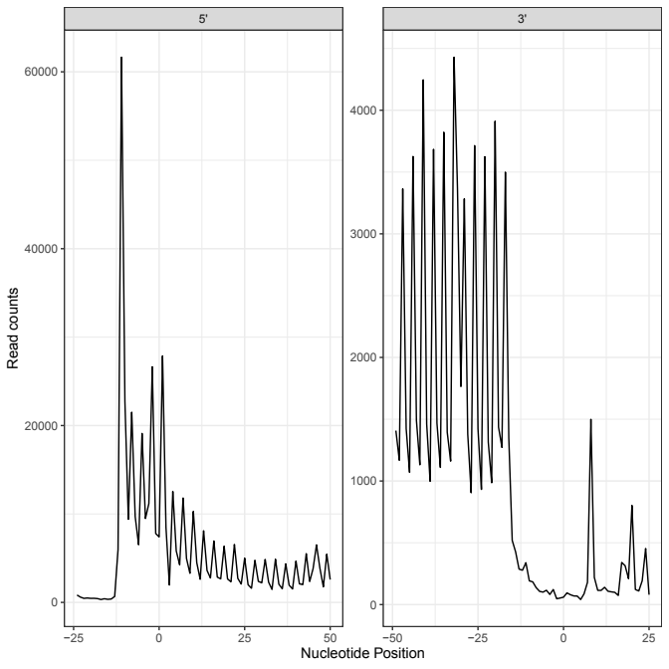
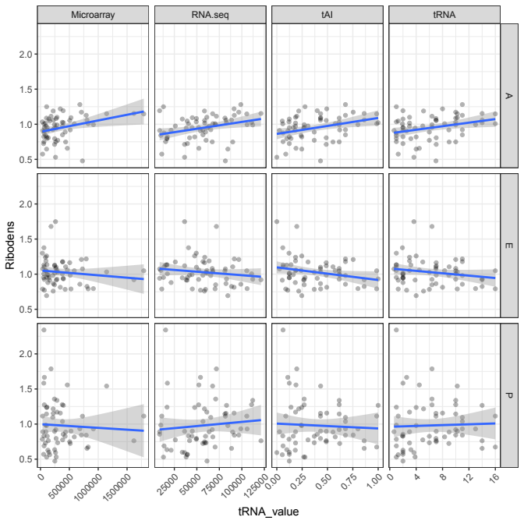
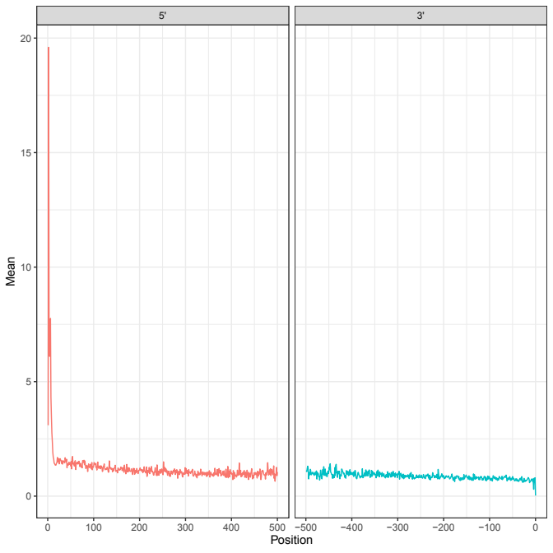
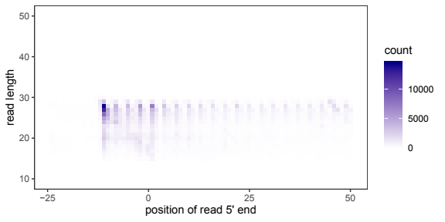
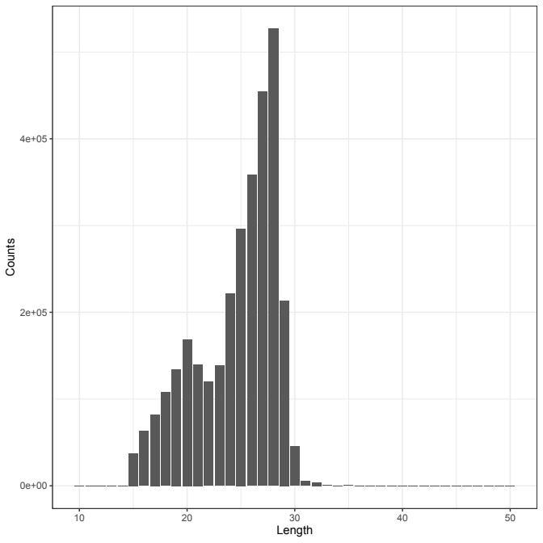
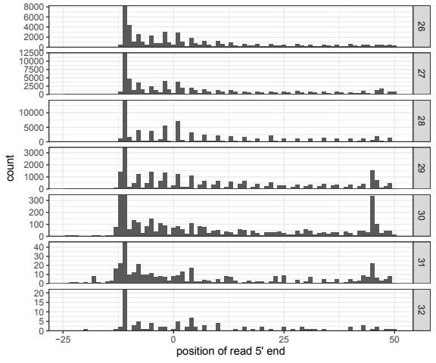
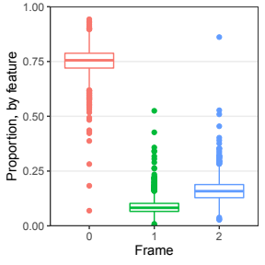
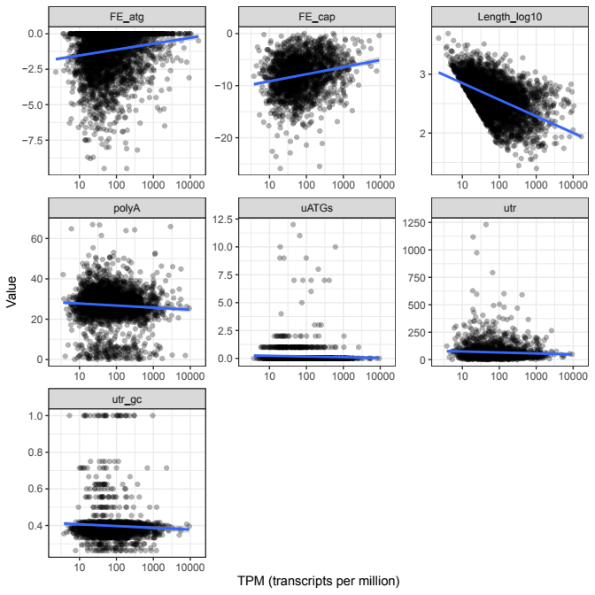
b)
B-Sc_2012: ANAPH_1
c)
d)
a)
f)
g)
e)
h)
a) 3nt_periodicity.pdf; b) startcodon_ribogrid.pdf; c) pos_sp_rpf_norm_reads.pdf;
d) codon_ribodens.pdf; e) read_lengths.pdf; f) 3ntframe_propbygene.pdf; g) startcodon_ribogridbar.pdf;
h) features.pdf
High-resolution View of the Yeast Meiotic Program Revealed by Ribosome Profiling, Brar et al. 2012
Notes:
PDF outputs from 1 sample of Saccharomyces cerevisiae in Anaphase conditions from Brar et al 2012.
This was a dataset selected by Ania (undergrad project in the Wallace lab)
As Wallace lab works a lot on this organism we have ALL the plots possible in this, I can show outputs from Cryptococcus neoformans later which doesn’t have all of these plots as some of the additional organism files are missing (e.g. features file, codon positions, a couple of others)

Slide 13
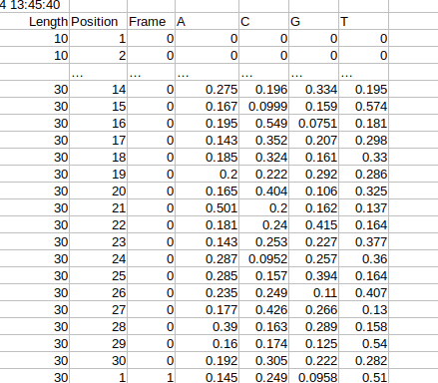
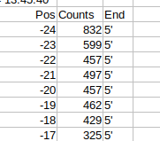


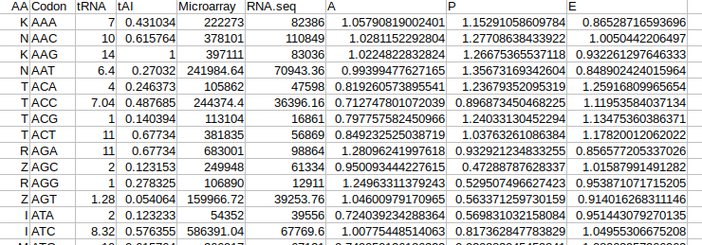
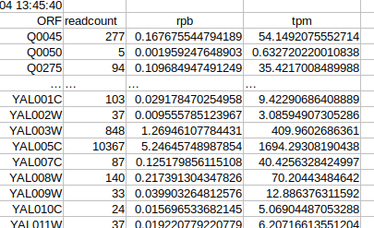
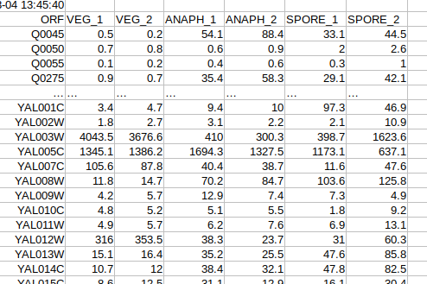
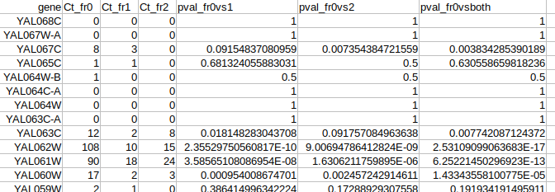
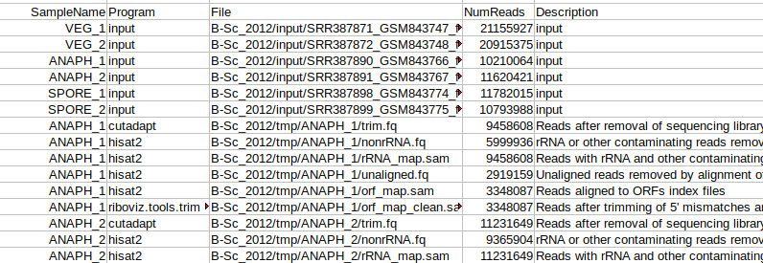
B-Sc_2012: ANAPH_1
c)
d)
a)
b)
e)
g)
h)*
f)
i)*
a) 3nt_periodicity.tsv; b) read_lengths.tsv; c) pos_sp_rpf_norm_reads.tsv;
d) pos_sp_nt_freq.tsv; e) codon_ribodens.tsv; f) 3ntframe_bygene.tsv; g) tpms.tsv;
h) TPMs_collated.tsv*; i) read_counts.tsv* * collates data from all 6 samples run
High-resolution View of the Yeast Meiotic Program Revealed by Ribosome Profiling, Brar et al. 2012
Notes:
.tsv outputs of the analysis code
* : collated data from across all samples run by riboviz.

Slide 14
Analysis
generate_stats_figs.R:
Generates summary statistics, analysis plots & quality control plots
Notes:
Fed in required parameters from the workflow, parses these & uses these to generate summary statistics, analysis plots & quality control plots for a sample
It’s run once per sample as part of the riboviz workflow & creates the same (comparable!) outputs for each.
3nt periodicity
Lengths all mapped reads
Biases in nucleotide composition
Calculate read frame for every orf
RPF position specific distribution of reads
mRNA position specific distribution of reads
TPMs of genes
TPMs correlations with gene features

Slide 15
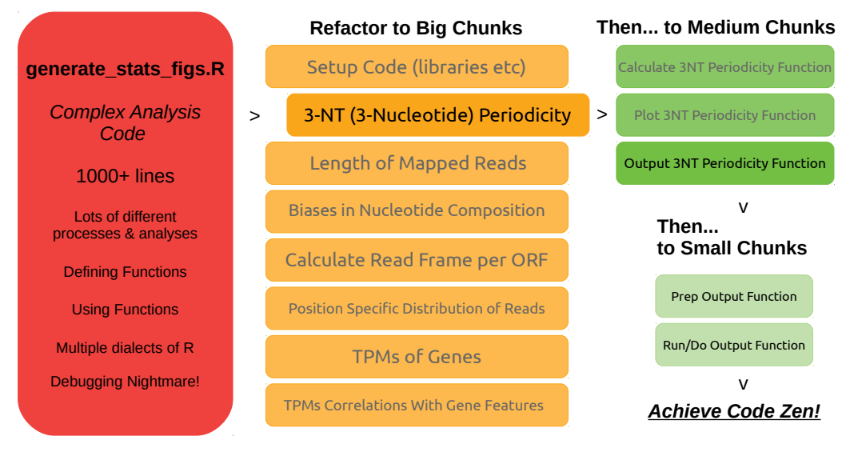
Refactoring Analysis Code
08 Apr 2020
Notes:
Setup Code
LARGE CHUNKS:
3nt periodicity
Lengths all mapped reads
Biases in nucleotide composition
Calculate read frame for every orf
RPF position specific distribution of reads
mRNA position specific distribution of reads
TPMs of genes
TPMs correlations with gene features
MEDIUM CHUNKS:
CalculateFunction - computational code
PlotFunction - plot creation
SaveFunction - PDF writeouts of plots
WriteFunction - .TSV file creation

Slide 16
generate_stats_figs.R
Medium Chunks
Setup Code (libraries, source etc)
stats_figs_block_functions.R
Calculate 3NT Periodicity Function
3-NT (3-Nucleotide) Periodicity
Plot 3NT Periodicity Function
Length of Mapped Reads
Output 3NT Periodicity Function
Biases in Nucleotide Composition
read_count_functions.R
Calculate Read Frame per ORF
Additional Libraries Loaded
Position Specific Distribution of Reads
Prep Output Function
TPMs of Genes
Run/Do Output Function
TPMs Correlations With Gene Features
Small Chunks
Big Chunks
Notes:
Did the chunking, but then ALSO separated these chunks out into separate scripts.
This keeps the main script tidy & readable, and have a good idea which functions should be in which external script if we think about their size & scope.
Source these other scripts in the set-up section of generate_stats_figs.R now.

Slide 17
Anatomy of a Code Chunk...
3NT Periodicity Big Code Chunk:
  Calculate! Get start positions & read counts at each position for each gene from the .h5 file, calculate periodicity from this matrix of positions & counts
  Plots! {ggplot2}
  Save plots as .pdf
  Write information out as .tsv (includes provenance info)

Slide 18
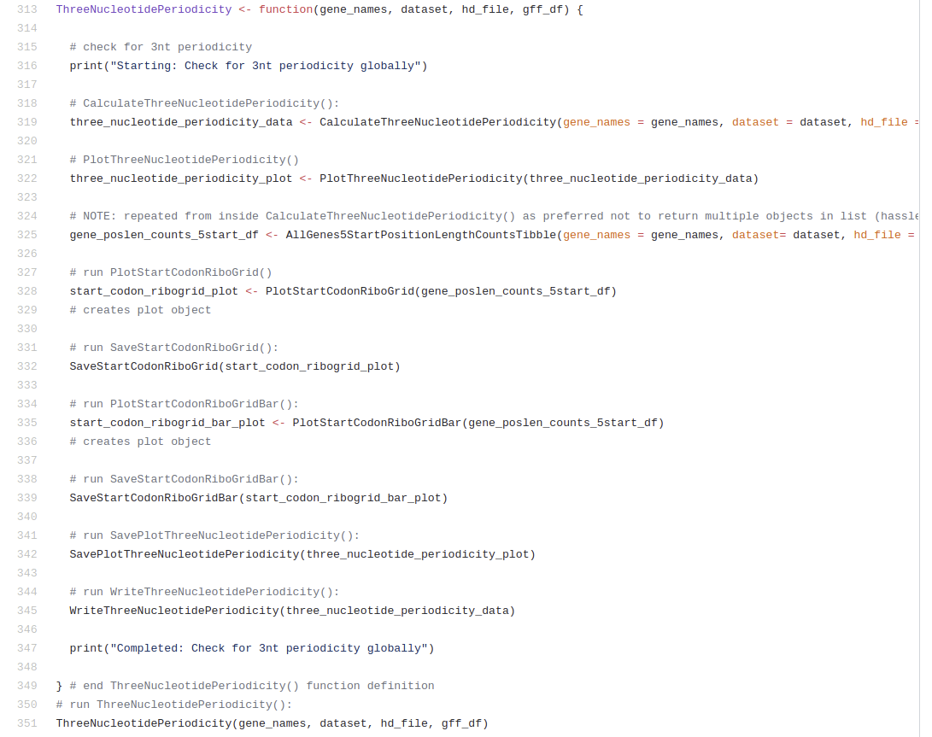
Notes:
3-NT Periodicity Big chunk code.
- Easy to read (maybe not on this screen, sorry)
- Functions & objects different styling (not my focus just now in this talk but lots of interesting / helpful stuff to say about it)
- Print statements help show where we’re at in the logs if something goes wrong
- If things DO go wrong, error messages benefit from middle-size functions with clear naming
- Aiming to go with nice tidyverse stuff: e.g. consistent variable names
- NOTE: the medium level functions are defined before this chunk or it doesn’t work :)

Slide 19
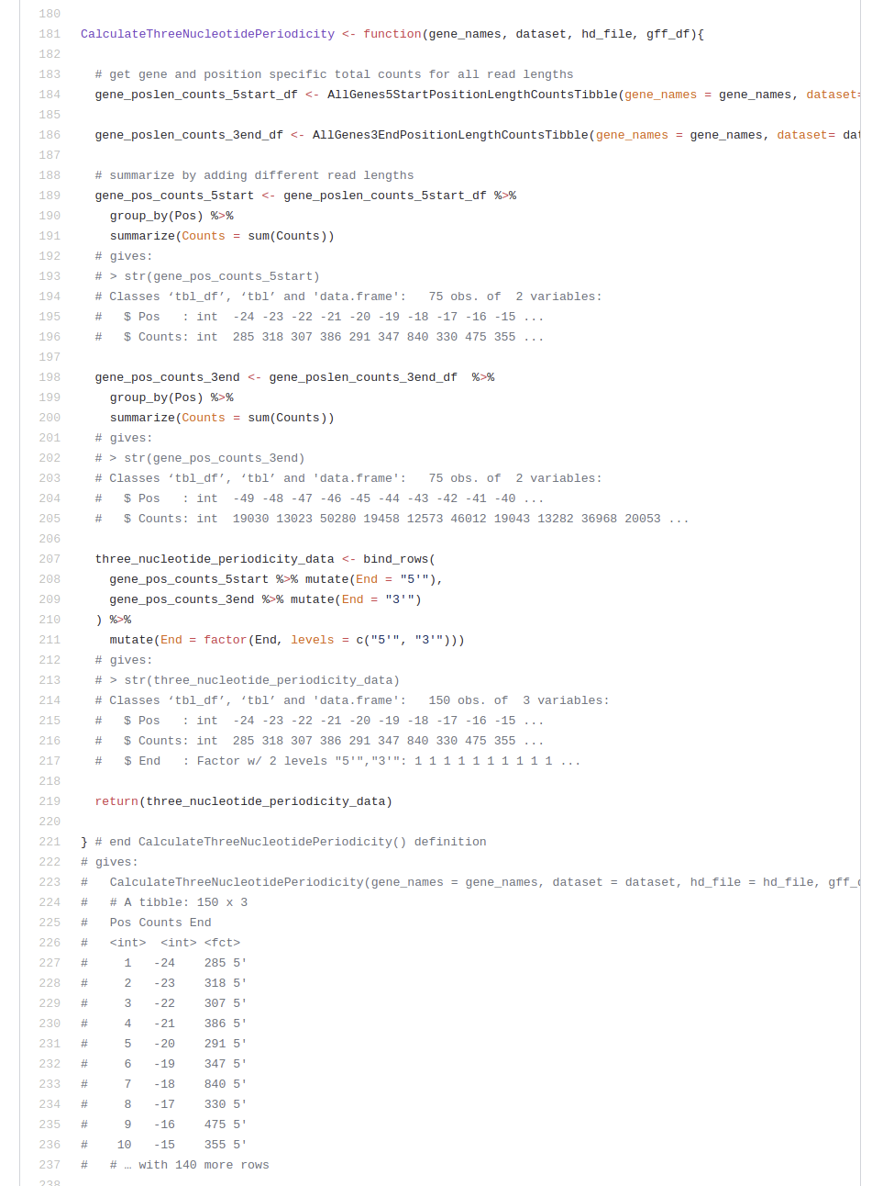
Notes:
CALCULATE (medium) block does all the heavy lifting.
Lots of functions used here which are defined in (small blocks in) read_count_functions.R script & sourced in - this keeps the structure of this script quite easy to read.
- {magrittr} pipes (%>%) where they help make code more understanable vs nested(functions(in(functions)))
- Returning things explicitly using return() to avoid unexpected behaviour! Also helps highlight the important objects.
I found it handy to put example output as comments to give an idea of the objects returned & what they might look like. Quite useful while refactoring, but maybe not necessary longer-term & can be removed with a styling pass.

Slide 20
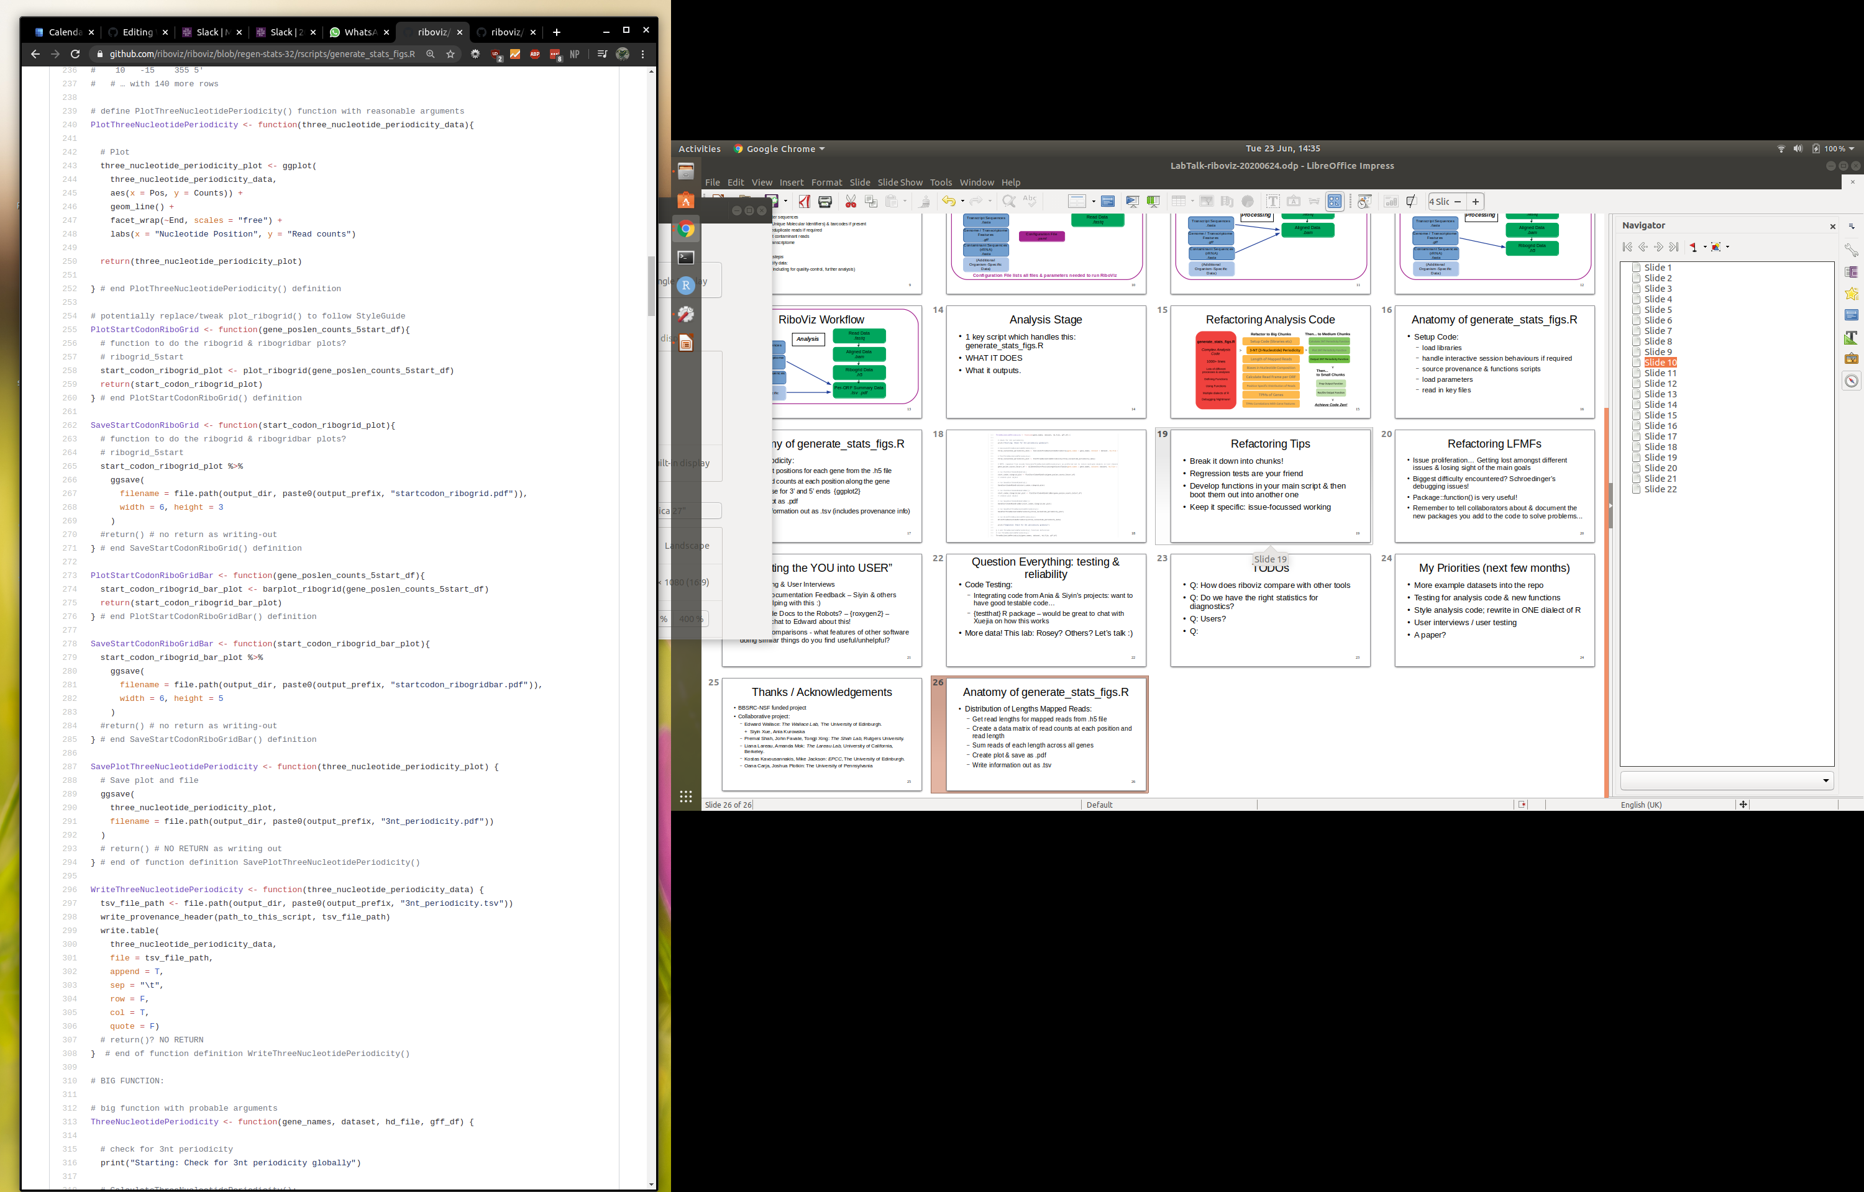
Notes:
PLOT & SAVE blocks
Same kind of thing: medium block where we’ve ot plotting code for each type of plot as a separate function.
‘Design choices’: when multiple blocks look quite similar (e.g. SaveStartCodonRiboGrid + SaveStartCodonRiboGridBar which save out ggplot objects) can be difficult to know when to make 1 function with differing parameters, or keep as 2 separate functions which do almost the same thing…
Decided in this case to keep separate & avoid losing time ‘over-optimising’, also easy to read so possibly not necessary to fix what ain’t broke :)

Slide 21
Notes:
WRITE medium block
Nice legible chunk of code: we’ve got a function with lots of parameters – write.table() - written across multiple lines to avoid going over recommended 80 chars length
Makes it easy to read & quick to identify/change any of those parameters.
Good to do that generally!
- Writing out as .tsv also super helpful because regression tests can’t compare content of .pdfs, just if .pdfs exist, but CAN compare values in .tsv files – if anything changes, it’s easy to know!
Note: #return()? comment handy note to self while I was thinking about what each block should output
Note: I included some “# end of function …” comments at the end after the last ‘}’ as it lets me see the end of that block clearly – something that really helped working on a lot of long code blocks. Stops me getting lost while scrolling, too!
Again, could be easily removed during a re-style.

Slide 22
Refactoring Tips
Break it down into chunks!
Regression tests are your friend, but fails are not always a failure...
Develop functions in your main script & then move into separate functions script
Keep it specific: issue-focussed working
… Decide how you’ll know you’re finished...
Notes:
Think about WWMJD: What Would Mike Jackson Do?
Break it down: Big chunks, Medium chunks, Small chunks, success!
Otherwise you spend hours looking bleakly at a page of impenetrable code & have no idea how to make a dent in it...
Regression Tests: SO useful at telling you something has suddenly stopped working or gives different answers! If the original code wasn’t tested, how do we know which output is *correct* when we’re comparing original output to new output from new code?
Functions in another script, called from the ‘main’ one. Avoids visual clutter, keeps the script easy to read & understand. Work in main first: easier to write them in the same script then move rather than troubleshooting everything + environment issues
Specific issue tickets & issue branches keep you focussed on ONE thing: open branch, do work, merge branch, close issue, move on.
A good issue ticket tells you how you’ll know when it’s done, also… Or it’s easy to keep tinkering forever… Refactoring turns into styling & then into adding more testing & so on...

Slide 23
Refactoring LFMFs
Issue proliferation… Getting lost amongst different issues & losing sight of the main goals
Schroedinger’s debugging issues!
Package::function() is very useful!
… Remember to tell collaborators about & document the new packages you add to the code to solve problems...
Notes:
Issue proliferation: I got lost and delayed as I tried fixing other issues as they came up & the issues THOSE issues created and… MADNESS. Avoid.
Interactive function behaviour: some functions behave differently when run interactively vs in a sourced script… Makes debugging SUPER tricky!
Package::function() You WILL forget which snazzy package that important function came from otherwise
Also you will probably forget add it to the documentation and tell people to install it and There Will Be Errors.

Slide 24
“Putting the YOU into USER”
User Testing & User Interviews
Existing Documentation Feedback – Siyin & others already helping with this :)
Leave the Code Docs to the Robots? – {roxygen2}
Notes:
User Testing & Interviews:
- First impressions
- Ease/difficulties of use
- Analyses you want to see
- What doesn’t work / isn’t helpful?
Getting folks to feedback on & improve existing documentation: learned quite a lot from Ania, & now Siyin, & other new users!
Documentation using {roxygen2}:
- Better code documentation is better for users (if nothing else, it ensures developers really THINK about their code before releasing it into the wild!!)

Slide 25
“Testable, Reliable CompYOUtation”
Code Testing:
  Helping integrate functions from Ania & Siyin’s projects: want to have good testable code…
  {testthat} R package – automated testing
More datasets!

Slide 26
Priorities
Tests for the analysis code
generate_stats_figs.R finishing touches: Documentation / better output format / styling
New datasets run & added to example datasets repository
Q: How does riboviz compare with other tools
Q: Do we have the right statistics & outputs for diagnostics?
Notes:
Would be good to compare riboviz with other tools & get a feeling for how easy they are to use, what outputs they give & whether their results ‘match’ - something I’d like to do ahead of a riboviz paper!
Hard to know without knowing what more users expect from riboviz and what questions they’re trying to answer with it. More idea of this as we get more users onboard (esp. user interviews etc)

Slide 27
Thanks / Acknowledgements
BBSRC-NSF funded project
Collaborative project:
  Edward Wallace: The Wallace Lab, The University of Edinburgh.
  + Siyin Xue, Ania Kurowska
  Premal Shah, John Favate, Tongji Xing: The Shah Lab, Rutgers University.
  Liana Lareau, Amanda Mok: The Lareau Lab, University of California, Berkeley.
  Kostas Kavousannakis, Mike Jackson: EPCC, The University of Edinburgh.
  Oana Carja, Joshua Plotkin: The University of Pennsylvania

Slide 28
b)
B-Sc_2012: ANAPH_1
c)
d)
a)
f)
g)
e)
h)
a) 3nt_periodicity.pdf; b) startcodon_ribogrid.pdf; c) pos_sp_rpf_norm_reads.pdf;
d) codon_ribodens.pdf; e) read_lengths.pdf; f) 3ntframe_propbygene.pdf; g) startcodon_ribogridbar.pdf;
h) features.pdf
High-resolution View of the Yeast Meiotic Program Revealed by Ribosome Profiling, Brar et al. 2012

Slide 29
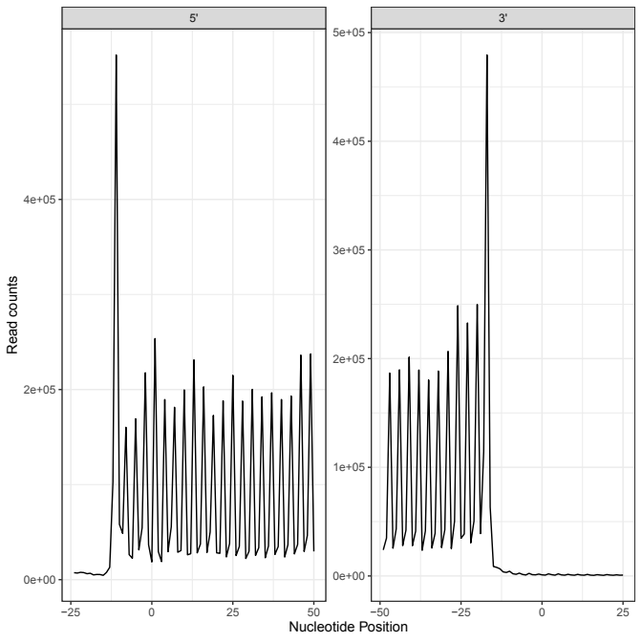
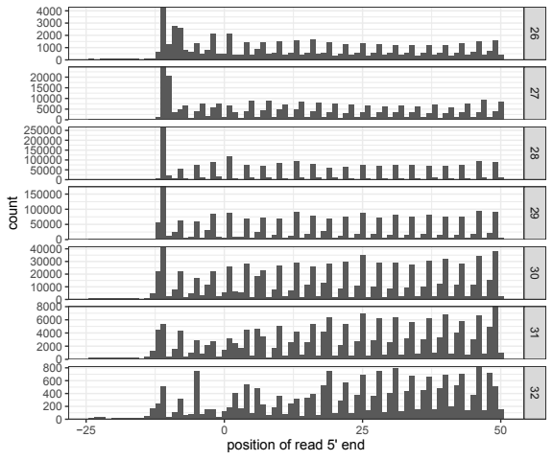

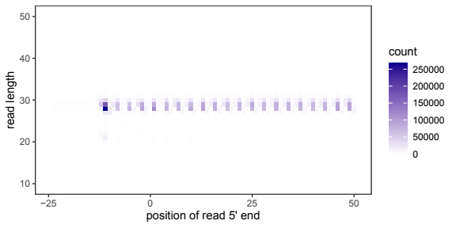
Outputs: Three Nucleotide Periodicity
W-Cn-H99_2020: H99r1
3nt_periodicity.tsv
startcodon_ribogrid.pdf
startcodon_ribogridbar.pdf
3nt_periodicity.pdf
Quantitative global studies reveal differential translational control by start codon context across the fungal kingdom. Wallace et al. 2020

Slide 30
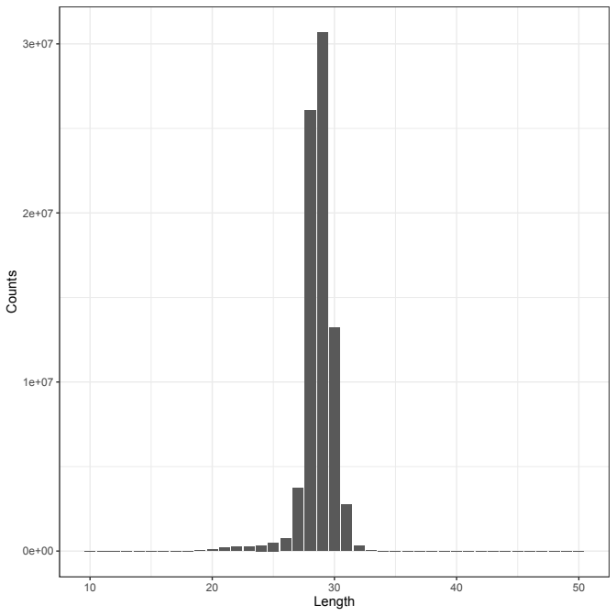

Outputs: Lengths of Mapped Reads
read_lengths.tsv
read_lengths.pdf
W-Cn-H99_2020: H99r1

Slide 31
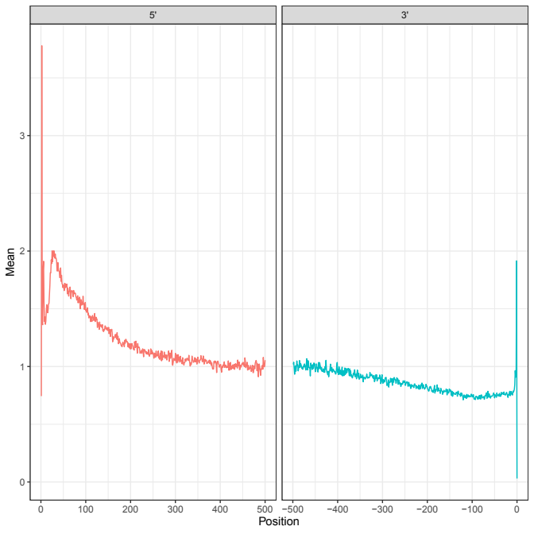

Outputs: Position Specific Distribution of Reads
pos_sp_rpf_norm_reads.tsv
W-Cn-H99_2020: H99r1
pos_sp_rpf_norm_reads.pdf

Slide 32


Outputs: TPMs of Genes
tpms.tsv
TPMs_collated.tsv
W-Cn-H99_2020: H99r1, HdGWO1, H99r2, HdAGO1
W-Cn-H99_2020: H99r1

Slide 33
b)
B-??_????: ANAPH_1
c)
d)
a)
f)
g)
e)
h)
a) 3nt_periodicity.pdf; b) startcodon_ribogrid.pdf; c) pos_sp_rpf_norm_reads.pdf;
d) codon_ribodens.pdf; e) read_lengths.pdf; f) 3ntframe_propbygene.pdf; g) startcodon_ribogridbar.pdf;
h) features.pdf
High-resolution View of the Yeast Meiotic Program Revealed by Ribosome Profiling, Brar et al. 2012

Slide 34
B-??_????: ANAPH_1
c)
d)
a)
b)
e)
g)
h)*
f)
i)*
a) 3nt_periodicity.tsv; b) read_lengths.tsv; c) pos_sp_rpf_norm_reads.tsv;
d) pos_sp_nt_freq.tsv; e) codon_ribodens.tsv; f) 3ntframe_bygene.tsv; g) tpms.tsv;
h) TPMs_collated.tsv*; i) read_counts.tsv* * collates data from all 6 samples run
High-resolution View of the Yeast Meiotic Program Revealed by Ribosome Profiling, Brar et al. 2012

Slide 35
EXTRA SLIDES

Slide 36
B-Sc_2012: ANAPH_1
c)
d)
a)
b)
e)
g)
h)*
f)
i)*
a) 3nt_periodicity.tsv; b) read_lengths.tsv; c) pos_sp_rpf_norm_reads.tsv;
d) pos_sp_nt_freq.tsv; e) codon_ribodens.tsv; f) 3ntframe_bygene.tsv; g) tpms.tsv;
h) TPMs_collated.tsv*; i) read_counts.tsv* * collates data from all 6 samples run
High-resolution View of the Yeast Meiotic Program Revealed by Ribosome Profiling, Brar et al. 2012

Slide 37
Questions?

Slide 38
Footprints to Ribosome Profiling Data
Processing: lots of steps
  Removing adapter sequences
  Remove UMIs (Unique Molecular Identifiers) & barcodes if present
  Demultiplex / Deduplicate reads if required
  Need to filter out contaminant reads
  Align reads to transcriptome
Analysis: more steps
  Analyse & quantify data:
  Create outputs (including for quality-control, further analysis)

Slide 39
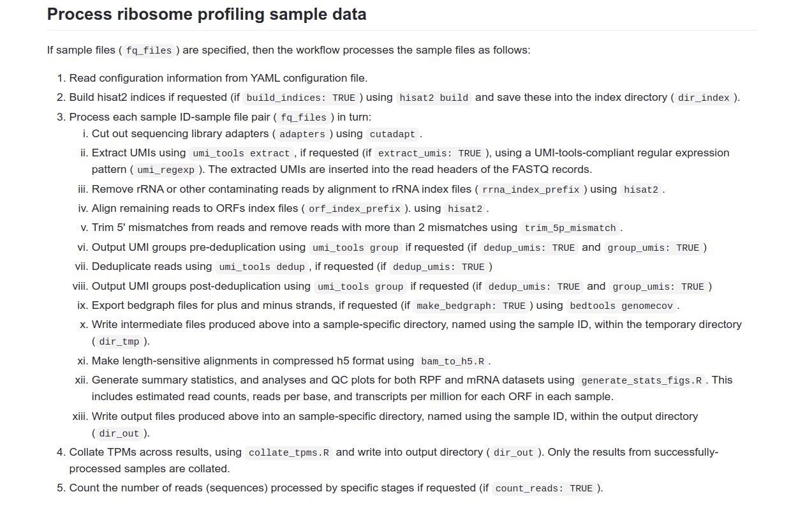
https://github.com/riboviz/riboviz/blob/develop/docs/user/prep-riboviz-operation.md

Slide 40
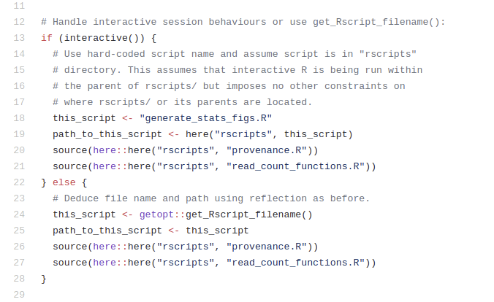
*
Notes:
get_Rscript_filename() useful function which produces the name of the script being run.
It doesn’t act the same way if it’s being run interactively, which

Slide 41
Fails are not ALWAYS a failure!
<3 Regression tests!
Which output is the correct output? How do we know?
How to decide when to make a new issue or keep working on a problem?
Rollback...
Importance of code testing… & understandable code!
Notes:
If the original code wasn’t tested, how do we know which output is *correct* when we’re comparing original output to new output from new code?
Currently we’ve got 1 section of ‘old’ code which we’ve had to roll back to because ‘new’ code produces different outputs & we need to investigate this!
This is now a new issue, instead of holding back the rest of the refactoring work.
Importance of code testing… & understandable code!

Slide 42
Updates! UX
Users:
  Building user base?
  Needs / wants?
  Oven-ready datasets*?
* https://github.com/riboviz/example-datasets
Notes:
Previously spoke about Challenges: UX & Testing Reliability. Now checking in on those.
UX:
Building user base I’m not sufficiently active enough on that, but our collaborators are currently running datasets with version 2.0-beta ahead of v2.0 release!
New users (inc Siyin!) posting questions & issues on github – that’s a good sign of the start of a building community!
What do users need/want? Haven’t survey’d anyone yet…
Onboarding with oven-ready datasets? YES! Example-datasets repo, PR for a Cryptococcus dataset Siyin has run on the Eddie cluster Progress!

Slide 43
Updates! UX
Support & Documentation:
  Existing docs suitable?
  Document outputs better?
  Translation UK workshop?
  2.0.beta → 2.0!
Notes:
UX contd.: Support & Docs:
Had comments from Ania, now Siyin reading & giving feedback, adding to & improving.
New documentation like running on Eddie (UoE-specific, certainly, but really useful to know how to set up on any cluster, potentially help other researchers do the same on theirs?)
Documentation of outputs? Still on my TODO list, but NOW I’ve worked through refactoring, it’s going to be easier to document. Also, #32 led to fixing #155 (.h5 issue) & now fixed the .Rmd issue, so can start to work on getting markdown output & win a 1-page .html option ?
Translation UK sadly postponed until 2021…
Version 2.0-beta? Out now, & working towards v2.0 release! Will include the refactored code!

Slide 44
Updates! Testing
General Testing:
  New feature development ongoing
  Bug fixes
  Code reviews happening
  New datasets
Notes:
New features like Nextflow workflow implementation alongside (sort of original) python implementation!
.h5 file access more reliable & can now be parallelised (e.g. plays better with clusters like Eddie)
Pull requests reviewed before being merged (more than one person checks it works), lots of this happened recently – very exciting to be part of tbh
New datasets through means new potential data weirdness that might break riboviz. Want to know it works over a wide range of different organisms/data sizes/etc & will work for other groups’ data & not just this lab.
e.g. Mouse data? Drosophila? Bacteria? Human? Transcriptome vs Genome files...

Slide 45
Updates! Testing
Methods Testing:
  Regression tests
  Expected outputs: simulated data.
Notes:
As I mentioned, the regression tests have been super useful at showing what’s different between old & new code
But, this has underlined that we didn’t have tests for the code in the first place. Some investigations to be done on some of the analysis code to confirm whether ‘new’ code is more correct or not…?
{testthat} unit testing R package for future? Would be really helpful to implement this for the generate_stats_figs.R code to make sure it DOES do what we expect! (Plus it promises to “make testing as fun as possible”, so who could say no?!)
Close to getting the Lareau Lab simulated ribosome profiling data through riboviz: going to be interesting to see what this shows us about riboviz!

Slide 46
First Things First: Setup
Initial Setup Code:
  load libraries
  handle interactive session behaviours if required*
  source provenance & functions scripts
  load parameters passed in from main riboviz workflow
  read in key files (.gff, .fa, .h5)
Notes:
Didn’t need too much work
Some libraries in main script, most in another sourced script (read_count_functions.R)
SuppressMessages(library(...)) avoids lots of loading messages
Talk a bit about the interactive session behaviours issue shortly
Parameters come from configuration .yaml file & are passed in to generate_stats_figs.R via riboviz pipeline (python script or nextflow workflow)
Parameters handled using option parseing, allows us to have set defaults
Read in: .gff info on sequence annotations, .fa has the coding sequences, .h5 has the sample reads

Slide 47
ThreeNucleotidePeriodicity (gene_names, dataset, hd_file, gff_df):
CalculateThreeNucleotidePeriodicity (gene_names, dataset, hd_file, gff_df)
PlotThreeNucleotidePeriodicity (three_nucleotide_periodicity_data)
SavePlotThreeNucleotidePeriodicity (three_nucleotide_periodicity_plot)
WriteThreeNucleotidePeriodicity (three_nucleotide_periodicity_data)
Notes:
3NT Periodicity Big Code Chunk:
Calculate! Get start positions & read counts at each position for each gene from the .h5 file, calculate periodicity from this matrix of positions & counts
Plots! {ggplot2}
Save plots as .pdf
Write information out as .tsv (includes provenance info)

Slide 48
ThreeNucleotidePeriodicity (gene_names, dataset, hd_file, gff_df):
CalculateThreeNucleotidePeriodicity (gene_names, dataset, hd_file, gff_df)
Get start positions for each gene_name from gff_df
Get read counts for each of these genes at the beginning of each read at every position, from the .h5 file hd_file for this dataset
Calculate periodicity: sum read counts at each position across all genes
Output: three_nucleotide_periodicity_data
Notes:
3NT Periodicity Big Code Chunk:
Calculate! Get start positions & read counts at each position for each gene from the .h5 file, calculate periodicity from this matrix of positions & counts
Plots! {ggplot2}
Save plots as .pdf
Write information out as .tsv (includes provenance info)

