Slide 1
Riboviz Current Outputs

Slide 2
Data abbreviations:
  B-Sc_2012: Saccharomyces cerevisiae yeast RPF samples at a range of meiotic phases from: High-resolution View of the Yeast Meiotic Program Revealed by Ribosome Profiling, Brar et al. 2012
    Files present: ‘all’
  W-Cn-H99_2020: Cryptococcus neoformans strain H99 yeasts from: Quantitative global studies reveal differential translational control by start codon context across the fungal kingdom. Wallace et al. 2020
    Files not present: A-site displacement length, codon positions file, features file, tRNA estimates file
  Yaml config files available at https://github.com/riboviz/example-datasets

Slide 3
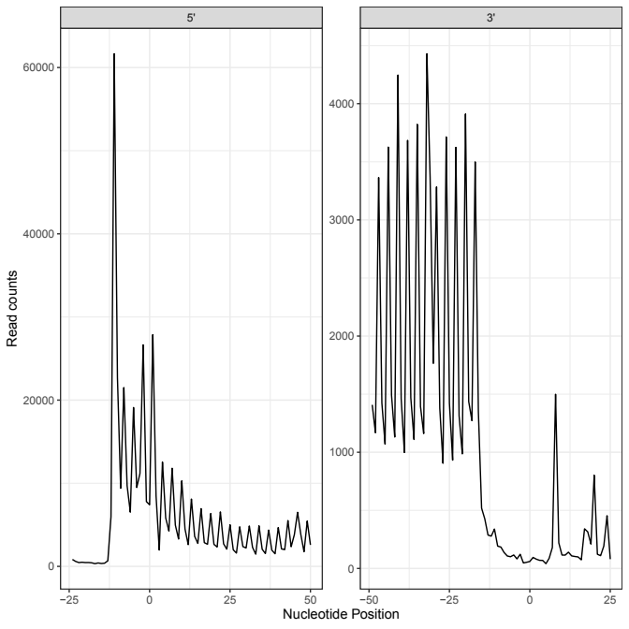
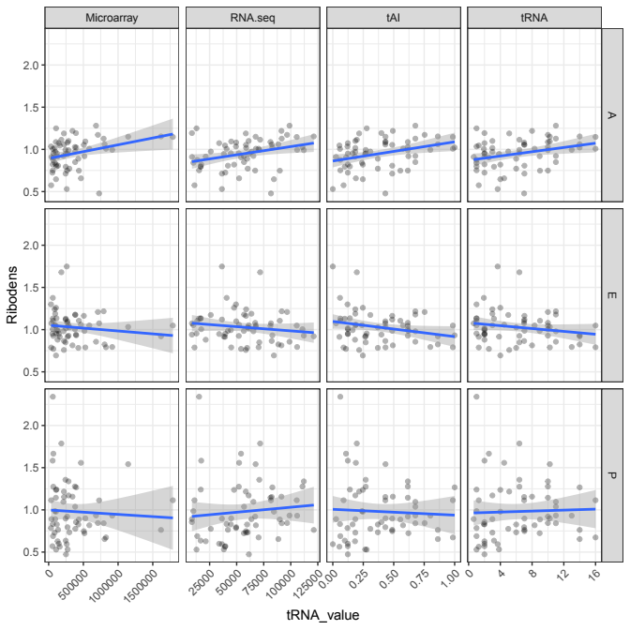
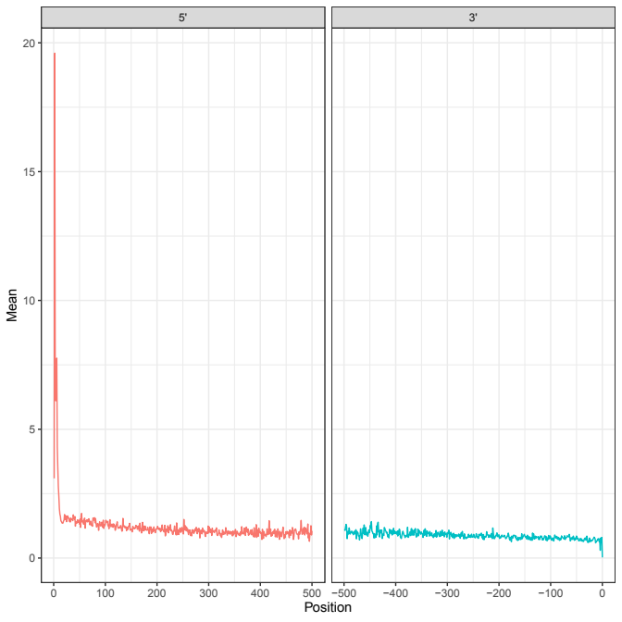
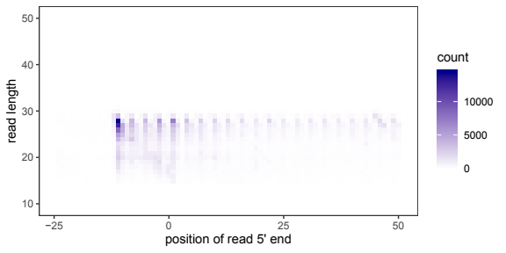
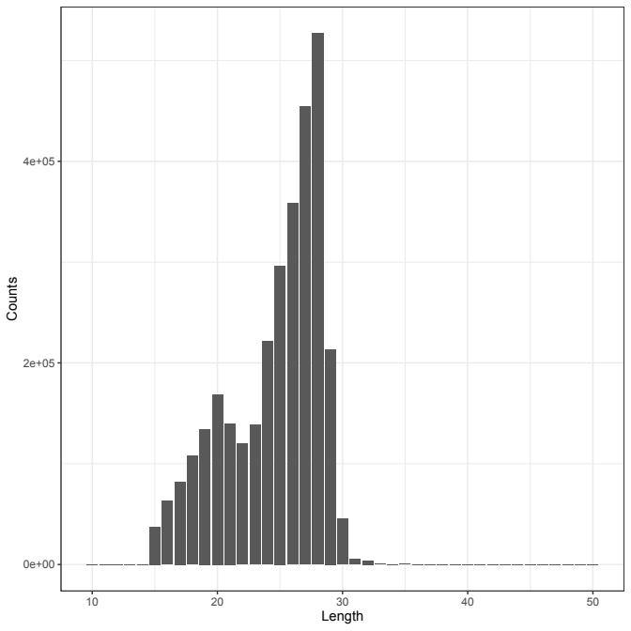
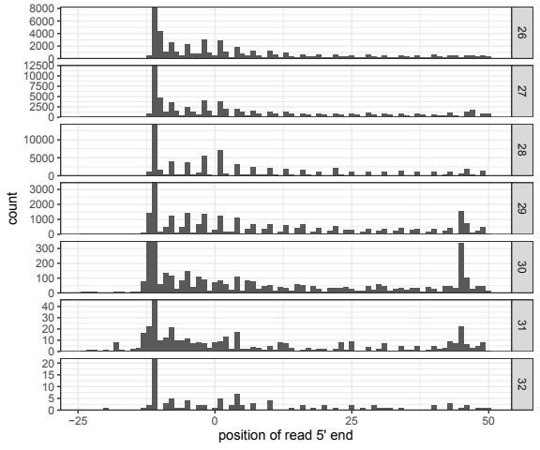
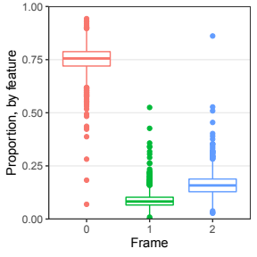
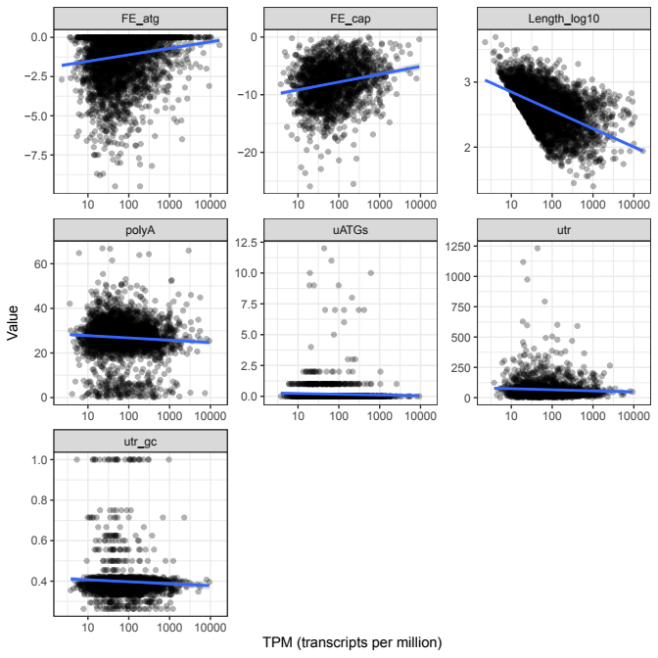
b)
B-Sc_2012: ANAPH_1
c)
d)
a)
f)
g)
e)
h)
a) 3nt_periodicity.pdf; b) startcodon_ribogrid.pdf; c) pos_sp_rpf_norm_reads.pdf;
d) codon_ribodens.pdf; e) read_lengths.pdf; f) 3ntframe_propbygene.pdf; g) startcodon_ribogridbar.pdf;
h) features.pdf
High-resolution View of the Yeast Meiotic Program Revealed by Ribosome Profiling, Brar et al. 2012
Notes:
PDF outputs from 1 sample of Saccharomyces cerevisiae in Anaphase conditions from Brar et al 2012.
This was a dataset selected by Ania (undergrad project in the Wallace lab)
As Wallace lab works a lot on this organism we have ALL the plots possible in this, I can show outputs from Cryptococcus neoformans later which doesn’t have all of these plots as some of the additional organism files are missing (e.g. features file, codon positions, a couple of others)

Slide 4
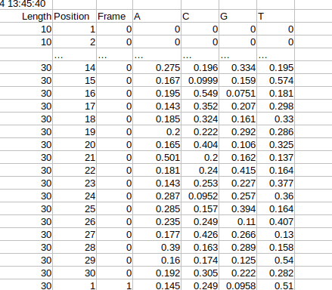
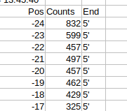


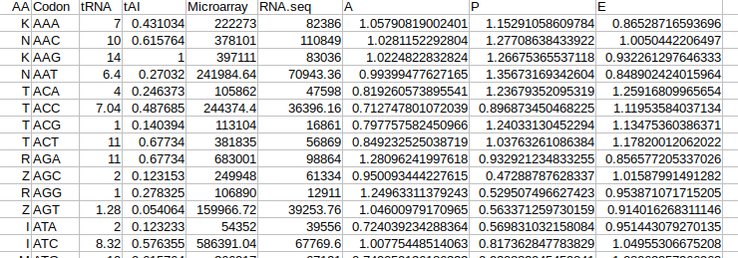
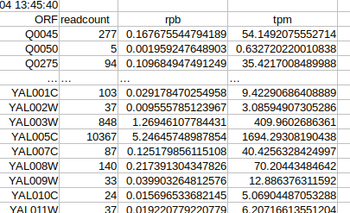
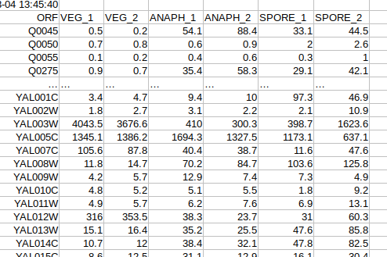
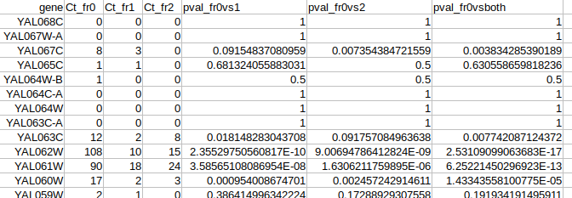
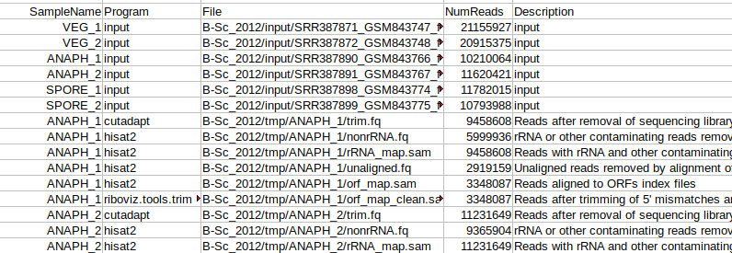
B-Sc_2012: ANAPH_1
c)
d)
a)
b)
e)
g)
h)*
f)
i)*
a) 3nt_periodicity.tsv; b) read_lengths.tsv; c) pos_sp_rpf_norm_reads.tsv;
d) pos_sp_nt_freq.tsv; e) codon_ribodens.tsv; f) 3ntframe_bygene.tsv; g) tpms.tsv;
h) TPMs_collated.tsv*; i) read_counts.tsv* * collates data from all 6 samples run
High-resolution View of the Yeast Meiotic Program Revealed by Ribosome Profiling, Brar et al. 2012
Notes:
.tsv outputs of the analysis code
* : collated data from across all samples run by riboviz.

Slide 5
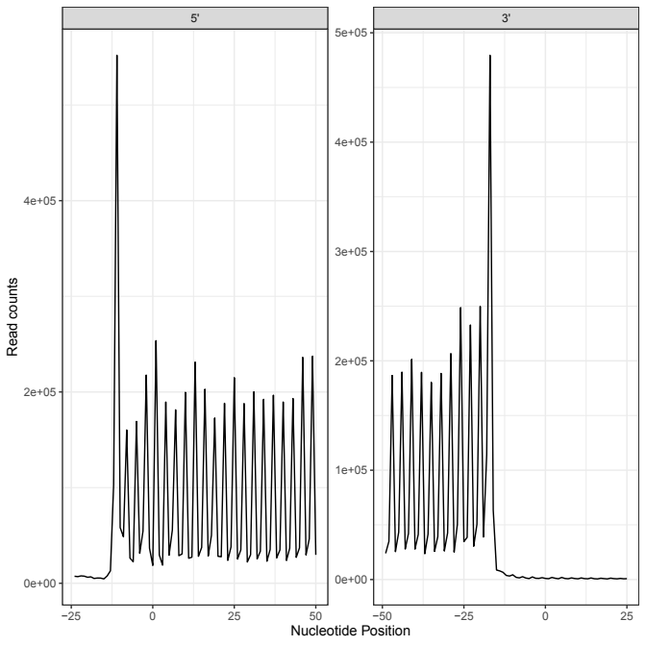
3nt_periodicity.pdf
Nucleotide periodicity of mapped reads showing counts, from 5’ and 3’ ends
W-Cn-H99_2020: H99r1
B-Sc_2012: ANAPH_1
Quantitative global studies reveal differential translational control by start codon context across the fungal kingdom. Wallace et al. 2020
High-resolution View of the Yeast Meiotic Program Revealed by Ribosome Profiling, Brar et al. 2012

Slide 6
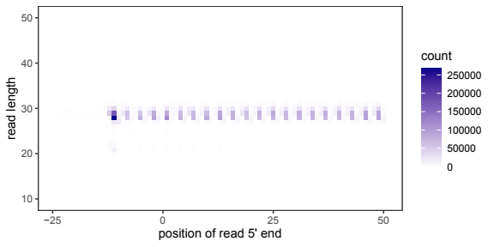
startcodon_ribogrid.pdf
Counts at different read lengths starting at each nucleotide position
W-Cn-H99_2020: H99r1
B-Sc_2012: ANAPH_1
Quantitative global studies reveal differential translational control by start codon context across the fungal kingdom. Wallace et al. 2020
High-resolution View of the Yeast Meiotic Program Revealed by Ribosome Profiling, Brar et al. 2012

Slide 7
codon_ribodens.pdf
tRNA abundances and ribosome densities
B-Sc_2012: ANAPH_1
High-resolution View of the Yeast Meiotic Program Revealed by Ribosome Profiling, Brar et al. 2012

Slide 8
features.pdf
Values of sequence-based features and TPMs
B-Sc_2012: ANAPH_1
High-resolution View of the Yeast Meiotic Program Revealed by Ribosome Profiling, Brar et al. 2012

Slide 9
3ntframe_propbygene.pdf
Proportion of reads in each frame
B-Sc_2012: ANAPH_1
High-resolution View of the Yeast Meiotic Program Revealed by Ribosome Profiling, Brar et al. 2012

Slide 10
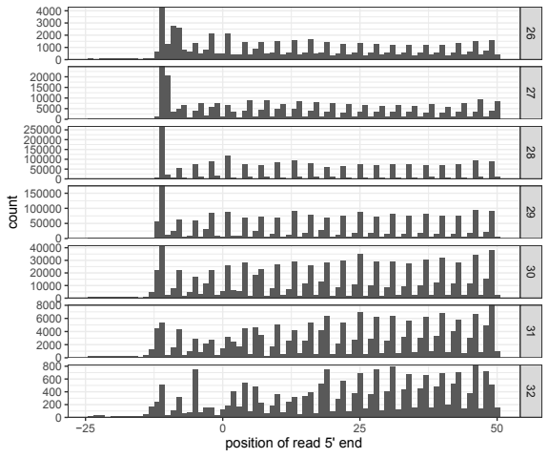
startcodon_ribogridbar.pdf
Read counts starting at each nucleotide position, per read length
W-Cn-H99_2020: H99r1
B-Sc_2012: ANAPH_1
Quantitative global studies reveal differential translational control by start codon context across the fungal kingdom. Wallace et al. 2020
High-resolution View of the Yeast Meiotic Program Revealed by Ribosome Profiling, Brar et al. 2012

Slide 11

3nt_periodicity.tsv
Read counts starting at each nucleotide position, from 5’ and 3’ ends
W-Cn-H99_2020: H99r1
B-Sc_2012: ANAPH_1
Quantitative global studies reveal differential translational control by start codon context across the fungal kingdom. Wallace et al. 2020
High-resolution View of the Yeast Meiotic Program Revealed by Ribosome Profiling, Brar et al. 2012

Slide 12
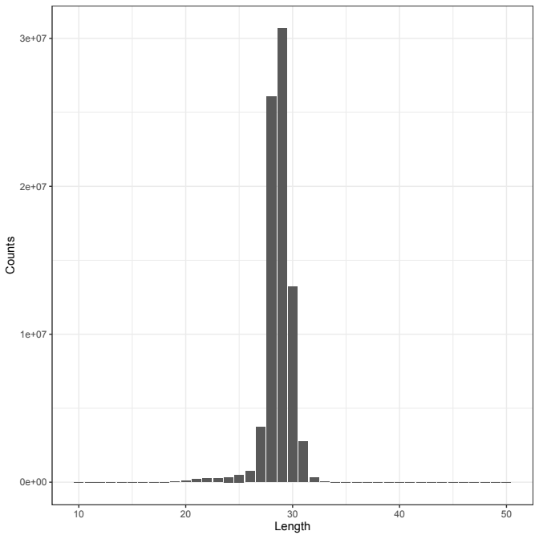
read_lengths.pdf
Distribution of lengths of reads
W-Cn-H99_2020: H99r1
B-Sc_2012: ANAPH_1
Quantitative global studies reveal differential translational control by start codon context across the fungal kingdom. Wallace et al. 2020
High-resolution View of the Yeast Meiotic Program Revealed by Ribosome Profiling, Brar et al. 2012

Slide 13

read_lengths.tsv
Counts by read lengths
W-Cn-H99_2020: H99r1
B-Sc_2012: ANAPH_1
Quantitative global studies reveal differential translational control by start codon context across the fungal kingdom. Wallace et al. 2020
High-resolution View of the Yeast Meiotic Program Revealed by Ribosome Profiling, Brar et al. 2012

Slide 14
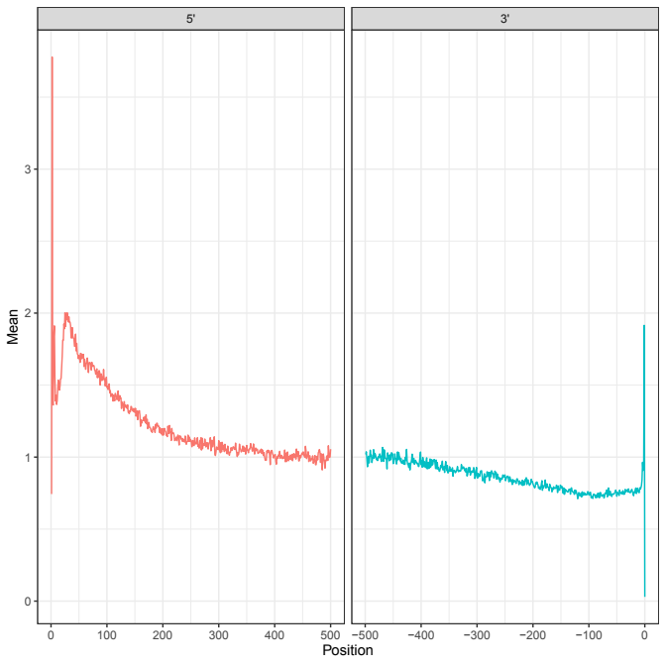
pos_sp_rpf_norm_reads.pdf
Position specific normalised reads
W-Cn-H99_2020: H99r1
B-Sc_2012: ANAPH_1
Quantitative global studies reveal differential translational control by start codon context across the fungal kingdom. Wallace et al. 2020
High-resolution View of the Yeast Meiotic Program Revealed by Ribosome Profiling, Brar et al. 2012

Slide 15

pos_sp_rpf_norm_reads.tsv
Position-specific normalised reads
W-Cn-H99_2020: H99r1
B-Sc_2012: ANAPH_1
Quantitative global studies reveal differential translational control by start codon context across the fungal kingdom. Wallace et al. 2020
High-resolution View of the Yeast Meiotic Program Revealed by Ribosome Profiling, Brar et al. 2012

Slide 16
pos_sp_nt_freq.tsv
B-Sc_2012: ANAPH_1
High-resolution View of the Yeast Meiotic Program Revealed by Ribosome Profiling, Brar et al. 2012

Slide 17
3ntframe_bygene.tsv
Calculated read frame per annotated ORF, sum by frame & Wilcoxon
B-Sc_2012: ANAPH_1
High-resolution View of the Yeast Meiotic Program Revealed by Ribosome Profiling, Brar et al. 2012

Slide 18
codon_ribodens.tsv
Values for features
B-Sc_2012: ANAPH_1
High-resolution View of the Yeast Meiotic Program Revealed by Ribosome Profiling, Brar et al. 2012

Slide 19

tpms.tsv
TPMs per gene
W-Cn-H99_2020: H99r1
B-Sc_2012: ANAPH_1
Quantitative global studies reveal differential translational control by start codon context across the fungal kingdom. Wallace et al. 2020
High-resolution View of the Yeast Meiotic Program Revealed by Ribosome Profiling, Brar et al. 2012

Slide 20

TPMs_collated.tsv
Collated TPMs by genes for all samples run
W-Cn-H99_2020: H99r1, HdGWO1, H99r2, HdAGO1
B-Sc_2012: VEG_1, VEG_2, ANAPH_1, ANAPH_2, SPORE_1, SPORE_2
Quantitative global studies reveal differential translational control by start codon context across the fungal kingdom. Wallace et al. 2020
High-resolution View of the Yeast Meiotic Program Revealed by Ribosome Profiling, Brar et al. 2012

Slide 21
read_counts.tsv
Number of reads at each stage of riboviz workflow, for each sample
(Available for both datasets, but only one shown for clarity)
B-Sc_2012: VEG_1, VEG_2, ANAPH_1, ANAPH_2, SPORE_1, SPORE_2
High-resolution View of the Yeast Meiotic Program Revealed by Ribosome Profiling, Brar et al. 2012

Slide 22
What other diagnostics do we need?

