Slide 1
FLIGHTSYSTEM
Bertil
Khalid
Prathusha

Slide 2
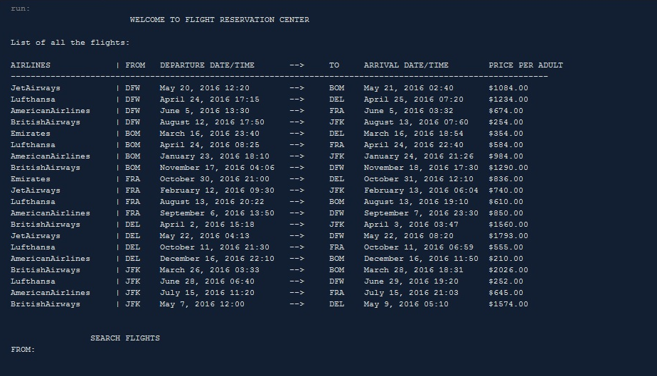
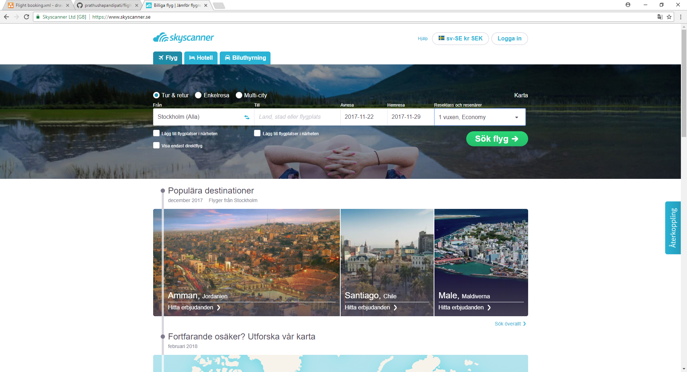
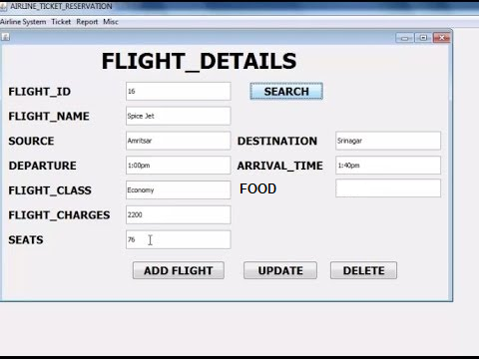
Visual Interfaces

Slide 3
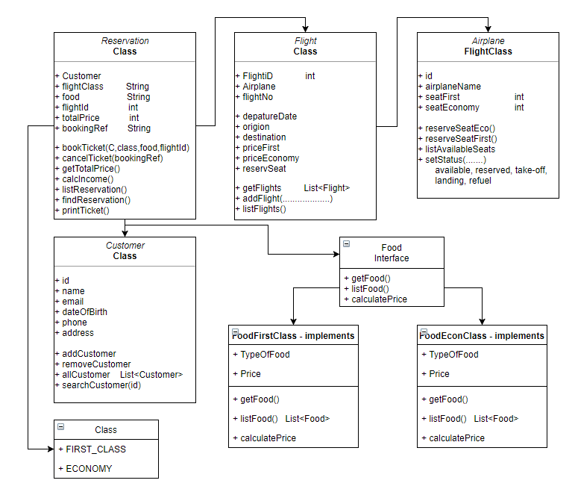
Reservation system implementation
Threads of Airplane (Status)
Refuel
Available
Reserved
Take-off
Landed

Slide 4
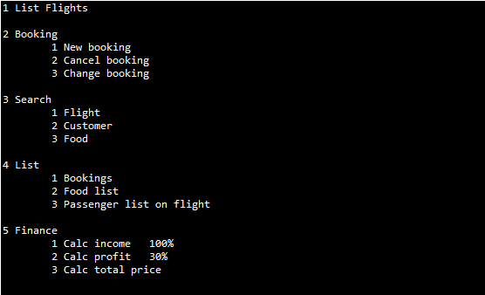
User interface

