Slide 1

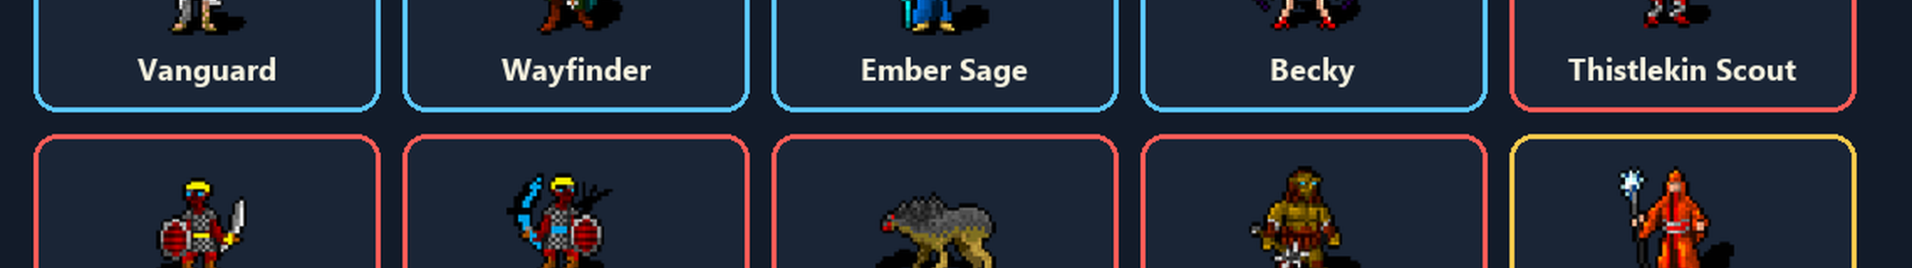
The Pharhad Road
Color manual and player reference
A road-by-road tactics game about keeping the heroes alive, waking the right fights, and using Pharhad's shrine and camp before the next clash.

Slide 2
Quick Start
The short path from menu to road victory
1. Pick a mode
2. Take turns
Every mode now goes to a second screen. Choose the road, read the mode text, then press Start Game.
On your turn, select a skill, pick a legal target, move, or end turn. The game log shows the player hint when you control that turn.
3. Clear encounters
4. Finish the roads
After each encounter, recover before walking into the next group. Dead heroes need Pharhad Idol first; wounded heroes want Safe Camp.
Road 1 leads to Road 2, then Road 3, then Road 4 when the heroes survive. If Game Over appears and a save exists, choose Restart From Save to resume the last autosave.
Autosave loop: finish an encounter -> recover -> autosave -> restart from that save after Game Over if needed.

Slide 3
Menu And Modes
All modes use a road/setup screen before Start Game
Play Heroes
Play Monsters
Normal party control. Pick Road 1-4, then lead Vanguard, Wayfinder, Ember Sage, and Becky.
Like Play Heroes, except you control the active monster turns. No monster-picking step. Flesh Beasts stay AI-only.
Play Pharhad / Send Cleric Z
Hero Chess
Play Pharhad gives divine intervention turns. The gold Send Cleric Z button opens its own setup screen for a solo run with Love and Truth.
A tactical duel against rival heroes. Fog is off, player units glow blue, enemy units glow red, and rivals carry one Salve Vial.
Menu buttons: Music, Fog, 11s, Tutorial, Email Me, Rename. 11s has no color when off, turns red when on, and is disabled in Tutorial.

Slide 4
Controls And UI
Where to look during play
Turn Queue
Game Log
Stats Popup
Top row shows who acts next. The active icon has the large glowing box. Hero Chess uses blue player markers and red enemy markers; Cleric Z allies glow green.
Skill selections write full explanations here, including cost, range, dice, saves, and special effects.
Click or tap icons to inspect units, items, and map features. The popup opens at the top-left with a darker background.
Target Highlights
Fog
Menu Pause
During player-controlled turns, legal enemy targets are highlighted orange. Converted Cleric Z allies stay visually separate from monsters with green glow markers.
Fog can be toggled from the menu. Play Monsters and Hero Chess run with fog off; Truth still respects line of sight and cannot pass through walls.
Opening the game menu pauses game activity and blocks status icon clicks while music keeps playing.

Slide 5
11s Mode
Fast turns with sound cues and a visible clock
11s
Actions finish
Tutorial lockout
The timer advances the turn after the time limit, but it still lets actions already started finish cleanly.
Tutorial disables 11s mode so new players can read, inspect, and learn without pressure.
When enabled, the player has 11 seconds to choose a turn. The last 3 seconds play the button sound, and the timer hitting 0 plays the turn-advance cue.
Clock location
Menu colors
The clock-like timer sits under the player turn queue icon so it is visible without covering the board.
11s turns red when active. When it is off, the button has no special color so it reads like a normal inactive menu option.
Use 11s after you already know the icons. It turns the game into a quick-read tactics drill.

Slide 6
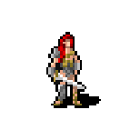
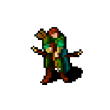
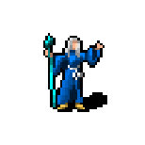

Hero Party
The four playable heroes
Vanguard
Wayfinder
Ember Sage
Becky
HP 14 | Move 6 | Guard 17
Attack +5 | Damage +7 | Init +2
STR 16 DEX 14 CON 15 WIS 10
HP 14 | Move 7 | Guard 14
Attack +4 | Damage +2 | Init +2
STR 12 DEX 15 CON 14 WIS 16
HP 9 | Move 6 | Guard 14
Attack +4 | Damage +1 | Init +0
STR 10 DEX 12 CON 16 WIS 14
HP 14 | Move 9 | Guard 14
Attack +4 | Damage +2 | Init +6
STR 12 DEX 20 CON 14 WIS 16
Rename keeps the roles clear: Vanguard, Wayfinder, Ember Sage, and Becky remain the four hero slots.

Slide 7






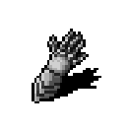





Hero Skill Playbook
What the party is built to do
Vanguard
Wayfinder
Steel Brand: Cost: Action. Range: 1-1 ft. Roll: 1d8 Slashing.
Grit Mend: Bonus: Heal 1d10 +2 Cost: Bonus Action.
Tempo Break: Free Action: Take one additional Attack action this turn. 1 per Food. Cost: Free.
Spear: Cost: Action. Range: 0-4 ft. Roll: 1d6 Piercing.
Trail Bow: Slow: -10 ft movement Cost: Action. Range: 2-30 ft. Roll: 1d8 Slashing.
Quarry Brand: Bonus Action: Mark one enemy in range. Deal +1d6 Force on every hit against the...
Food: The party eats food between encounters. Vanguard regains 1 Grit Mend, Tempo Bre...
Auto Move: Cost: Free.
Ember Sage
Becky
Ember Shot: Cost: Action. Range: 2-24 ft. Roll: 1d10 Slashing.
Homing Sparks: Cost: Action. Range: 1-24 ft. Roll: 3d4+3 Psychic.
Inner Flare: Cost: Bonus Action.
Field Mend: Touch to Heal 2d8 + Wis [1 focus] Cost: Action. Range: 1-1 ft.
Two Kicks: ADV next attack Cost: Action. Range: 1-2 ft. Roll: 1d6+4 Bludgeoning. Save: Dex...
Spear: Cost: Action. Range: 0-4 ft. Roll: 1d6 Piercing.
Tempo Break: Free Action: Take one additional Attack action this turn. 1 per Food. Cost: Free.
Field Mend: Touch to Heal 2d8 + Wis [1 focus] Cost: Action. Range: 1-1 ft.

Slide 8
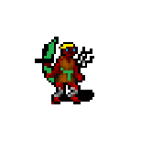
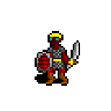
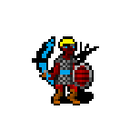
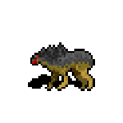
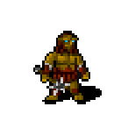
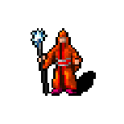
Enemies And Rivals
What fights back
Thistlekin Scout
Thistlekin Captain
Thistlekin General
Basic road fighter. Numbers matter more than one big hit.
HP 7 | Move 6 | Guard 15
Captain pressure piece. Watch clustering and focus fire.
HP 21 | Move 6 | Guard 17
Now the Thistlekin General. Stronger road leader.
HP 21 | Move 6 | Guard 17
Flesh Beast
Cave Brute
Pharhad
Renamed Flesh Beast. AI-only in Play Monsters.
HP 11 | Move 8 | Guard 13
Heavy hitter with high HP and guard.
HP 27 | Move 6 | Guard 16
Powerful protector in Play Pharhad mode.
HP 110 | Move 30 | Guard 30
Hero Chess marks players blue and enemies red on the map and turn queue. Cleric Z converts enemies into allies with glowing green markers.

Slide 9





Items And Map Features
Pickups and recovery points
Spear
Food
Safe Camp
Cost: Action. Range: 0-4 ft. Roll: 1d6 Piercing.
The party eats food between encounters. Vanguard regains 1 Grit Mend, Tempo Break refreshes, Ember Sage and Wayfinder regain 1 focus charge. Cost: Free.
The party makes a safe camp. All resources fully restored and HP fully healed. Cost: Free.
Pharhad Idol
Salve Vial
Stand next to the idol between encounters to bring every dead hero back to life. Cost: Free.
2d4+2 Salve Vial Cost: Action.
Post-encounter hint: revive dead heroes at Pharhad Idol first, then use Safe Camp to restore skills and health.

Slide 10

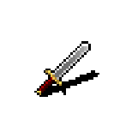




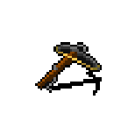

Skill Encyclopedia 1
Attack and pressure skills
Steel Brand
Quick Blade
Cost: Action. Range: 1-1 ft. Roll: 1d8 Slashing.
Vex: ADV next attack. Cost: Action. Range: 1-1 ft. Roll: 1d6 Slashing.
Cleaver Strike
Curved Blade
Graze: damage on miss Cost: Action. Range: 1-1 ft. Roll: 2d6 Slashing.
Cost: Action. Range: 1-1 ft. Roll: 1d6 Slashing.
Iron Maul
Trail Bow
Cost: Action. Roll: 2d8 Piercing.
Slow: -10 ft movement Cost: Action. Range: 2-30 ft. Roll: 1d8 Slashing.
Skirmish Bow
Bolt Launcher
Cost: Action. Range: 2-16 ft. Roll: 1d6 Slashing.
Push: 10 ft Cost: Action. Range: 2-20 ft. Roll: 1d10 Slashing.
Spear
Two Kicks
Cost: Action. Range: 0-4 ft. Roll: 1d6 Piercing.
ADV next attack Cost: Action. Range: 1-2 ft. Roll: 1d6+4 Bludgeoning. Save: Dexterity DC 19; fail: prone.

Slide 11


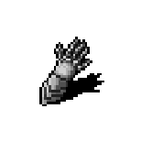



Skill Encyclopedia 2
Support, movement, and recovery
Dash
Disengage
Extra movement Cost: Action.
Do not provoke opportunity attacks Cost: Action.
Auto Move
Help
Cost: Free.
Touch to stabilize Cost: Action. Range: 1-1 ft.
Grit Mend
Field Mend
Bonus: Heal 1d10 +2 Cost: Bonus Action.
Touch to Heal 2d8 + Wis [1 focus] Cost: Action. Range: 1-1 ft.
Salve Vial
Food
2d4+2 Salve Vial Cost: Action.
The party eats food between encounters. Vanguard regains 1 Grit Mend, Tempo Break refreshes, Ember Sage and Wayfinder regain 1 focus charge. Cost: Free.
Safe Camp
The party makes a safe camp. All resources fully restored and HP fully healed. Cost: Free.

Slide 12








Skill Encyclopedia 3
Magic, Pharhad, Cleric Z, and special effects
Ember Shot
Homing Sparks
Cost: Action. Range: 2-24 ft. Roll: 1d10 Slashing.
Cost: Action. Range: 1-24 ft. Roll: 3d4+3 Psychic.
Inner Flare
Quarry Brand
Cost: Bonus Action.
Bonus Action: Mark one enemy in range. Deal +1d6 Force on every hit against them. Concentration, up to 1 hour. 2 free casts per Safe Camp. Cost: Bonus Action. Range: 2-90 ft.
Love
Truth
Melee touch. On contact, the target becomes your ally.
Range 4 tiles, line of sight. Visible enemies in radius make Wisdom DC 19 saves; failures become allies.
Divine Restore
Pharhad Idol
Cost: Free. Range: 0-120 ft. Target: Sphere area, radius 30 ft.
Stand next to the idol between encounters to bring every dead hero back to life. Cost: Free.
Tempo Break
Flesh Beast Bite
Free Action: Take one additional Attack action this turn. 1 per Food. Cost: Free.
Cost: Action. Range: 1-1 ft. Roll: 2d6 Slashing. Save: Strength DC 11; fail: prone.

Slide 13
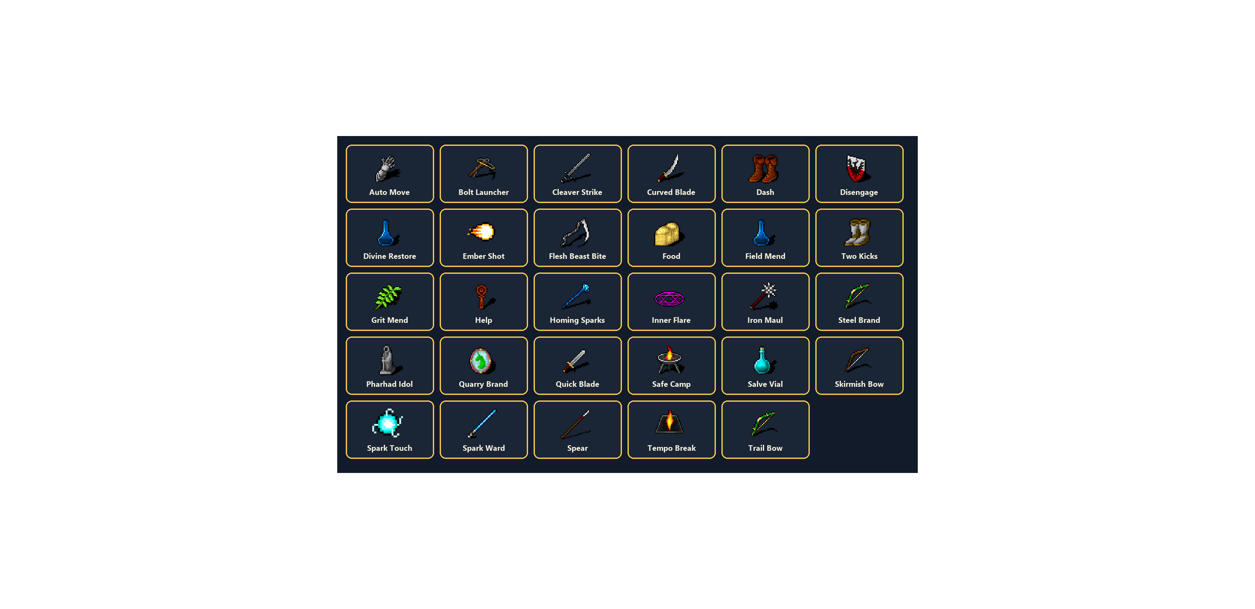
Image Atlas 2
Skill icons

Slide 14
Road Wisdom
A practical play guide
Protect action economy
Do not drift apart
Use Bonus Actions before attacks: Grit Mend, Inner Flare, Quarry Brand, then hit.
The party survives better when healers can reach unconscious allies.
Respect opportunity attacks
Recover between fights
If an enemy is adjacent, Disengage before walking away.
Safe Camp is not just flavor; it restores the resources that win the next encounter.
Use the idol first
Restart from save
If anyone is dead, Pharhad Idol before Safe Camp.
After Game Over, choose Restart From Save to load the last autosave when one exists.

