Slide 1
Healthcare Database Management System
Brandon Sandoval
Nicholas Bridges
Christopher Witt

Slide 2
Main Idea
The main goal is to create a database system that may be utilized via website by hospitals, insurance companies, and patients to store and access data.
This system will focus on the general information that a health facility is expected to incorporate:
Patients
Insurance
Billing
Procedure data

Slide 3



Existing Systems in the Industry
MEDITECH
Offers integrated EHR (Electronic Health Record) and healthcare data management solutions for both healthcare organizations and hospitals. MEDITECH Expanse provides efficient and safe support for a wide range of applications.
Epic Systems
- Epic is one of the largest EHR providers in the world. Their system, EpicCare, is widely used and specializes in seamless interoperability between different health facilities.
Cerner
Cerner's flagship platform is called Cerner Millennium. It is mainly utilized to manage patient records, workflows, medication, and revenue. It focuses on operation efficiency and improving clinical outcomes.

Slide 4
Design

Slide 5
Accessibility
The database will be accessible to users via website.
Depending on the user, different data will be available to view and edit.
Authority will be determined by which login portal is used, and each user type will have a specific type of login credentials.

Slide 6
How will it work?
Patient Portal:
Account information
Billing and Medical History
HTML and CSS:
All pages of the website will feature a similar design but different key aspects
Main Web Page:
Login
Data Base (SQL):
Information is accessible to each specific user using JavaScript
Administration Portal:
Overall tasks records
Employee Information

Slide 7
Typical End Users
Patient:
Full view patient data, May only edit with permission Select view but not edit procedure, billing, and insurance information
Administrator:
- Full edit and view all data
Hospital
Partial view patient, billing, insurance info.
May edit procedure and some billing data.
Insurance Company
Partial view patient and billing info.
May edit insurance info.
Possible types of Staff

Slide 8
Staff vs Patient
Staff
Closest to “Admin” role
View all patient data
Add new bills/payments
Add new patients
Patient
General users
View their own data
Create new account
Change account information

Slide 9
Technology Stack

Slide 10

MySQL Workbench
A majority of the backend database work will be completed in MySQL Workbench.
MySQL Workbench is an accessible editor that provides a comprehensive set of tools that will be necessary for work.
All queries and schemas will be created here.

Slide 11


Technology
HTML
HTML (HyperText Markup Language) is the standard markup language used to create web pages.
This will offer a good structure to put the content of the website. It's very accessible and easy to understand language that offers a vast amount of creativity.
CSS
CSS (Cascading Style Sheets) is a style sheet language used to describe the presentation of a document written in HTML.
It defines how the on-screen elements are seen.
It generally revolves around writing rules to format the HTML code.

Slide 12


Technology cont.
MySQL
MySQL is a popular relational database management system (RDBMS) that is widely used for storing and managing structured data.
MySQL coding refers to writing queries and commands to access the data.
JavaScript
JavaScript is a versatile programming language primarily used for web development.
It enables developers to add interactivity and dynamic functionality to websites.
The database will be accessed with the website through the usage of JavaScript.

Slide 13


Technology cont.
PHP
PHP is a widely-used open-source general-purpose scripting language that is especially suited for web development
It allows us to easily integrate SQL with HTML.
This makes using the website to alter the database easier.
XAMPP
XAMPP, which stands for Cross-Platform, Apache, MySQL, PHP, and Perl, is a free platform that allows developers to test their code locally on their own computers.
Using this software makes the testing and debugging process simpler.

Slide 14
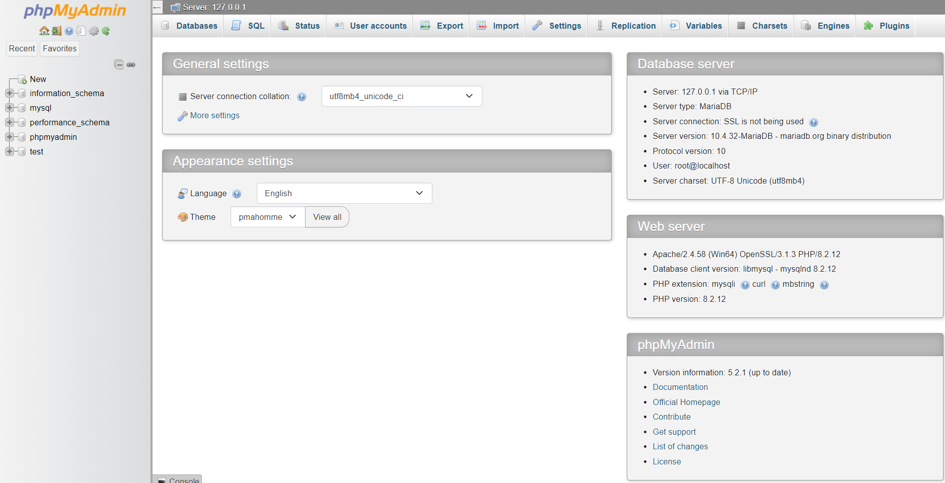
PHPMYADMIN
- XAMPP gives us access to a control panel where we can manage our database server and view information about it.

Slide 15
PHP and SQL
PHP is easily integrated with HTML and makes querying the database using website data streamlined.
It can be used to read and validate the data from the website before querying.

Slide 16
Front End

Slide 17
Overall Website Design
Due to the database containing private information, several user portals are used to restrict the data they can view.
Login type is different per user.
Patient Page
Staff Page

Slide 18
Webpage Flowchart
View Information
Patient Login
Staff Access Page
Update Personal Information
Main Login
Page
Add New Patient
Staff Login
Staff Access Page
Create Bills

Slide 19
Database & Back End

Slide 20
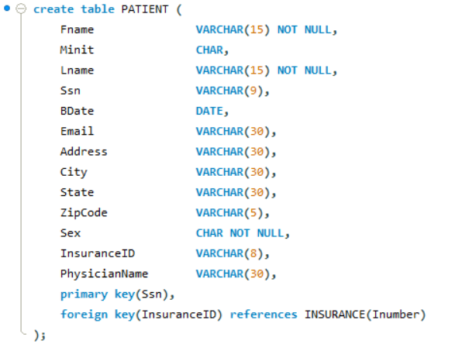
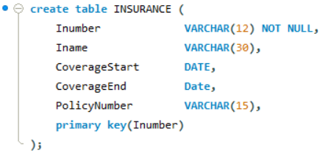
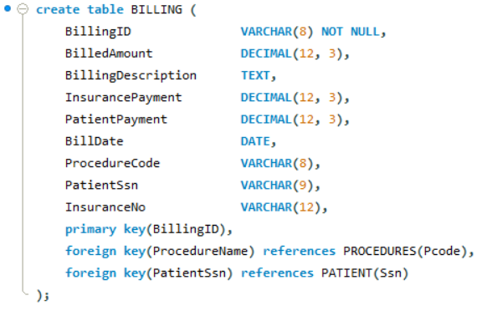
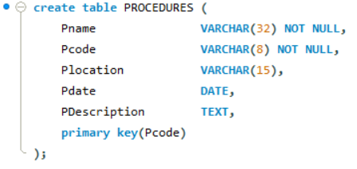
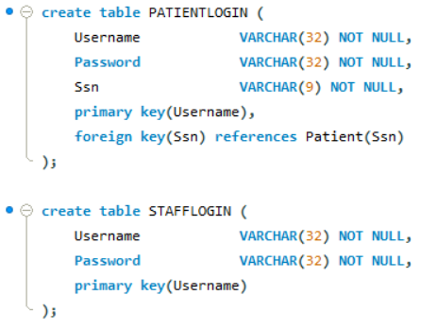
Basic Schema

Slide 21
Patient Table
Contains information about individual patients.
Attributes include personal information such as social security number, address, and contact information.
Its primary key is social security number.
Its foreign key is an insurance ID number, which is used to access the insurance table.

Slide 22
Billing Table
Contains information about transactions.
Attributes include information on procedure costs, past operations, and anything related to payment.
Its primary key a billing ID number.
Its first foreign key is SSN to access the patient table.
Its second foreign key is a procedure code which accesses the procedure table.

Slide 23
Insurance Table
Contains insurance information
Attributes include insurance company name, policy number, and dates.
Its primary key is insurance number.
It has no foreign key.

Slide 24
Procedure Table
Contains information about past procedures.
Attributes include dates, operation type via code, and a description of the operation.
Its primary key is the procedure code.
It has no foreign key.

Slide 25
Staff and Patient Login Tables
Hold login information for each type of user.
Used to validate credentials and serve users based on type.

Slide 26
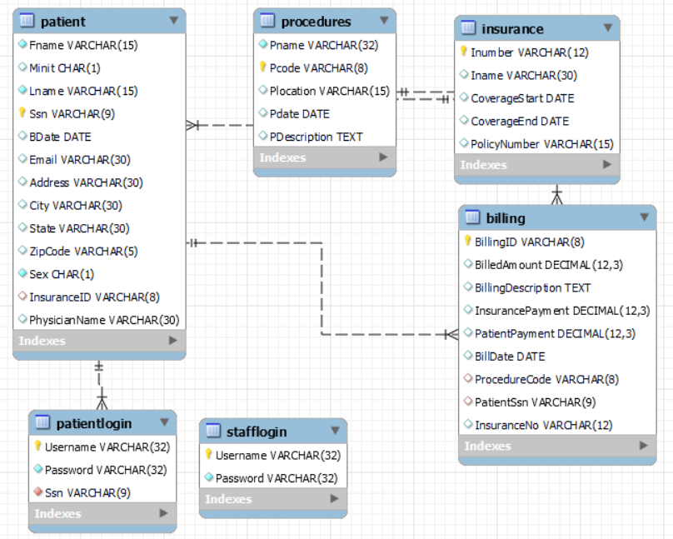
EER Diagram

Slide 27
Short Demo

