Slide 1
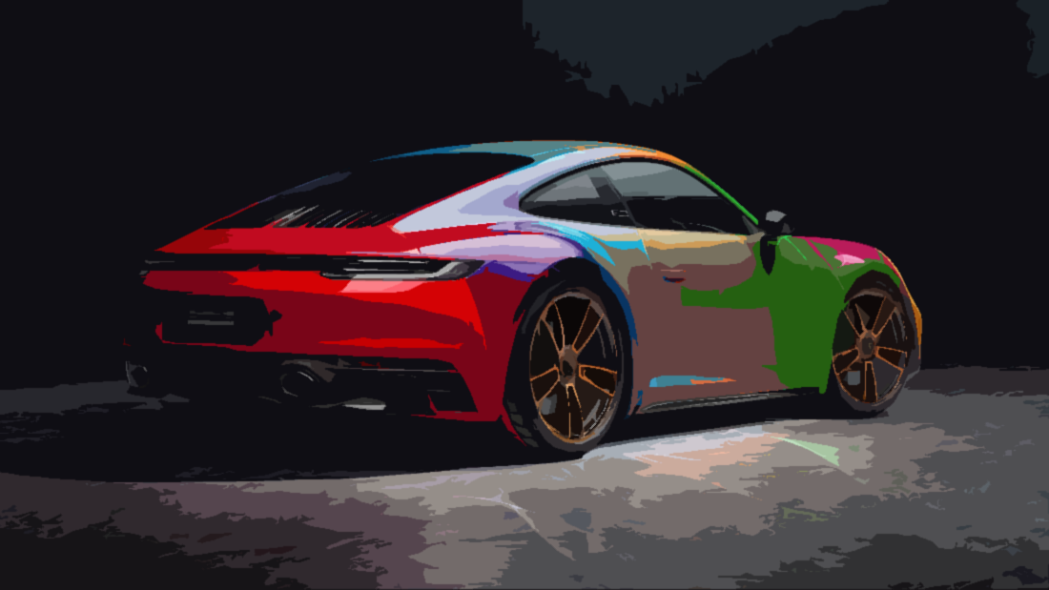
AI Porsche Classifier
21 years old
Working at SCHOTT in Mainz
Studies CS in Mannheim
Currently expanding my knowledge on AI and ML
Porsche enthusiast

Slide 2

Introduction
- Contact Porsche
- Find Dataset
- First Trainings
end April
Nov-Mar
- Data refactoring
- New models
- Onnx
- Web Hosting
- Data cleaning
- Second model
- Evaluate models
- UI
- Architecture
- AWS Hosting
- Data Pipeline
mid April
today

Slide 3



Models
Models used for different levels of classification
All based on a pretrained model (VGG16, efficientnet)
Only 3-15 Epochs
Data augmentation
Discord Callback for notifications
Hardware: Laptop and GTX 3050 TI mobile/GTX 1060
Export to onnx
Onnxruntime

Slide 4
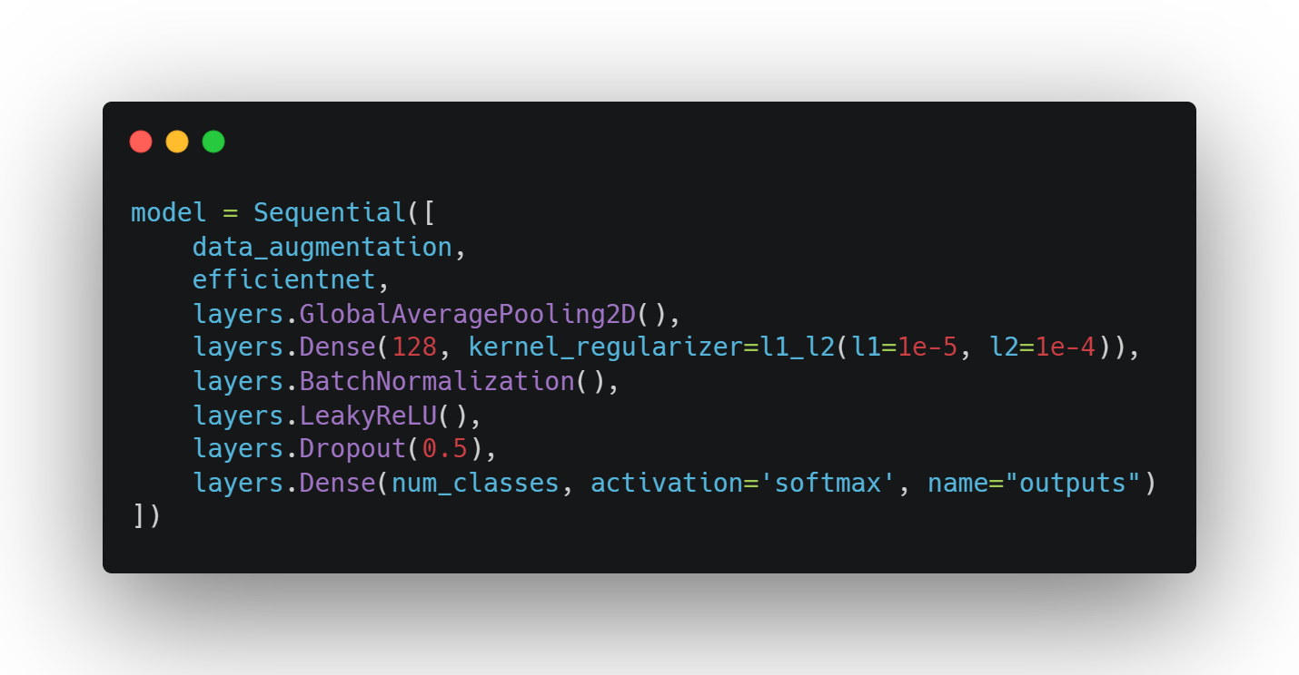

Slide 5
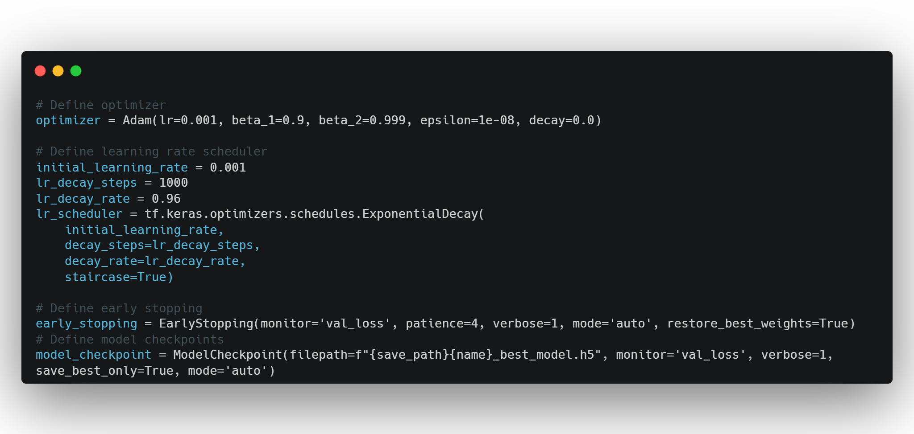

Slide 6
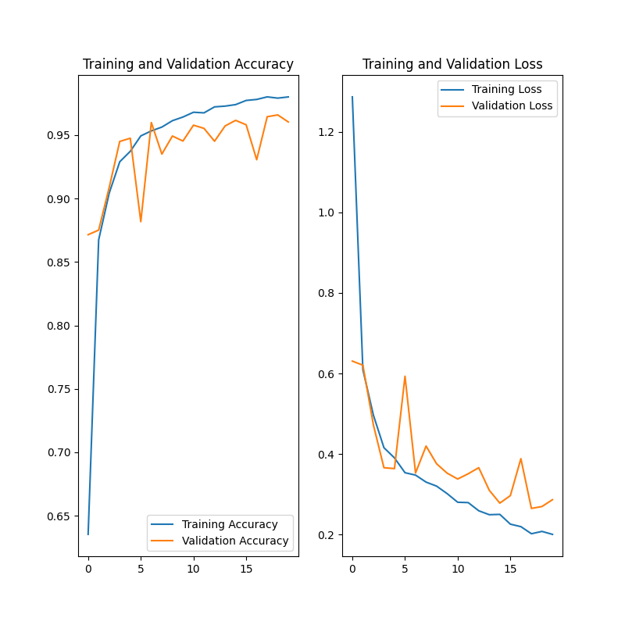

Slide 7
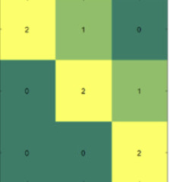
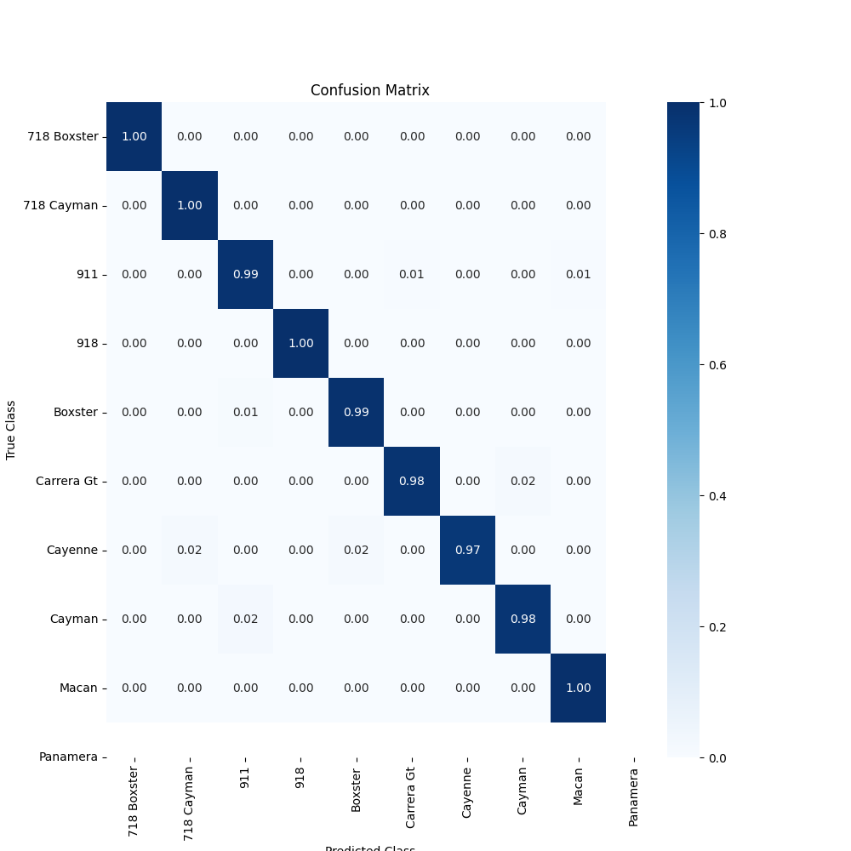
Confusion matrix

Slide 8

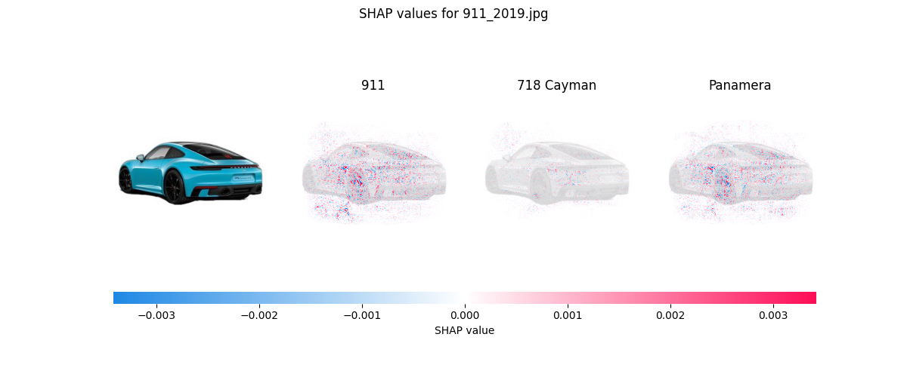
SHAP Explainer

Slide 9

Dataset
DVM Dataset
Great variety of image quality
Many false categorized
Manual dataset cleaning and restructuring
Open Source
1,451,784 images
Covers last two decades.
300x300 resolution
Background removed
~ 30.000 images of Porsche cars

Slide 10
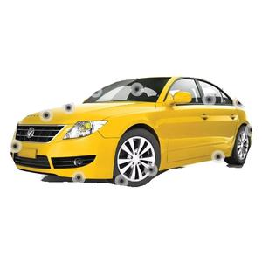
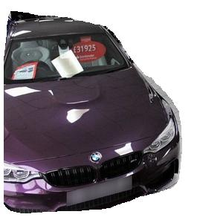
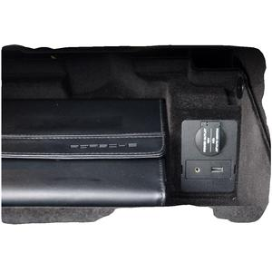
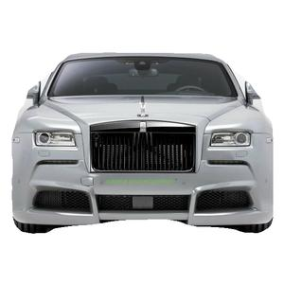

Slide 11







UI/Web App
First version
Web version

Slide 12
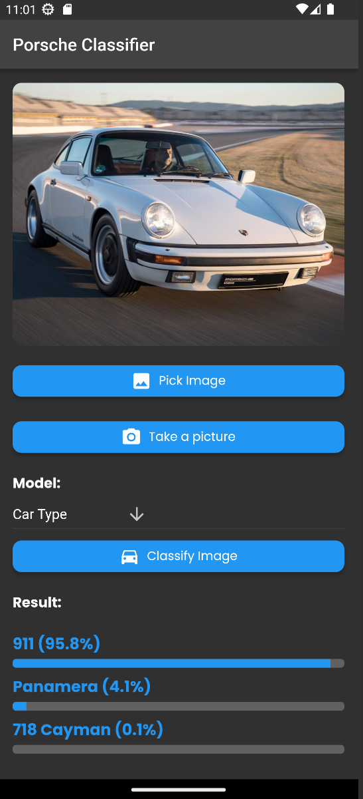

Android/iOS App

Slide 13
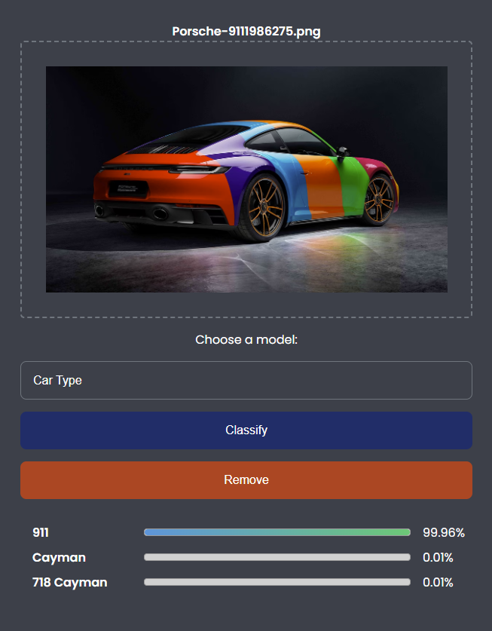

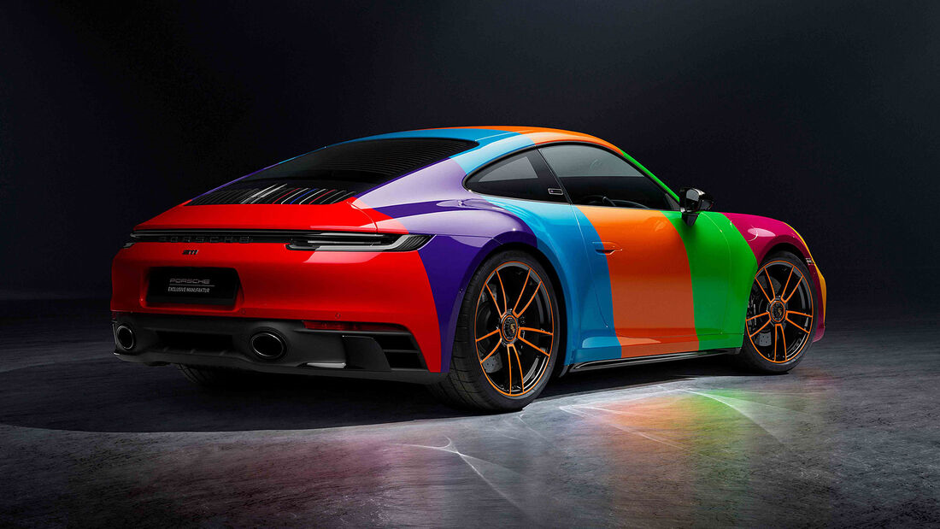


Data Pipeline
Porsche
No Porsche
Remove Background
Resize and center mask
Pre Filter
Car Prediction

Slide 14
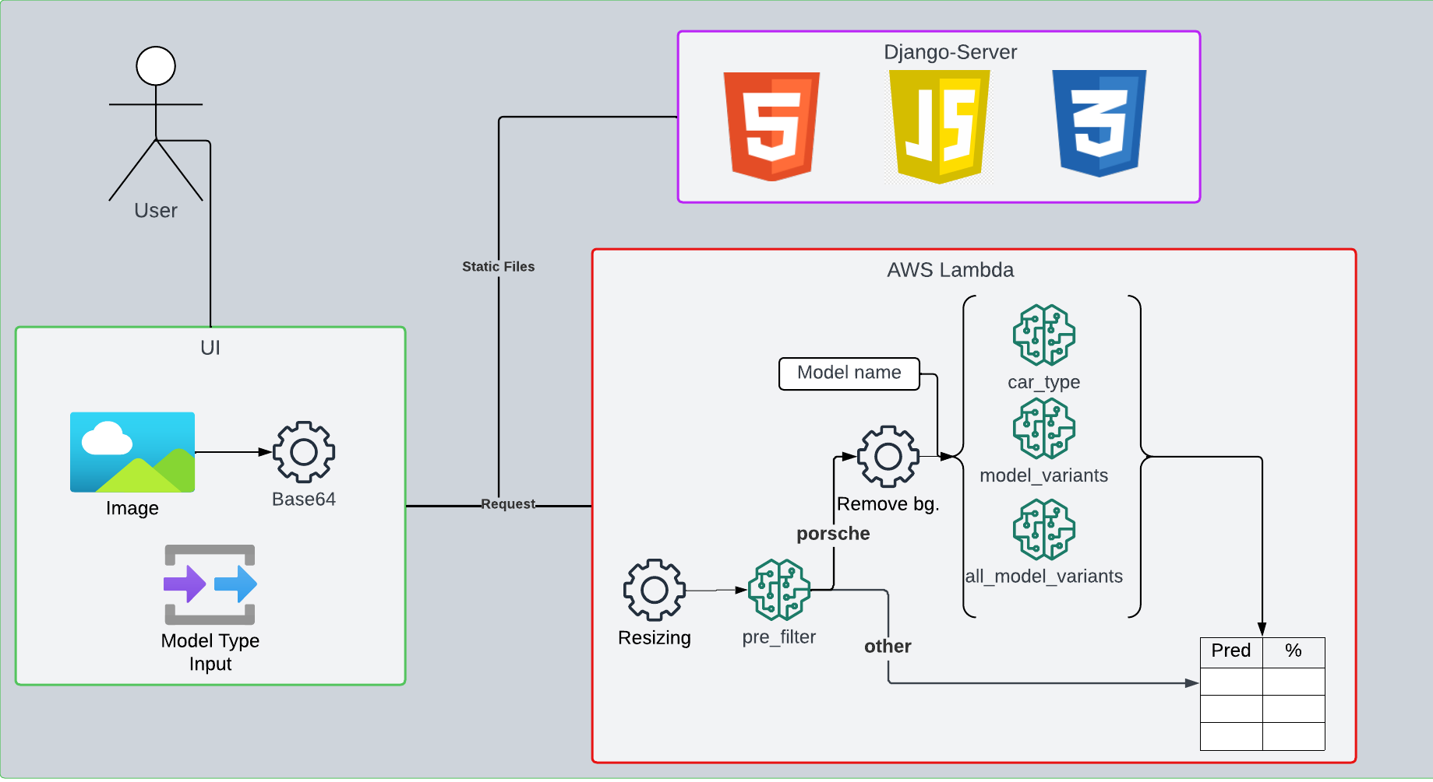

Slide 15
Lessons Learned
Data Quality and Preparation
Model Selection and Improvement
Continuous improvement
Model Evaluation and Insights
Web UI Design and Architecture

Slide 16


Limitations and Future
Dataset
Quality and Quantity
Pre filter predictions
Only images without background
Free Tier AWS
Improve dataset Retrain models on improved dataset
Faster inference
Scaling

Slide 17
Recap
Training and implementing various AI models
Developing a Web UI
Gaining valuable insights from model evaluation
Importance of continuous learning and improving
Addressing data quality issues
Experimenting with different models and parameters
Experimenting with different inference architectures
Staying committed and following through is worthwhile
Reaching out to Porsche
Fixing bugs and improving product

Slide 18




github.com/Flippchen/PorscheInsight-CarClassification-AI
classify.autos

