Slide 1



Presentation of Semester Project-
Created By Filip Nordhagen
Themes, epics, features, user stories
Scope of Work and Gantt chart
Styletile
Sketchesand design
The Final Product
Q&A

Slide 2

Themes, epics, features, user stories
Why I chose the different
Themes
Epics
Features
User stories

Slide 3
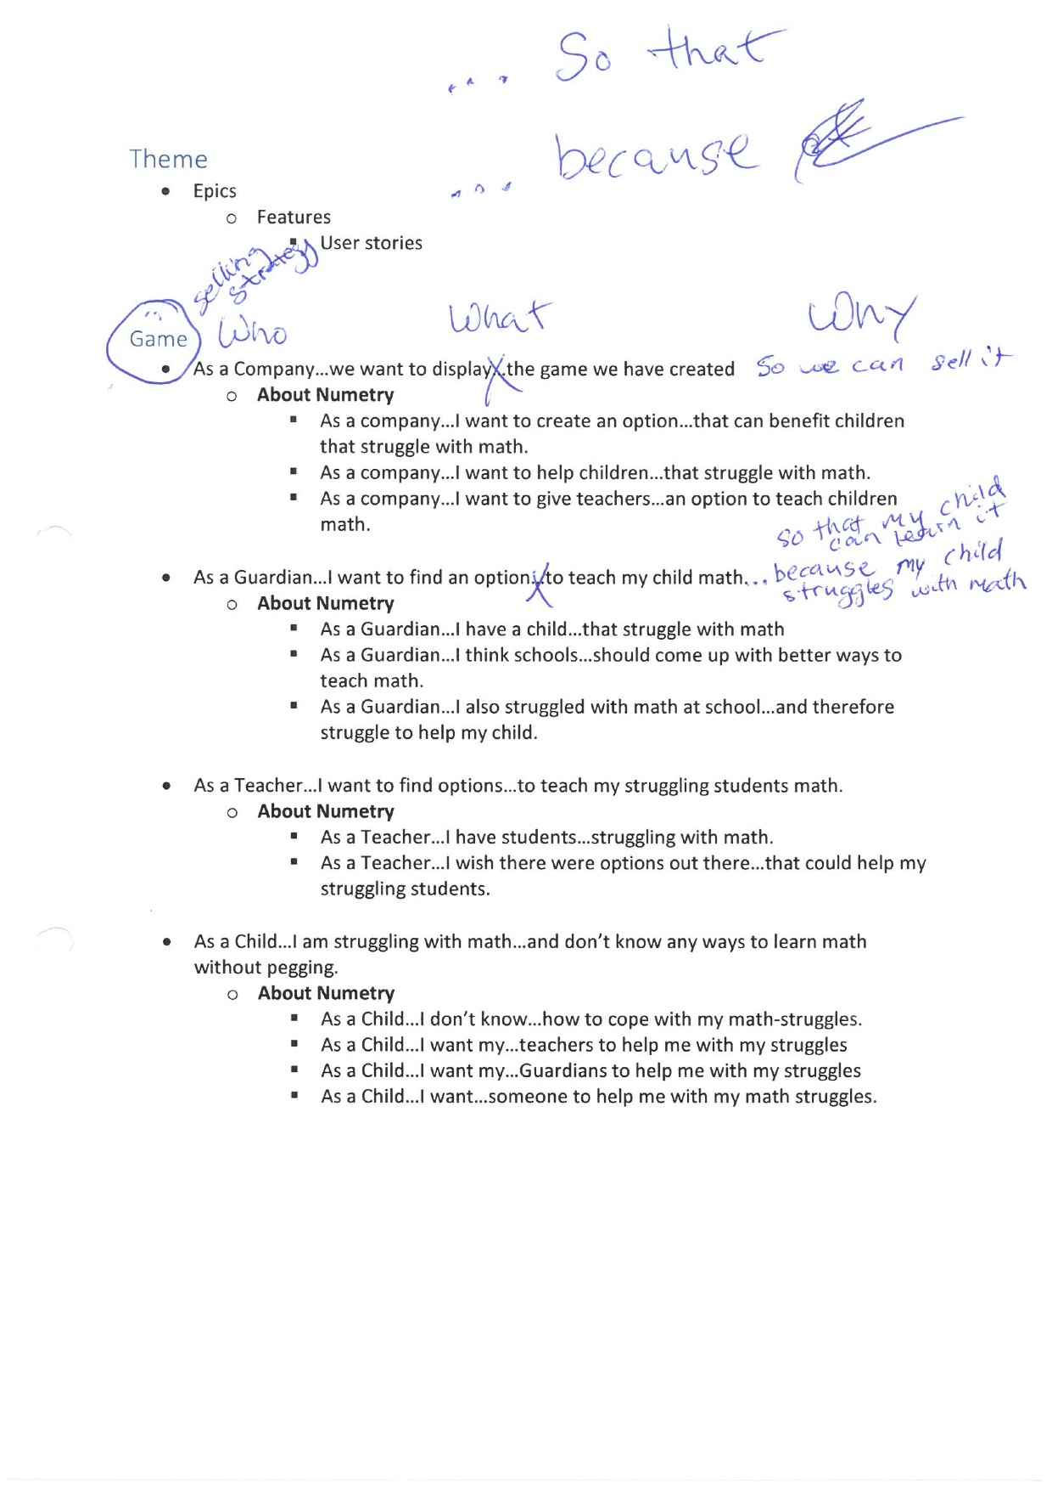

Slide 6
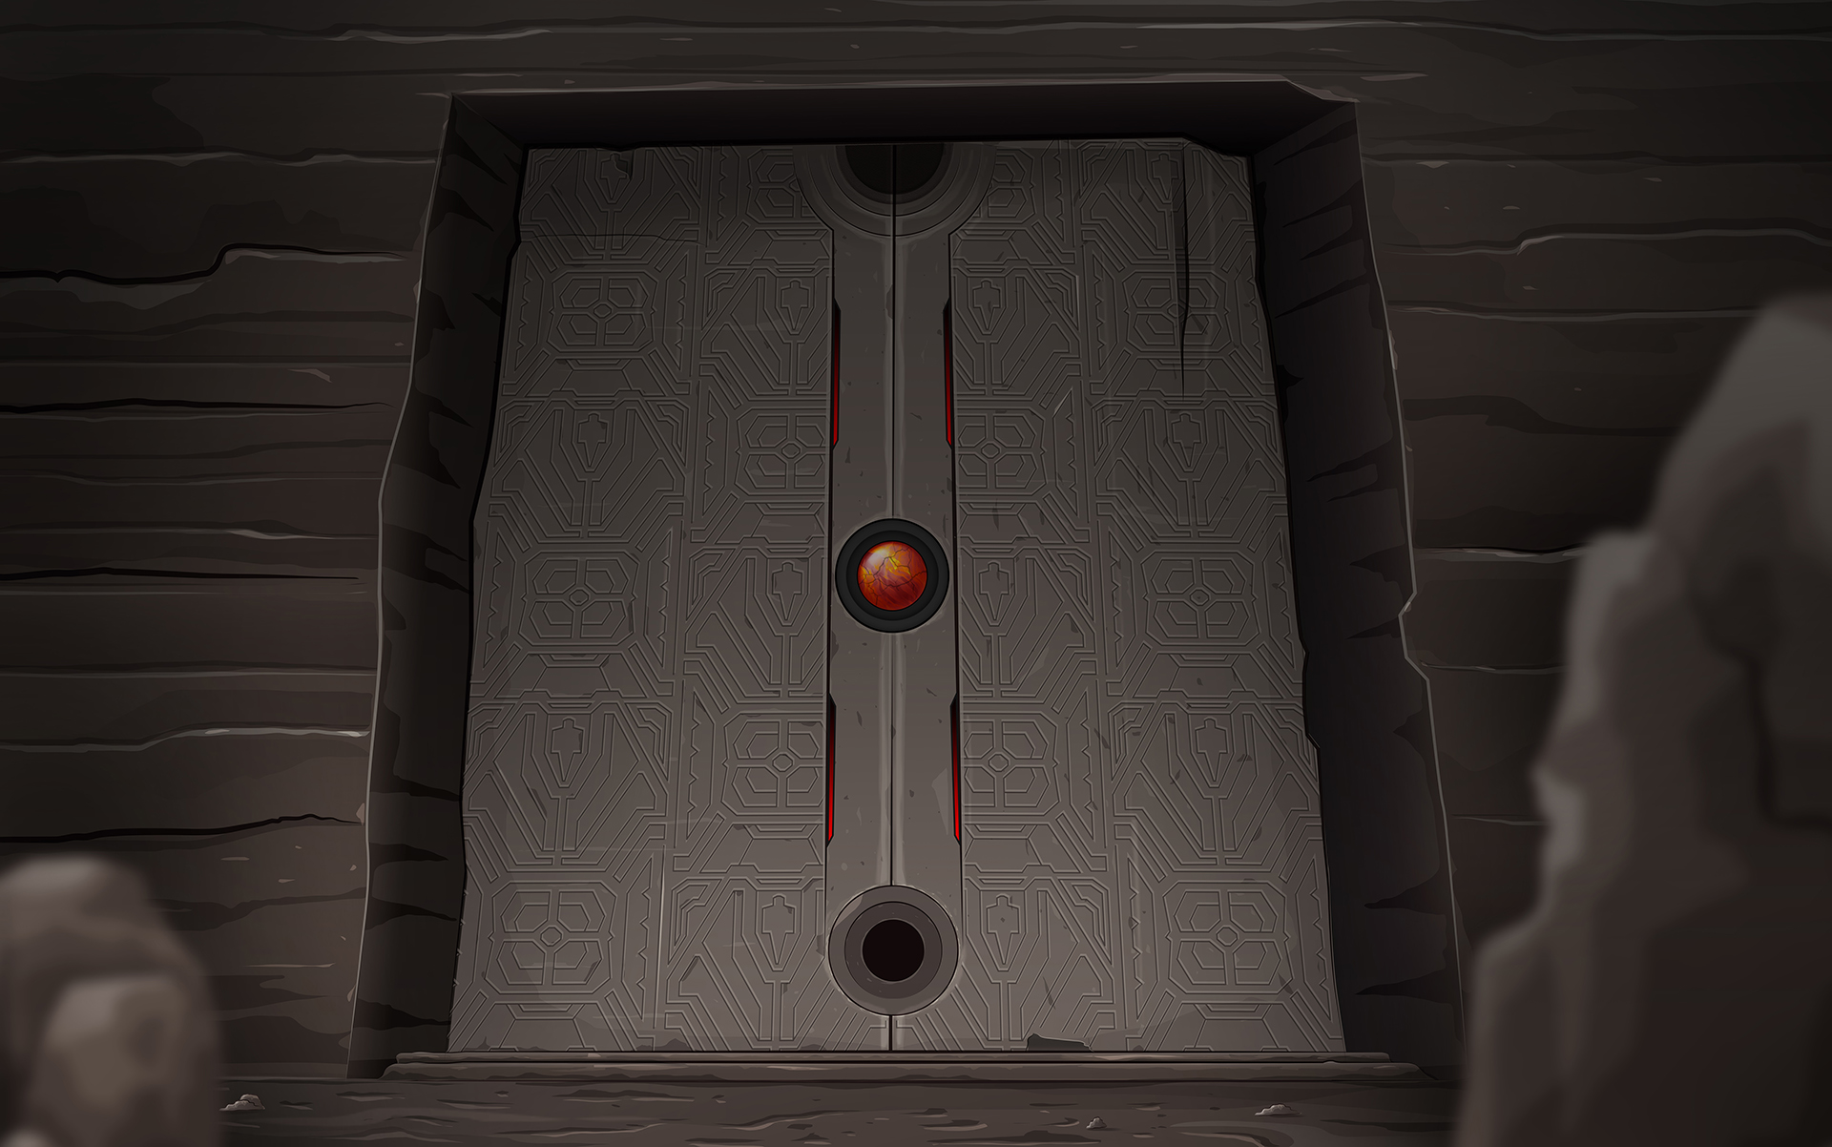
Scope of Work and Gantt chart
Present Scope of work rev 1A
Present Gantt chart rev 1A
Present Gantt chart rev 2A
What I would have done diffrently.
Lessons learned.

Slide 7

Styletile:
Fonts used
Buttons
Logos
Graphics
Pictures
Colour-schemes

Slide 8
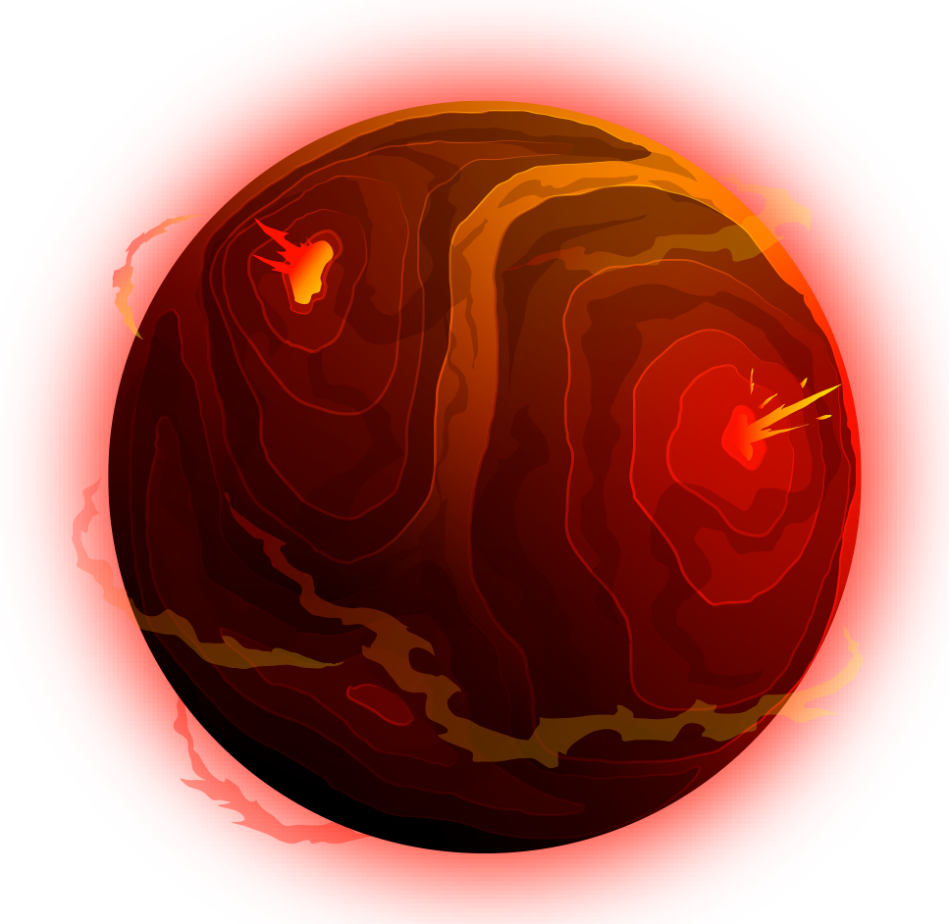

Sketches, wireframes and design
Show Sketches
Show wireframes
Show Design

Slide 9
The Final Product
Show final product: http://eduplaytion.filipnordhagen.com/index.html
Responsiveness Mobile
Responsivness Tablet
Responsivness Desktop
What I would have done if skills and permission had been there.

Slide 10
Q&A
Any Questions???
Thank you all for your time and patience.
Happy Hollidays! ☺
Created By Filip Nordhagen

