Slide 1
Lecturer: Mr Frank Bsc.ITS (MU) Office: New Building 213
Introduction to
Management Information
System
CIT

Slide 2
Information System
Frank Msonge

Slide 3
system
A system is defined as a set of interrelated components, with a clearly defined boundary, working together to achieve a common set of objectives by accepting inputs and producing outputs in an organized transformation process .
Systems have three basic functions:
Input- involves capturing and assembling elements that enter the system to be processed. For example, raw materials, energy, data, and human effort must be secured and organized for processing.
Processing- involves transformation processes that convert input into output. Examples are manufacturing processes, the human breathing process, or mathematical calculations.
Output- involves transferring elements that have been produced by a transformation process to their ultimate destination. For example, finished products, human services, and management information must be transmitted to their human users.

Slide 4
Information system (IS)
can be any organized combination of people, hardware, software, communications networks, data resources, and policies and procedures that stores, retrieves, transforms, and disseminates information in an organization

Slide 5
IT infrastructure
IT infrastructure refers to various components required to run IT and IT-enabled operations. These include software, composite hardware, network services, and resources. The infrastructure enables organizations to deliver services and solutions to customers, partners, and employees.

Slide 6
The Fundamental Roles of IS in Business
there are three(3) fundamental reasons for all business applications of information technology.
They are found in the three vital roles that information systems can perform for a business enterprise:
Support of business processes and operations.
Use computer-based information systems to help their daily activities
Support of decision making by employees and managers.
Information systems also help store managers and other business professionals make better decisions
Support of strategies for competitive advantage.
Gaining a strategic advantage over competitors requires the innovative application of information technologies

Slide 7
The Role of e-Business in Business
e-business is using Internet technologies to work and empower business processes, e-commerce, and enterprise collaboration within a company and with its customers, suppliers, and other business stakeholders.
The Internet and related technologies and applications have changed how businesses operate and people work and how information systems support business processes, decision-making, and competitive advantage. Thus, many businesses today are using Internet technologies to Web-enable their business processes and create innovative e-business applications

Slide 8
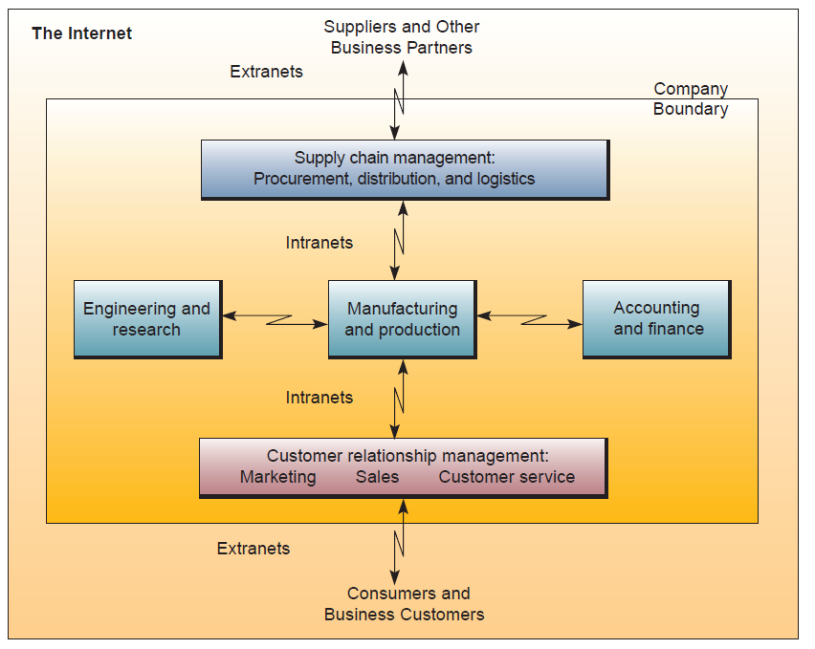
CONT…
Businesses Today depend on the Internet, intranets, and Extranets to implement and manage innovative e-business applications.

Slide 9
Types of Information Systems
several types of information systems can be classified as either operations or management information systems.
Operational support System
Information systems have always been needed to process data generated by, and used in, business operations. Such operations support systems produce a variety of information products for internal and external use; however, they do not emphasize the specific information products that can best be used by managers. Further processing by management information systems is usually required.
Transaction processing systems. Process data resulting from business transactions, update operational databases, and produce business documents. Examples: sales and inventory processing and accounting systems.
Process control systems. Monitor and control industrial processes. Examples: petroleum refining, power generation, and steel production systems.
Enterprise collaboration systems. Support team, workgroup, and enterprise communications and collaborations. Examples: e-mail, chat, and videoconferencing groupware systems.

Slide 10
Management Support System
When information system applications focus on providing information and support for effective decision making by managers, they are called management support systems . Providing information and support for decision making by all types of managers and business professionals is a complex task. Conceptually, several major types of information systems support a variety of decision-making responsibilities:
Management information systems. Provide information in the form of pre-specified reports and displays to support business decision making. Examples: sales analysis, production performance, and cost trend reporting systems.
Decision support systems. Provide interactive ad hoc support for the decision-making processes of managers and other business professionals. Examples: product pricing, profitability forecasting, and risk analysis systems.
Executive information systems. Provide critical information from MIS, DSS, and other sources tailored to the information needs of executives. Examples: systems for easy access to analyses of business performance, actions of competitors, and economic developments to support strategic planning.

Slide 11
Achieving Competitive Advantage with IS
major role of information systems applications in business is to provide effective support of a company’s strategies for gaining competitive advantage. This strategic role of information systems involves using information technology to develop products, services, and capabilities that give a company major advantages over the competitive forces it faces in the global marketplace.
Businesses can develop competitive strategies to counter the actions of the competitive forces they confront in the marketplace.

Slide 12
Basic Strategies in the Business Use of Information Technology
Lower Costs
Use IT to substantially reduce the cost of business processes.
Use IT to lower the costs of customers or suppliers.
Differentiate
Develop new IT features to differentiate products and services.
Use IT features to reduce the differentiation advantages of competitors.
Use IT features to focus products and services at selected market niches.
Innovate
Create new products and services that include IT components.
Develop unique new markets or market niches with the help of IT.
Make radical changes to business processes with IT that dramatically cut costs;
improve quality, efficiency, or customer service; or shorten time to market.
Promote Growth
Use IT to manage regional and global business expansion.
Use IT to diversify and integrate into other products and services.
Develop Alliances
Use IT to create virtual organizations of business partners.
Develop inter-enterprise information systems linked by the Internet and extranets that support strategic business relationships with customers, suppliers, subcontractors, and others.

Slide 13
Basic Strategies in the Business Use of Information Technology
Lower Costs
Use IT to substantially reduce the cost of business processes.
Use IT to lower the costs of customers or suppliers.
Differentiate
Develop new IT features to differentiate products and services.
Use IT features to reduce the differentiation advantages of competitors.
Use IT features to focus products and services at selected market niches.
Innovate
Create new products and services that include IT components.
Develop unique new markets or market niches with the help of IT.
Make radical changes to business processes with IT that dramatically cut costs;
improve quality, efficiency, or customer service; or shorten time to market.
Promote Growth
Use IT to manage regional and global business expansion.
Use IT to diversify and integrate into other products and services.
Develop Alliances
Use IT to create virtual organizations of business partners.
Develop inter-enterprise information systems linked by the Internet and extranets that support strategic business relationships with customers, suppliers, subcontractors, and others.

Slide 14
Telecommunication
Frank msonge

Slide 15
Telecommunications,
The Greek word tele, means “distance,” is part of such words as “telephone,” “teleconference,” and other words referring to technologies that allow communications over a distance.
Thus, telecommunications is communications over a distance. Telephone, e-mail, the World Wide Web—none of these essential business services would be available without fast, reliable telecommunications. Telecommunications, made possible by networking technologies,
Telecommunications, or telecom, refers to the process of exchanging information such as voice, data and video transmissions via electronic technologies like telephones (wired and wireless), microwave communications, fiber optics, satellites, radio and television broadcasting, and the internet.

Slide 16
Importance of Telecommunication
Better business communication. When no physical objects need to be transferred from one place to another, telecommunications technology can make geographical distance irrelevant. E-mail, voice mail, instant messaging (IM), faxing, file transfer, mobile telephony, and teleconferencing enable detailed and instant communication, within and between organizations. Telecommunications can also be used by one person to monitor another person’s performance in real time. The use of e-mail, IM, and voice mail has brought some secondary benefits to business communications by establishing a permanent written or electronic record of, and accountability for, ideas. Web-based instant messaging is used to support online shoppers in real time.The result is more accurate business communications and reduced need for manual recording.

Slide 17
Greater efficiency.
Telecommunications has made business processes more efficient. Any information that is recorded electronically can become immediately available to anyone involved in a business process, even when the business units are located far apart. For example, as soon as an order is placed, anyone in the organization who will be involved with it at any stage can view the order: from the marketing people, to purchasing officers, to manufacturing managers, to shipping workers, to billing and collection clerks. For example, if a store lacks a certain item, a clerk can check the entire chain’s inventory and tell the customer the nearest store that has the item available. If a customer wishes to return an item, she can do so at any store of the chain because a sales associate can easily verify the purchase details. This may also help retail chains discover “serial returners.”

Slide 18
Better distribution of data
Organizations that can transmit vital data quickly from one computer to another can choose not to have centralized databases. Business units that need certain data frequently might store it locally, while others can access it remotely. Only fast, reliable transfer of data makes this efficient arrangement possible.

Slide 19
Instant transactions.
The availability of the Internet to millions of businesses and consumers has shifted a significant volume of business transactions to the Web. Both businesses and consumers can shop, purchase, and pay instantly online. Wireless technology has also made possible instant payment and data collection using small radio devices, such as electronic toll collection tags. In addition to commercial activities, people can use telecommunications for online education and entertainment.

Slide 20
Flexible and mobile workforce
Employees do not have to come to the office to carry out their work as long as their jobs only involve the use and creation of information. They can telecommute using Internet connections. Salespeople, support personnel, and field workers are more mobile with wireless communication.

Slide 21
Alternative channels.
Services that used to be conducted through specialized dedicated channels can be conducted through alternative channels. For example, voice communication used to be conducted only through proprietary telephone networks but is now also conducted through the Internet, which decreased its cost. Radio and television broadcasts were conducted through radio frequencies and company-owned cables. Newer technologies enable organizations to broadcast over the Internet and provide telephone services over the Internet as well.

Slide 22
TELECOMMUNICATIONS IN DAILY USE

Slide 23
Cellular Phones
Using cellular phone networks, people can transmit and receive calls almost anywhere, freeing them from a fixed office location. Cellular phones (often called mobile phones) can also be used for e-mail and faxing, and many are Web-enabled. Many mobile phones have been merged with digital cameras, PDAs, and GPS (global positioning system) circuitry. “My car is my office” is a reality for many professionals who spend much of their time traveling. As technology advances and more capabilities are squeezed into smaller casings, some professionals can say, “My pocket is my office.”
The major advantage of cell phones is that they are attached to people, not offices. This is why, despite the higher cost of mobile phones over landline phones, some companies have decided to discard the latter and adopt the former for some or all of their employees. For example, in 2005, Ford Motor Company disconnected the landline phones of 8,000 employees and equipped them with mobile phones. The purpose is to make engineers more available to each other.

Slide 24
Video-conferencing
People sitting in conference rooms thousands of miles apart are brought together by their transmitted images and speech in what is called videoconferencing. Businesses use videoconferencing to save on travel costs and lodging, car fleets, and the time of highly salaried employees, whether they work in different organizations or at different sites of the same organization. From national and global perspectives, videoconferencing also reduces traffic congestion and air pollution. The increasing speed of Internet

Slide 25
Why you should Understand Telecommunication
As a professional, you will be responsible for ensuring that your organization maximizes its benefits from fast and reliable telecommunications. To do so, you might be involved in selecting from networking alternatives. To be a creative and productive contributor to these decisions, it is essential that you understand the fundamental promises and limitations of networking and telecommunications. Many tasks that used to be in the sole domain of highly paid specialists are being performed by professionals whose main occupation is not IT. For example, creating small networks in businesses and homes used to be the responsibility of technicians. Now any professional is expected to know how to create hotspots and how to use a plethora of networks: wired, wireless, cellular, and Internet-based.

Slide 26
INDIVIDUAL ASSIGNMENT (10 MARKS)
Please explain in detail how telecommunication applications simplify our daily life activities. Do you agree? Explain your answer.
To be submitted on E-Learning before 10/04/2023

