Slide 1
Sentiment Classification of Chess Annotations
Master Thesis

Slide 2
Outline
Problem Description
Background
Text Mining Process
Results

Slide 3
Motivation
Chess games are noted and stored in text files
Game analysis of chess grandmasters by annotating the file with comments and/or standardized symbols (NAGs)
Evaluation of chess games possible based on those symbols/NAGs
Problem: Symbols/NAGs are not given for every comment
Idea: Learning patterns to assign comments to symbols/NAGs
Topics:
Text Mining > Sentiment Classification
Supervised Learning > Multiclass Classification > Ordinal Classification

Slide 4
Comments in PGN File
32. Nxe3 Qxe3 33. Qxf2 $4
{sad, but how else could White save the game?.}
(33. Rd1 Bg7 34. Qb3 Bxd4 35. Qxe3 Bxe3 36. Be2 $19)
33... Bh3+ $1
{the final blow}
34. Kg1
{Black now must not overlook the idea Re1}
Blue: comments Red: NAGs Bold: game moves

Slide 5
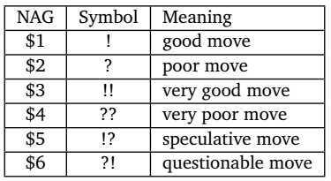
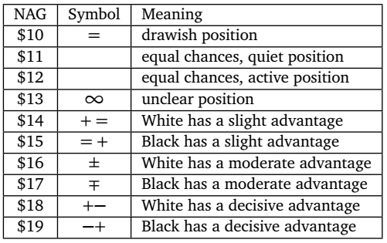
Numeric Annotation Glyphs (NAGs)
Move-annotating NAGs
Position-annotating NAGs

Slide 6
Problem Definition
Classification into move and position annotations
2 classes (1 = move, 2 = position)
Classification of move annotations
2 classes (1 = good, 2 = poor)
6 classes (1 = very good, …, 6 = very poor)
Classification of position annotations
3 classes (1 = advantage white, 2 = equal, 3 = advantage black)
7 classes (1 = decisive advantage white, …, 4 = equal, …, 7 = decisive advantage black)

Slide 7
Multiclass Classification Problems
Three approaches to handle multiclass classification problems:
Decomposition into binary classification
One-against-All
One-against-One (with or without pairwise coupling)
Hierarchical classification
Class-Balanced Nested Dichotomies
Data-Balanced Nested Dichotomies
Extension of algorithms

Slide 8
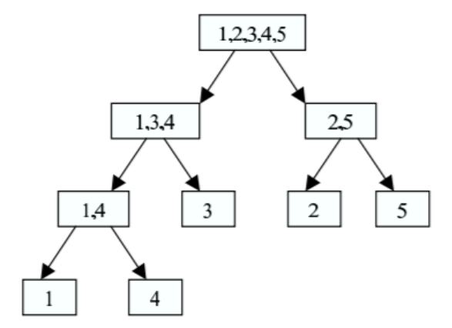
Nested Dichotomies
Idea:
Split data set in two subsets and solve binary classification problem
Apply step 1 recursively for all subsets until it contains only one class
Variants:
Split by equal number of classes
→ Class-Balanced
Split by equal number of instances
→ Data-Balanced

Slide 9
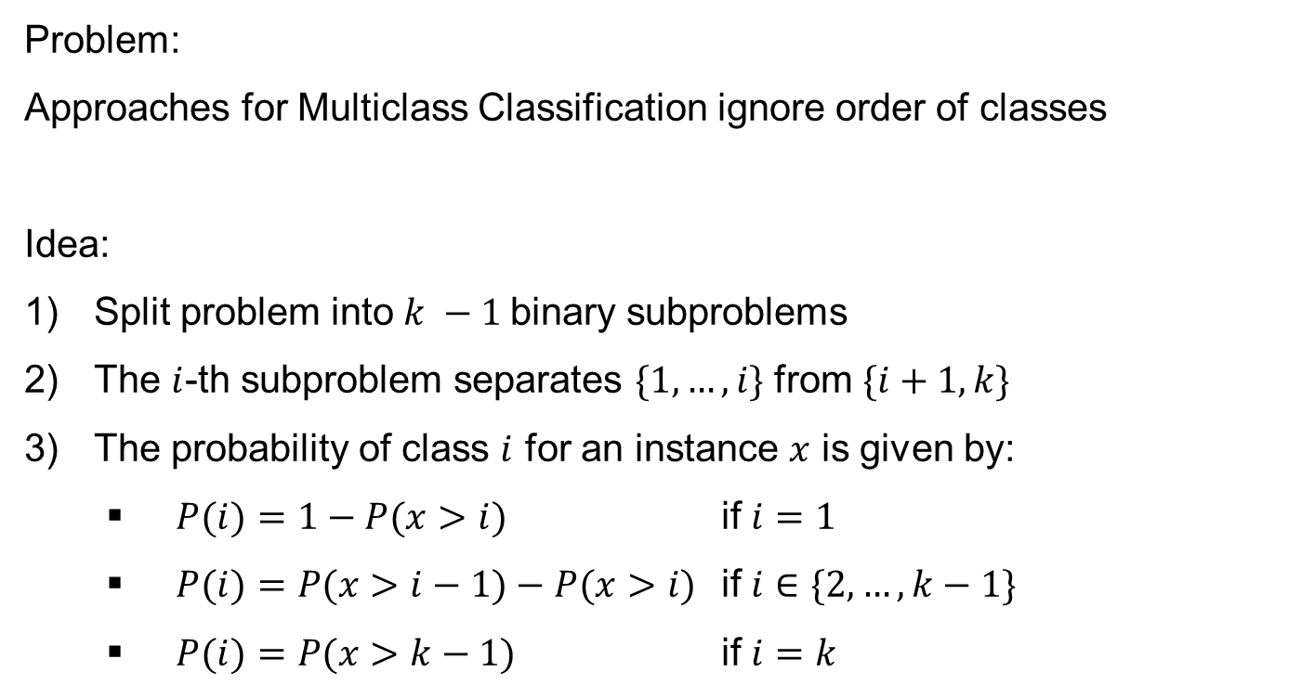
Ordinal Classification
Problem:
Approaches for Multiclass Classification ignore order of classes
Idea:
Split problem into $k −1$binary subproblems
The $i$-th subproblem separates $\{1,…,i\}$ from $\{i+1,k\}$
The probability of class $i$ for an instance $x$ is given by:
$P(i)=1−P(x>i)$ if $i=1$
$P(i)=P(x>i−1)−P(x>i)$ if $i∈\{2,…,k−1\}$
$P(i)=P(x>k−1)$ if $i=k$

Slide 10
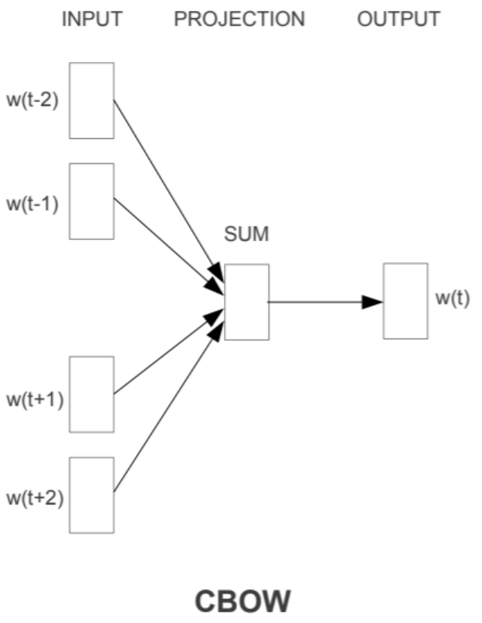
Word Embeddings
Idea:
Map words to a vector space of a fixed size by learning the context in a two-layer neural network
Output:
Vectors that can be compared by cosine similarity

Slide 11
Text Mining Process
NLTK
Comment and NAG Extraction
Tokenization
Weka
Testing
Evaluation of Results
Normalization
sklearn / gensim
Training
Feature Extraction
Feature Selection
ChessBase DB / other sources
Collection of PGN Data
Conversion to ARFF format
Data Cleansing

Slide 12
NLTK Preprocessing
Comment and NAG Extraction
Tokenization
Normalization
Lowercase
Lemmatization
Data Cleansing
Minimum length: 3 tokens
Minimum 3 tokens in English
(„No! White makes a mistake“, $4)
([„no“, „!“, „white“, „make“, „a“, „mistake“], 2)

Slide 13
Feature Extraction
Absolute count of top 2000 terms/bigrams/trigrams (count)
2000 attributes, sparse data
Relative TF-IDF value of top 2000 terms/bigrams/trigrams (tfidf)
2000 attributes, sparse data
Word2Vec model based on chess vocabulary (w2v-own)
100 attributes, dense data
Word2Vec model based on Google News (w2v-pretrained)
300 attributes, dense data

Slide 14
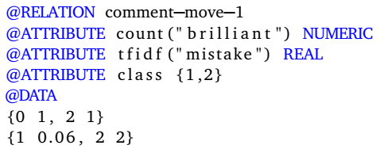
Conversion to ARFF format
Example for move annotations (2 classes)
Comment 1: “a brilliant counterattack of white” → class 1 (good move)
Comment 2: “a big mistake of black” → class 2 (poor move)

Slide 15
Weka
Evaluation method: accuracy
Validation method: 10-fold cross-validation
Classifiers:
Multiclass Classifier (MCC)
One-against-All (MCC0)
One-against-One (MCC3)
One-against-One with Pairwise Coupling (MCC3P)
Ordinal Class Classifier (OCC)
Nested Dichotomies (ND)
Class-Balanced (NDC)
Data-Balanced (NDD)
Random Forest (RF)
Naïve Bayes (NB)

Slide 16
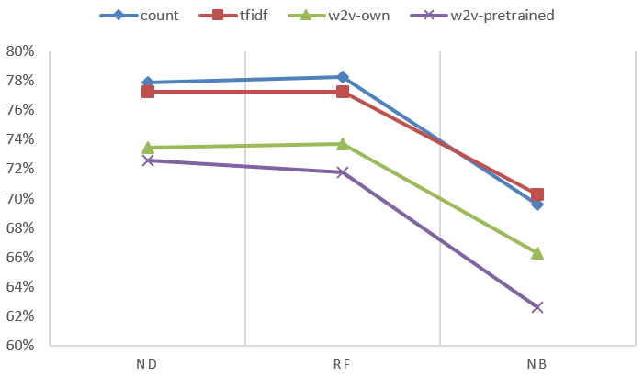
Results - Move vs. Position Annotations

Slide 17
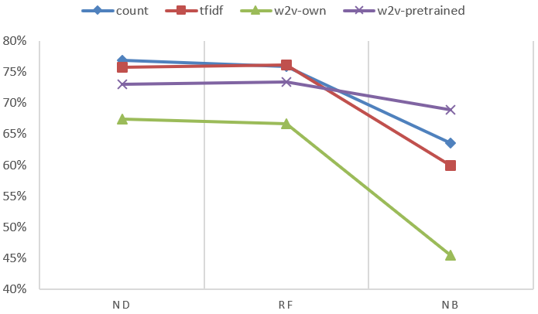
Results - Move Annotations (2 Classes)

Slide 18
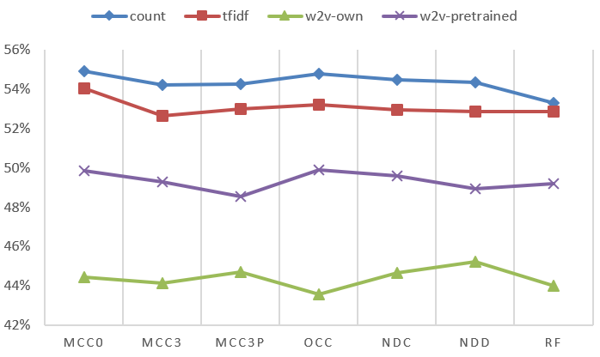
Results - Move Annotations (6 Classes)

Slide 19
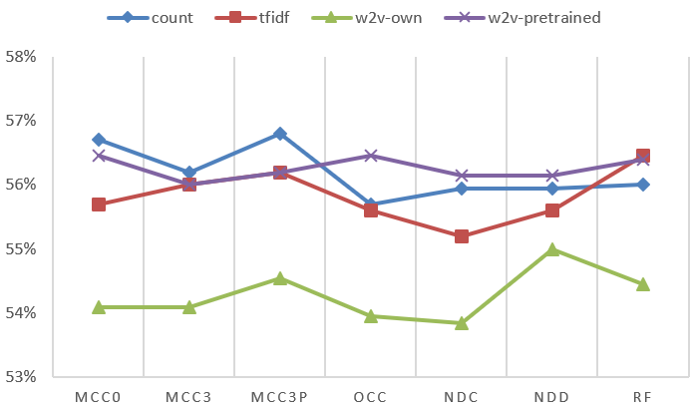
Results - Position Annotations (3 Classes)

Slide 20
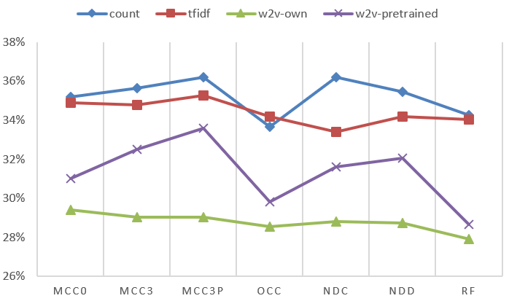
Results - Position Annotations (7 Classes)

Slide 21
Results - Short vs. Long Comments
Maximum Accuracies
 | M. vs. P. | Move (2) | Move (6) | Position (3) | Position (7)
Mixed | 78,25% | 76,90% | 54,90% | 56,80% | 36,20%
Short | 74,95% | 81,40% | 56,70% | 59,85% | 42,10%
Long | 78,13% | 75,35% | 52,75% | 58,90% | 35,35%
Conclusions
Short comments are easier to classify than long comments

Slide 22
Results - Short vs. Long Comments
 | M. vs. P. | Move (2) | Move (6) | Position (3) | Position (7)
Mixed | Count RF | Count ND | Count MCC0 | Count MCC3P | Count MCC3P
Short | Count ND | Count ND | Count NDD | Count RF | Count NDC
Long | TF-IDF ND | Count ND | Count MCC0 | TF-IDF NDD | Count NDD
Conclusions
Count model is best, TF-IDF nearly as good for long comments
No clear trend if ND is better or MCC based on RF

Slide 23
Results - Rule Patterns Move
(count(mistake) >= 1) => class=2 (65.0/2.0)
(number_of_tokens <= 5) and (count(.) <= 0) and (count(of) >= 1) => class=2 (17.0/2.0)
(count(but) >= 1) and (count(this) >= 1) and (count(of) <= 0) => class=2 (49.0/16.0)
(count(lose) >= 1) and (number_of_tokens <= 13) => class=2 (37.0/7.0)
(number_of_tokens <= 5) and (count(by) >= 1) => class=2 (17.0/1.0)
(count(miss) >= 1) and (count(miss_this) <= 0) => class=2 (30.0/4.0)
(count(wa) >= 1) and (number_of_tokens >= 10) and (count(_comma_) <= 0) => class=2 (48.0/15.0)
(count(blunder) >= 1) => class=2 (21.0/0.0)
(number_of_tokens <= 6) and (count(too) >= 1) => class=2 (9.0/0.0)
(count(allow) >= 1) => class=2 (35.0/10.0)
=> class=1 (1672.0/413.0)

Slide 24
Results - Rule Patterns Position
(count(0-1) >= 1) and (number_of_tokens >= 18) => class=3 (58.0/26.0)
(count(/) <= 0) and (count(win) >= 1) and (count(white) <= 0) and (number_of_tokens >= 9) => class=3 (34.0/11.0)
(count(1/2) >= 1) and (count(ext) <= 0) => class=2 (136.0/65.0)
=> class=1 (1772.0/733.0)

Slide 25
Results - Word Embedding Chess
„check“
„blunder“
Word | Cosine Similarity
mate | 51,11%
pin | 50,75%
capture | 45,05%
fork | 44,42%
move | 41,45%
perpetual | 41,08%
guard | 38,12%
penetration | 37,36%
threat | 35,91%
attack | 34,98%
Word | Cosine Similarity
mistake | 81,91%
error | 73,49%
oversight | 72,88%
miscalculation | 64,97%
inaccuracy | 61,69%
touch | 53,17%
time-trouble | 50,77%
blow | 49,59%
shoot | 49,09%
concession | 48,49%

Slide 26
Thanks for your attention

