Slide 1
Sentiment Classification of Chess Annotations
Master Thesis

Slide 2
Outline

Slide 3
Motivation
Chess games are noted and stored in text files
Game analysis of chess grandmasters by annotating the file with comments and/or standardized symbols (NAGs)
Evaluation of chess games possible based on those symbols/NAGs
Problem: Symbols/NAGs are not given for every comment
Idea: Learning patterns to assign comments to symbols/NAGs
Topics:
Text Mining > Sentiment Classification
Supervised Learning > Multiclass Classification > Ordinal Classification

Slide 4
Comments in PGN File
32. Nxe3 Qxe3 33. Qxf2 $4
{sad, but how else could White save the game?.}
(33. Rd1 Bg7 34. Qb3 Bxd4 35. Qxe3 Bxe3 36. Be2 $19)
33... Bh3+ $1
{the final blow}
34. Kg1
{Black now must not overlook the idea Re1}
Blue: comments Red: NAGs Bold: game moves

Slide 5
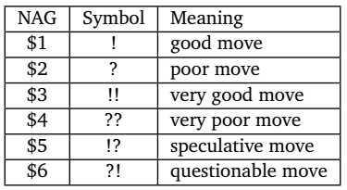
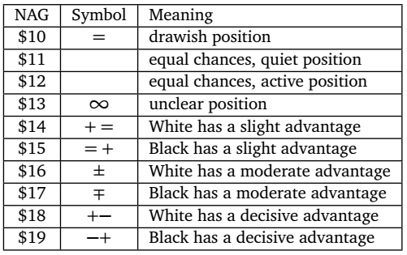
Numeric Annotation Glyphs (NAGs)
Move-annotating NAGs
Position-annotating NAGs

Slide 6
Problem Definition
Classification into move and position annotations
2 classes (1 = move, 2 = position)
Classification of move annotations
2 classes (1 = good, 2 = poor)
6 classes (1 = very good, …, 6 = very poor)
Classification of position annotations
3 classes (1 = advantage white, 2 = equal, 3 = advantage black)
7 classes (1 = decisive advantage white, …, 4 = equal, …, 7 = decisive advantage black)

Slide 7
Multiclass Classification Problems
Three approaches to handle multiclass classification problems:
Decomposition into binary classification
One-against-All
One-against-One
Hierarchical classification
Class-Balanced Nested Dichotomies
Data-Balanced Nested Dichotomies
Extension of algorithms

Slide 8
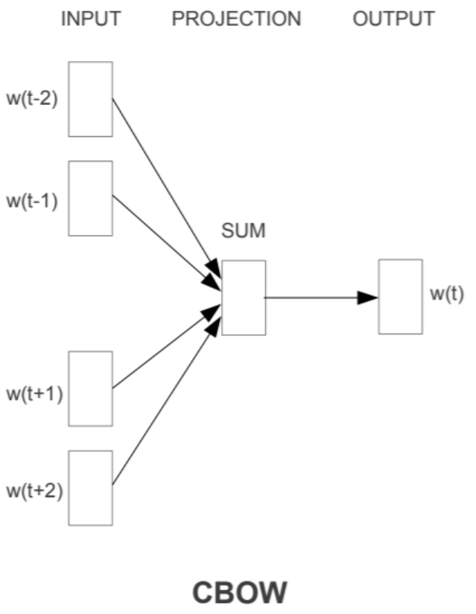
Word Embeddings

Slide 9
Ordinal Classification Problems

Slide 10
Text Mining Process
NLTK
Comment and NAG Extraction
Data Cleansing
Weka
Testing
Evaluation of Results
Text Normalization
sklearn / gensim
Training
Feature Extraction
Conversion to ARFF format
Feature Selection
Tokenization
Collection of PGN Data

Slide 11
Tokenization

Slide 12



Feature Extraction
Count (TF)
TF-IDF
Word2Vec model based on chess vocabulary
Word2Vec model based on Google News

Slide 13
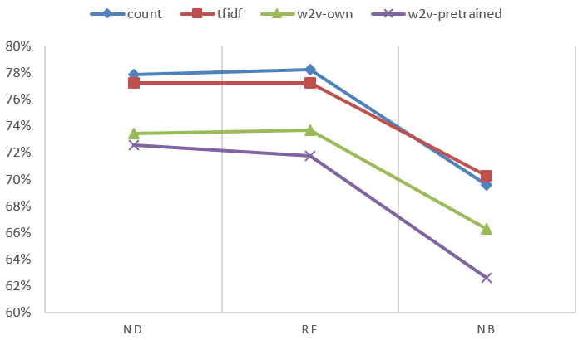
Results - Move vs. Position Annotations

Slide 14
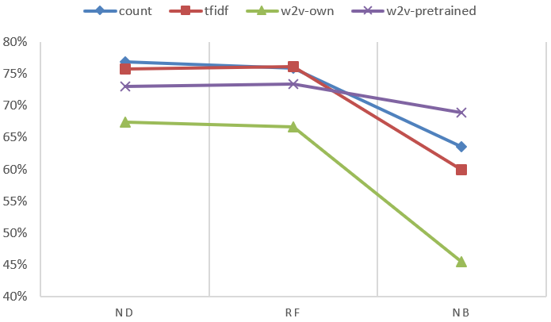
Results - Move Annotations (2 Classes)

Slide 15
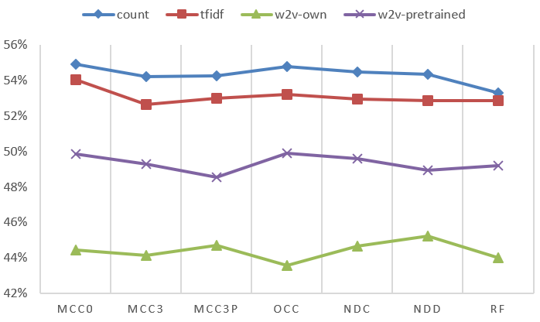
Results - Move Annotations (6 Classes)

Slide 16
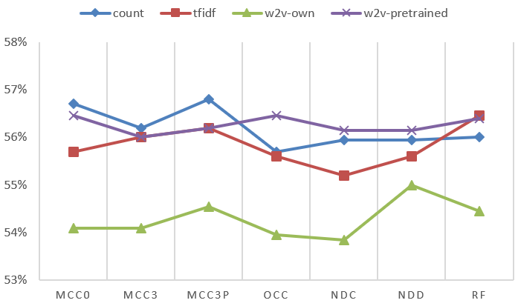
Results - Position Annotations (3 Classes)

Slide 17
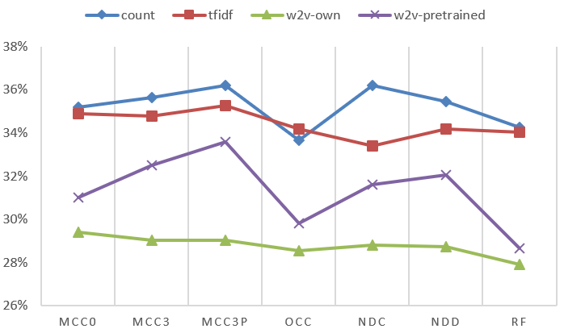
Results - Position Annotations (7 Classes)

Slide 18
Results - Short vs. Long Comments
Maximum Accuracies
 | M. vs. P. | Move (2) | Move (6) | Position (3) | Position (7)
Mixed | 78,25% | 76,90% | 54,90% | 56,80% | 36,20%
Short | 74,95% | 81,40% | 56,70% | 59,85% | 42,10%
Long | 78,13% | 75,35% | 52,75% | 58,90% | 35,35%
Conclusions
Short comments are easier to classify than long comments
Evaluation of chess games possible based on those symbols/NAGs

Slide 19
Results - Short vs. Long Comments
 | M. vs. P. | Move (2) | Move (6) | Position (3) | Position (7)
Mixed | Count RF | Count ND | Count MCC0 | Count MCC3P | Count MCC3P
Short | Count ND | Count ND | Count NDD | Count RF | Count NDC
Long | TF-IDF ND | Count ND | Count MCC0 | TF-IDF NDD | Count NDD
Conclusions
Count model is best, TF-IDF nearly as good for long comments
Evaluation of chess games possible based on those symbols/NAGs

Slide 20
Thanks for your attention

