Slide 1
Predictive Modeling and Clustering of NYC Taxi Trip Data
Team 4: Khushboo Modha
Nicholas Bartram
Florian Caffier
Sura Ali
Phuong Nguyen

Slide 2
Introduction
1
2
3
4
ETL
PCA Analysis
Trip Duration Analysis
Machine Learning
Talk Data to me
Data Interpretation
Random Forest Regressor
Linear Regression
Model Optimization

Slide 3
NYC Yellow Taxi ETL
01
02
03
04
Identify Dataset
Update
Review
Revert
We found a kaggle dataset (train.csv).
The dataset is outdated (2016). Create new one (new_train.csv)
Compare the two datasets after cleaning.
The original dataset was used.
Notes:
First, we found a dataset that interested us and met the specifications for our analysis. This was easier said than done. However, we did find this rich NYC Taxi Cab dataset from kaggle. Initially we attempted to clean a fresh dataset because the kaggle dataset was from 2016 and we wanted an more up-to-date version. Upon review it was determined that the original 2016 dataset was better suited for the needs of this analysis.

Slide 4
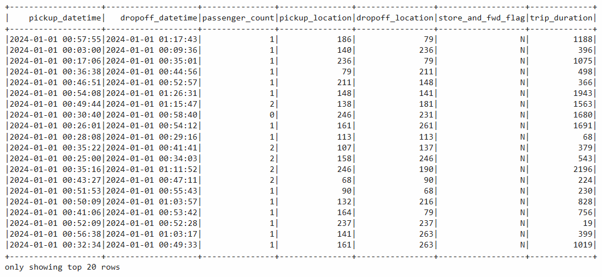
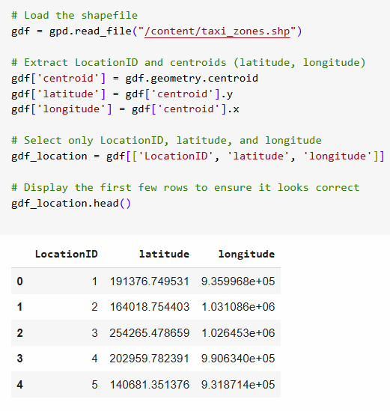
Cleaning Data
The 2024 dataset does not contain lat/lng locations
`taxi_zones.shp` (bottom right) contained polygons for neighborhood codes
A “centroid” was created to mark a middle point in the neighborhood
Notes:
While cleaning the data we faced a challenge: the dataset did not have specific latitude and longitude locations. Using a shape file we decoded the neighborhood codes and created a latitude and longitude location using the centroid of the of polygon. This was then added to the dataframe to provide a specific location for each ride.

Slide 5
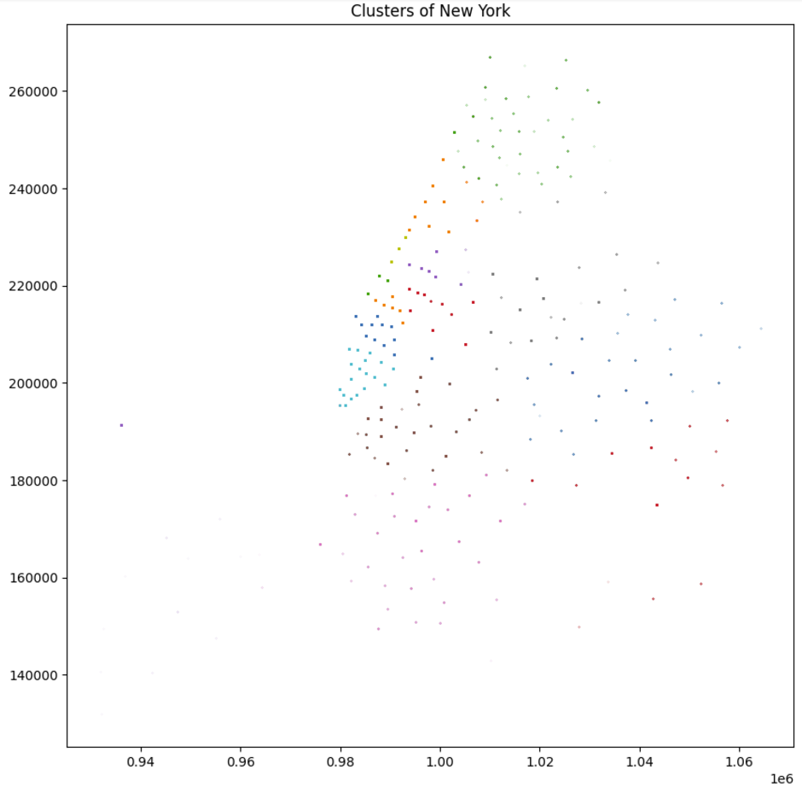
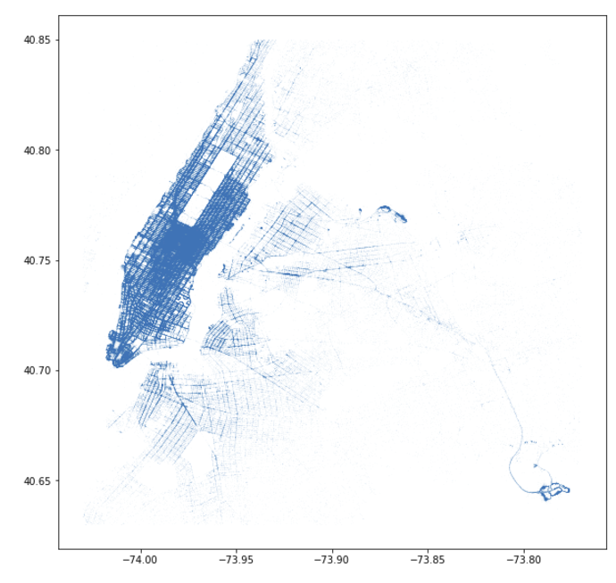
Details of ETL
Notes:
The table on the left shows our cleaned data, the table on the right is the original CSV data.

Slide 6
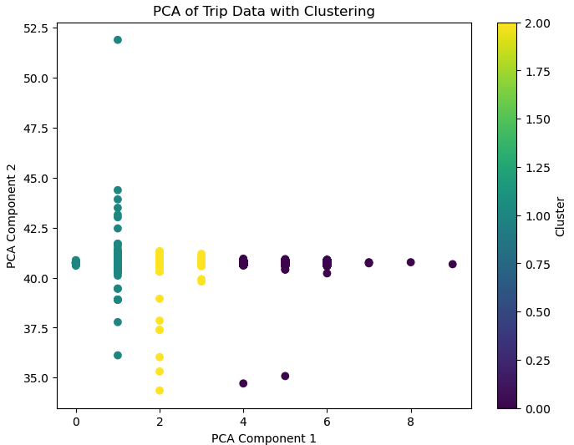
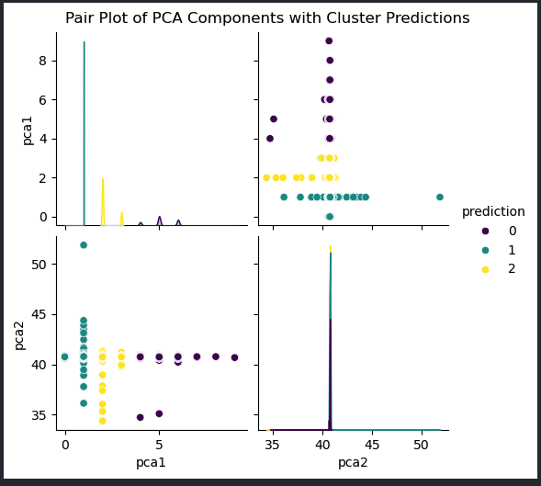
PCA Analysis
This image shows a scatter plot of the first two principal component analysis (PCA) components, PCA1 and PCA2, for a dataset. The data points are colored based on their predicted cluster membership, with three different cluster predictions represented by the colors blue, yellow, and purple.
The plot provides a visual representation of how the data is distributed across the two primary principal components and how the different clusters are separated or grouped within this 2D space.
Some key observations from the image:
· There is a clear separation between the three cluster predictions, with the blue, yellow, and purple points forming distinct groupings.
· The PCA1 component appears to have a wider spread of values compared to the PCA2 component.
· There are a few outlier data points that do not neatly fit within the main cluster groupings.

Slide 7
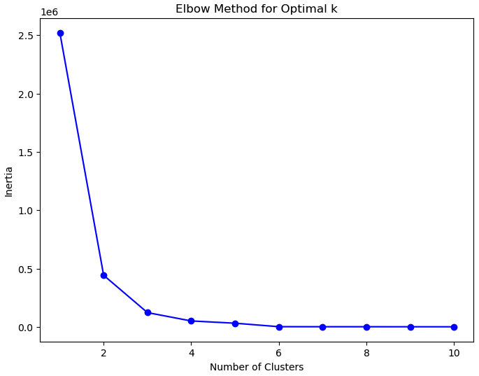
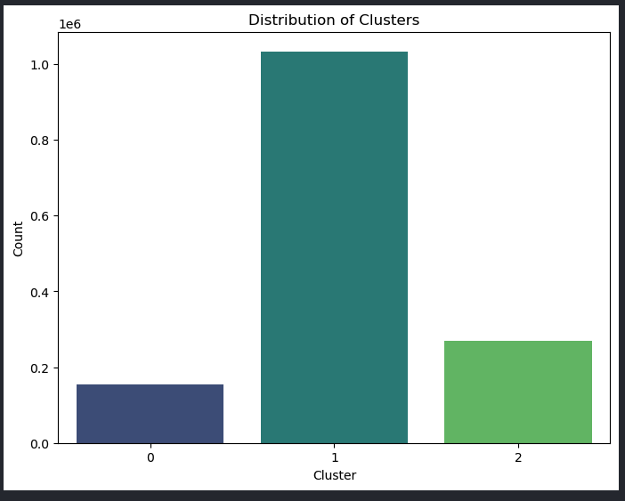
Clusters and Elbow

Slide 8
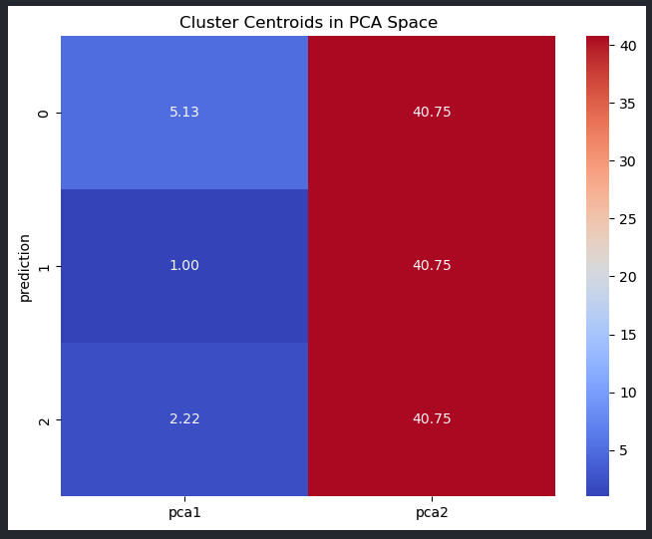
Next
The image shows a visualization of the cluster centroids in the PCA space. The key insights are:
There are 3 distinct clusters identified, represented by the 3 data points.
The x-coordinate (PC1) of the cluster centroids is 5.13, 1.00, and 2.22.
The y-coordinate (PC2) of the cluster centroids is 40.75 for all 3 clusters.
The positioning of the cluster centroids in the PCA space suggests there are 3 dominant trip patterns or profiles captured by the data. The high PC2 value (40.75) indicates this dimension is a significant factor in differentiating the clusters.

Slide 9
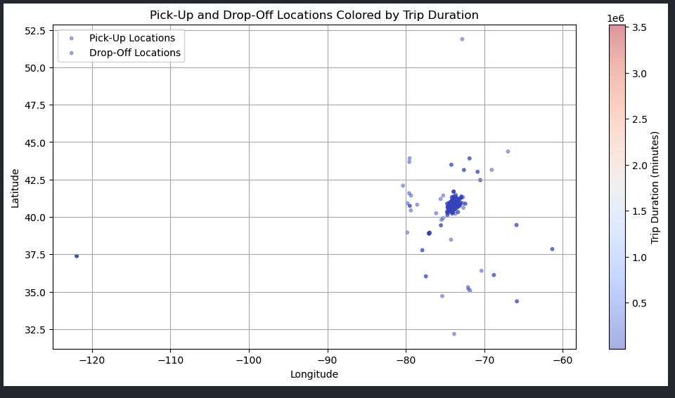
Pick-up and Drop-off Locations colored by Trip Duration
The image shows a scatter plot of pickup and dropoff locations for NYC taxi trips, colored by trip duration. Key insights:
Longer trips tend to have pickup and dropoff locations that are geographically further apart.
The drop off locations are more dispersed than the pickup locations, suggesting trips can end at a wider range of destinations.
Some clusters of pickup and dropoff points suggest certain high-traffic routes or zones in the city.

Slide 10
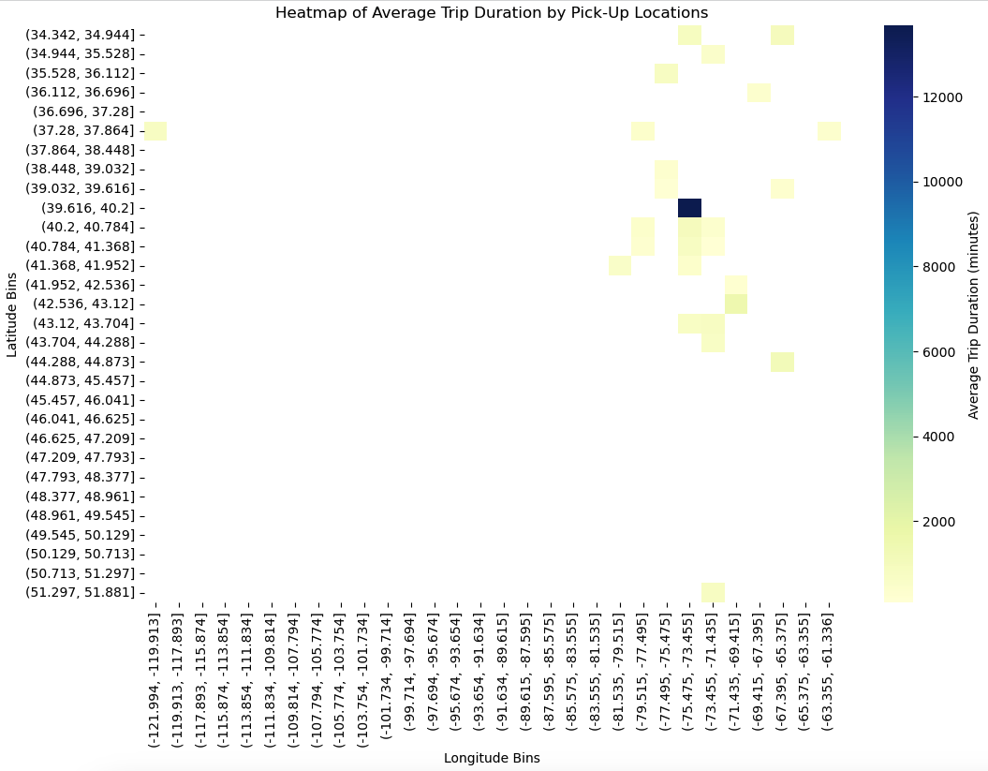
Heatmap of Average trip Duration By Pick_up Location
The heatmap displays the average trip duration for each pickup location in the NYC taxi data. The darker areas indicate longer average trip durations, while the lighter areas show shorter average trip times.

Slide 11
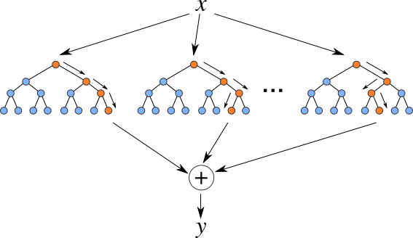
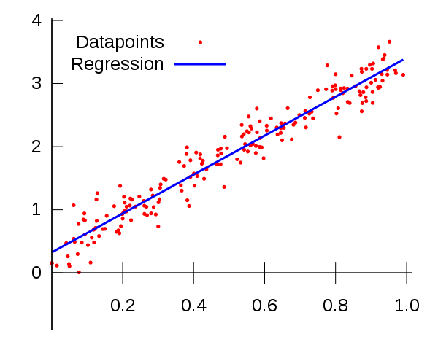
Trip Duration Prediction
01
Linear Regression
Linear Regression was selected as a simple baseline model, efficient for linear datasets and requiring minimal tuning.
02
Random Forest Regressor
The Random Forest Regressor was chosen for its ability to handle non-linear relationships, outliers, and irrelevant features, while also providing feature importance insights
Notes:
The objective is to predict trip duration using two machine learning models: Linear Regression and Random Forest Regressor.
Why We Chose Linear Regression and Random Forest Regressor
1. Linear Regression
Reason for Choosing: Linear regression is a simple, interpretable, and foundational model that serves as a baseline for comparison.
Conclusion for Use: Linear regression is a logical starting point to assess model performance and establish a baseline for predicting trip durations.
2. Random Forest Regressor
Reason for Choosing: Random forest is chosen as a more advanced model to capture complex patterns and interactions in the data, offering a practical benchmark for performance comparison with linear regression.

Slide 12
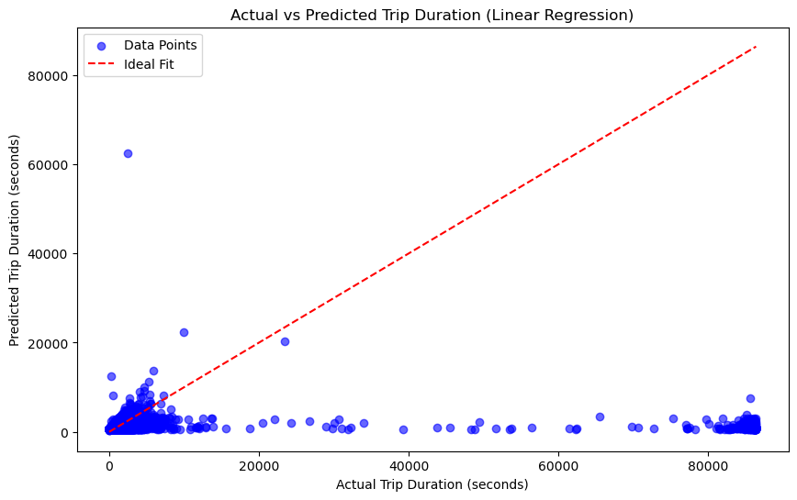
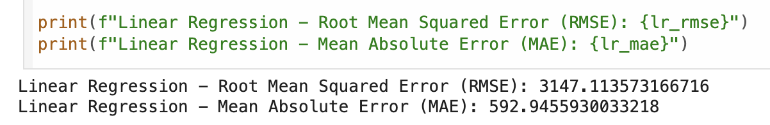
Linear Regression - Trip Duration
Root Mean Squared Error (RMSE):
Value: ~3147 seconds (~52.5 minutes).
Indicates the model's average prediction error, highlighting relatively high inaccuracies in predictions.
Mean Absolute Error (MAE):
Value: ~593 seconds (~9.9 minutes).
Represents the average deviation of predictions from actual trip durations.
Notes:
Model Evaluation Metrics
Root Mean Squared Error (RMSE):
Value: ~3147 seconds (~52.5 minutes).
Indicates the model's error magnitude which highlights its struggle with complex relationships.
Mean Absolute Error (MAE):
Value: ~593 seconds (~9.9 minutes).
Shows the average deviation of predictions from actual values.
Graph Insights
Scatter plot compares actual vs. predicted trip durations.
Deviations from the ideal fit line highlight the limitations of this model.
Key Takeaway
While linear regression is simple and interpretable, its inability to handle complex data limits its performance in this context.

Slide 13
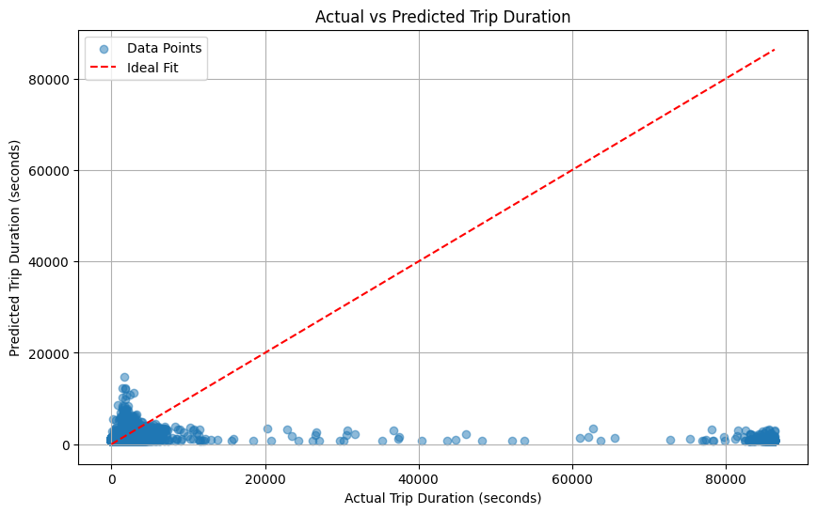
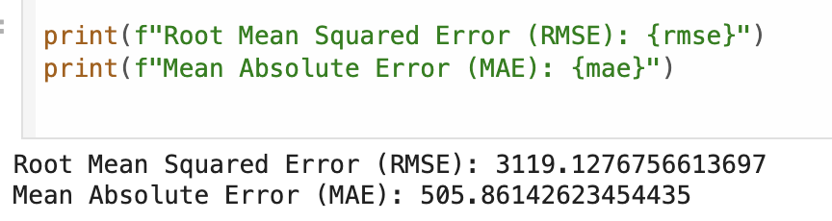
Random Forest Regressor - Trip Duration
Root Mean Squared Error (RMSE):
Value: 3119.13 seconds (~52 minutes).
Indicates the average magnitude of error between predicted and actual trip durations.
Penalizes larger errors more heavily, suggesting some significant deviations in predictions.
Mean Absolute Error (MAE):
Value: 505.86 seconds (~8.4 minutes).
Represents the average absolute error.
Shows that most predictions are relatively accurate, but larger errors inflate the RMSE.
Notes:
Key Insights:
Prediction Accuracy: The MAE of 8.4 minutes indicates that for most cases, the model does well in predicting trip durations. However, the RMSE being significantly higher suggests that the model struggles with outlier trips or unusual data points.
Room for Improvement: While the model performs decently, it can likely be improved by:
Incorporating additional features (e.g., weather, traffic data, holiday indicators).
Optimizing Random Forest hyperparameters (e.g., increasing the number of trees, adjusting maximum depth).
Addressing potential outliers in the data that may skew the RMSE.
Summary:
The Random Forest model is effective in predicting trip durations on average, but its performance could be improved to handle outlier cases better. If predicting extreme trip durations is critical, consider focusing on feature engineering and hyperparameter tuning.
—
This chart provides a visual comparison of actual versus predicted trip durations. Here's the evaluation based on the chart:

Slide 14
Comparison: Random Forest vs Linear Regression
A
Linear Regression
Advantages:
Simple, interpretable, and quick to train.
Effective as a baseline model.
Limitations:
Struggles with non-linear relationships, which are likely in trip duration data.
Sensitive to outliers, leading to reduced prediction accuracy.
B
Random Forest Regressor
Advantages:
Handles non-linear relationships well, which is common in datasets like trip duration influenced by various factors (e.g., traffic, time of day).
Robust to outliers and irrelevant features.
Provides feature importance, helping to understand which variables contribute most to predictions.
Limitations:
Can be computationally intensive with large datasets.
May not generalize well if the dataset has extreme noise.
Notes:
Linear Regression
Advantages:
Quick and easy to train.
Useful as a baseline model for linear datasets.
Limitations:
Struggles with non-linear relationships.
Sensitive to outliers, leading to reduced accuracy.
Random Forest Regressor
Advantages:
Handles non-linear relationships and outliers effectively.
Provides insights into feature importance, aiding in data interpretation.
Limitations:
Computationally intensive, especially with large datasets.
May not perform well with extreme noise.
—------
Recommendation:
Based on both the visual and numerical evaluations, Random Forest is the better-performing model for this dataset.
It handles the dataset's complexity, outliers, and non-linear relationships more effectively than linear regression.
Next Steps:
To further enhance performance, we can explore hyperparameter tuning for the Random Forest model, such as adjusting the number of trees or maximum depth.
Feature engineering, like better scaling features, could improve both models' accuracy

Slide 15
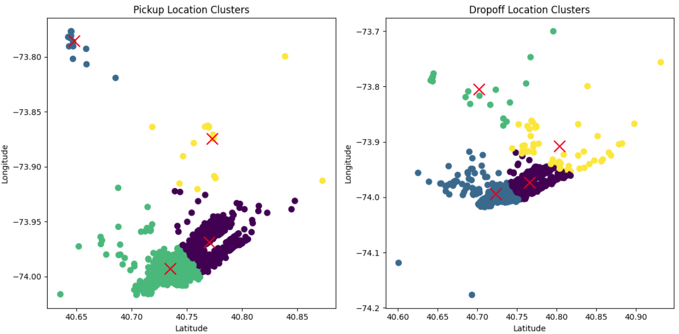
Pick up & Drop off Clusters using K-Means

Slide 16
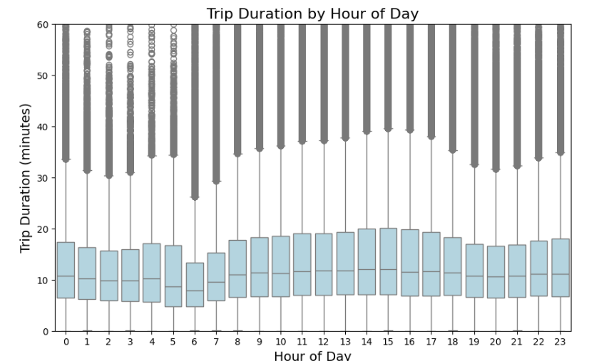
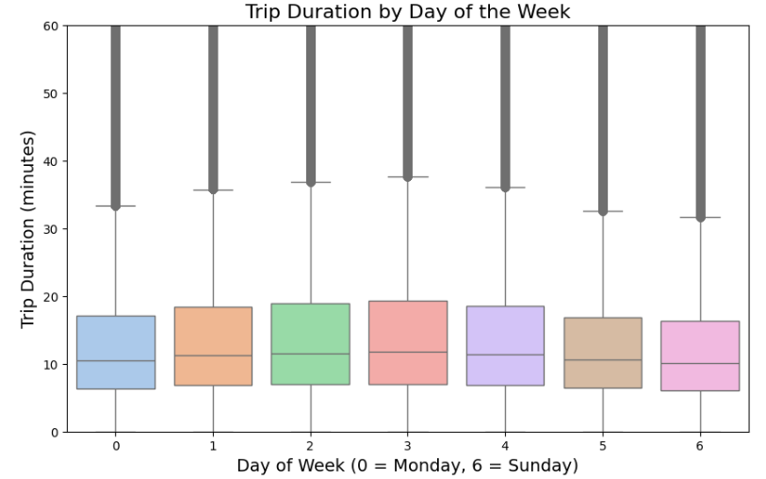
Boxplot showing Trip Duration

Slide 17

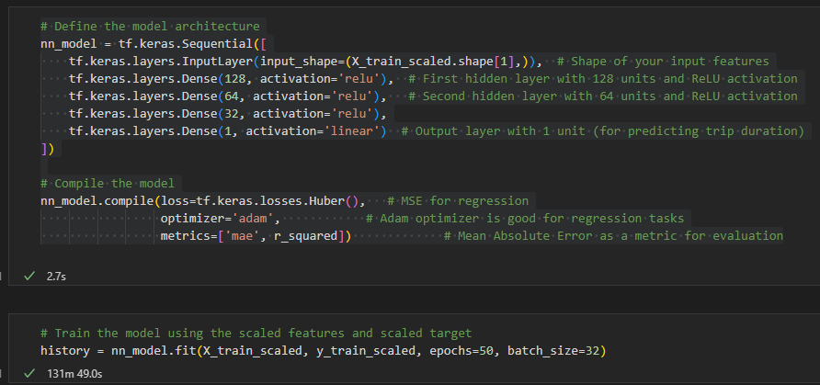
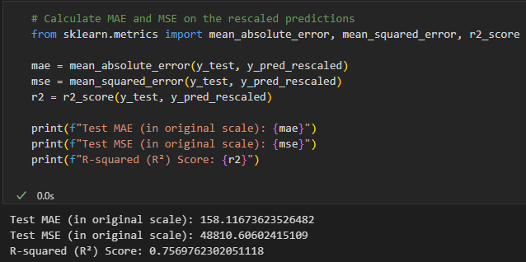
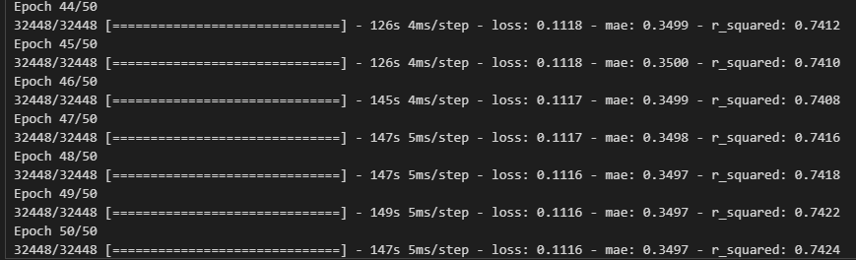
Neural Network Model
A neural network model was slowly tuned and optimized
The final model two 2+ hours to run locally with Pandas
Many iterations of the model during optimization
The final model r2 = 75%
Model was still improving (below)

Slide 18
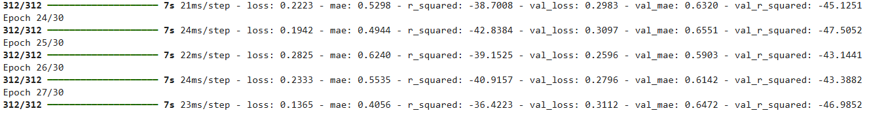

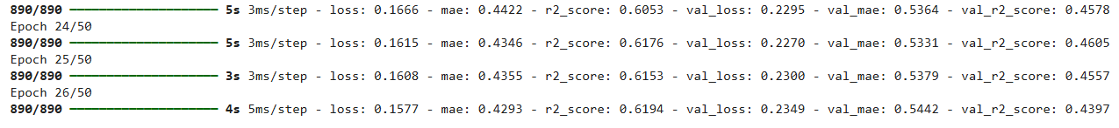
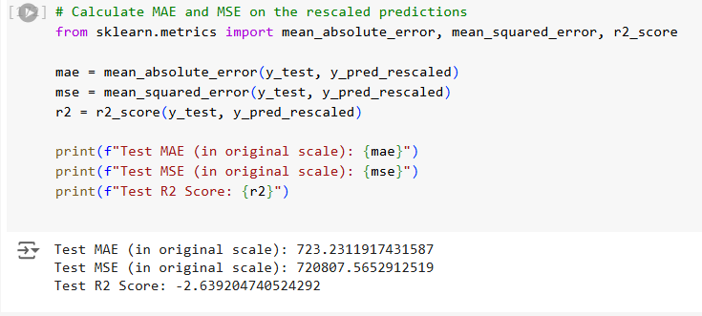
Bumpy Optimization Road
Pure Spark model
Spark/ Pandas model
Notes:
Many attempts were made to optimize this model. Initial test were done locally as a proof of concept. Next a machine learning model was created on Google Colab using PySpark and TensorFlowonSpark. This was an arduous task, and a fruitless one at that. The pure spark model had an r2 of -36%; this is very poor predictive power. Next, Spark was used on Colab but only for preprocessing the data. For the neural network model itself the dataset was converted back to Pandas. This Spark/Pandas combo trained much better than the pure Spark model (r2 of about 60% in training), although in evaluation it receive a -2% r2 score.

Slide 19
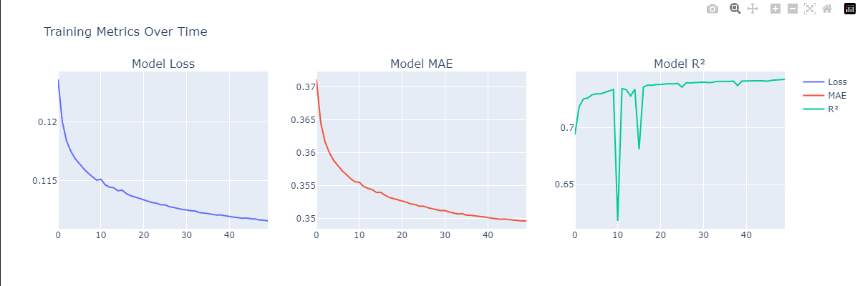
Optimized Model
Notes:
Here we see the model loss over time, model Mean Average Error over time, and finally r2 value over time. All three metrics improve over time, although after 50 epochs the improvements were much more gradual. The model fitting took over 2 hours to complete with pandas on a local machine, and received a r2 score of 75%. The gradual improvement suggests that perhaps, given more epochs, it could have reached r2 score of +80%. Time and resource constraints limited this model to 50 epochs.

Slide 20

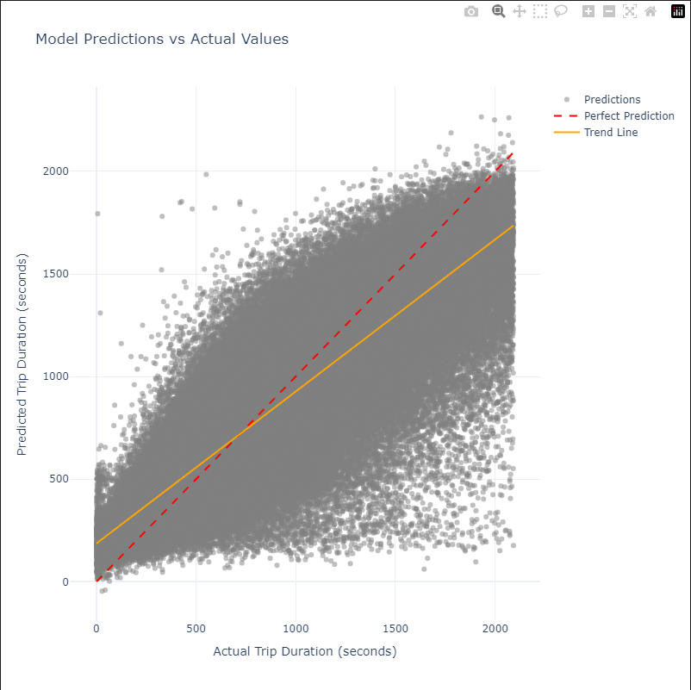

Optimized Model Continued
This model had a r2 score of 75%
This translates to predicting the trip duration with a MAE of about 2-3 minutes.
The sweet spot for the model seems to be around 500 seconds (8.3 minutes)
This visual also shows the amount of noise in the model
This dataset had over 1.4 million points

Slide 21
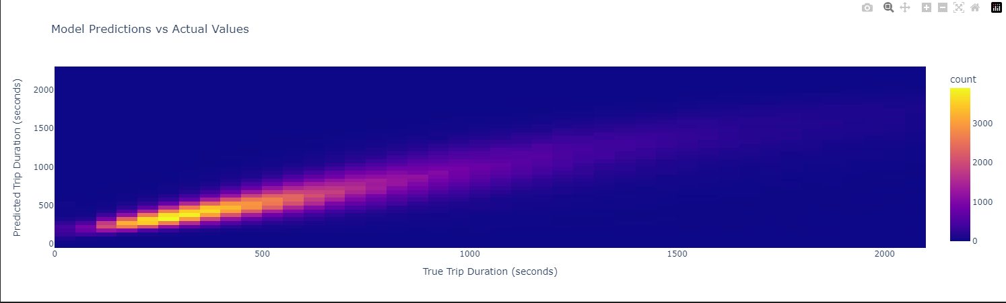
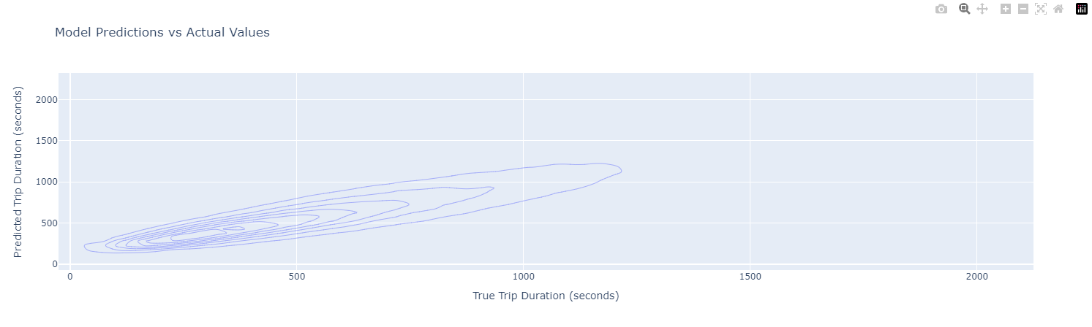
Notes:
This heatmap and density contour map show roughly the same thing: the model makes better predictions with shorter trips. After about 1000 seconds (about 16 minutes) the model starts to lose it predictive power.

Slide 22
Conclusion
Clusters
Neural Network
Prediction
Time and location groups
Trip duration target
Better for short trips
Analysis
Use
Investigation and key insights
Could be used by drivers and passengers

Slide 23
Questions?

