Slide 1

Cooperative vs. Non-Cooperative Game Theory on Solving Mazes

Slide 2
The Model
Agents inside the maze:
Have a value, which determines if agent cooperates with other person
Three roles:
Altruists cooperate with everyone who has information_ratio > 0.5
Individualists cooperate with everyone has information_ratio > 1
Competitive only cooperate with agents with information_ratio > 2
Agents exchange information, i.e. the location of dead ends in the maze
Maze is modelled as a Graph G = (V, E), where V is the set of nodes and E is the set of edges.
An Agent can travel from Nodes n and m, if the edge e = (n,m) exists

Slide 3
Simulation and Implementation
Simulation enviroment was created with Python and kivy to investigate mazes and agents
Mazes were randomly generated as well as starting positions
Agents run through the maze with a modified Depth-First-Search:
Agents run through the maze randomly and outrule certain paths based on visiting dead ends or cooperating with other agents which have information.

Slide 4
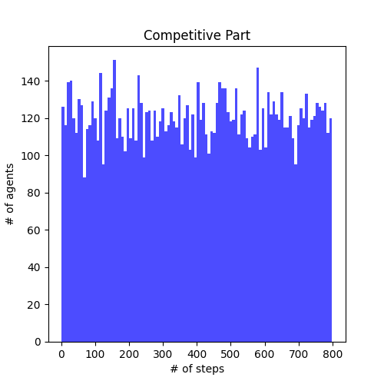
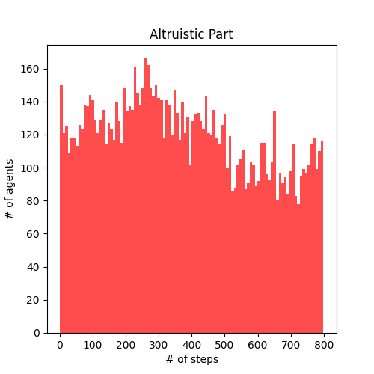
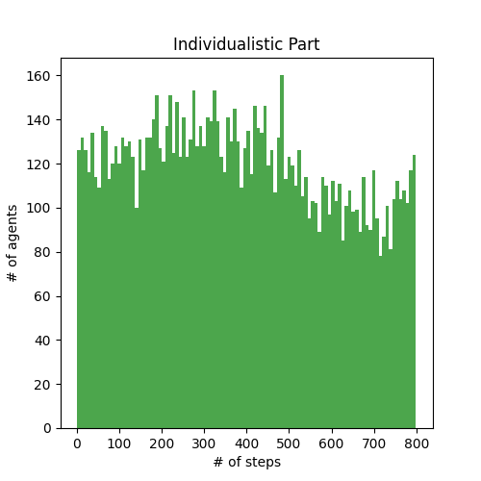
Results
Simulation was run with 20x20 mazes + 18 players and 30x30 mazes + 12 players.
Data of Simulation of a 20x20 maze and 6 Altruistic, 6 Individualistic, 6 Competitive Agents

Slide 5
Discussion
The simulation clearly showed that agents who share information more often have an advantage to agents who require lots of information.
This could be explained that the mazes were too easy, i.e. too small to give Competitive agents the advantage of getting information from others.
In a follow-up project, things like maze size and other variations could be explored
This model shows the advantage of sharing information well but has its weaknesses
Competitive agents are exploitive, but since cooperation comes from both end, Competitive never gain an advantage to the other Agents

Slide 6
Mazes in Nature - Ants
Ant colonies use collective intelligence when finding and bringing food to their nest
Ants scout for food and when bringing it home, they leave a pheromone trail that leads to the source
Since the pheromone trail evaporates and food can be discovered from different directions, then this will lead to the most efficient path since the shortest path will evaporathe the latest

Slide 7
Mazes in Nature - Funghi
Physarum polycephalum is a funghi that can solve the shortest path problem
Can create an efficient network when placed between different oat sources
Can even balance between different nutrients
P. polycephalum can be modelled with differential equations

