Slide 1
Using a Raspberry Pi as a PC-DMX interface
Florian Edelmann
Bachelor's Thesis – final presentation
Supervisor: Prof. Dr. Dieter Kranzlmüller
Advisors: Dr. Nils gentschen Felde
Tobias Guggemos
Date of presentation: 28th Nov. 2017

Slide 2
Technical background (1):
What is DMX?
Entertainment Services and Technology Association standard DMX512-A (2013)
Digital Multiplex with 512 individual pieces of information
first version: U.S. Institute for Theatre Technology (1986)
Used to control lighting fixtures
  Spotlights, Strobe lights, Moving heads, Scanners
Value for each of 512 channels: integer 0...255
DMX source: desk consoles / lighting control software

Slide 3
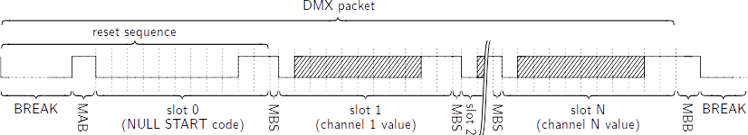
Technical background (2):
DMX protocol
Recognizing DMX packet start: BREAK
  low signal longer than one slot time
Other slots contain channel values
Not all 512 channels have to be included → faster refresh
Notes:
Universe

Slide 4
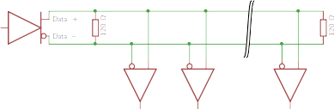
Technical background (3):
DMX: Electrical specifications
Based on EIA-485: differential bus
  Data encoded by potential difference between Data + and Data –
  Decreases interference liability
  Noise adds to both data lines equally → cancels itself out
  Termination resistors (120 ohms) prevent reflections

Slide 5

Technical background (4):
Art-Net
Created by Artistic License (1998)
DMX over UDP (multiple universes per IP address)
  Allows to use standard network equipment
Common setup: Art-Net Node

Slide 6
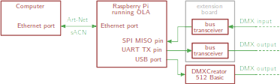
Requirements & System design
Easy for end-users
Less than 100€ in total
Extensible (e.g. more DMX inputs / outputs)
Open-source
Notes:
2 DMX outputs, 1 DMX input → haptic control

Slide 7
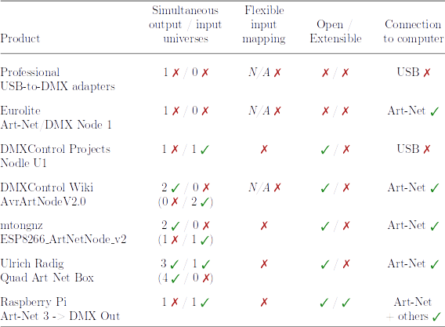
Market study:
Available interfaces < 100€

Slide 8
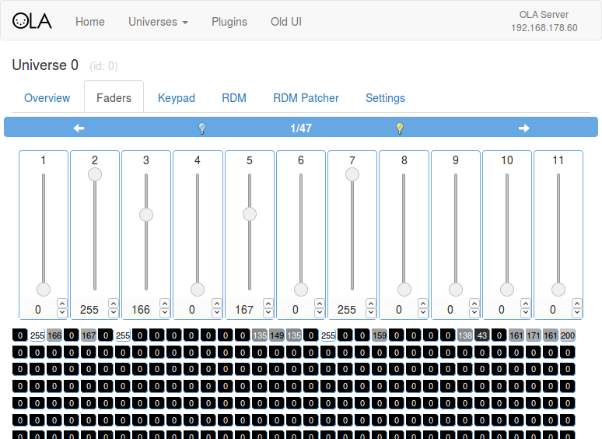

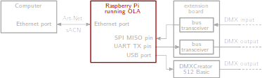
Open Lighting Architecture
Open-source software to convert different protocols
to / from DMX
Raspberry Pi
version available
Web interface

Slide 9
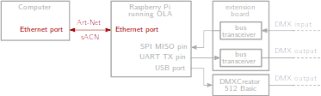
Art-Net Plugin
Does already exist

Slide 10
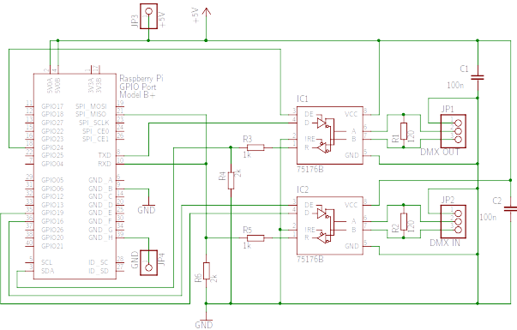
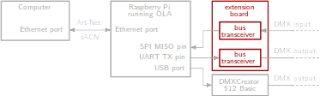
Electrical engineering (1):
Schematic

Slide 11
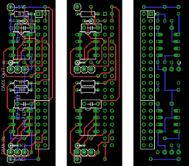
Electrical engineering (2):
Layout

Slide 12
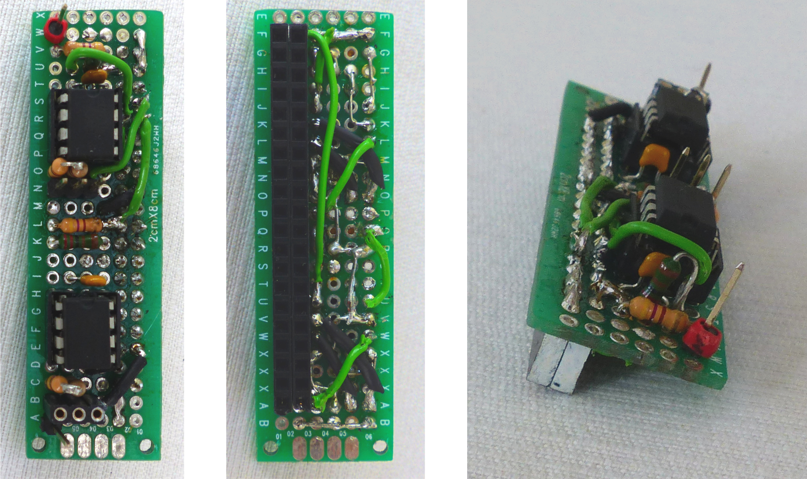
Electrical engineering (3):
Photos

Slide 13
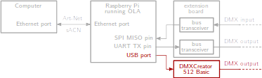
USB DMX sub-plugin
Reverse engineering USB traffic with Wireshark
Implementation as USB DMX sub-plugin
Provides one DMX output port

Slide 14
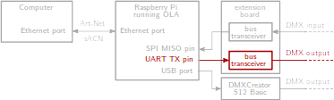
Native UART DMX Plugin
Universal Asynchronous Receiver Transmitter
  Serial protocol, often in microcontrollers (EIA-232)
  Slots, start bits, stop bits, BREAK → similar to DMX
Existing plugin provides one DMX output port

Slide 15
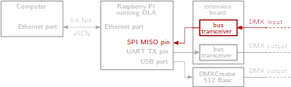
Native SPI DMX Plugin (1):
Failed approaches (1)
Extension of Native UART DMX Plugin
  High-level interface
  BREAK detection difficult: How to distinguish 0 value from BREAK?
  Only random data after a while → UART possibly confused by BREAKs

Slide 16
Native SPI DMX Plugin (2):
Failed approaches (2)
Bit bang reading GPIO pins
  Too inaccurate at 250kbit/s

Slide 17
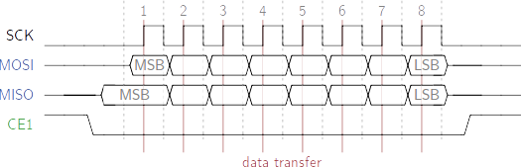
Native SPI DMX Plugin (3):
SPI
Serial Peripheral Interface
  SCK (synchronous), MISO, MOSI, CE lines
  Master and slave(s) simultaneously read / write

Slide 18
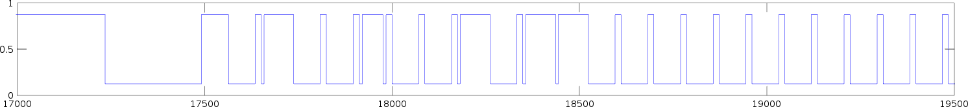
Native SPI DMX Plugin (4):
SPI sampling technique
SPI designed for higher speeds → separate timing
  8x oversampling (2MHz)
DMX signal fed into MISO pin, other pins unconnected
Proof of concept: Receive and plot in GNU Octave

Slide 19
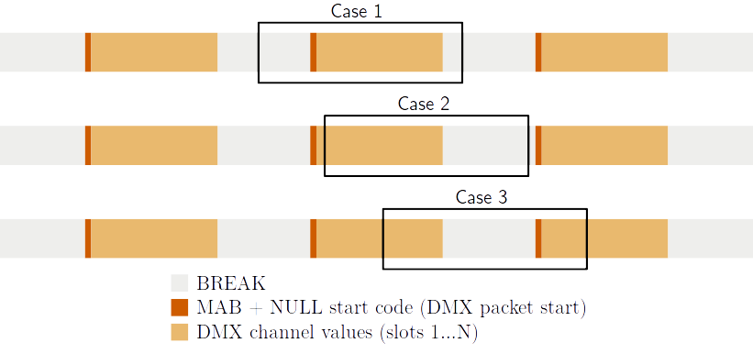
Native SPI DMX Plugin (5):
SPI sampling problems
SPI chunks separated by uncaptured gaps
No stream parsing possible
Notes:
Chunk size adjustable

Slide 20
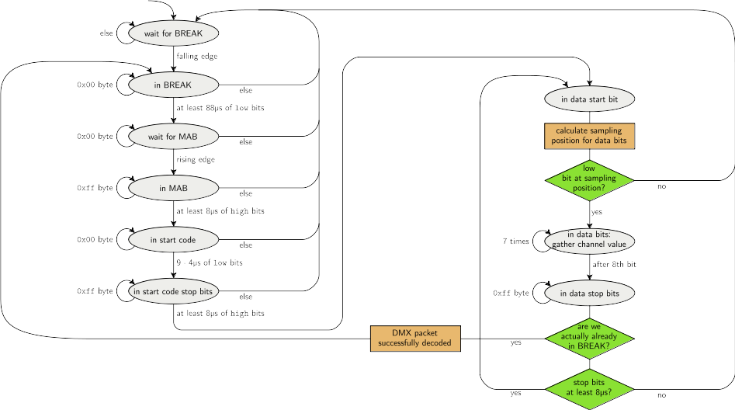
Native SPI DMX Plugin (6):
SPI sampling state machine

Slide 21
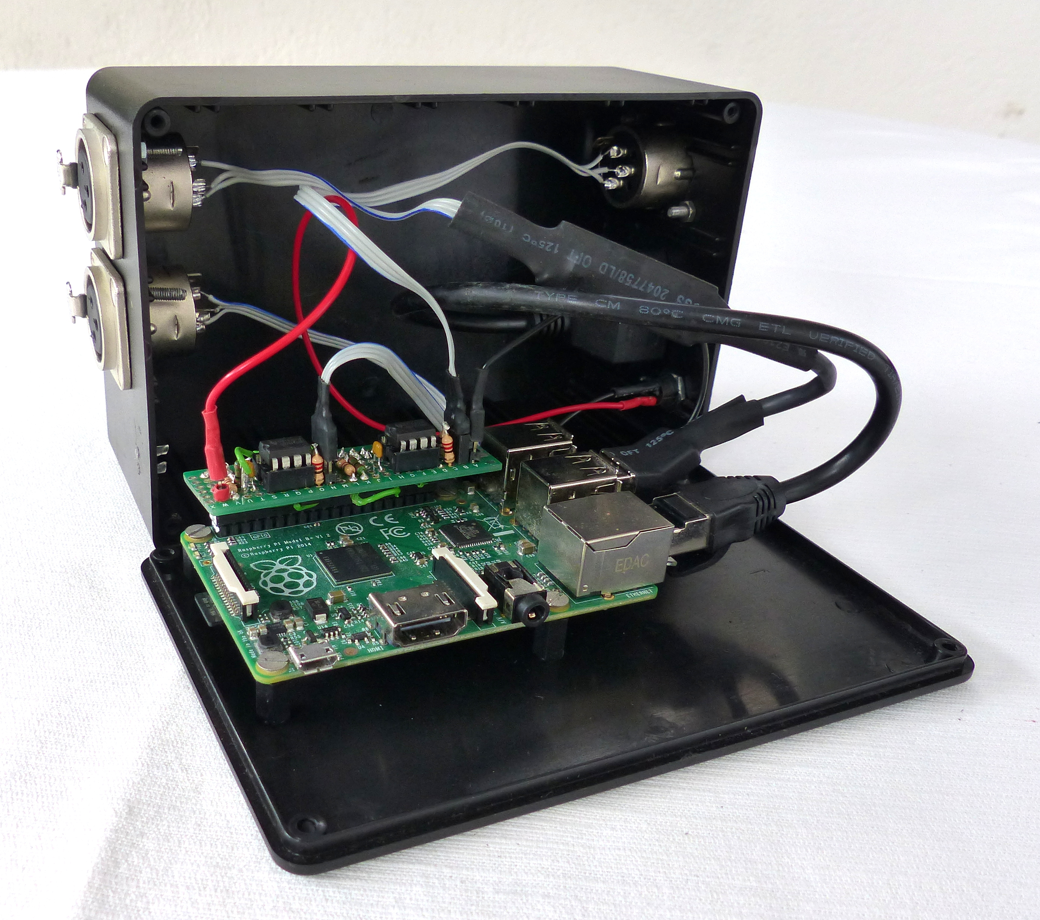
Finished PC-DMX interface
Notes:
Explain connections
Price: 60€ (+400€)
Automatic Testing difficult, but...

Slide 22

Manual testing

Slide 23
Backup slides
Backup slides

Slide 24
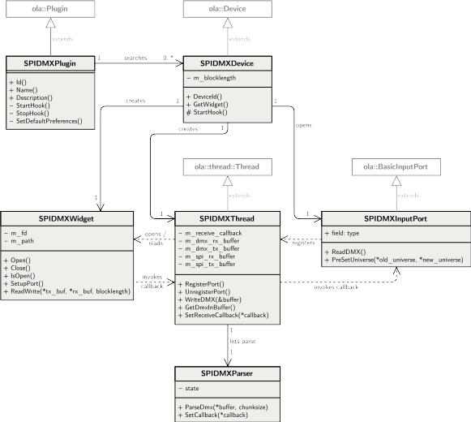
Native SPI DMX Plugin (7):
Wrapping into OLA Plugin

Slide 25
Outlook
More Raspberry Pi-native output ports
  SPI MOSI (promising)
  GPIO bit banging (worth investigating)
Remote Device Management (RDM)
  Bidirectional DMX protocol extension
  Input & output port together needed
Improve network management
  Hardware switch for master mode
  Master runs DHCP server and provides Wi-Fi access point

