Slide 1
Pluralism and Alignment
SE Emerging Trends in Spatial Data Science (2026W)
Mattis Gerhardt
Florian Frank

Slide 2
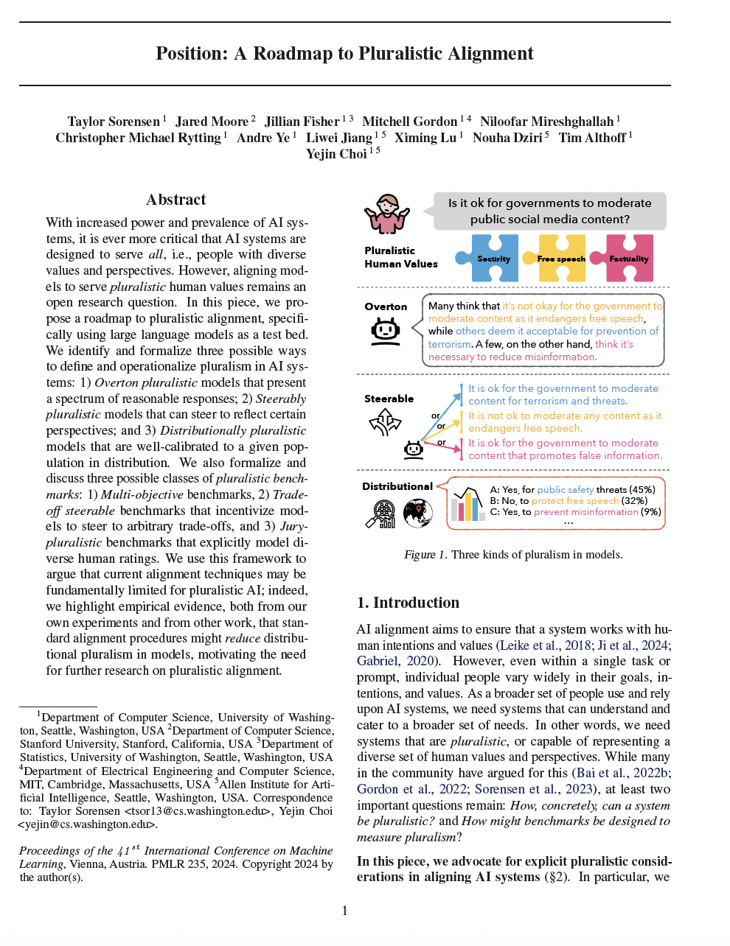
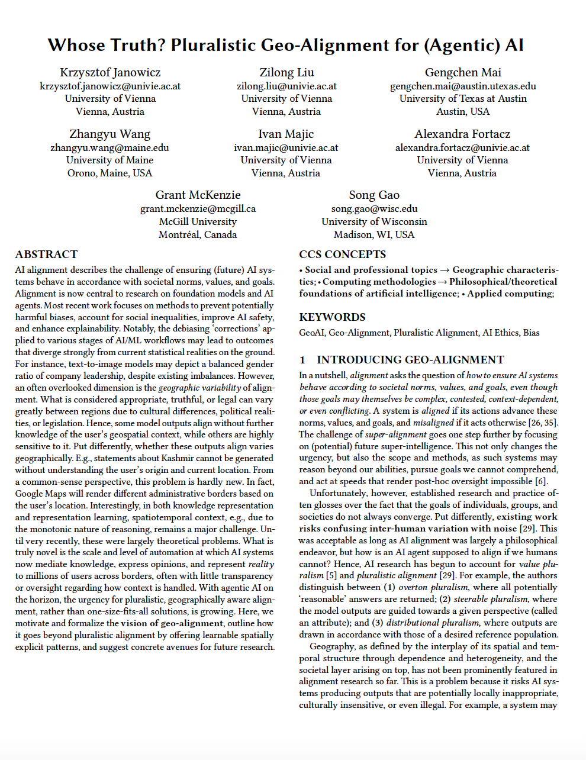
Papers overview
A roadmap to pluralistic alignment
  Sorensen, Taylor, Jared Moore, Jillian Fisher, Mitchell Gordon, Niloofar Mireshghallah, Christopher Michael Rytting, Andre Ye et al.
Whose Truth? Pluralistic Geo-Alignment for (Agentic) AI – Autoren
  Janowicz, Krzysztof, Zilong Liu, Gengchen Mai, Zhangyu Wang, Ivan Majic, Alexandra Fortacz, Grant McKenzie, and Song Gao.

Slide 3

What ist Pluralism?
Coexistence of diverse groups in a society
With differnet values, perspectives, cultures, relegions, political beliefs ...

Slide 4
What is Alignment?
Ensure that Ai-Systems behave according to societal norms, values and goals
Problem: How can Ai-Systems serve a diverse groupe of people

Slide 5
Concrete Problems – Roadmap
When a question has multiple (resonable) answers, a model may just give one of them, acting as if it was the only answer
Models may be biased towards certain perspectiv -> research shows that Ai-Models are most aligned with male, liberal, wealthy americans
Evaluation benschmarks do not properly represent these issues

Slide 6
Reserach – Roadmap
Comparing pre and post aligment Models
Three definition of pluralistic models
Three definition of pluralistic benchmarks

Slide 7
Key findings – Roadmap
Aligment can reduce response diversity
Pluralismus needs differnt training and evaluation
Catering to the average opinion does not represent the population

Slide 8
Concrete Problems – What is Alignment?
If an Answer ist resenable depends on the location, model answers often ignore this - > Geo-Alligment
Geo-Alligment: adding learnable spatially explicit patterns, that underly the diverse perspectives all should align it

Slide 9
Reserach – What is Alignment?
Formalizing Geo-Aligment
Highlighting some proposed research dirctions

Slide 10
Key findings – Roadmap
Its about ideas and future reasearch topics for Geo-Aligment research
Spatial veriation ist not properly imported in Ai-Aligment but offers learnable solutions

Slide 11
Experiment
Pose the question to the audience
  Eg.: How do you greet a stranger?
Ask the AI ​​for its response from various perspectives
Compare the AI's answers with the opinions expressed by the audience

