Slide 1
Pluralism and Alignment
SE Emerging Trends in Spatial Data Science (2026W)
Mattis Gerhardt Florian Frank
Notes:
Mattis

Slide 2
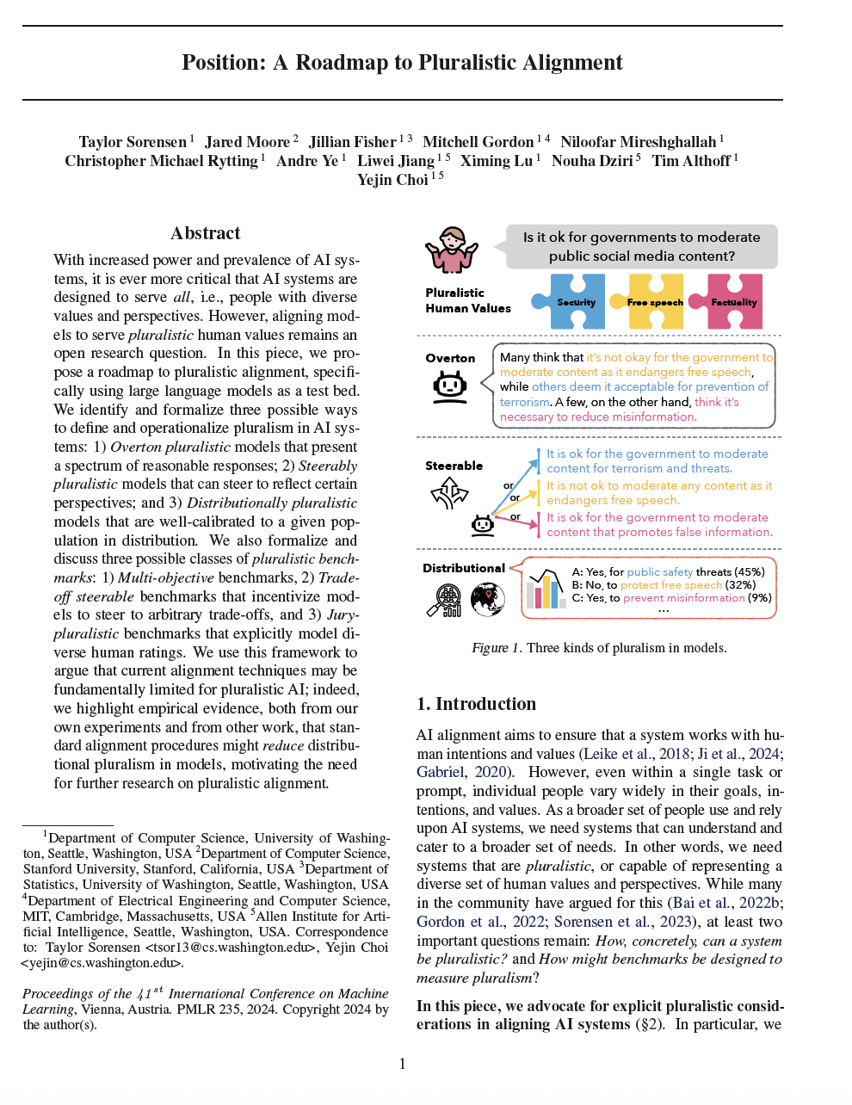
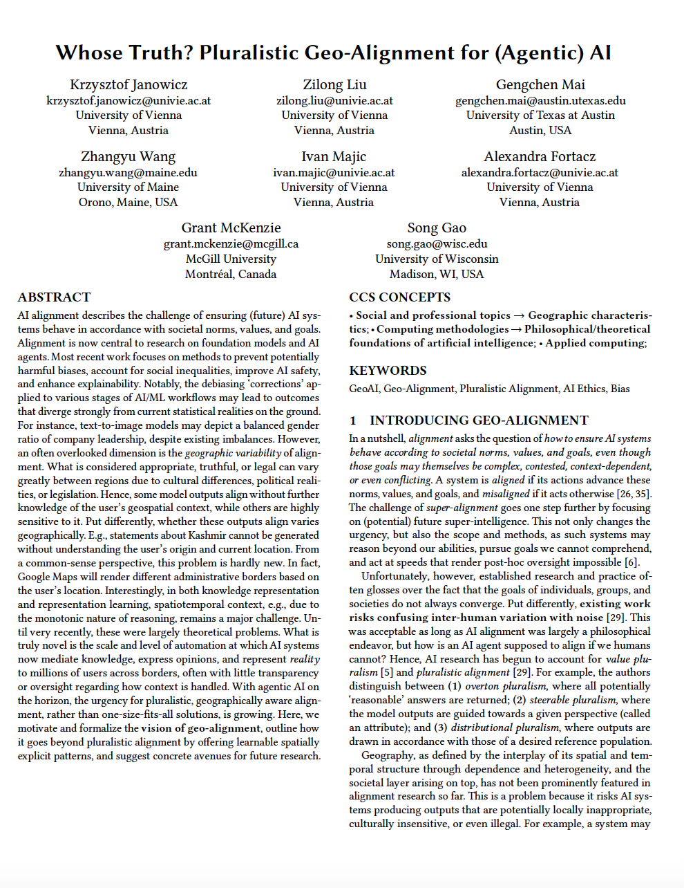
Literature
Notes:
Mattis

Slide 3


What are Pluralism and Alignment?
Pluralism
  Coexistence of diverse groups in society
  Diverse values, perspectives, cultures, religions, political beliefs, …
Alignment
  AI-Systems should behave according to societal norms, values and goals
Notes:
Mattis

Slide 4
A Roadmap to Pluralistic Alignment
Problems
Multiple reasonable answers model response is only one of them
Models may be biased towards certain perspectives
  White, male, liberal, wealthy, american
Evaluation benchmarks do not properly represent these issues
Notes:
Florian

Slide 5
A Roadmap to Pluralistic Alignment
Research
Comparison of pre- and post-aligned models
Three definitions of pluralistic models
Three definitions of pluralistic benchmarks
Notes:
Florian

Slide 6
A Roadmap to Pluralistic Alignment
Key Findings
Alignment can reduce response diversity
Pluralism needs different training and evaluation
Catering to the average opinion does not represent the population
Notes:
Florian

Slide 7
Whose Truth? Pluralistic Geo-Alignment for AI Problem
If an answer is reasonable depends on the location,
model answers often ignore this
Geo-Alignment
Adding learnable spatially explicit patterns
Notes:
Mattis
Adding learnable spatially explicit patterns, that underly the diverse perspectives AI should align to
Bild?

Slide 8
Whose Truth? Pluralistic Geo-Alignment for AI Research
Formalizing Geo-Alignment
Highlighting some proposed research directions
Notes:
Mattis

Slide 9
Whose Truth? Pluralistic Geo-Alignment for AI Key Findings
Geo-Alignment can be formalized using a divergence measure
Spatial variation is not properly implemeted in AI alignment but offers learnable solutions and should be researched further
Notes:
Mattis
HIER MUSS NOCH WAS PASSIEREN

Slide 10
Experiments for our Presentation
Create questions with multiple correct answers that differ between places
Collect answers from commen AI models, answered from different perspectives
Collect answers from the audience
Compare, maybe build a small application to make it pretty
Notes:
Florian

Slide 11

THANK YOU FOR YOU ATTENTION!
Notes:
Florian

