Slide 1
Male and female IPF polygenic risk scores and predictive accuracy
Flo Goemans, BVMS MSc MRCVS
8 March 2023
Project July – December 2021, University of Leicester MSc Medical Statistics 2022
Supervisors: Louise Wain & Olivia Leavy

Slide 2
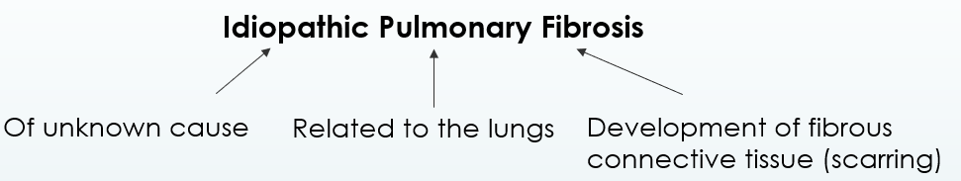
Background and Aims
To investigate the existence of any sex differences in the genetic architecture of IPF.
To test whether taking sex into account can help to improve prediction accuracy of a PRS.
Notes:
IPF – Idiopathic pulmonary fibrosis is a rare and devastating lung disease with a median survival time of just 3 – 5 years. It results in irreversible scarring and progressively worsening lung function. About 70% of people diagnosed with IPF are male.
IPF risk is influenced by genetic factors and genome wide association studies (GWAS) have discovered a number of individual genetic variants associated with IPF, with the group at Leicester at the forefront of this research (nice paper Richard).
Recently, sex differences in the genetic architecture of other traits have been identified. Establishing if such a sex difference exists in IPF could increase our understanding of the disease. Additionally, this project aims to test whether taking sex into account can help to improve prediction accuracy of a polygenic risk score (PRS).
AIMS:
1) To investigate the existence of any sex differences in the genetic architecture of IPF.
2) To test whether taking sex into account can help to improve prediction accuracy of a PRS.

Slide 3
Data
Base Data
GWAS Summary Statistics
Effect sizes and p-values from
2668 cases
1811 male, 806 female
8591 controls
~ 11 million variants
Target Data
793 cases
597 male, 196 female
9999 controls
Age, sex smoking history match
Allen R et al. (2020). Genome-Wide Association Study of Susceptibility to Idiopathic Pulmonary Fibrosis. Am J Respir Crit Care Med.
Notes:
Rather than focus on individual associations, the effect of multiple SNPs can be combined into a cumulative estimate of risk. Generally, the polygenic score provides a measure of individual risk based on the sum of risk alleles a subject possesses weighted by the effect size of each risk allele. For a binary trait like IPF the effect sizes are the beta coefficients (log Odds Ratios) taken from an initial training sample (base data) – a GWAS with as large a sample size as possible. The score is then applied to a target sample with individual genotype and phenotype data.
Moving onto the data. I’m basically using 2 quite large datasets.
First, the summary statistics from the Allen et al study mentioned previously. However, because IPF is a rare disease, the sample size is still fairly small in GWAS terms.
The second dataset is our target data. This is made up of 793 cases, of which 196 are female
The controls are from the UK biobank and were selected so that the age, sex and smoking history matched the overall distributions found in the cases.
If there are differences in the genetic risk factors between males and females, we might expect a score calculated using GWAS summary statistics (which contain more males than females) to perform less well when applied to the females in our target data.

Slide 4
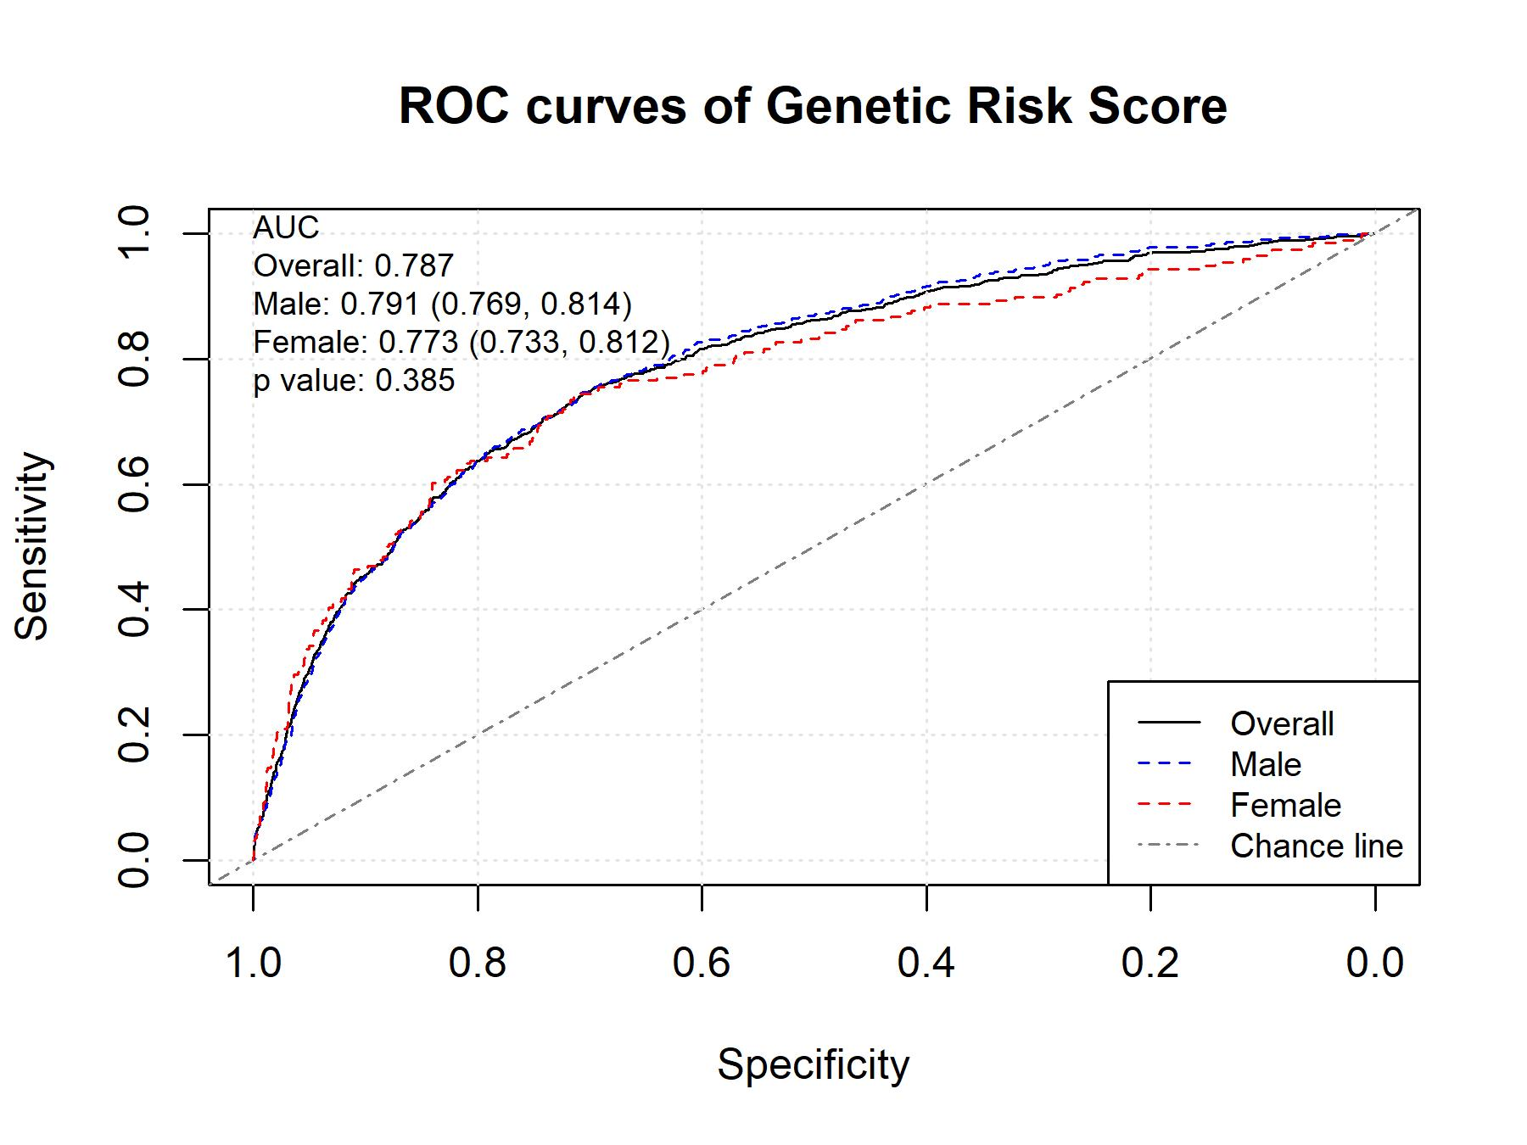
ROC curves of a Genetic Risk Score from the
15 known IPF risk variants
Notes:
The initial analysis of the 15 SNP GRS using sex-agnostic effect sizes showed that the combining effects from the 15 known IPF risk variants produced a score that was highly associated with IPF (OR 2.67; p=1.49 x 10⁻¹⁶⁰) with a moderately high discriminative ability between cases and controls (AUC 0.787 CI: 0.768 to 0.806).
Stratifying the score by sex did not improve predictive accuracy (males 0.791 CI: 0.769 to 0.814); females 0.773 CI: 0.733 to 0.812; p = 0.385). The clinical utility of the score was considered and, despite the moderately high AUC, the positive predictive value at population level was low.
If there were differences in the genetic risk profiles between sexes, then we simply haven’t had the power in current GWAS for variants that are more associated with IPF risk in females to achieve genome wide significance. In other words, we need to look beyond just the known genetic associations.
The AUC looks good, but remember that IPF is a rare disease, so the positive predictive value – which is the probability that someone with a score above a particular cut-off actually has IPF will be low at any of the chosen cut-offs.
Prevalence difficult to estimate accurately because of inconsistent case definition and difficulty diagnosing, but estimates in the literature range from to 1.25 to 63 cases per 100,000 population. Prevalence is higher in over 65s (as might be expected), but even then, we may no get much clinical utility from applying this score.
Sensitivity – proportion of patients with IPF who are correctly identified as having IPF at a given cut-off Specificity – proportion of patients without IPF who are correctly identified as not having IPF No sex difference when looking at these 15 known risk loci. However, if the genetic risk profile was different between sexes we might expect that variants that are more associated with IPF risk in females would not have the power to achieve genome wide significance in the GWAS performed to date

Slide 5
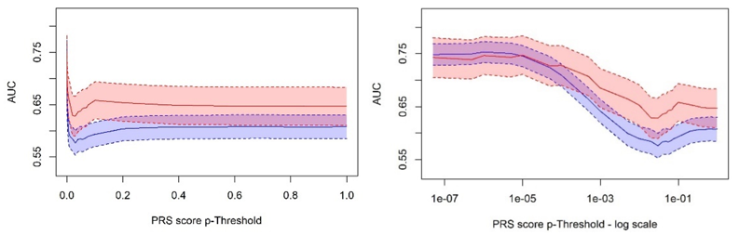
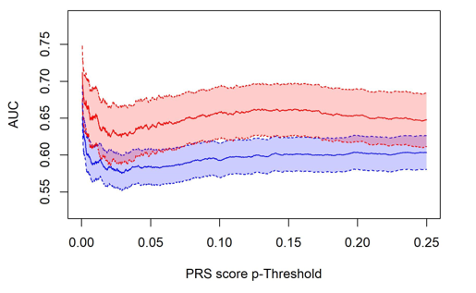
Polygenic Risk Score Results
AUC (95%CAUC (95%CI) of PRS across p-value thresholds by sex
I) of PRS across p-value thresholds by sex
Biggest sex difference
threshold 0.1012
AUC (95%CI) of PRS across p-value thresholds by sex
AUC (95%CI) of PRS across p-value thresholds by sex
pT = 1x10-6
pT = 1x10-5
Sex difference not significant at α = 0.1%
No increase in performance when optimising by sex
No improvement compared to using known risk factors
Notes:
To expand the GRS to PRS scoring with many p-value thresholds, PRSice v1.25 was used.
Some sex differences were seen when performing PRS scoring using the sex-agnostic weightings with a maximum difference at around pT=0.1. The p-value of difference between the AUC was 0.0022.
Optimising for predictive accuracy by sex did not produce improved scores compared to the GRS (males p value threshold 1x10⁻⁶, AUC 0.753 CI: 0.730 to 0.776; females p value threshold 1x10⁻⁵, AUC 0.747 CI: 0.707 to 0.788). In other words, these analyses yielded no improvements over the GRS seen on the previous slide

Slide 6
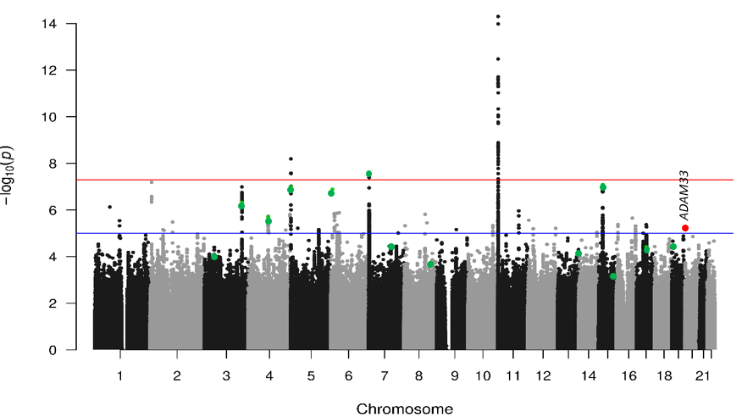
Meta-analysis of female specific effect sizes from a sex-interaction GWAS
Manhattan Plot of β₁ SNP term (for females) p-values.
PDZD2
RBM20
ZFAND3
RBFOX1
DNAI4
SOX5
ADAM33
Each dot represents a variant. Position is indicated along the x-axis, with the association of each variant given on the y-axis where higher -log₁₀(p) indicates stronger association. Red horizontal line at 5x10⁻⁸ is the genome-wide significance line, blue line at 1x10⁻⁵ the genome-wide suggestive line. Green dots represent SNPs used in the initial 15 SNP GRS (SPDL1 not included as MAF <1%). Y axis truncated at 15 (MUC5B variant not shown). Red dots are female specific SNPs (above genome wide suggestive line in this GWAS, but not in the sex-agnostic GWAS) with MAF > 5%.
Notes:
We meta-analysed the SNP term – which was equivalent to the effect size estimate for females (in our parameterization) and looked at PRS scores using these effect estimates. Using the sex specific estimates did not improve predictive accuracy in females.
I performed a GWAS of the female specific effect estimates. No signals reached genome wide significance, but it highlighted 16 variants of interest including a variant in ADAM33, a gene which has been previously implicated in IPF.
When these were added to the GRS they did not improve the predictive accuracy with either sex-agnostic or female-specific effect estimates.

Slide 7
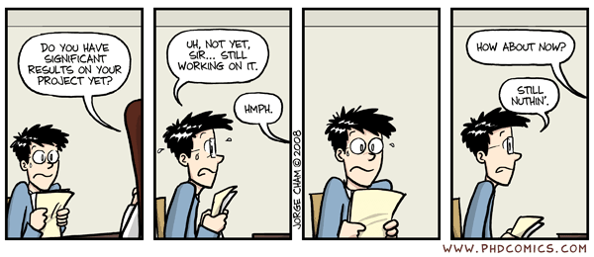
Conclusion
I learnt a lot, and really enjoyed the project
R 4.0.1
SPECTRE
PRSice v1.25
PLINK v1.9
PRS
Meta-analysis
Logistic Regression
GWAS
Interaction terms
AUC
Notes:
We further considered using the results of a sex-interaction GWAS.
The direction of the effect of the sex interaction term was used to inform the selection of SNPs before creating a PRS. We partitioned the SNPs from the sex-agnostic GWAS into ‘male’ or ‘female’ subsets to see if these showed sex differences when tested against the target data.
Within this project we have established that PRS scores can be used to investigate sex differences in genetic architecture of a rare complex trait such as IPF.
A GRS of just the known IPF risk variants had moderate predictive accuracy with an overall AUC of 0.787.
None of the more complex analyses improved on this.
More work needs to be done with larger datasets and sex-specific GWAS before we can conclude whether there are sex differences within the genetics of IPF. However, at present, there is no evidence to recommend that sex-specific PRS scores be considered for risk prediction.

Slide 8
Questions
Notes:
That concludes my presentation and I’d now be very happy to take any questions or comments.

Slide 9
Supplementary Materials

Slide 10
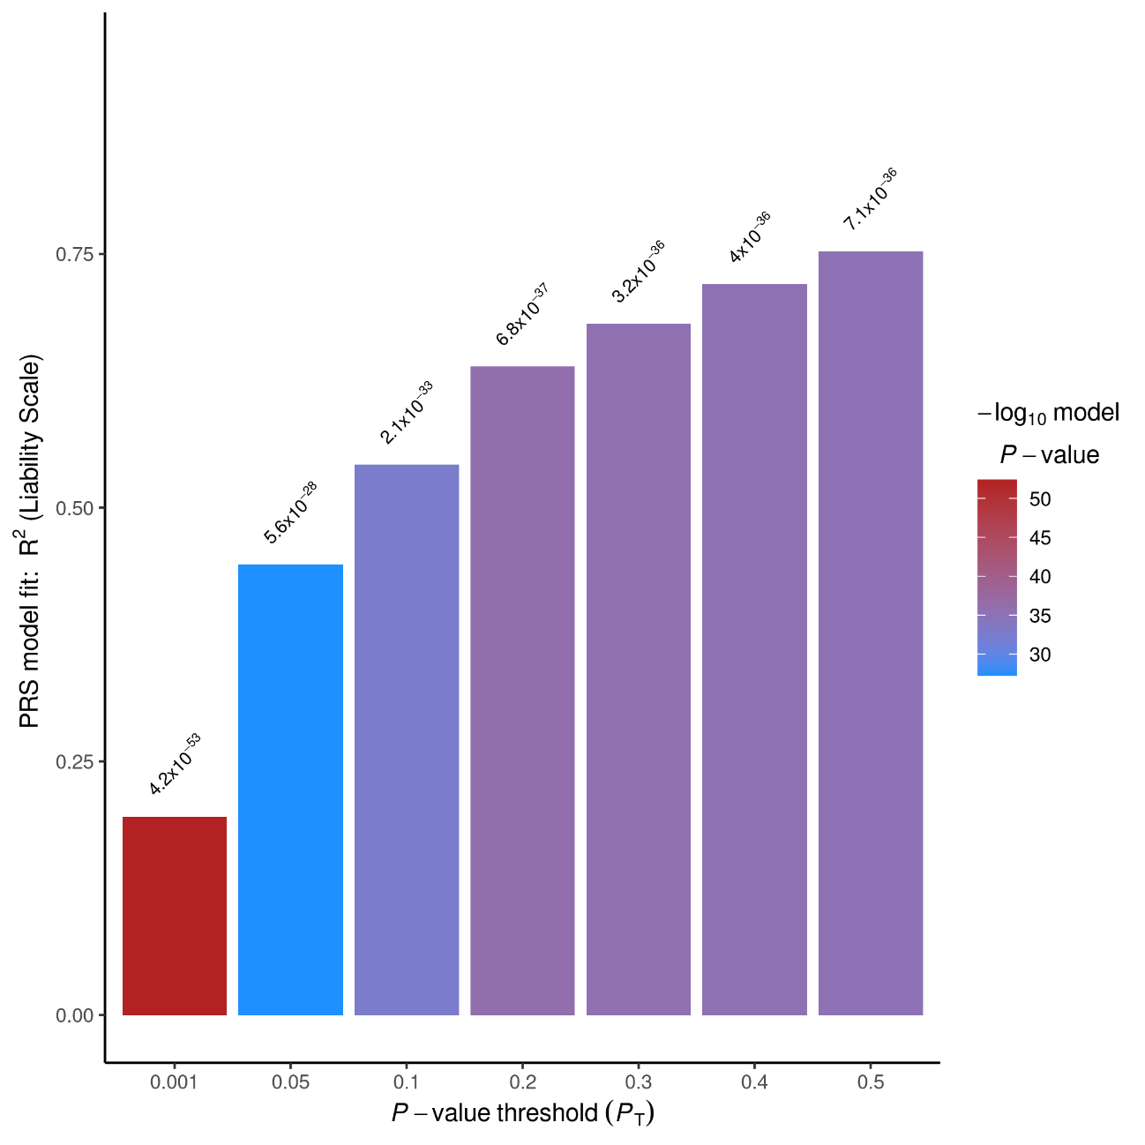

PRSice – sex agnostic estimates,
$${GRS}_{j}= \sum_{i=1}^{N}{β_{i} ×G_{ij}}$$
Logistic regression to test association between
GRS score and disease status.
$${IPF}_{i}= β_{0}+{ β}_{1}{Score}_{i}+ { β}_{2}{Sex}_{i}+{β_{3}PC}_{1i}+…+ β_{12}{PC}_{10i}+ ε_{i}$$

Slide 11
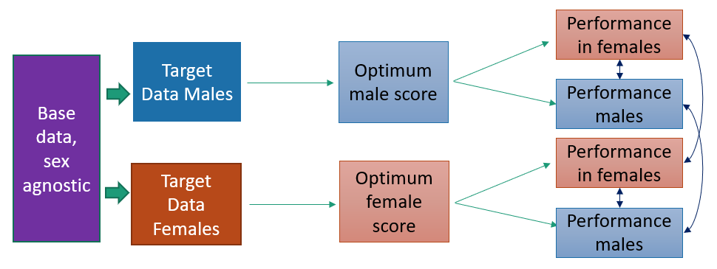
Optimising the PRS by sex
Notes:
If needed to show how PRS was optimised and compared for sex specific predictive accuracy

Slide 12
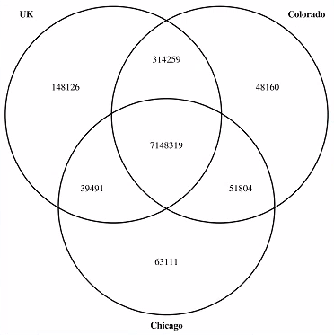

Sex-interaction Analysis
$${IPF Status}_{i}= β_{0}+{ β}_{1}{SNP}_{i}+ { β}_{2}{Sex}_{i}+{ β}_{3}{SNP}_{i}{Sex}_{i} +{PC}_{1i}+…+ {PC}_{10i}+ ε_{i}$$
Notes:
Where ${IPF}_{i}$ is the log of odds of having IPF for subject $i$ with ${ SNP}_{i}$ risk alleles, ${ Sex}_{i}$ and ${PC}_{1i}$ to ${PC}_{10i}$, where${ PC}_{1}$to ${PC}_{10}$ are the genetic principal components.${ {SNP}_{i}Sex}_{i}$ is the sex-interaction term.$β_{j}$ is the log(OR) for a 1 unit increase in the j^{th} covariate. Within the analysis, the sex coding was female=0 and male=1. Therefore, for each SNP, the risk, or log(OR) for a female is given by β₁, with the log(OR) for a male given by β₁ + β₂ + β₃. Both β₁ and β₃ increment for each copy of the effect allele, whilst β₂ is constant within a SNP.
The 3 studies were meta-analysed using PLINK1.9 using a fixed-effect, inverse-variance weighted meta-analysis to give one effect size per SNP.
SNPS included if they were present in 2/3 studies.

Slide 13
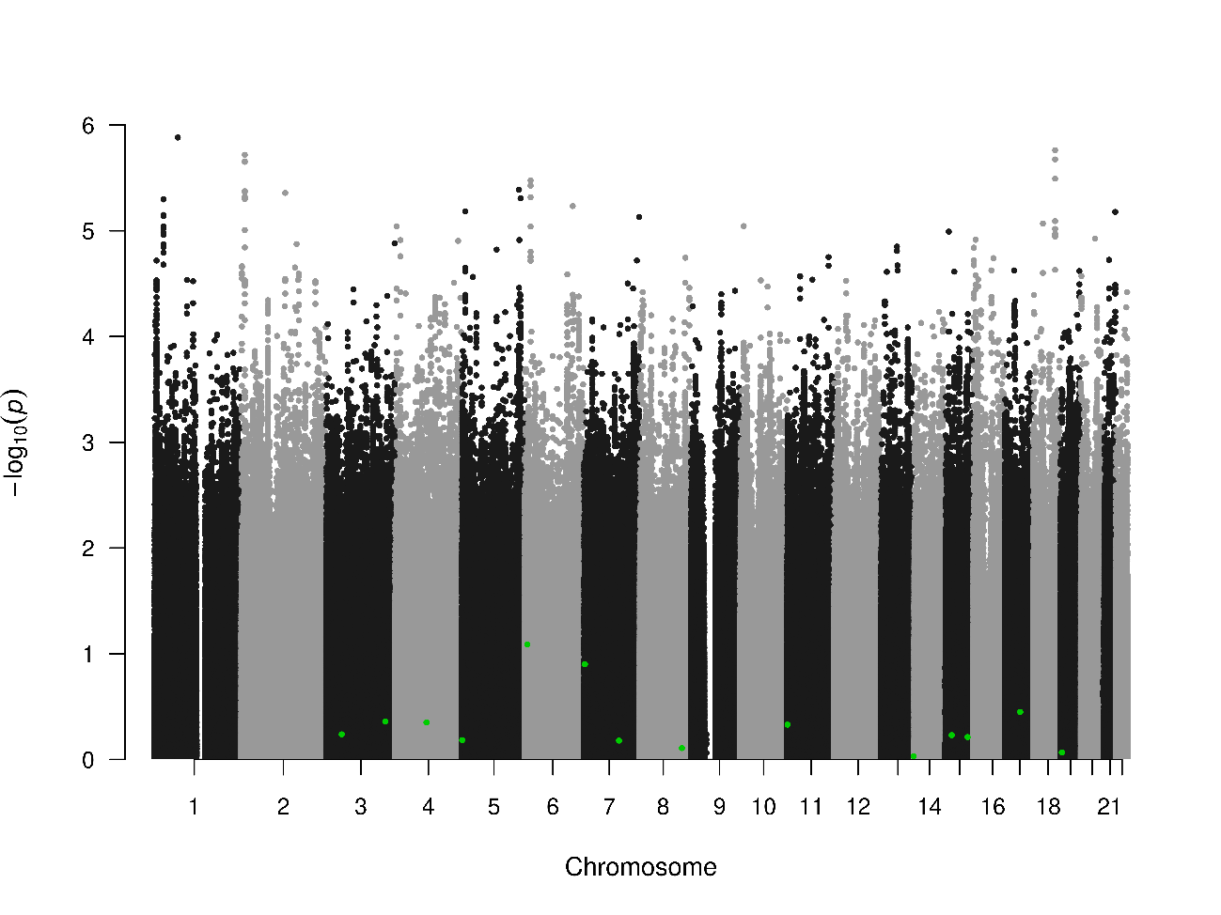
Meta-analysis of female specific effect sizes from a sex-interaction GWAS
Manhattan Plot of β₁ SNP term (for females) p-values.
ADAM33
Each dot represents a variant. Position is indicated along the x-axis, with the association of each variant given on the y-axis where higher -log₁₀(p) indicates stronger association. Green dots represent SNPs used in the initial 15 SNP GRS (SPDL1 not included as MAF <1%).
Notes:
The most predictive SNPs for IPF risk do not have large sex interaction p-values.
Given that a PRS of the 15 known IPF risk variants did not show any sex difference this is to be expected.

Slide 14
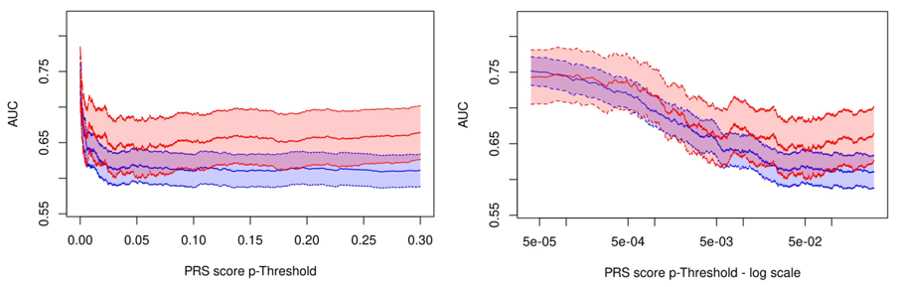
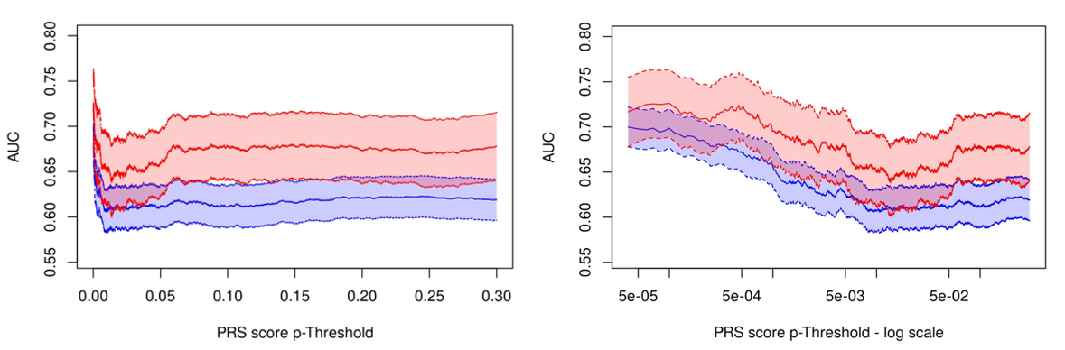
Can using sex interaction effect direction to inform SNP selection improve the predictive accuracy?
Male SNPs (OR > 1 in sex-interaction term)
¹p-value from de Long’s test of 2 ROC curves ²Score p-value as generated by PRSice, from logistic regression including score + covariates. Produced by PRS scoring by each sex separately
Female SNPs (OR > 1 in sex-interaction term)
Notes:
Within the sex interaction analysis there were 3,710,485 Male SNPs (OR > 1 in sex-interaction term), and 3,840,584 Female SNPs (OR < 1 in sex-interaction term). 2804 SNPs had an OR of exactly 1 and these were excluded from this analysis. Note that the MUC5B variant with an OR of 1.083 is considered a Male SNP here. After clumping and the removal of ambiguous SNPs, 235,933 Male SNPs and 243,289 Female SNPs remained for polygenic scoring using the sex-agnostic effect sizes.

Slide 15
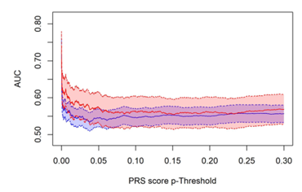
Does using female specific effect size estimates improve predictive performance in females
AUC (95%CI) of PRS across p-value thresholds by sex
Sex agnostic effect size estimates
Female specific effect size estimates

Slide 16
Does adding genome suggestive hits from the sex specific (female GWA) to the PRS improve performance in females?
Performance of GRS + female hits, compared to GRS using sex-agnostic and female specific effect sizes ¹p-value of score from model in equation (3.2) ³SPDL1 variant missing from female effect estimates due to MAF < 1%

Slide 17
Further Work
The use of sex-specific GWAS also allows for the calculation of sex-specific heritability. Sex can then be considered as a trait, and the assessment of genetic overlap between the sexes investigated through methods such as LD score regression^{107,108}. Unfortunately, performing a sex stratified GWAS on the data available in this project, with just 806 female cases, and 1811 male cases is not likely to yield individual variant effect estimates with a precision to allow meaningful PRS scores to be created, especially in females and much larger sample sizes will be needed⁷⁸
Adjustment of effect size estimates to obtain unbiased estimates
Alternative methods for creating PRS score – modelling LD and effect estimate shrinkage
The use of sex-specific GWAS
also allows for the calculation of sex-specific heritability.
Sex can then be considered as a trait, and the assessment of genetic overlap between the sexes investigated through methods such as LD score regression.
Unfortunately, performing a sex stratified GWAS on the data available in this project, with just 806 female cases, and 1811 male cases is not likely to yield individual variant effect estimates with a precision to allow meaningful PRS scores to be created, especially in females and much larger sample sizes will be needed.

