Slide 1

The Earth Mover’s Pinball Loss
Quantiles for Histogram-Valued Regression
Florian List
Sydney Institute for Astronomy
School of Physics
ICML 2021

Slide 2
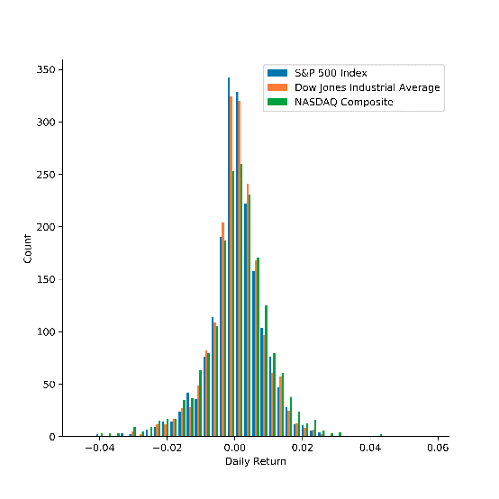
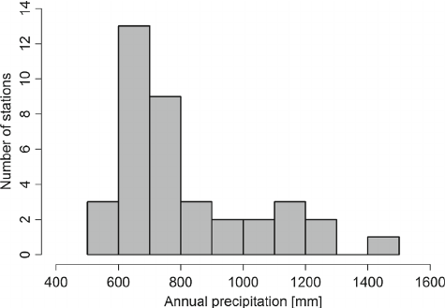
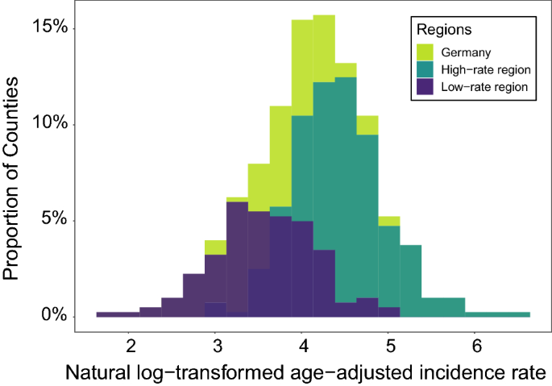
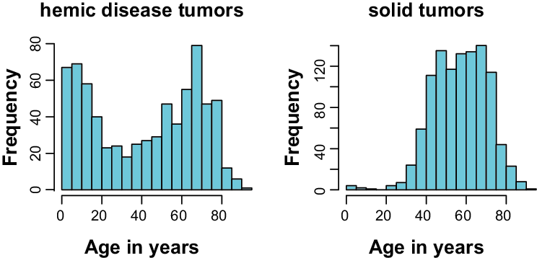
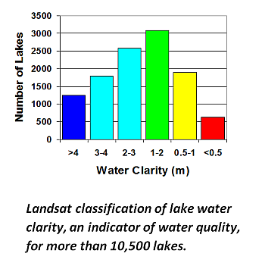
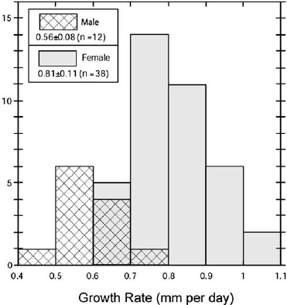
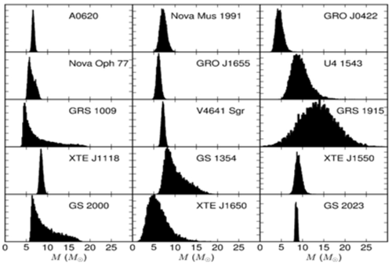
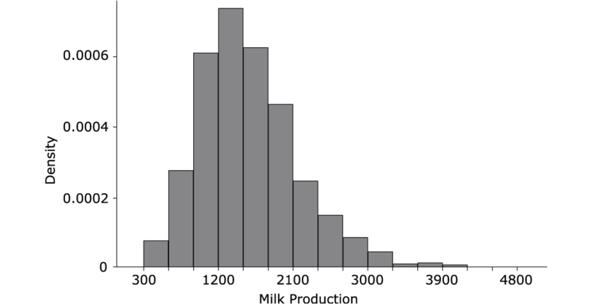
Histograms
Climatology
Finance
Climatology
COVID 19
[Svoboda+, Theor Appl Climatol. (2014)]
[Toth & Jones, arXiv:1906.10325]
[Scarpone+, Int. J. Health. Geogr. (2020)]
Hydrology
Medicine
Ecology
[https://rs.umn.edu/water]
[Schmidberger+, Bioinform. Biol. Insights (2011)]
Agriculture
[Wittemyer+, Chem. Geo. (2009)]
Astrophysics
[Ramos+, Ital. J. Anim. Sci. (2010)]
[https://www.ck12.org/book/ck-12-probability-and-statistics-concepts/section/4.6/]

Slide 3
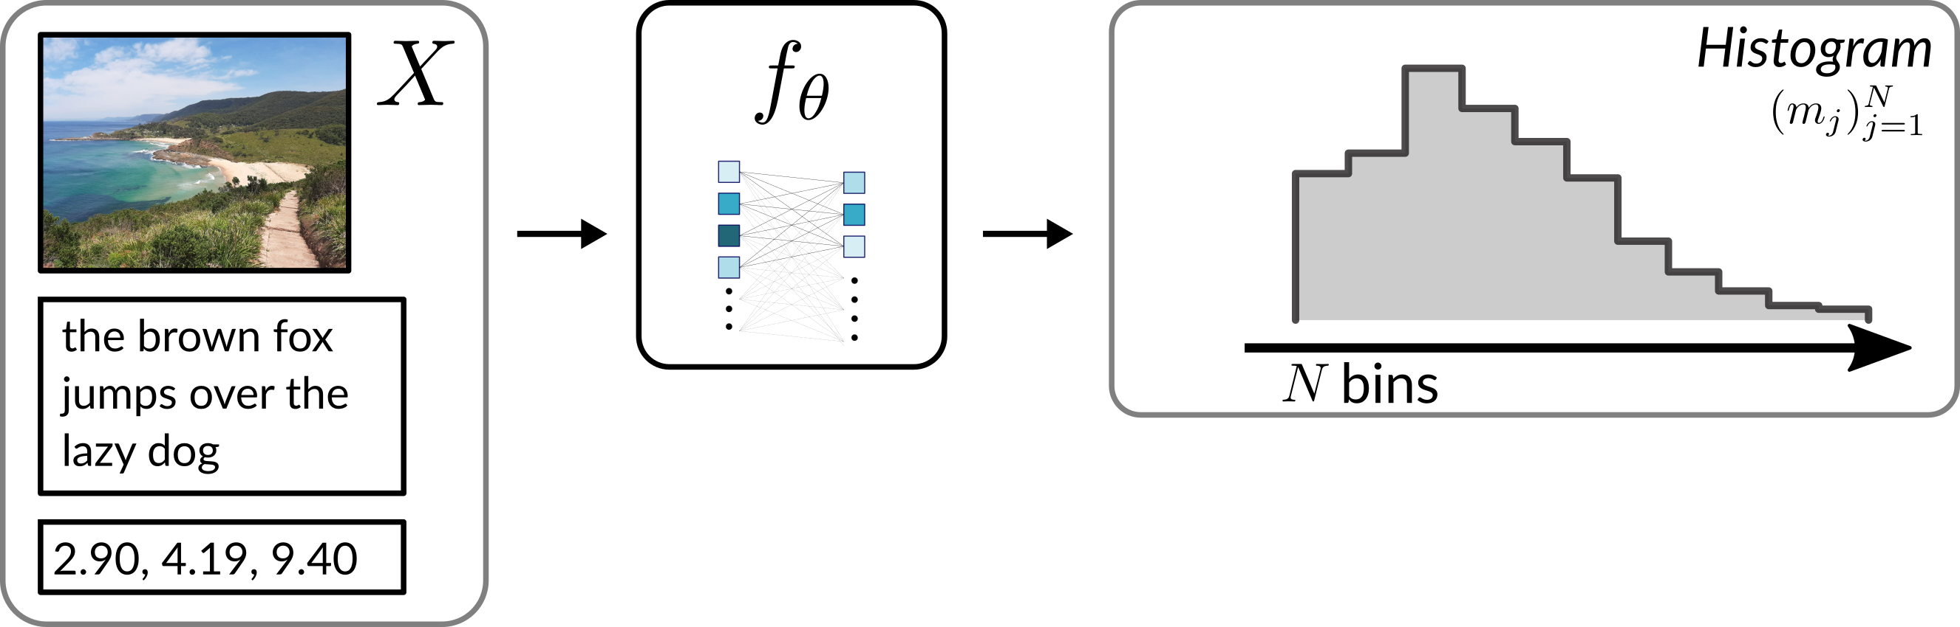
NN-based histogram regression
Framework for Deep Learning-based histogram regression
Intuitive and easy to implement
Accounts for cross-bin correlations
Quantifies uncertainties in terms of quantiles

Slide 4
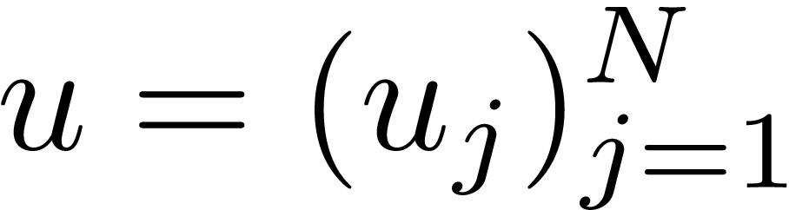
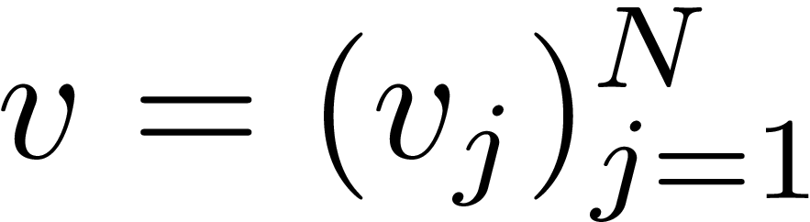
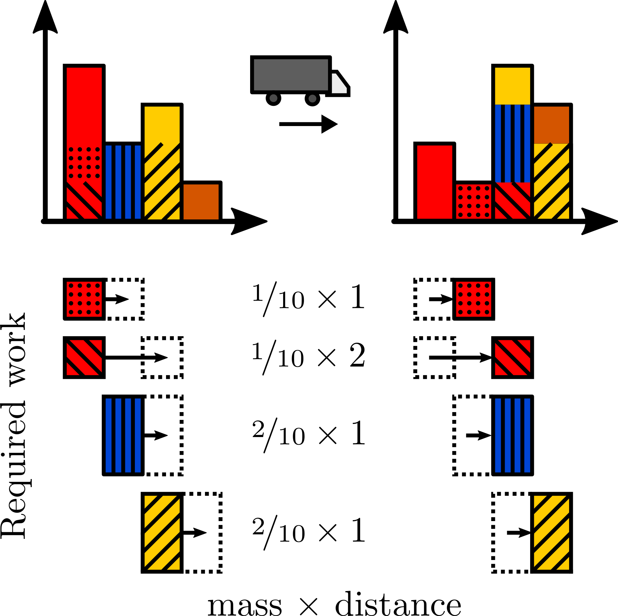
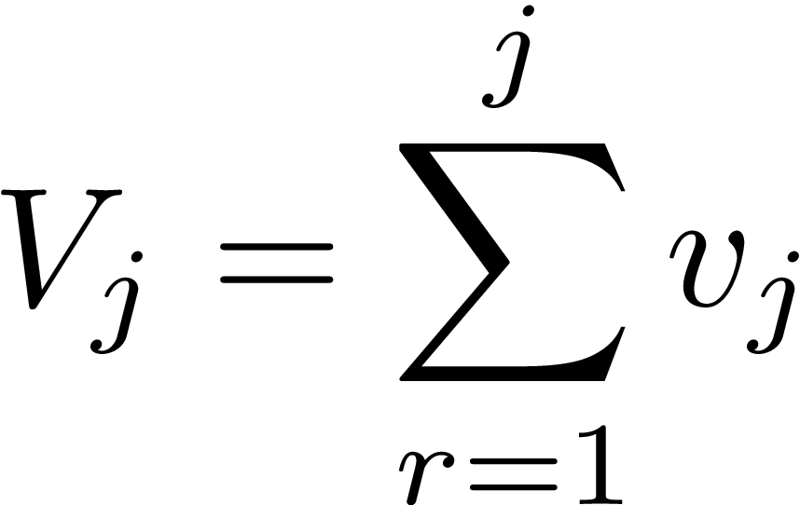
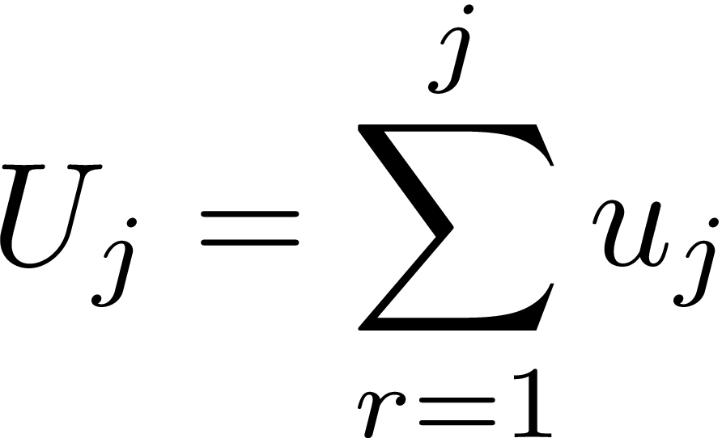
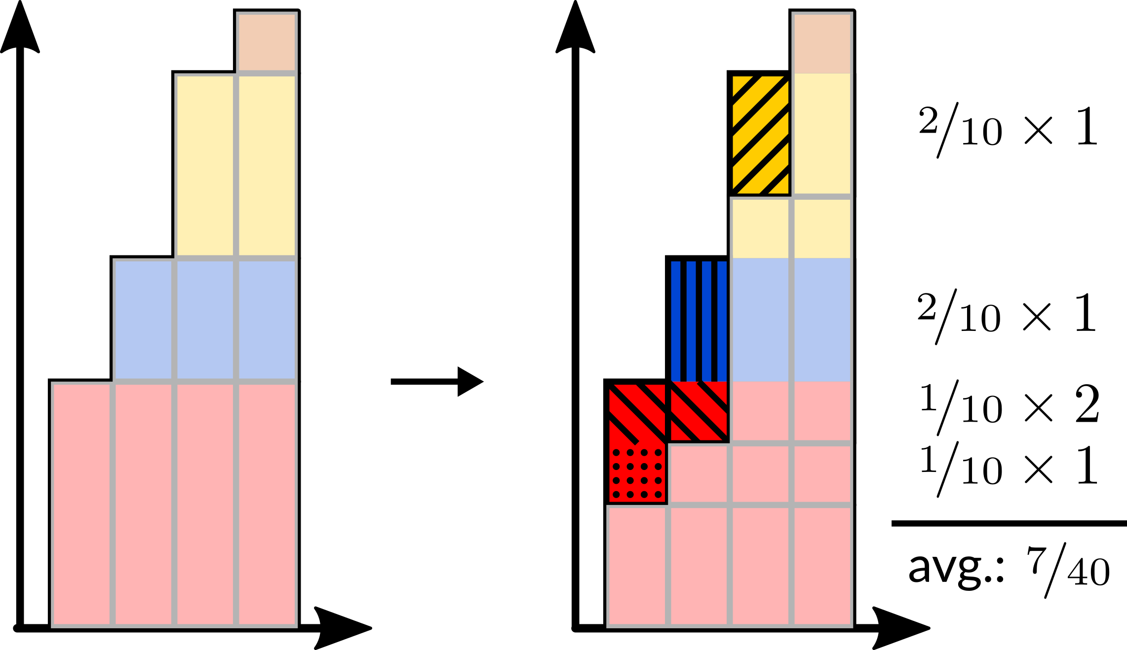
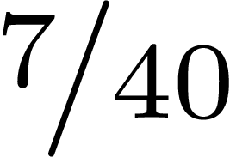

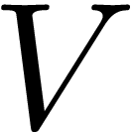


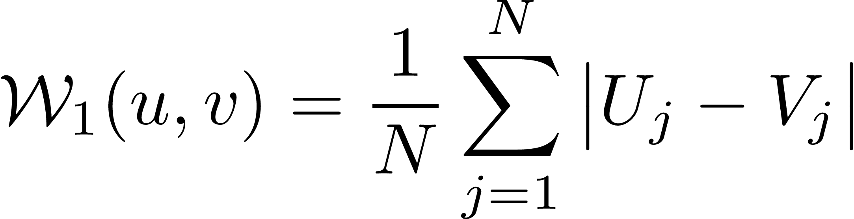
Earth Mover’s pinball loss
Cross-bin correlations:
Earth Mover’s distance
Cumulative histograms:
EMD:
(avg. over 4 bins)
The EMD between two normalized 1D histograms and is simply given by:

Slide 5
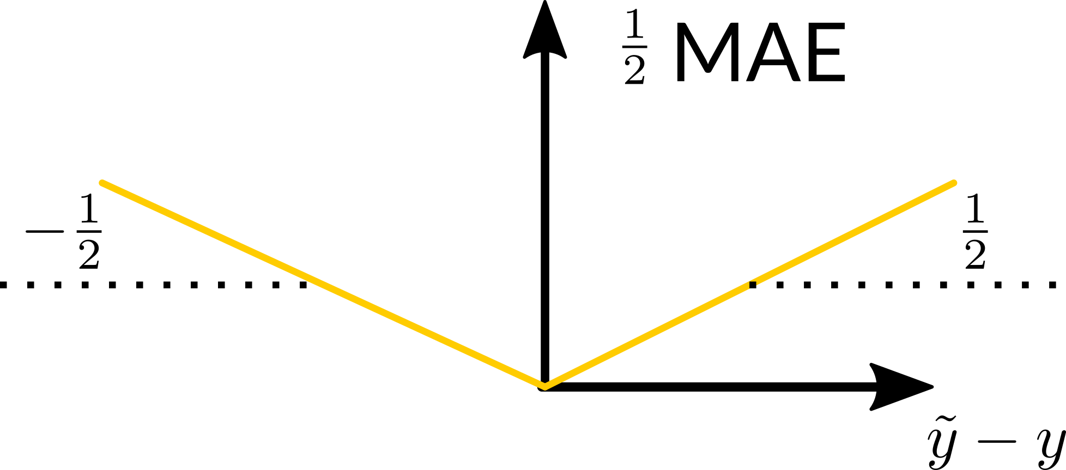

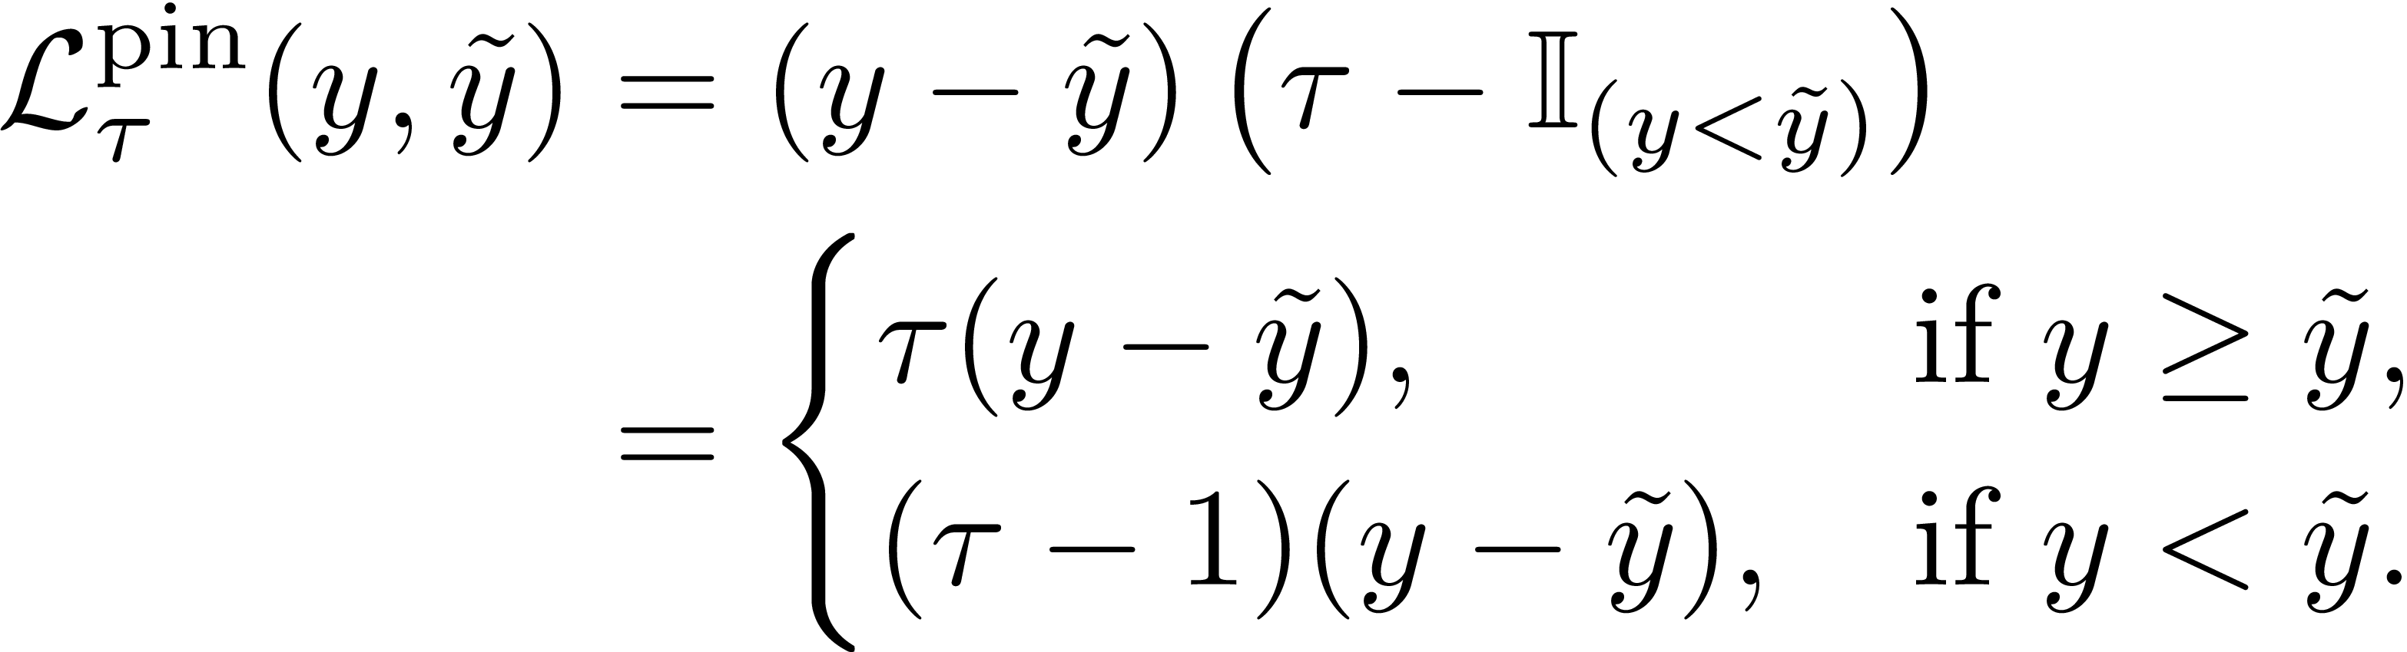
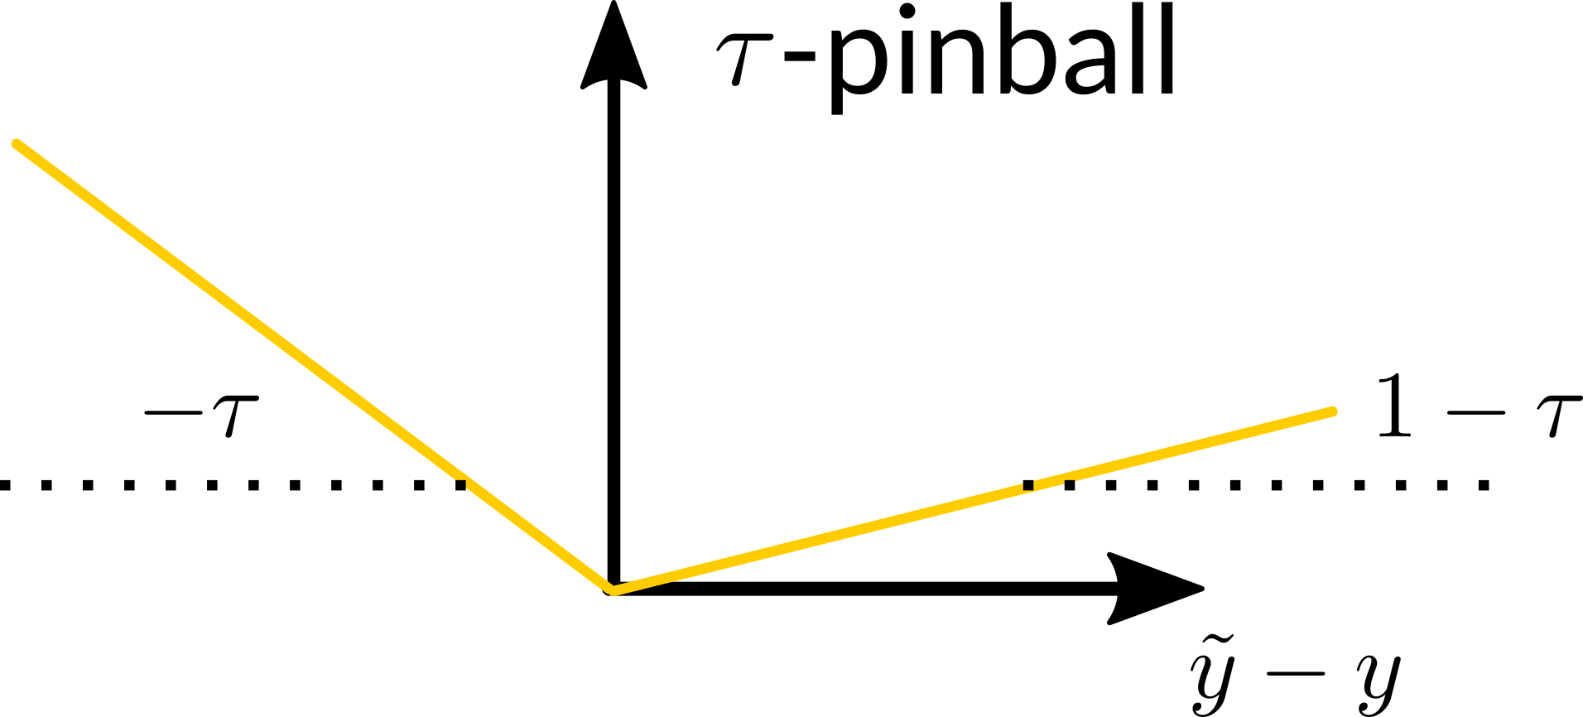

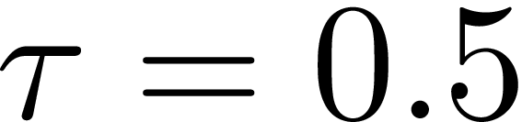
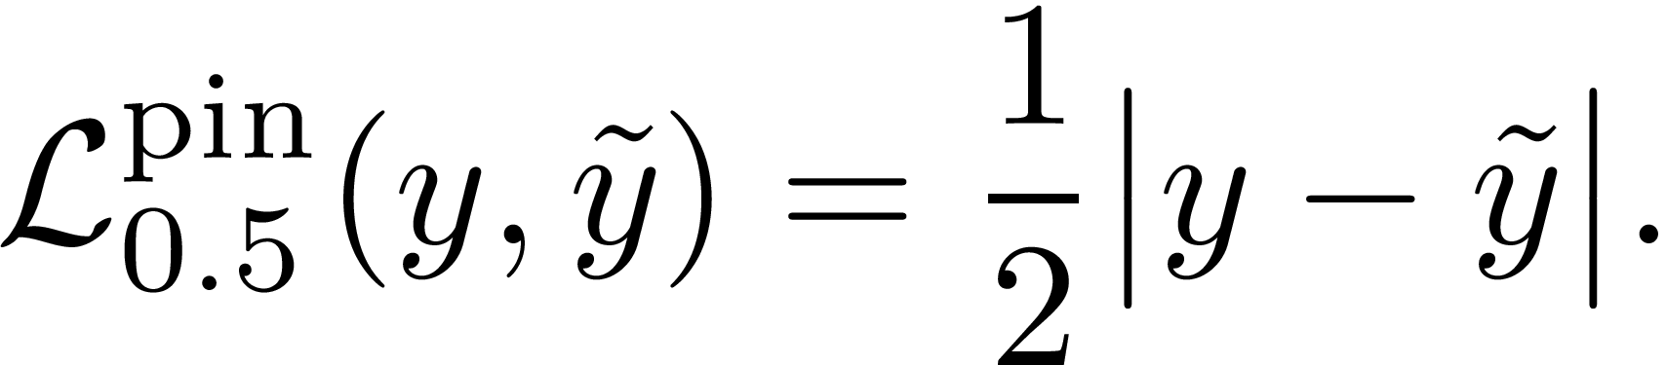
Earth Mover’s pinball loss
Uncertainties:
Pinball loss
The mean minimizes the mean squared error
The median minimizes the mean absolute error
The -th quantile minimizes the -pinball loss
For (median):

Slide 6
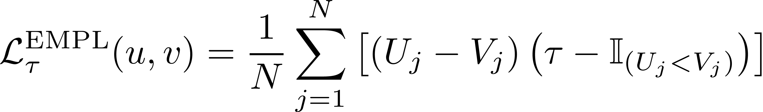
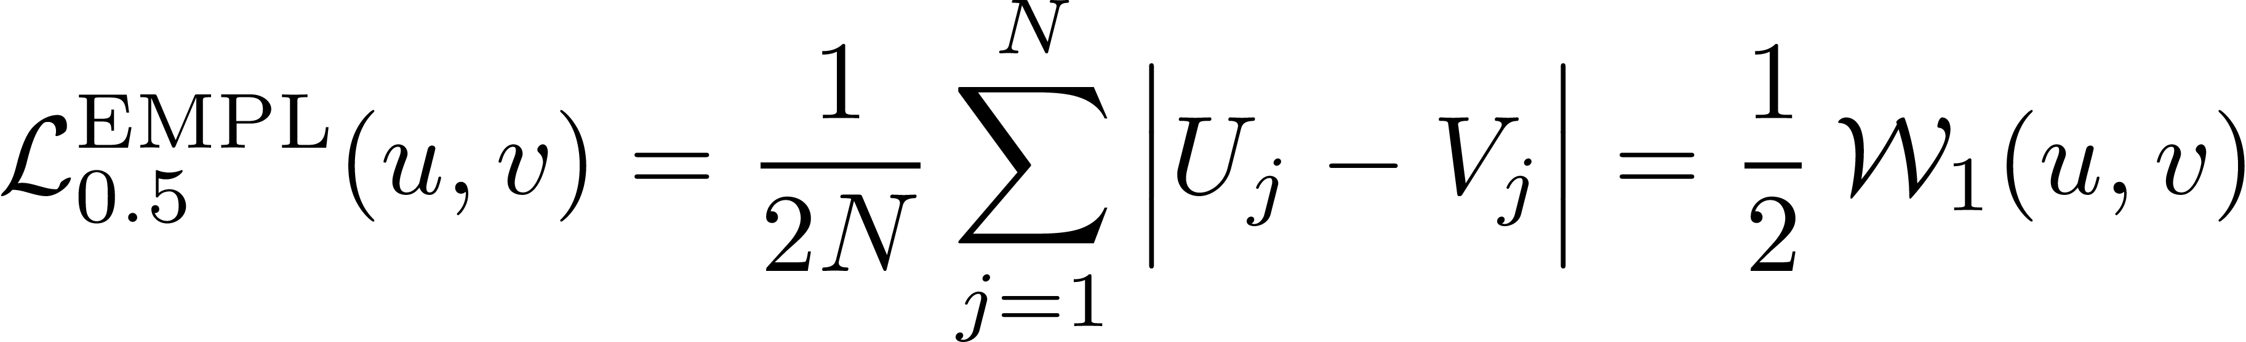
Earth Mover’s pinball loss
Cross-bin correlations:
Earth Mover’s distance
Uncertainties:
Pinball loss
Earth Mover’s pinball loss
→ minimizes the -th quantile of the true cumulative histogram in each bin
For :

Slide 7
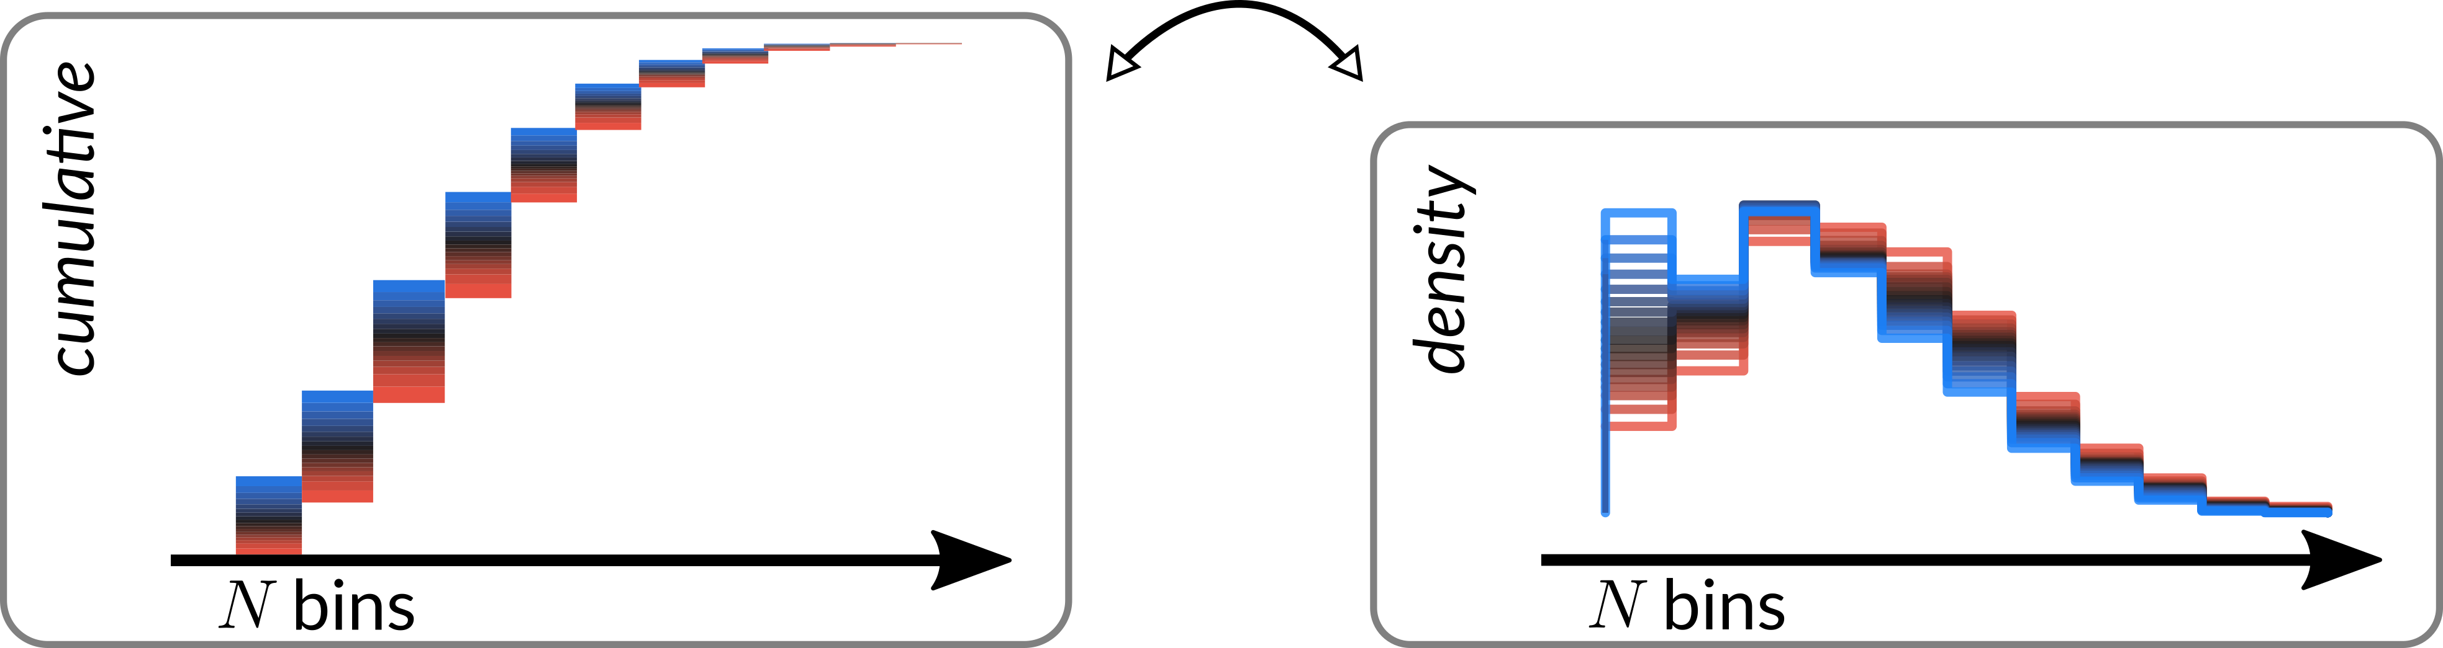
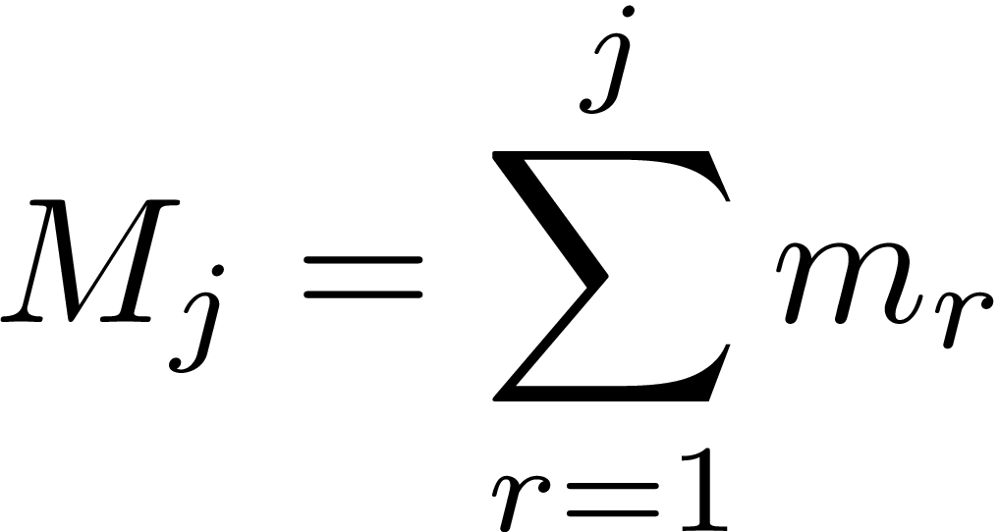
Earth Mover’s pinball loss
Cumulative and density histograms are related via

Slide 8
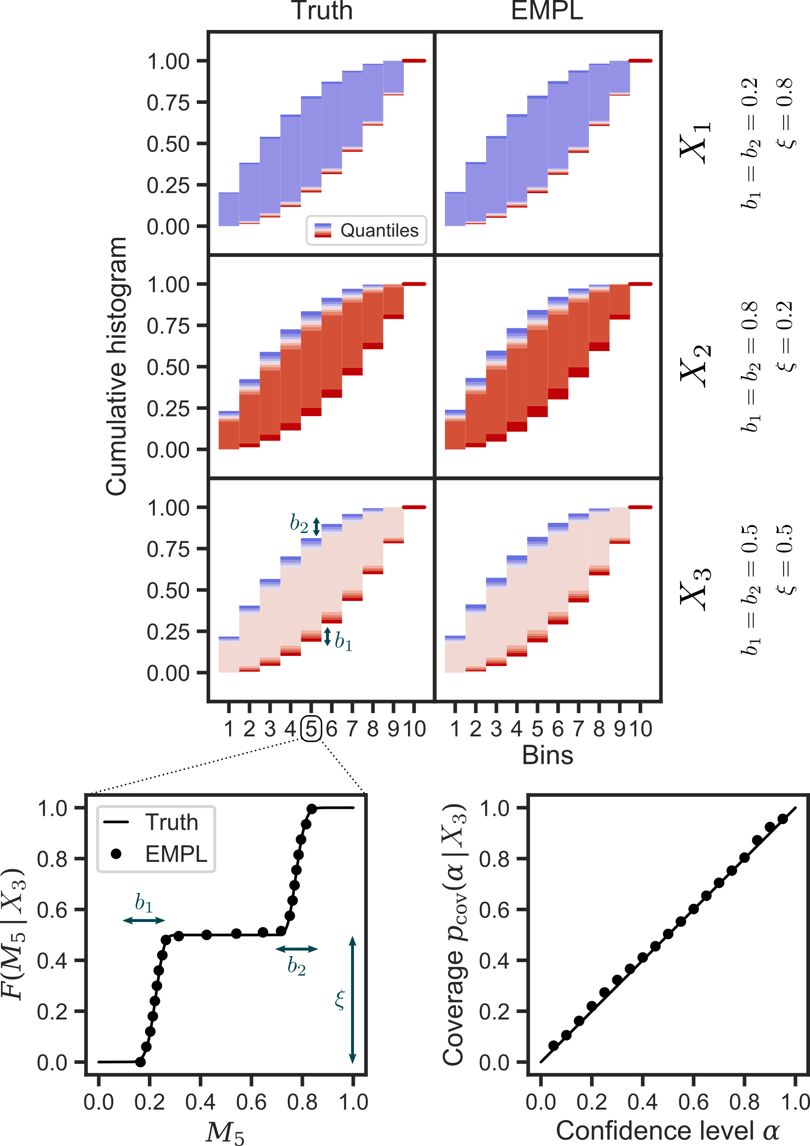
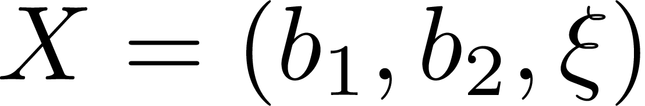
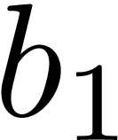
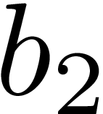

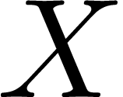
Results
Toy example
Bimodal distribution of true cumulative
histogram values in each bin
3 scalar inputs determine
— the width of each mode ( , )
— the height ratio between the modes ( )
Quantile-based framework:
no distribution needs to be assumed
The neural network accurately recovers
the distribution of plausible histograms
as a function of the input

Slide 9
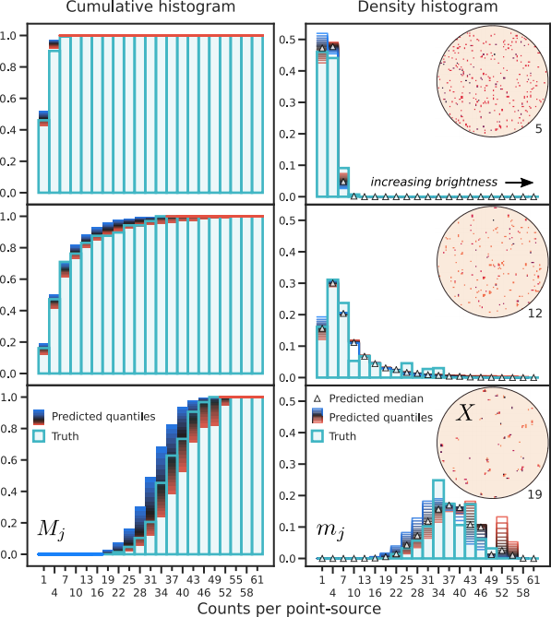
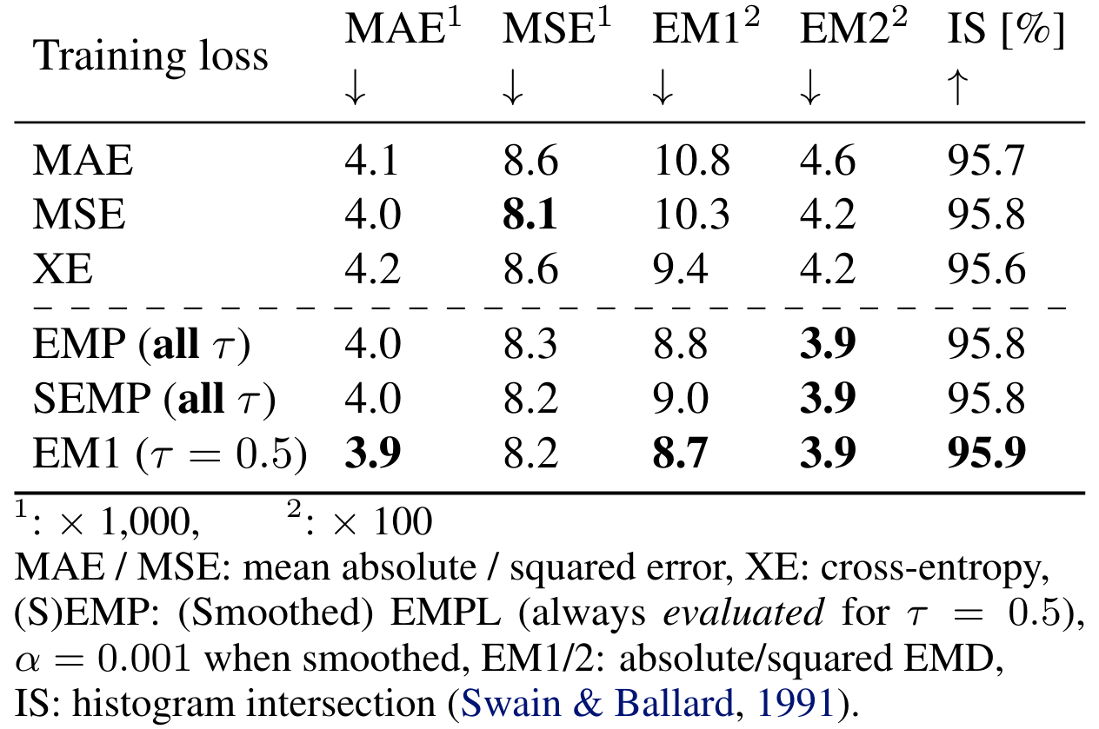
Results
Astrophysical example
evaluated for
Learning all the quantiles (rather than only with the standard EMD) leaves
the median accuracy almost unaffected

Slide 10
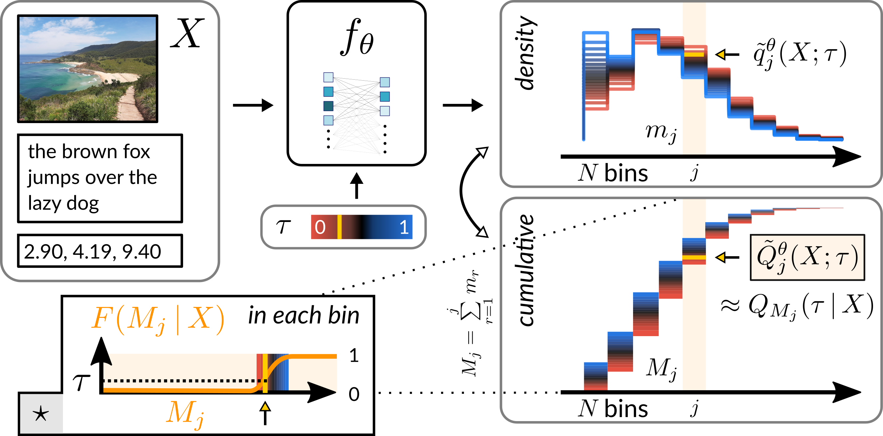
Conclusions
Deep Learning-based histogram regression framework
Accounts for cross-bin correlations
Quantifies uncertainties
Easy to implement
Github: https://github.com/FloList/EMPL
Preprint: https://arxiv.org/pdf/2106.02051.pdf

