Slide 1
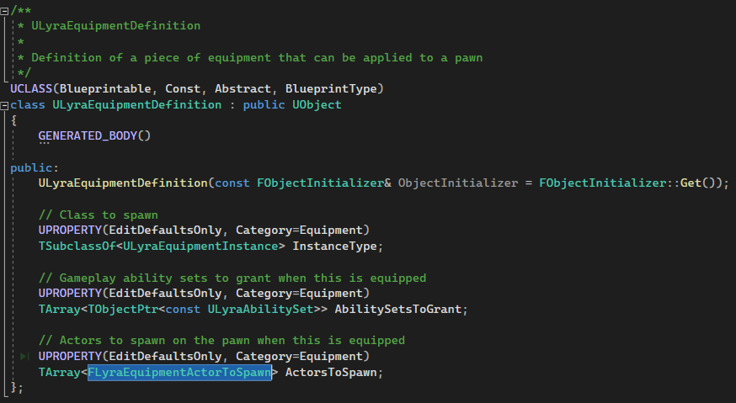
ULyraInventoryItemInstance
FGameplayTagStaskContainer ;
TSubclassOf<ULyraInvewntoryItemDefinition>;
ULyraInventoryItemDefinition
Ftext DisplayName;
Tarray<UFragment> Fragments;
ULyraInventoryItemFragment
UInventoryFragment_EquippableItem
TSubclassOf<ULyraEquipmentDefinition> EquipmentDefinition;
ULyraEquipmentInstance
ULyraEquipmentDefinition

