Slide 1

Secure your environment with your super hero OMS
Florent Appointaire
Dieter Wijckmans
“Do you really think you’re safe?”

Slide 2
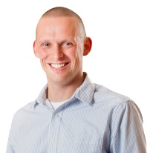




About me
Community
Scug.be
@DieterWijckmans

Slide 3
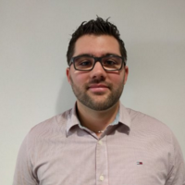

About me
Community
Scug.be
@florent_app

Slide 4
Motto
It’s doing common things uncommonly well that brings success…

Slide 5
SCOPE
Are you really secure?
Engage the battle
Feel safe again
Find the right super hero

Slide 6

Thanks to our sponsor!

Slide 7
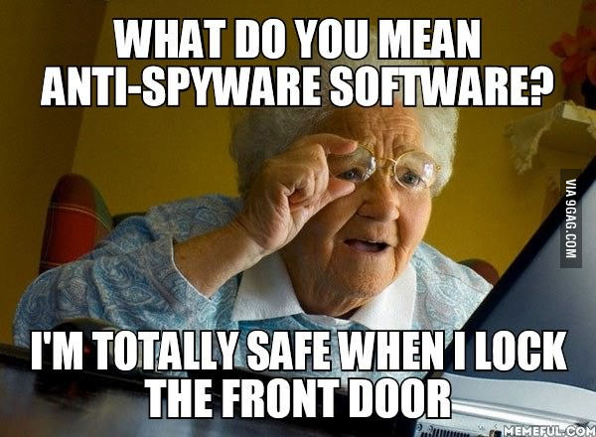
Are you really secure?

Slide 8
Do you think you’re safe?
Knowledge is power!
Let’s talk facts…

Slide 9
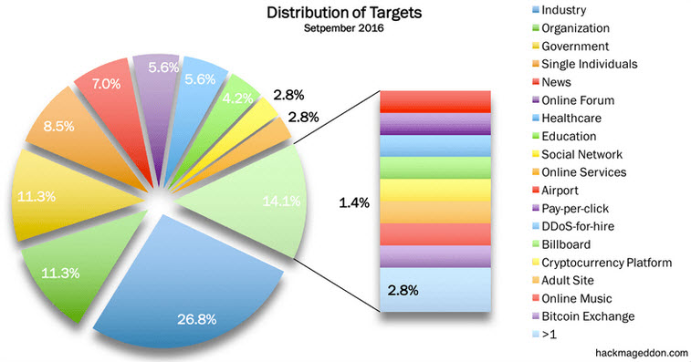
Who’s the target?

Slide 10
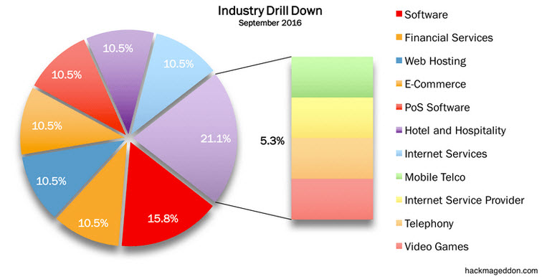
Is your industry safe?

Slide 11
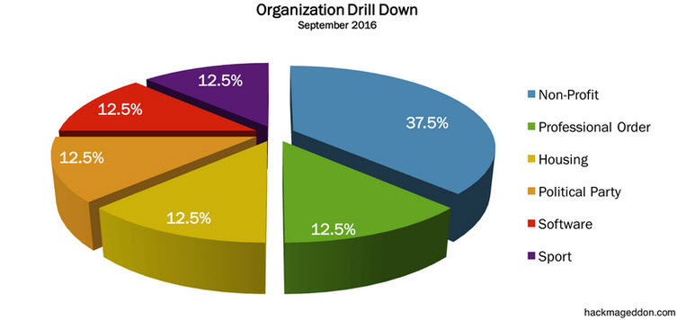
Is your organization safe?

Slide 12
Surprised?
We didn’t even talk about the danger from inside
Easy to guess passwords
Users communicating passwords
Bad password policies
Users with too much rights
Malicious programs installed through clicks on mail attachments

Slide 13
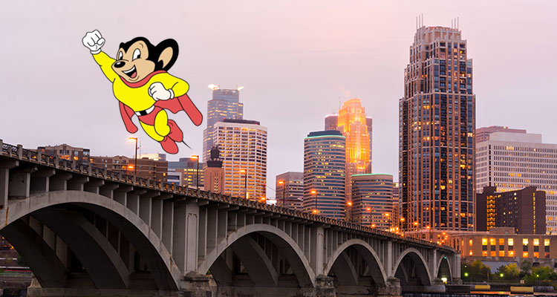
Find the right super hero

Slide 14
Is OMS your mighty mouse?
Security solution
Detect attacks and where they are happening
Create insights of what they are after
Find the weak spots and tighten your security
Get alerts and automate remediation

Slide 15
Is OMS your mighty mouse?
Compliancy checks
Get insights in how you are doing for Best practices
Work proactively to avoid any possible issues
Compliancy and patching is key to stay safe

Slide 16
Is OMS your mighty mouse?
Compliancy Solutions
AD/SQL/Antimalware/Change Tracking/Security and Audit solutions available
Monitor specific events
Analyze specific events
Provide the solution to solve problems

Slide 17
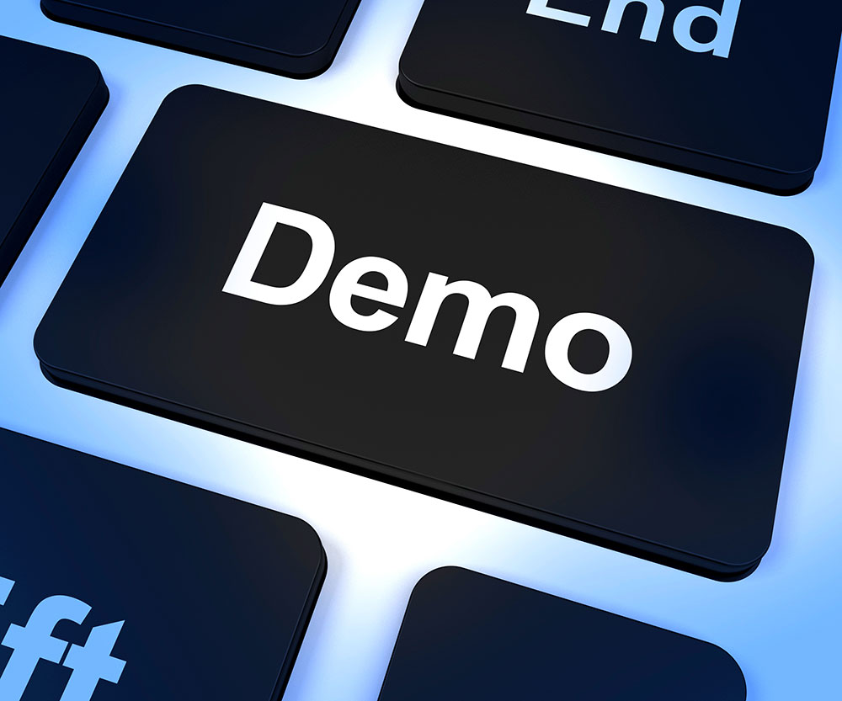
Is OMS your mighty mouse?
Notes:
AD / SQL / Antimalware / Update Management / Change Tracking

Slide 18
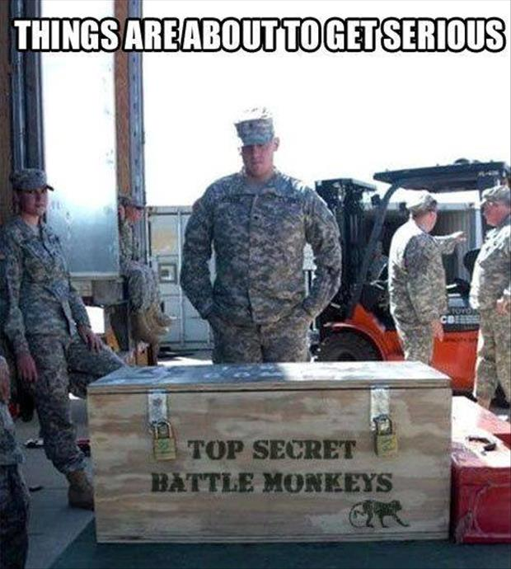
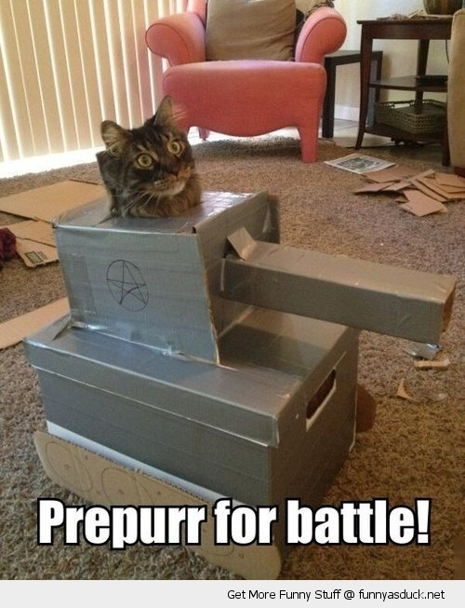
Engage the battle

Slide 19
Configure the security solution
Install security solution
Make sure your security events are sent
Add your iis logs
Wait for the magic to happen

Slide 20
What’s in it?
Security Domains
Notable Issues
Detections
Threat Intelligence
Common security queries

Slide 21
Compliancy
AD Assessment
Antimalware Assessment
SQL Assessment
Change tracking

Slide 22

Feel safe again

Slide 23
Things you will get in return
What’s under attack
Where am I under attack
Possibility to remediate with Azure Automation

Slide 24
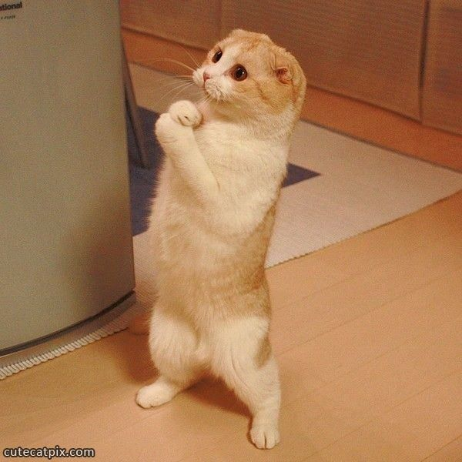
Can you show me some demo’s?

Slide 25
Key takeaways

Slide 26
Insights in your security boundaries is key
Danger is not only coming from the outside
Security and Compliancy helps you to gain insights
Security is an ongoing battle so stay safe.

Slide 27

Q and A

Slide 28

© 2013 Microsoft Corporation. All rights reserved. Microsoft, Windows and other product names are or may be registered trademarks and/or trademarks in the U.S. and/or other countries.
The information herein is for informational purposes only and represents the current view of Microsoft Corporation as of the date of this presentation. Because Microsoft must respond to changing market conditions, it should not be interpreted to be a commitment on the part of Microsoft, and Microsoft cannot guarantee the accuracy of any information provided after the date of this presentation. MICROSOFT MAKES NO WARRANTIES, EXPRESS, IMPLIED OR STATUTORY, AS TO THE INFORMATION IN THIS PRESENTATION.

