Slide 1


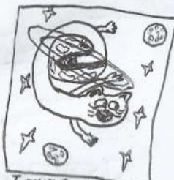





Slide 2
AKASHA
Bounties Network
+
https://site.com

Slide 3
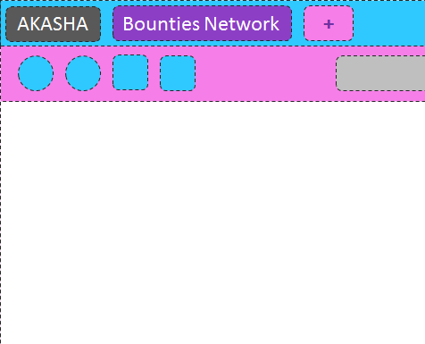
Please select your theme
Delicate
Common Design

