Slide 1
Physical Security
Why it's important for businesses,
and some history

Slide 2

Ninja Info
Trained in social engineering since children.
Popular ninja schools were Iga, Koga, Togakureryu
Sneaking, espionage, social engineering, deceat
Training organized around 15th century

Slide 3
Ninja VS Pen Testers
Consent
Can be hired
Throws Snakes
Equipment maturity
Social Engineering
Lawful
Questionable ethics?
Physical Exfiltration
Notes:
Ninja:
Did Not’ need consent, were sometimes hired
Throws animals or dead snakes as psychological distraction
Ninja could be hired as bodyguards, also given assasination, espionage, or stealing requests
Point:
They are very similar
Technological differences
Different standard of acceptability, constraints

Slide 4
Ninja VS Black Hat
Stealing
Less Tech
More Tech
Lieing
Always in person
Motivations
Killing?
Depends where you sit
Can be physically abstracted
Notes:
Depends where you sit - could be black hat to one government, to another just hired workers.

Slide 5
Social Engineering, Also is Physical Security
Physical to Geographical?
🏃‍♂️
Physical does not mean in same location, it could be over phone/email
2 Sides of
Same Coin
Cross-Over
Exploit People
Cross-over between weakest point in businesses
Social engineering can use physical techniques, physical techniques can be social engineering

Slide 6
Social Engineering Methods
Phishing
Manipulation
Lieing
Tailgating
Vishing
Bad USB’s
Whaling
Impersonation
Spear Phishing
Mustache
RFID Cloning

Slide 7
1.8 Billion
^^^ Dollars lost in 2020, just from phishing
5th top attack vector 2021

Slide 8
Demos
Gandalf, Pico, Leonardo
Setup both Raspberry Pi Pico and Arduino Pro Micro (Leonardo) as HID devices. Basically they are now user input devices. System does not know difference. Pico also a mass storage device (2mb). Simulate user input to enter commands in RUN box.
Persistent Reverse Shell, w/BAD-USB
TLDR: During class created persistent Kali USB for a lab. Listening with NC on port 87, for any IP. Pico injects powershell, creates scheduled task on logon, logs out user.
Caveat: Thought PS turns off firewall and Live-Protection, tamper protection has to be disabled (not by default), though this does not get reset when restarted, 1 time dealee.

Slide 9
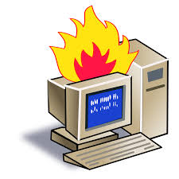
Demos, cont
Brute-Force, Android-10, 4 digit lock
TLDR: Pico can connect to android phone like a computer, because it is one, duhhh. Lockout time is limited to 30 seconds, try every 30 seconds, only 10k possabilities, ~4 days, no lockdown/wipe by default.
Hash-Collection, Win-10, .py Script
TLDR: Using lab (from Mike L, ITEC285, MHC) as process. Python Script used as delivery method, already runs fine, installed on Kali. Detects largest drive, guesses is Win-10, mounts, collects hashes, outputs to file, uses pastebin API to send to internet (anon), unmounds drive. Process finishes in <5 seconds if successful.

Slide 10
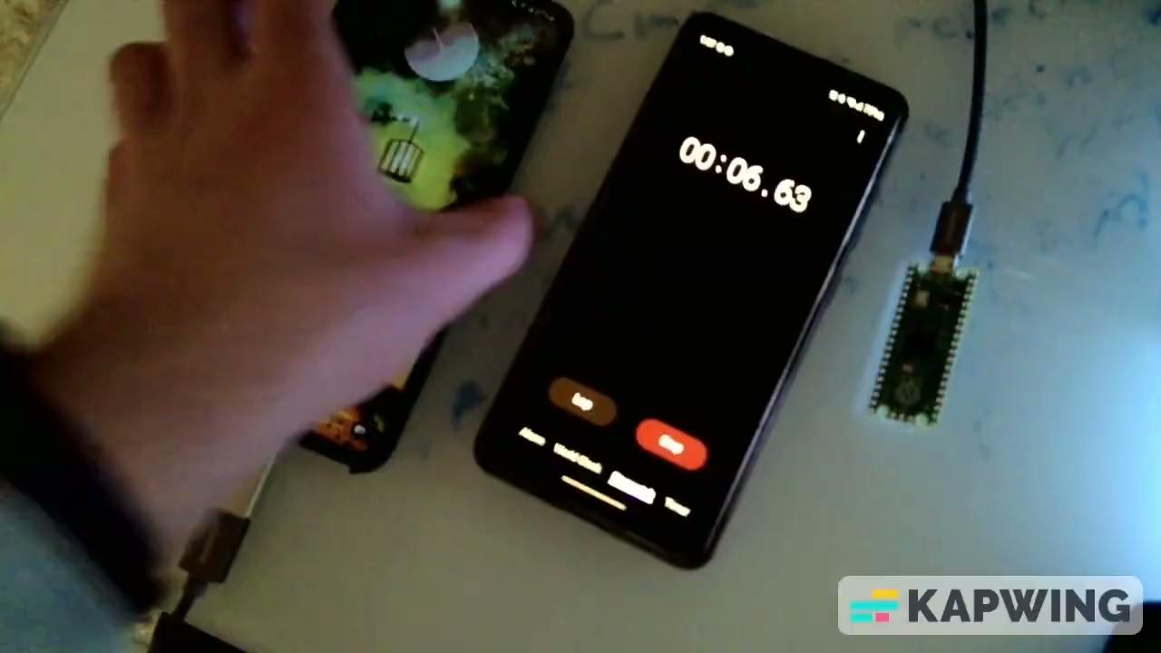
Brute-Force, Android-10, 4 digit lock

Slide 11

Persistent Reverse Shell, w/BAD-USB

Slide 12
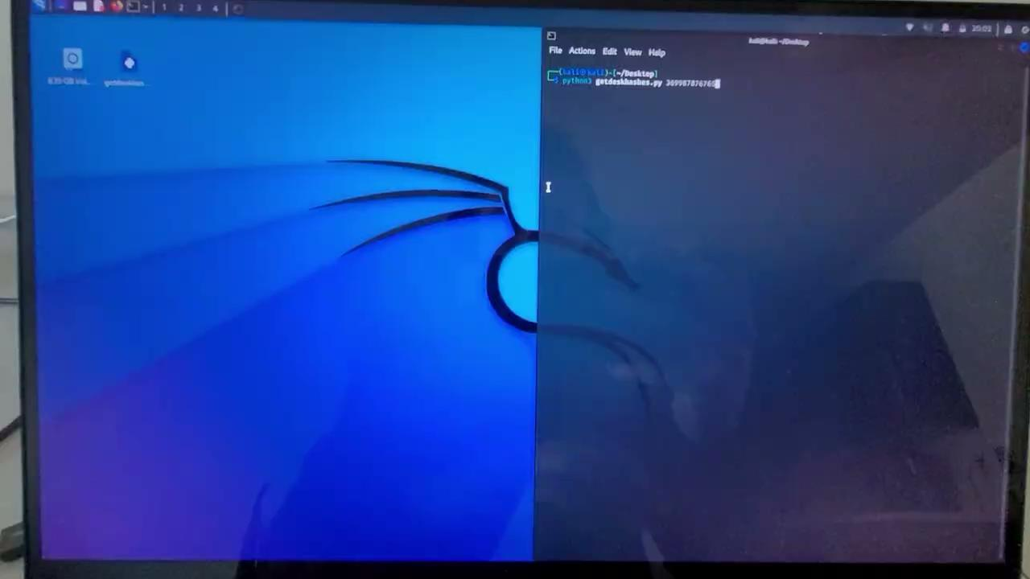
Hash-Collection, Win-10, .py Script

Slide 13
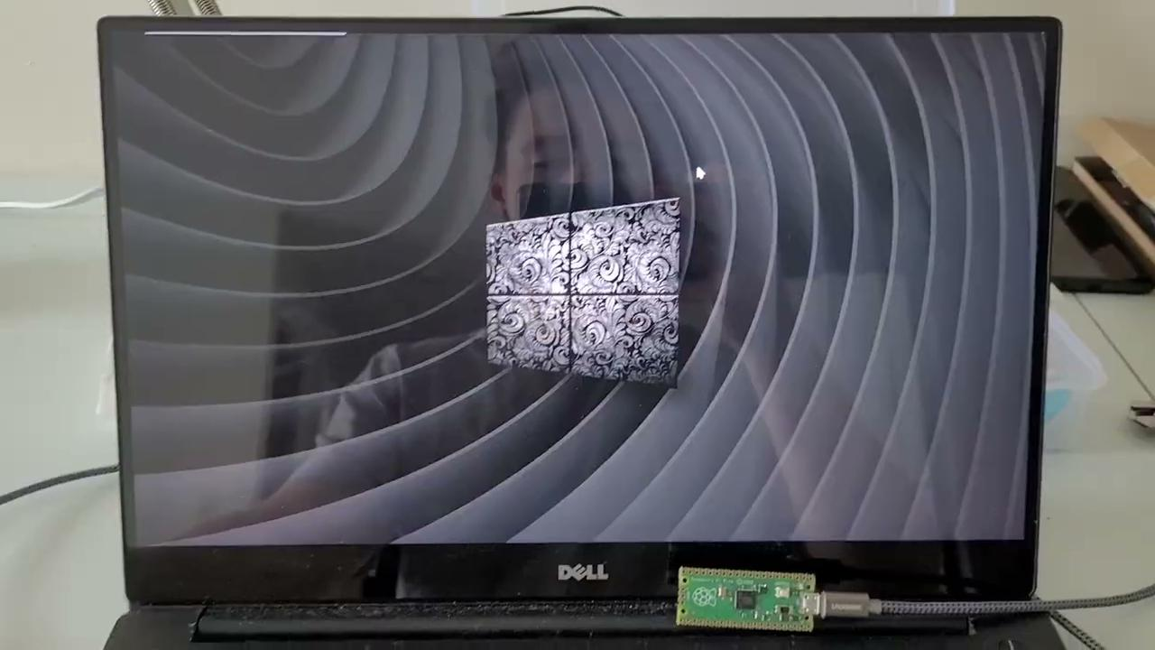
Gandalf, Pico, Leonardo

Slide 14
Staying Safe, Saving Money
Layers, Seperation
MFA
In event of breach, limit what access people have, who has access. Joe who is in accounting probs doesn’t need to be a domain admin to use printer
Not many of 1 but greater than 1 types/methods of authentication!
🤦‍♂️
Regular Awareness
Cameras
Training on intervals to keep users aware of potential issues. Enforce possible risks by way of policy
Watch for sus people!

Slide 15
Resources
Sexy-Gandalf
Pico
Starting point, SEXY-GANDALF - Kylerees64
Project here
GitHub Profile here
Pico setup, file resources, guide
YouTube Video here
YouTube Channel here
Arduino Version
ChatGPT as debugger, transpiler, someone to talk too
Had to make minor changes, issue with type(‘_’, false) vs should have been keyboard.press(‘_’);
DuckyScript Resources, Examples
Github Hak5 Library here

Slide 16
Resources, cont
Persistent Reverse Shell, w/BAD-USB
Starting point, Netcat-Reverseshell-On-Log-In - HokkaidoInu
Project here
GitHub Profile here
Pair Programmer, help w/Debugging, Emotional Support
ChatGPT
PowerShell syntax/commands, debugging assistance
Issues
Stuck in session 0 😭
Permissions issue, which users to use
Task Scheduler running but not running script 👀
Disabling live-protection
Tamper protection
Potencial dependency issue
Currently working with this one

Slide 17
Resources, cont
Brute-Force, Android-10, 4 digit lock
Starting point, Idea, droidbrute - mandatoryprogrammer
Project here
Github Profile here
Idea, Information
YouTube Video here
YouTube Channel here
Suggestions, initially learning ducky syntax
ChatGPT
Hash-Collection, Win-10, .py Script
Process, starting point
Mike Long’s ITEC285, labs.
Practiced python in his labs
Given lab on collecting hashes, following same process in code
Boilerplate, syntax help, debugging help
ChatGPT
CoPilot

Slide 18
Resources, cont
Hacker Slides Template
Hacker slides template
Diagram Template
Venn Diagram template
Ninja PNG
From PNG Tree here

