Slide 1
BA Seminar sS 2022
Elektronik und Computer Engineering
Florian Zwittnigg
Determining the internal resistance
of a lithium ion battery

Slide 2


Motivation
Condition of a Lithium Ion Battery
Information about durability of the Battery
Simple and fast measurement

Slide 3
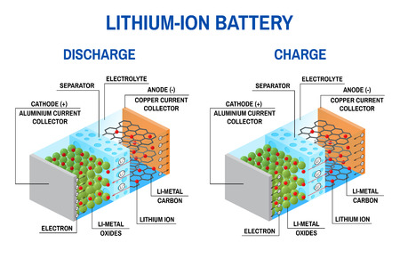
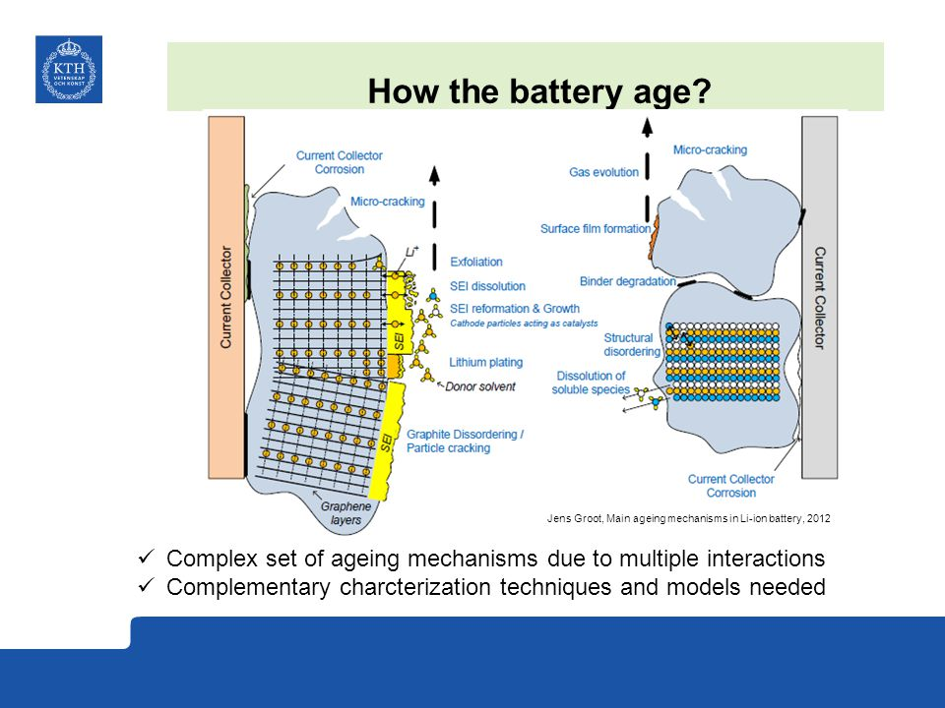
Lithium Ion Battery general information
Build of a Lithium Ion Battery
Aging Process
Meaning of the internal resistance

Slide 4
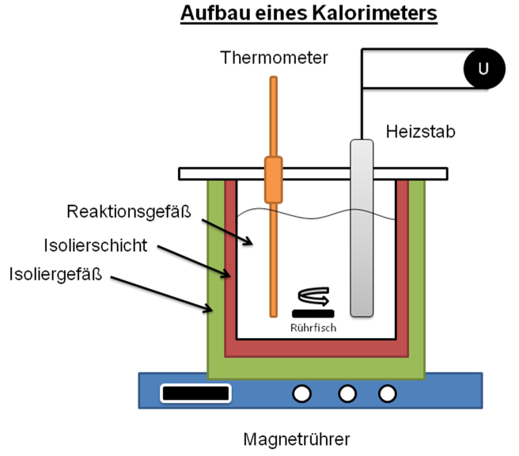
Methods to determine the internal resistance of a Lithium Ion battery
Hybrid Pulse Power Characterization (HPPC)
Galvanostatic Intermittent Titration Technique (GITT)
Electrochemical Impedance Spectroscopy (EIS)
Calorimetric Measurement
DC Charging Method
Parameterization using current pulses

Slide 5
Findings
The internal resistance gives use information about the state of charge
And about the ability how much current can be delivered by the battery
Best method is the parameterization using current pulses
Because it is a fast and accurate measurement
Other measurements are to complex or take to much time respectively need expensive measureng devices

Slide 6
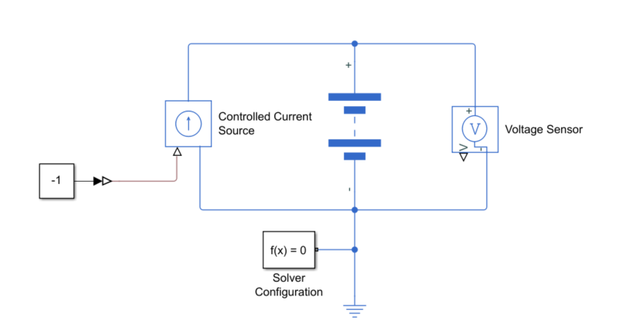
Outlook
Model building in Simulink
Equivalent electric circuit to reality
Data Evaluation of the system response
Comparison of the results with the findings from the literature

Slide 7
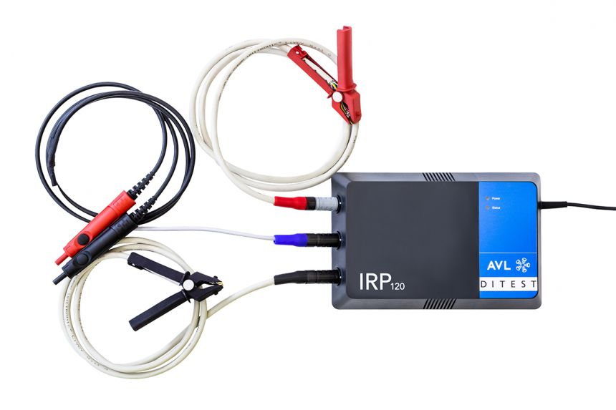
Outlook
Measurements with available
hardware
Device IRP120
Measurement of 400V System
Measurement of single cells
Comparison between Matlab
results and measurement results

